Slide 1
ペイントゲン
Encyclopedia

Slide 2
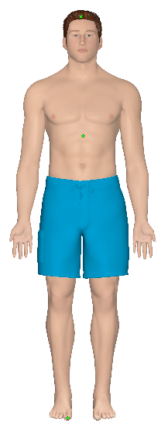
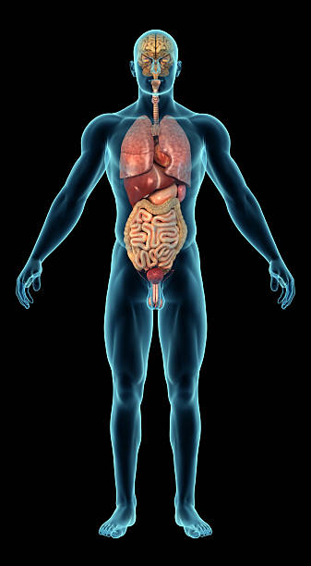
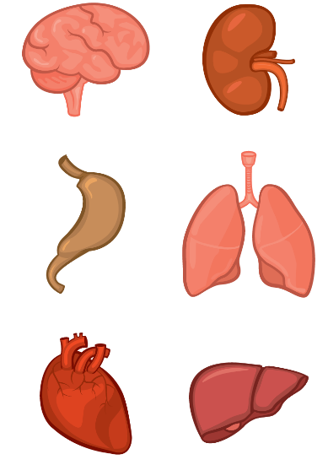
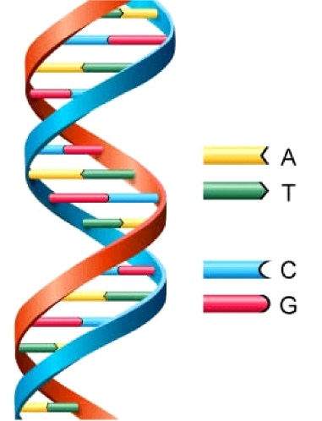
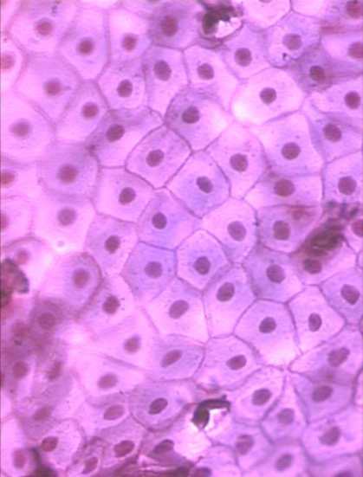
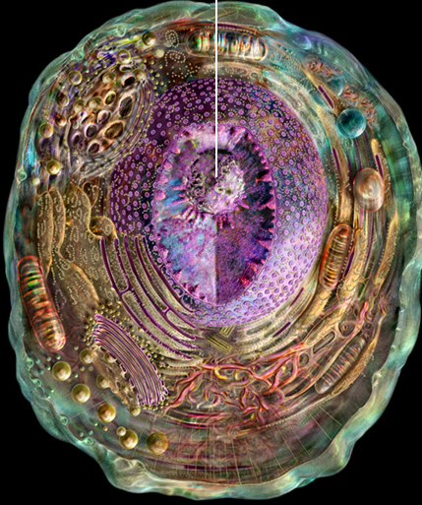
This is what you are made of

Slide 3
Text to add…
Organism
Organ systems
Organs
Tissues
Cells
DNA

Slide 4
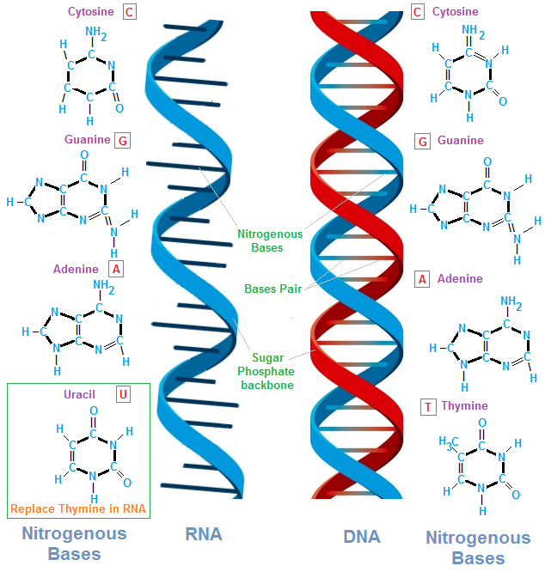

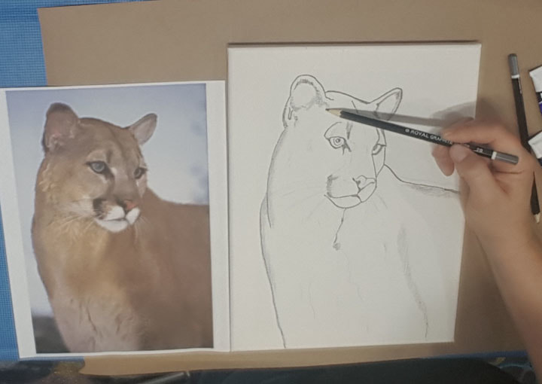
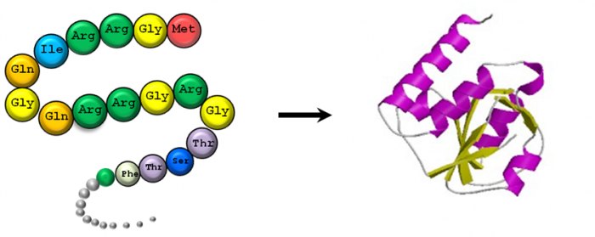

Central dogma

Slide 5
Text to add..
DNA- blueprint, template
RNA- transcript/ copy, temporary state
Protein-finished product, functional

Slide 6
Transcriptome
Refers to the full accession / database of transcripts or messenger RNA for a given organism
The transcriptome, being less stable than the genome, also varies depending on stage of development and environmental conditions.

Slide 7
But why mRNA?
Isn`t it better to use the sequence of DNA (the template) rather than that of messenger RNA (the copied transcript)?
Post transcriptional modification removes introns
mRNA is a better measure of expression

Slide 8
Microarray
Can provide gene expression profiles
Can show expression for a particular environmental condition, disease or treatment

Slide 9
How to visualize this type of data

Slide 10
Applications

