Slide 1


Slide 2
Some kind of Introduction Session
About me

Slide 3
Self Introduction
Name: Amy (Yixin) Hu
Tutor of Tuesday 4-6 pm COMP3702 sessions
Currently doing Bachelor of Computer Science/Mathematics at UQ
General committee at UQ Computing Society
Email: yixin.hu1@student.uq.edu.au

Slide 4
Why did I become a tutor?
I am poor and need money.
Food. Food at campus is good but they are expensive :’(
And my parents think I should start paying rent.
I like teaching people, and showing off my skills >:)

Slide 5
About tutorials
How to access tutorial materials?
Log into learn.uq.edu.au (also referred as blackboard), open COMP3702 – Learning Resources – Tutorials.
Solutions (including the solution PPT I will use later) will be uploaded to blackboard by the end of each week.
Other resources such as this slide exclusive to me:
https://github.com/firefried-fries/COMP3702

Slide 6
Knowledge Check!
Python
Do you have experience with python before?
Have you installed it onto your device? (If not, put your hand up later and I’ll come help)
CSSE1001/CSSE7030 (Pre-requisite)
MATH1061/MATH7861
COMP3506

Slide 7
What I recommend
Work in groups and discuss with your peers
Do assignments early! There is a 100% penalty for late submission!
(This advise came from experience :’D)
Attempt at tutorials beforehand
Don’t worry if you haven’t though, I’ll try my best to structure tutorials so you can follow, and make people who had done tutorial beforehand not feel like they wasted time.

Slide 8
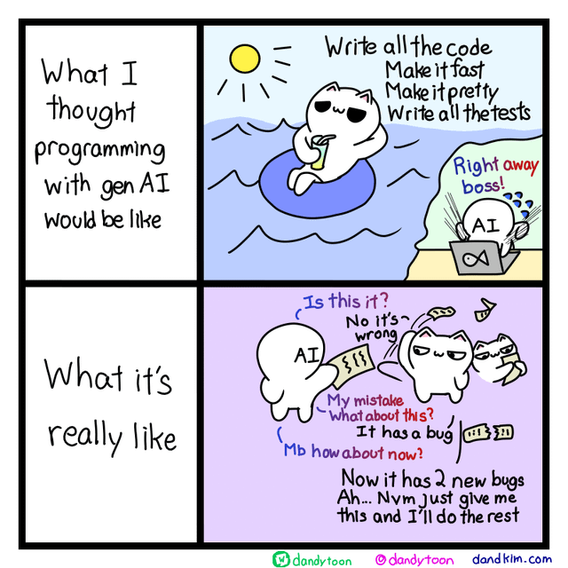
Problem with AI/ChatGPT
How much error have you caught from the sample ChatGPT solution?
By running prompt yourself, how good is your ChatGPT solution?
Image from: https://www.instagram.com/p/C8DN1pxKKSj/

