Slide 1


Deep Neural Network-Based Severity Prediction of Bug Reports
Abhigyan Pandey (22075001)
Param Ramesh Parsewar (22075057)
Piyush Goyal (22075058)

Slide 2

Introduction and Objective
Software maintenance is an essential phase of software development.
Software maintenance includes dealing with bugs.
Many bug reports to assess, a tedious manual work.
Need to automate severity assessment of bug reports.
We implement a Deep Neural Network based approach for this automation.

Slide 3
Approach
Extract the history data of bug reports from open-source projects.
Preprocess the bug reports using natural language processing techniques.
Compute and assign an emotion score to each bug report.
Create a vector (word-embeddings) for each preprocessed bug report.
Train a deep learning-based classifier for severity prediction.
Input the emotion score and the vector of each bug report to the classifier for its severity prediction.

Slide 4
Extraction
Data source – Public repository containing bug reports of Mozilla and Eclipse
Used attributes of bug report
Description
Severity

Slide 5
Preprocessing
Removing URLs, newlines, punctuations, alpha-numeric words, stopwords
Lowercasing
Tokenization, Lemmatization

Slide 6
Sentiment Analysis
Exploiting use of emotional words in bug reports.
Positive Emotion - (good, well, right)
Negative Emotion - (bad, wrong, suffer)
Severe indication - (break, crash, and error)
Non-severe indication - (warn, minor, and incorrect)

Slide 7
Emotional Score Calculation
Used RoBERTa*
Recent and commonly used.
Good results for scoring: Positive, Negative or Neutral
*- The RoBERTa model was proposed in RoBERTa: A Robustly Optimized BERT Pretraining Approach. It is based on Google’s BERT model released in 2018.

Slide 8
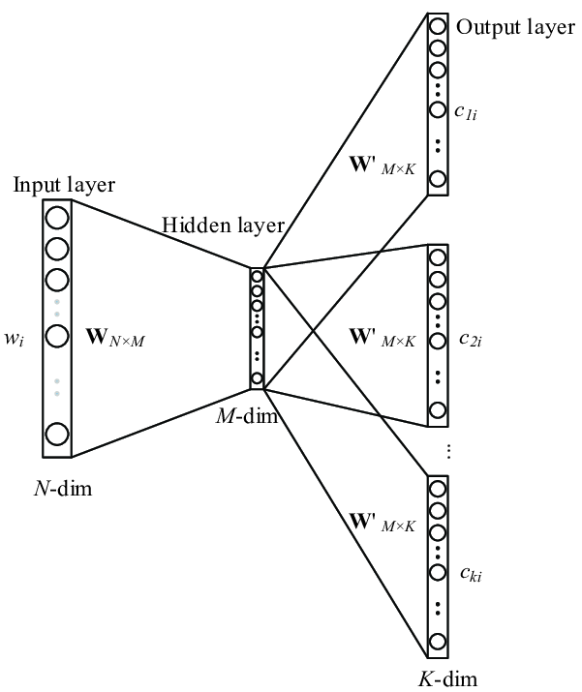
Creating Vectors
^{Used Word2Vec**}
Outstanding results for world analogies and context word predictions
e.g., Italy : Rome :: France : Paris (Predicted)
Efficient representation of words
**-Used to convert words to words to vectors by using the skip gram approach.

Slide 9
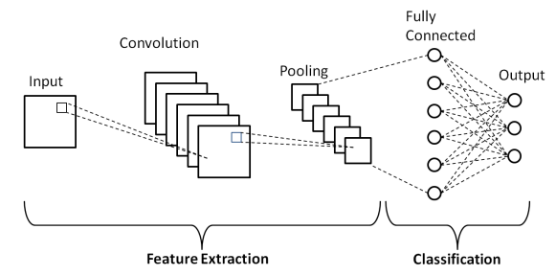
Neural Network Model
Used CNN
CNN layers may learn the deep semantical relationships between input words for severity prediction of bug reports.
Reduces training time due to its capability for parallel computation on modern powerful GPU
Use different filter size filters that avoid the exploding gradient problem of recurrent neural network

Slide 10
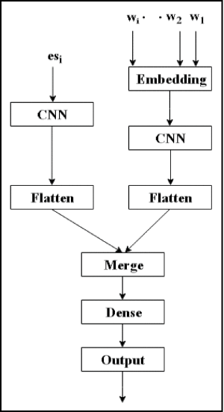
Model Description
Word Embeddings
CNN with settings : filter = 128, kernel size = 1 and activation = tanh used
3 such CNN layers used for optimal performance
Emotional Score
CNN with settings : filter = 128, kernel size = 1 and activation = tanh used
Merge
Output of both Word embedding and emotional score layer are flattened and Merged.
Dense and Output
A Dense layer with 128 neurons and Output layer with 1 neuron used.

Slide 11
Evaluation Metrics
Accuracy
Precision
Recall
F1 - Score

Slide 12
Results
We have used three models for results and discussions
Convolutional Neural network with emotional scores
Convolutional Neural network without emotional scores
LSTM with emotional scores

Slide 13
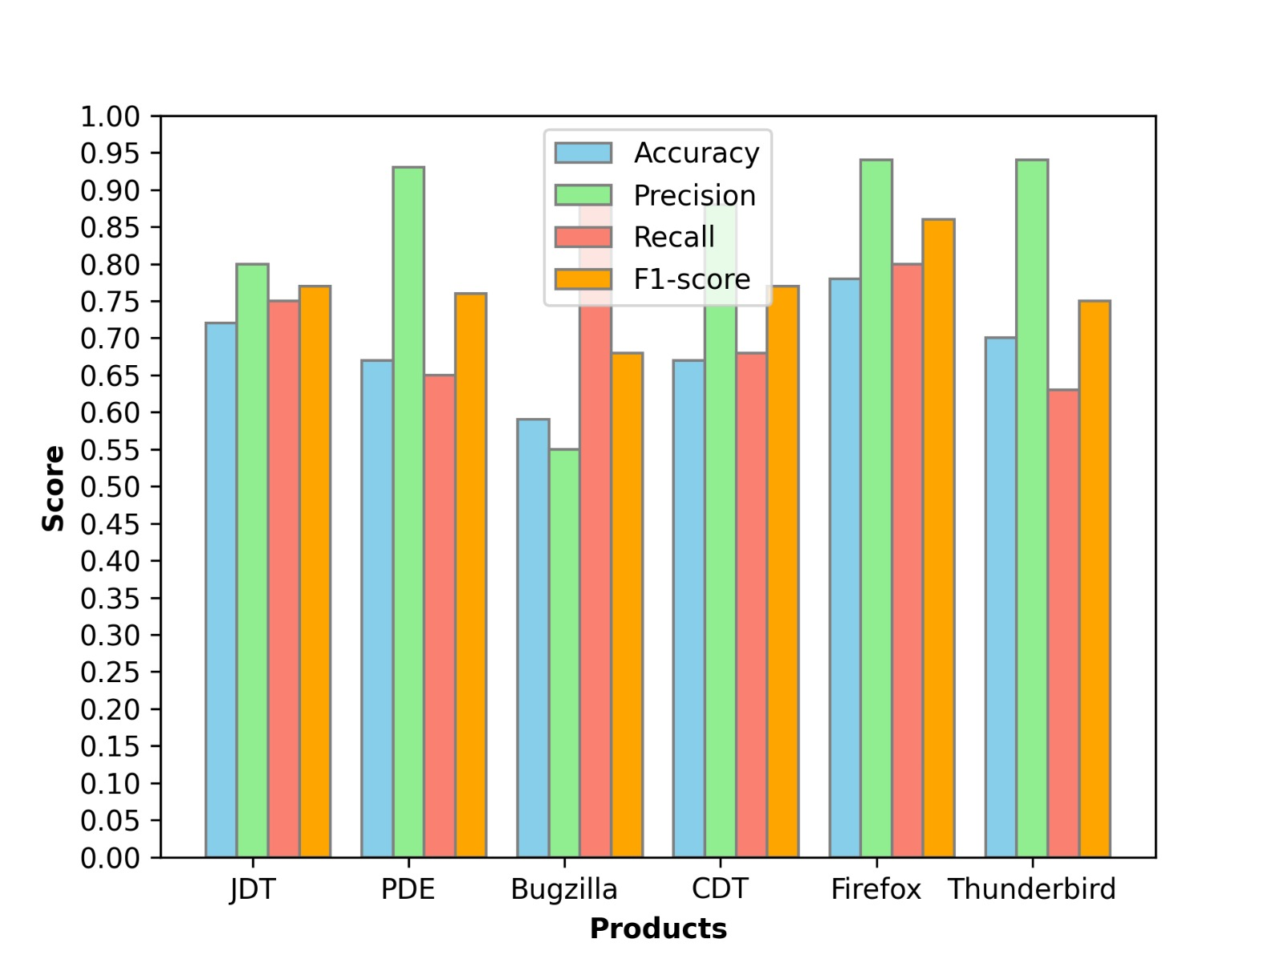
Convolutional Neural Network without emotional score
Products | Accuracy | Precision | Recall | F1-Score
JDT | 0.72 | 0.80 | 0.75 | 0.77
PDE | 0.67 | 0.93 | 0.65 | 0.76
Bugzilla | 0.59 | 0.55 | 0.89 | 0.68
CDT | 0.67 | 0.88 | 0.68 | 0.77
Firefox | 0.78 | 0.94 | 0.80 | 0.86
Thunderbird | 0.70 | 0.94 | 0.63 | 0.75
Average | 0.69 | 0.84 | 0.73 | 0.765

Slide 14
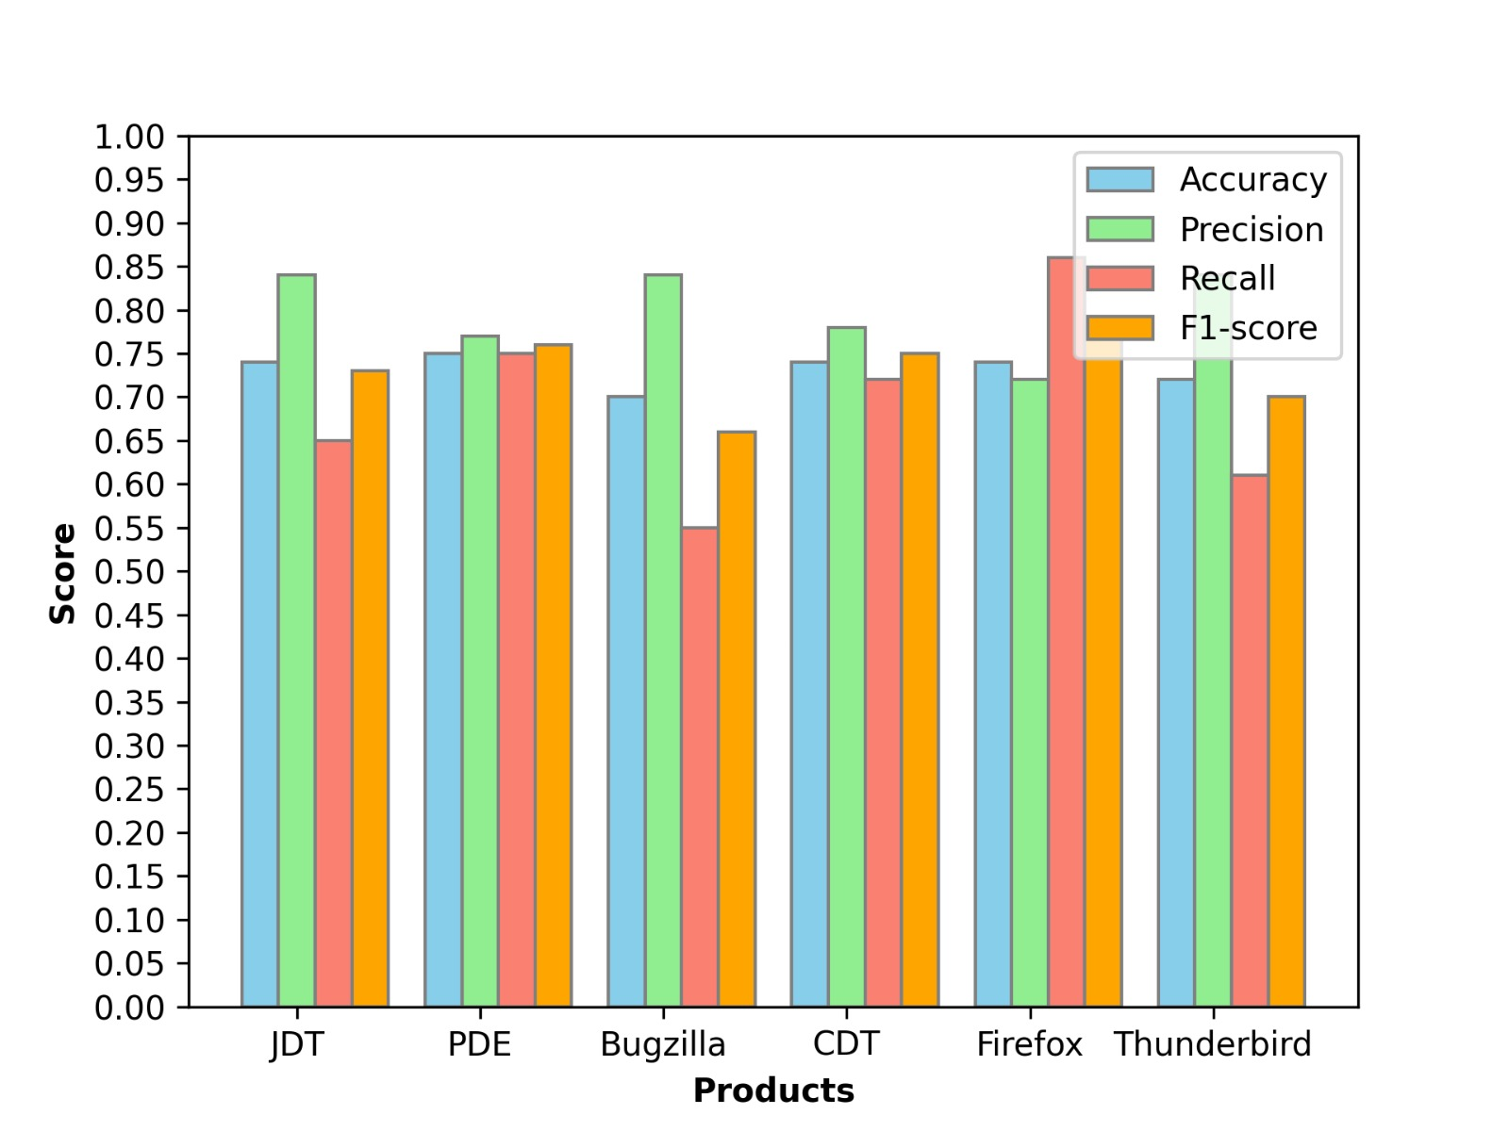
Convolutional Neural Network with emotional score
Products | Accuracy | Precision | Recall | F1-Score
JDT | 0.74 | 0.84 | 0.65 | 0.73
PDE | 0.75 | 0.77 | 0.75 | 0.76
Bugzilla | 0.70 | 0.84 | 0.55 | 0.66
CDT | 0.74 | 0.78 | 0.72 | 0.75
Firefox | 0.74 | 0.72 | 0.86 | 0.78
Thunderbird | 0.72 | 0.84 | 0.61 | 0.70
Average | 0.73 | 0.80 | 0.69 | 0.73

Slide 15
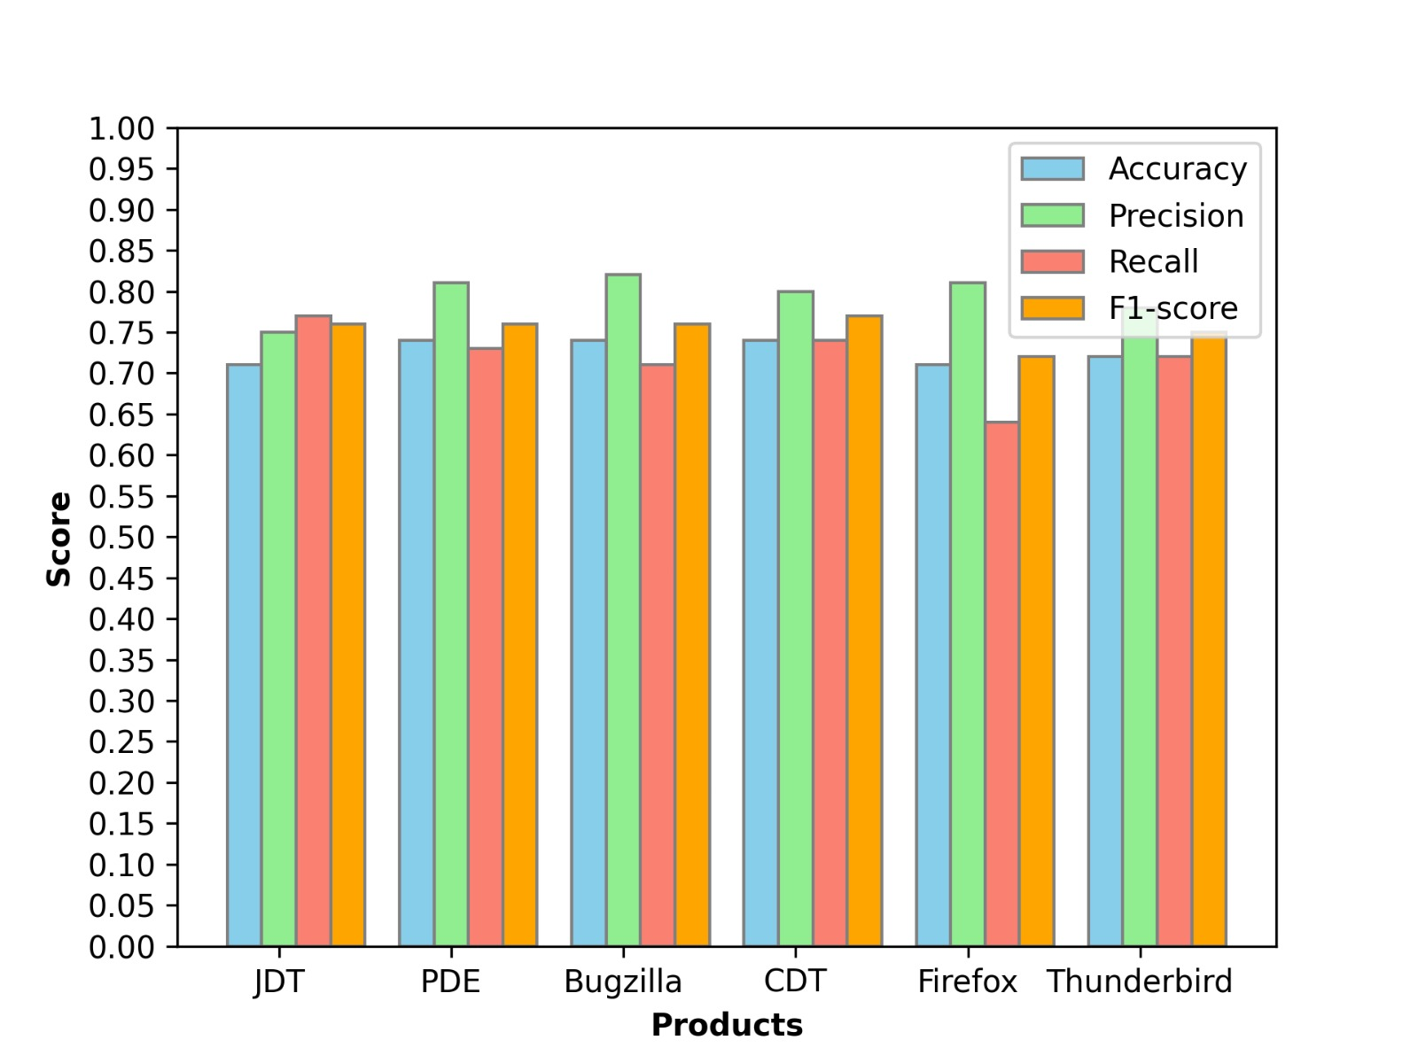
LSTM with emotional score
Products | Accuracy | Precision | Recall | F1-Score
JDT | 0.71 | 0.75 | 0.77 | 0.76
PDE | 0.74 | 0.81 | 0.73 | 0.76
Bugzilla | 0.74 | 0.80 | 0.74 | 0.77
CDT | 0.74 | 0.80 | 0.74 | 0.77
Firefox | 0.71 | 0.81 | 0.64 | 0.72
Thunderbird | 0.72 | 0.78 | 0.72 | 0.75
Average | 0.73 | 0.80 | 0.70 | 0.75

Slide 16
Discussion
Major improvement in accuracy when using emotional analysis
Improvement in accuracy = 3.66%
Products | CNN without ES | CNN with ES | Improvement
JDT | 72% | 74% | 2%
PDE | 67% | 75% | 8%
Bugzilla | 59% | 70% | 11%
CDT | 67% | 74% | 7%
Firefox | 78% | 74% | -4%
Thunderbird | 70% | 72% | -2%
Average | 69% | 73% | 3.66%

Slide 17
Future Improvements
Better Word-2-Vec model that not only encapsulates the similarities between words but also the contrast between words
Use of other new and advanced classification models like Transformers.
Try to establish similarities between different software for better bug classification on cross-validation
Improvements in sentiment analysis

Slide 18
Reference
[1] W. Y. Ramay, Q. Umer, X. C. Yin, C. Zhu, and I. Illahi, “Deep neural network based severity prediction of bug report.”
[2] T.Mikolov, I. Sutskever, K. Chen, G. Corrado, and J. Dean. (2013). “Distributed representations of words and phrases and their compositionality”.
[3] X.Ouyang, P. Zhou, C. H. Li, and L. Liu, “Sentiment analysis using convolutional neural network,” in Proc. IEEE Int. Conf. Comput. Inf. Technol., Ubiquitous Comput. Commun., Dependable, Autonomic Secure Comput., Pervasive Intell. Comput., Oct. 2015, pp. 2359–2364.
[4] E. Loper and S. Bird, “NLTK: The natural language toolkit,” in Proc. Workshop Effective Tools Methodologies Teach. Natural Lang. Process.

