Slide 1


Modeling Smoke Detectors
Kevin McGrattan
Building and Fire Research Laboratory
National Institute of Standards and Technology
Gaithersburg, Maryland

Slide 2
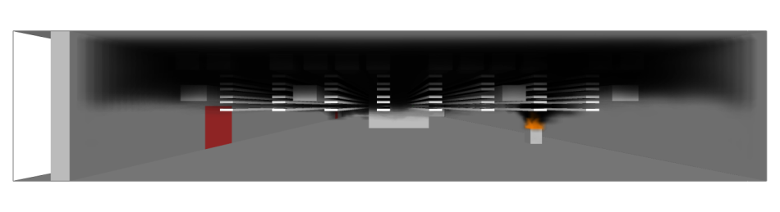
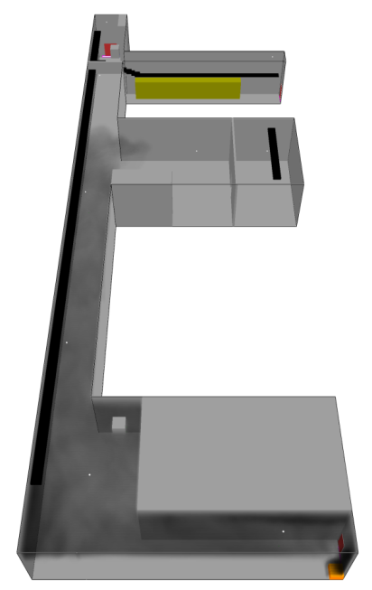
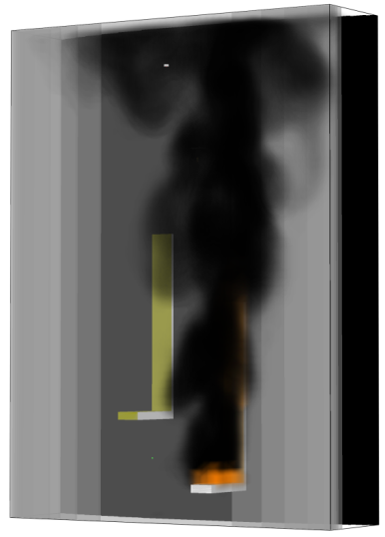
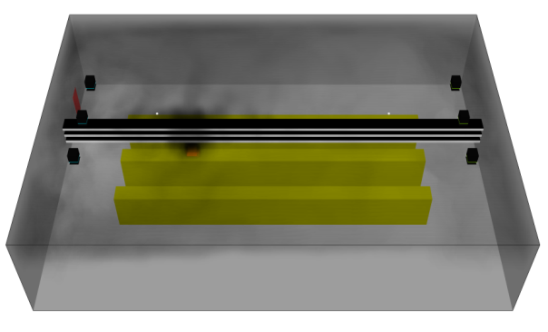
What’s the Problem?

Slide 3
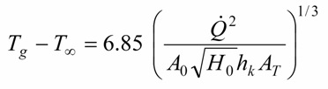
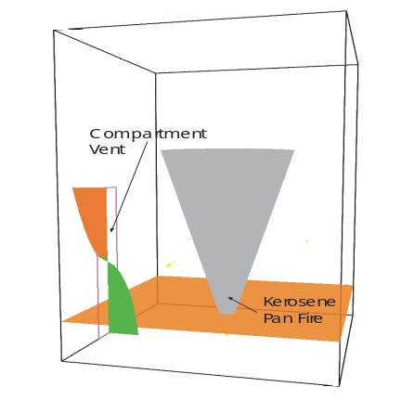
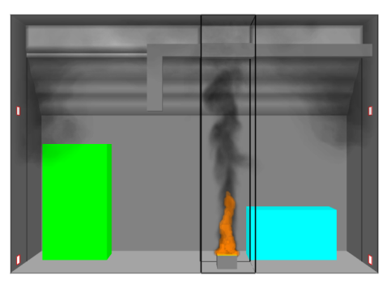
Three Classes of Fire Models
Empirical Models
Two-Zone Models
McCaffrey, Quintiere, Harkleroad (MQH)
CFD
FDS, NIST
CFAST, NIST
Notes:
The models for sprinkler and smoke detector activation have to be consistent with, and of comparable accuracy to, the current generation of fire models.

Slide 4
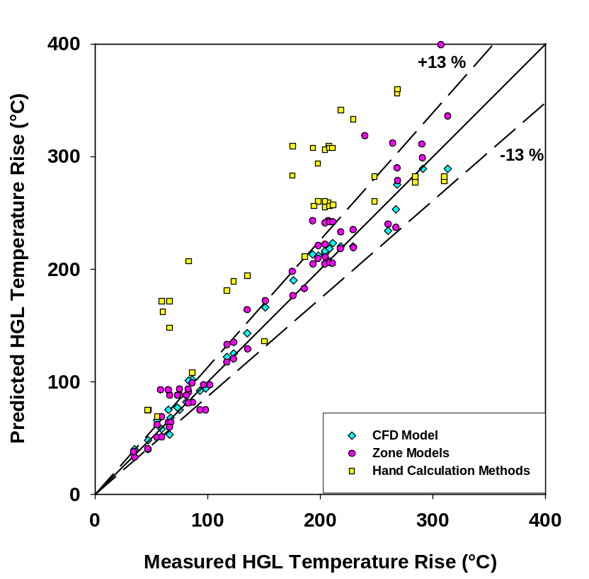
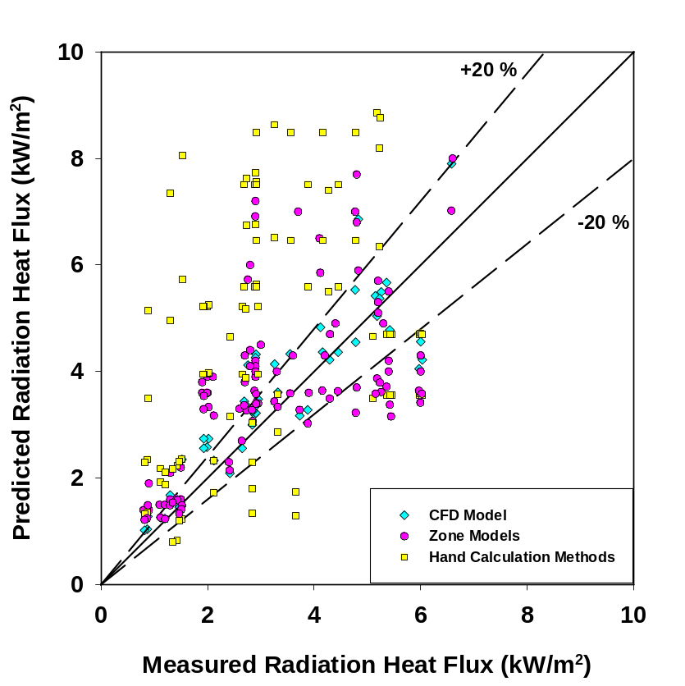
Fire Model Validation
US Nuclear Regulatory Commission and NFPA 805
From Fire Protection Engineering, Spring 2007

Slide 5
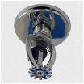
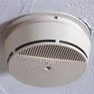
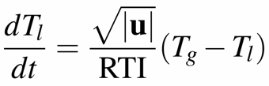

Simple Response Models in Fire
Solve for link temperature using velocity u and gas temperature from Fire Model. The RTI (Response Time Index) is unique to each sprinkler.
Source: Gunnar Heskestad, Factory Mutual
Solve for smoke chamber concentration
using external smoke concentration and
velocity u from Fire Model. L is a length
scale unique to each detector.

Slide 6
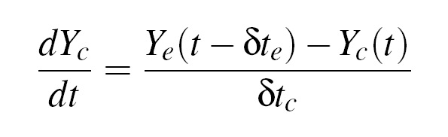
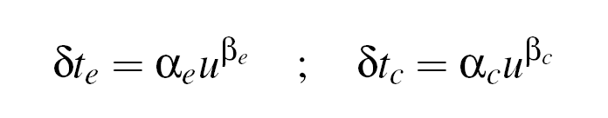
Cleary Model
4 parameters instead of 1

Slide 7
Smoke Transport:
Clutter?
Ceiling Type?
Smoke Deposition?
HVAC Effects?
Detectors: Sensitivity Parameters?
Fire:
Fuel Properties?
Burning Rate?
Smoke Yield?
Resolution Issues?

Slide 8
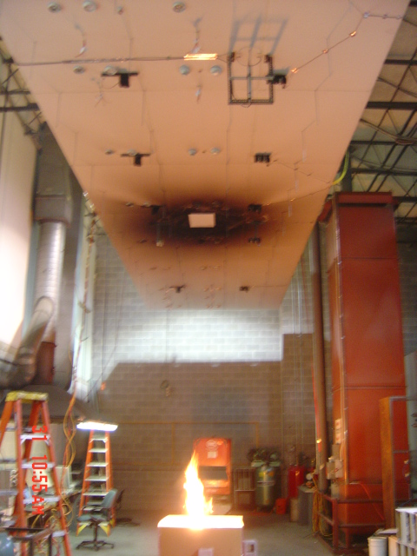
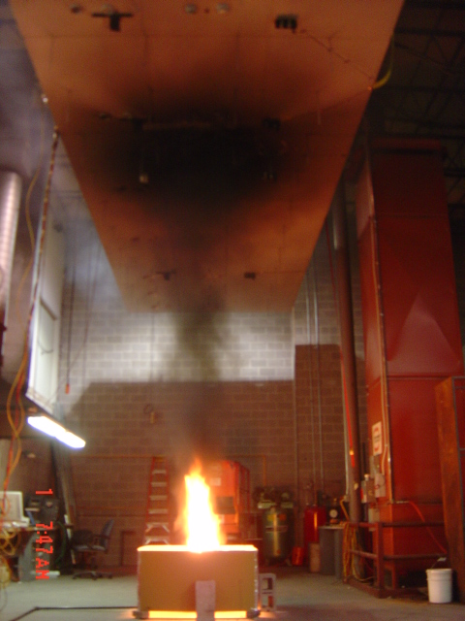
Smoke Detector Spacing Requirements for Complex Beamed/Sloped Ceilings
Chris Mealy, Siamik Riahi, Jason Floyd, & Dan Gottuk
Hughes Associates
Propane
Propylene

