Slide 1
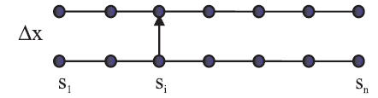
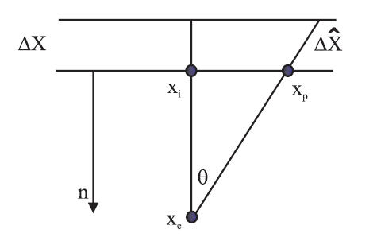
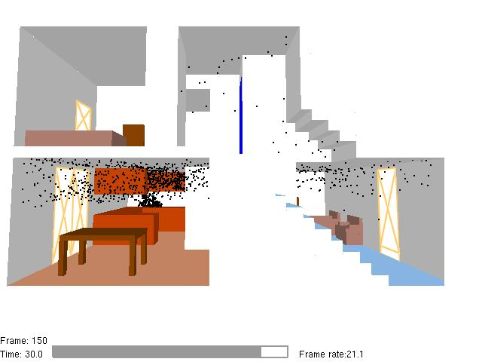
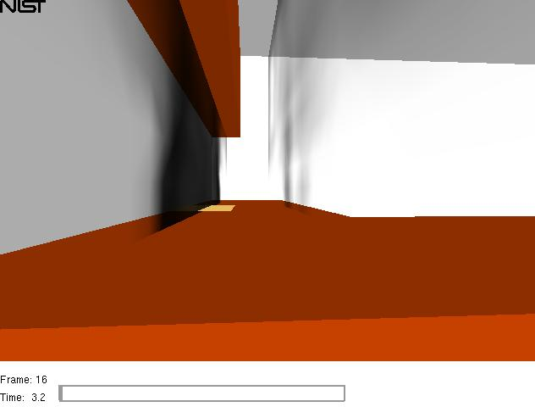
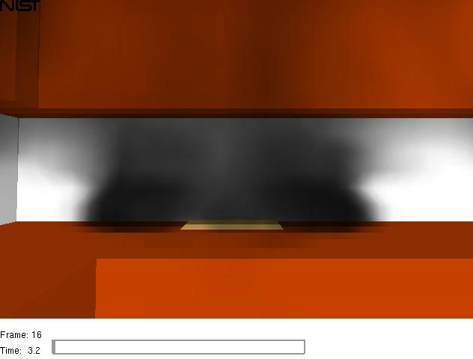
Light/Smoke interactions
absorption
out-scattering
emission
in-scattering
Volume Rendering Equation – Radiation Transport Equation
Beer-Lambert law
Using Transparency to Visualize Smoke
Physics-based computation of smoke transparency
Using Transparency to Visualize Smoke
Physics-based computation of smoke transparency
Using Transparency to Visualize Smoke
Physics-based computation of smoke transparency
Using Transparency to Visualize Smoke
Physics-based computation of smoke transparency
Using Transparency to Visualize Smoke
Physics-based computation of smoke transparency
Using Transparency to Visualize Smoke
Physics-based computation of smoke transparency
Using Transparency to Visualize Smoke
Physics-based computation of smoke transparency
Using Transparency to Visualize Smoke
Physics-based computation of smoke transparency
Using Transparency to Visualize Smoke
Physics-based computation of smoke transparency
Using Transparency to Visualize Smoke
Physics-based computation of smoke transparency
Using Transparency to Visualize Smoke
Physics-based computation of smoke transparency
FDS computes and compresses obscurations, a, (using Dx between adjacent grid planes) at each grid node using soot density data, s_{i}, and Beer’s law, a_{i} = 1 - exp(-ks_{i}Dx)
FDS computes and compresses obscurations, a, (using Dx between adjacent grid planes) at each grid node using soot density data, s_{i}, and Beer’s law, a_{i} = 1 - exp(-ks_{i}Dx)
FDS computes and compresses obscurations, a, (using Dx between adjacent grid planes) at each grid node using soot density data, s_{i}, and Beer’s law, a_{i} = 1 - exp(-ks_{i}Dx)
FDS computes and compresses obscurations, a, (using Dx between adjacent grid planes) at each grid node using soot density data, s_{i}, and Beer’s law, a_{i} = 1 - exp(-ks_{i}Dx)
FDS computes and compresses obscurations, a, (using Dx between adjacent grid planes) at each grid node using soot density data, s_{i}, and Beer’s law, a_{i} = 1 - exp(-ks_{i}Dx)
FDS computes and compresses obscurations, a, (using Dx between adjacent grid planes) at each grid node using soot density data, s_{i}, and Beer’s law, a_{i} = 1 - exp(-ks_{i}Dx)
FDS computes and compresses obscurations, a, (using Dx between adjacent grid planes) at each grid node using soot density data, s_{i}, and Beer’s law, a_{i} = 1 - exp(-ks_{i}Dx)
FDS computes and compresses obscurations, a, (using Dx between adjacent grid planes) at each grid node using soot density data, s_{i}, and Beer’s law, a_{i} = 1 - exp(-ks_{i}Dx)
FDS computes and compresses obscurations, a, (using Dx between adjacent grid planes) at each grid node using soot density data, s_{i}, and Beer’s law, a_{i} = 1 - exp(-ks_{i}Dx)
FDS computes and compresses obscurations, a, (using Dx between adjacent grid planes) at each grid node using soot density data, s_{i}, and Beer’s law, a_{i} = 1 - exp(-ks_{i}Dx)
FDS computes and compresses obscurations, a, (using Dx between adjacent grid planes) at each grid node using soot density data, s_{i}, and Beer’s law, a_{i} = 1 - exp(-ks_{i}Dx)
Smokeview adjusts each a_{i} in real time for non-axis aligned view distances using
Smokeview adjusts each a_{i} in real time for non-axis aligned view distances using
Smokeview adjusts each a_{i} in real time for non-axis aligned view distances using
Smokeview adjusts each a_{i} in real time for non-axis aligned view distances using
Smokeview adjusts each a_{i} in real time for non-axis aligned view distances using
Smokeview adjusts each a_{i} in real time for non-axis aligned view distances using
Smokeview adjusts each a_{i} in real time for non-axis aligned view distances using
Smoke may be drawn faster by skipping planes (need to adjust a’s for planes that remain)
Smoke may be drawn faster by skipping planes (need to adjust a’s for planes that remain)
Smoke may be drawn faster by skipping planes (need to adjust a’s for planes that remain)
Smoke may be drawn faster by skipping planes (need to adjust a’s for planes that remain)
Smoke may be drawn faster by skipping planes (need to adjust a’s for planes that remain)
Smoke may be drawn faster by skipping planes (need to adjust a’s for planes that remain)
Smoke may be drawn faster by skipping planes (need to adjust a’s for planes that remain)
3D smoke display using transparency
3D smoke display using transparency
3D smoke display using transparency
3D smoke display using transparency
Side view
(between two slices)
Front view
Side view
(between two slices)
Front view
Side view
(between two slices)
Front view
Side view
(between two slices)
Front view
Notes:
Light and smoke interact in 4 ways only 2 of which are presently accounted for (absorption and out-scattering).

Slide 2
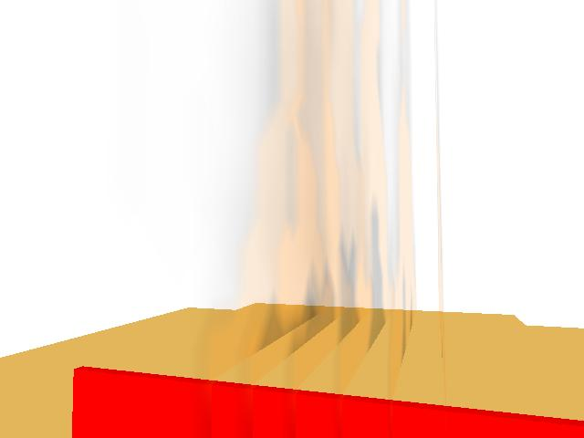
Beer’s law
I/I0=exp(-σ_{t}Δξ)
Orient planes to be most perpendicular to line of sight
ΔX
Using Transparency to Visualize Smoke
Physics-based computation of smoke transparency
Using Transparency to Visualize Smoke
Physics-based computation of smoke transparency
Using Transparency to Visualize Smoke
Physics-based computation of smoke transparency
Using Transparency to Visualize Smoke
Physics-based computation of smoke transparency
Using Transparency to Visualize Smoke
Physics-based computation of smoke transparency
Using Transparency to Visualize Smoke
Physics-based computation of smoke transparency
Using Transparency to Visualize Smoke
Physics-based computation of smoke transparency
Using Transparency to Visualize Smoke
Physics-based computation of smoke transparency
Using Transparency to Visualize Smoke
Physics-based computation of smoke transparency
Using Transparency to Visualize Smoke
Physics-based computation of smoke transparency
Using Transparency to Visualize Smoke
Physics-based computation of smoke transparency
FDS computes and compresses obscurations, α, (using Δx between adjacent grid planes) at each grid node using soot density data, s_{i}, and Beer’s law, α_{i} = 1 - exp(-ks_{i}Δx)
FDS computes and compresses obscurations, α, (using Δx between adjacent grid planes) at each grid node using soot density data, s_{i}, and Beer’s law, α_{i} = 1 - exp(-ks_{i}Δx)
FDS computes and compresses obscurations, α, (using Δx between adjacent grid planes) at each grid node using soot density data, s_{i}, and Beer’s law, α_{i} = 1 - exp(-ks_{i}Δx)
FDS computes and compresses obscurations, α, (using Δx between adjacent grid planes) at each grid node using soot density data, s_{i}, and Beer’s law, α_{i} = 1 - exp(-ks_{i}Δx)
FDS computes and compresses obscurations, α, (using Δx between adjacent grid planes) at each grid node using soot density data, s_{i}, and Beer’s law, α_{i} = 1 - exp(-ks_{i}Δx)
FDS computes and compresses obscurations, α, (using Δx between adjacent grid planes) at each grid node using soot density data, s_{i}, and Beer’s law, α_{i} = 1 - exp(-ks_{i}Δx)
FDS computes and compresses obscurations, α, (using Δx between adjacent grid planes) at each grid node using soot density data, s_{i}, and Beer’s law, α_{i} = 1 - exp(-ks_{i}Δx)
FDS computes and compresses obscurations, α, (using Δx between adjacent grid planes) at each grid node using soot density data, s_{i}, and Beer’s law, α_{i} = 1 - exp(-ks_{i}Δx)
FDS computes and compresses obscurations, α, (using Δx between adjacent grid planes) at each grid node using soot density data, s_{i}, and Beer’s law, α_{i} = 1 - exp(-ks_{i}Δx)
FDS computes and compresses obscurations, α, (using Δx between adjacent grid planes) at each grid node using soot density data, s_{i}, and Beer’s law, α_{i} = 1 - exp(-ks_{i}Δx)
FDS computes and compresses obscurations, α, (using Δx between adjacent grid planes) at each grid node using soot density data, s_{i}, and Beer’s law, α_{i} = 1 - exp(-ks_{i}Δx)
Smokeview adjusts each α_{i} in real time for non-axis aligned view distances using
Smokeview adjusts each α_{i} in real time for non-axis aligned view distances using
Smokeview adjusts each α_{i} in real time for non-axis aligned view distances using
Smokeview adjusts each α_{i} in real time for non-axis aligned view distances using
Smokeview adjusts each α_{i} in real time for non-axis aligned view distances using
Smokeview adjusts each α_{i} in real time for non-axis aligned view distances using
Smokeview adjusts each α_{i} in real time for non-axis aligned view distances using
Smokeview adjusts each α_{i} in real time for non-axis aligned view distances using
Smoke may be drawn faster by skipping planes (need to adjust α’s for planes that remain)
Smoke may be drawn faster by skipping planes (need to adjust α’s for planes that remain)
Smoke may be drawn faster by skipping planes (need to adjust α’s for planes that remain)
Smoke may be drawn faster by skipping planes (need to adjust α’s for planes that remain)
Smoke may be drawn faster by skipping planes (need to adjust α’s for planes that remain)
Smoke may be drawn faster by skipping planes (need to adjust α’s for planes that remain)
Smoke may be drawn faster by skipping planes (need to adjust α’s for planes that remain)
Smoke may be drawn faster by skipping planes (need to adjust α’s for planes that remain)
Notes:
Smokeview draws smoke by drawing a set of 2D slice planes. Each plane is colored black using opacity (alpa) values determined using Beer’s law (discussed earlier). Smoke data however is stored in 3D. So planes are selected to be most perpendicular to line of sight.

Slide 3
3D Smoke
Δx distance between adjacent grid planes
S_{i} soot density
α_{i} opacity
FDS computes α for each grid node
Smokeview combines α’s using the video card
Δx
α_{i} = 1 - exp(-ks_{i}Δx)
S₁
S_{i}
S_{N}
Using Transparency to Visualize Smoke
Physics-based computation of smoke transparency
Using Transparency to Visualize Smoke
Physics-based computation of smoke transparency
Using Transparency to Visualize Smoke
Physics-based computation of smoke transparency
Using Transparency to Visualize Smoke
Physics-based computation of smoke transparency
Using Transparency to Visualize Smoke
Physics-based computation of smoke transparency
Using Transparency to Visualize Smoke
Physics-based computation of smoke transparency
Using Transparency to Visualize Smoke
Physics-based computation of smoke transparency
Using Transparency to Visualize Smoke
Physics-based computation of smoke transparency
Using Transparency to Visualize Smoke
Physics-based computation of smoke transparency
Using Transparency to Visualize Smoke
Physics-based computation of smoke transparency
Using Transparency to Visualize Smoke
Physics-based computation of smoke transparency
FDS computes and compresses obscurations, α, (using Δx between adjacent grid planes) at each grid node using soot density data, s_{i}, and Beer’s law, α_{i} = 1 - exp(-ks_{i}Δx)
FDS computes and compresses obscurations, α, (using Δx between adjacent grid planes) at each grid node using soot density data, s_{i}, and Beer’s law, α_{i} = 1 - exp(-ks_{i}Δx)
FDS computes and compresses obscurations, α, (using Δx between adjacent grid planes) at each grid node using soot density data, s_{i}, and Beer’s law, α_{i} = 1 - exp(-ks_{i}Δx)
FDS computes and compresses obscurations, α, (using Δx between adjacent grid planes) at each grid node using soot density data, s_{i}, and Beer’s law, α_{i} = 1 - exp(-ks_{i}Δx)
FDS computes and compresses obscurations, α, (using Δx between adjacent grid planes) at each grid node using soot density data, s_{i}, and Beer’s law, α_{i} = 1 - exp(-ks_{i}Δx)
FDS computes and compresses obscurations, α, (using Δx between adjacent grid planes) at each grid node using soot density data, s_{i}, and Beer’s law, α_{i} = 1 - exp(-ks_{i}Δx)
FDS computes and compresses obscurations, α, (using Δx between adjacent grid planes) at each grid node using soot density data, s_{i}, and Beer’s law, α_{i} = 1 - exp(-ks_{i}Δx)
FDS computes and compresses obscurations, α, (using Δx between adjacent grid planes) at each grid node using soot density data, s_{i}, and Beer’s law, α_{i} = 1 - exp(-ks_{i}Δx)
FDS computes and compresses obscurations, α, (using Δx between adjacent grid planes) at each grid node using soot density data, s_{i}, and Beer’s law, α_{i} = 1 - exp(-ks_{i}Δx)
FDS computes and compresses obscurations, α, (using Δx between adjacent grid planes) at each grid node using soot density data, s_{i}, and Beer’s law, α_{i} = 1 - exp(-ks_{i}Δx)
FDS computes and compresses obscurations, α, (using Δx between adjacent grid planes) at each grid node using soot density data, s_{i}, and Beer’s law, α_{i} = 1 - exp(-ks_{i}Δx)
Smokeview adjusts each α_{i} in real time for non-axis aligned view distances using
Smokeview adjusts each α_{i} in real time for non-axis aligned view distances using
Smokeview adjusts each α_{i} in real time for non-axis aligned view distances using
Smokeview adjusts each α_{i} in real time for non-axis aligned view distances using
Smokeview adjusts each α_{i} in real time for non-axis aligned view distances using
Smokeview adjusts each α_{i} in real time for non-axis aligned view distances using
Smokeview adjusts each α_{i} in real time for non-axis aligned view distances using
Smoke may be drawn faster by skipping planes (need to adjust α’s for planes that remain)
Smoke may be drawn faster by skipping planes (need to adjust α’s for planes that remain)
Smoke may be drawn faster by skipping planes (need to adjust α’s for planes that remain)
Smoke may be drawn faster by skipping planes (need to adjust α’s for planes that remain)
Smoke may be drawn faster by skipping planes (need to adjust α’s for planes that remain)
Smoke may be drawn faster by skipping planes (need to adjust α’s for planes that remain)
Smoke may be drawn faster by skipping planes (need to adjust α’s for planes that remain)
Notes:
2 lines of nodes from an FDS computation. The alpha’s are pre-computed by FDS (for orthogonal direction between cell rows).

Slide 4
3D Smoke Correcting α
FDS computed:
α
Smokeview computed:
Solve for exp(-ks):
Skipping Frames
Using Transparency to Visualize Smoke
Physics-based computation of smoke transparency
Using Transparency to Visualize Smoke
Physics-based computation of smoke transparency
Using Transparency to Visualize Smoke
Physics-based computation of smoke transparency
Using Transparency to Visualize Smoke
Physics-based computation of smoke transparency
Using Transparency to Visualize Smoke
Physics-based computation of smoke transparency
Using Transparency to Visualize Smoke
Physics-based computation of smoke transparency
Using Transparency to Visualize Smoke
Physics-based computation of smoke transparency
Using Transparency to Visualize Smoke
Physics-based computation of smoke transparency
Using Transparency to Visualize Smoke
Physics-based computation of smoke transparency
Using Transparency to Visualize Smoke
Physics-based computation of smoke transparency
Using Transparency to Visualize Smoke
Physics-based computation of smoke transparency
FDS computes and compresses obscurations, α, (using Δx between adjacent grid planes) at each grid node using soot density data, s_{i}, and Beer’s law, α_{i} = 1 - exp(-ks_{i}Δx)
FDS computes and compresses obscurations, α, (using Δx between adjacent grid planes) at each grid node using soot density data, s_{i}, and Beer’s law, α_{i} = 1 - exp(-ks_{i}Δx)
FDS computes and compresses obscurations, α, (using Δx between adjacent grid planes) at each grid node using soot density data, s_{i}, and Beer’s law, α_{i} = 1 - exp(-ks_{i}Δx)
FDS computes and compresses obscurations, α, (using Δx between adjacent grid planes) at each grid node using soot density data, s_{i}, and Beer’s law, α_{i} = 1 - exp(-ks_{i}Δx)
FDS computes and compresses obscurations, α, (using Δx between adjacent grid planes) at each grid node using soot density data, s_{i}, and Beer’s law, α_{i} = 1 - exp(-ks_{i}Δx)
FDS computes and compresses obscurations, α, (using Δx between adjacent grid planes) at each grid node using soot density data, s_{i}, and Beer’s law, α_{i} = 1 - exp(-ks_{i}Δx)
FDS computes and compresses obscurations, α, (using Δx between adjacent grid planes) at each grid node using soot density data, s_{i}, and Beer’s law, α_{i} = 1 - exp(-ks_{i}Δx)
FDS computes and compresses obscurations, α, (using Δx between adjacent grid planes) at each grid node using soot density data, s_{i}, and Beer’s law, α_{i} = 1 - exp(-ks_{i}Δx)
FDS computes and compresses obscurations, α, (using Δx between adjacent grid planes) at each grid node using soot density data, s_{i}, and Beer’s law, α_{i} = 1 - exp(-ks_{i}Δx)
FDS computes and compresses obscurations, α, (using Δx between adjacent grid planes) at each grid node using soot density data, s_{i}, and Beer’s law, α_{i} = 1 - exp(-ks_{i}Δx)
FDS computes and compresses obscurations, α, (using Δx between adjacent grid planes) at each grid node using soot density data, s_{i}, and Beer’s law, α_{i} = 1 - exp(-ks_{i}Δx)
Smokeview adjusts each α_{i} in real time for non-axis aligned view distances using
Smokeview adjusts each α_{i} in real time for non-axis aligned view distances using
Smokeview adjusts each α_{i} in real time for non-axis aligned view distances using
Smokeview adjusts each α_{i} in real time for non-axis aligned view distances using
Smokeview adjusts each α_{i} in real time for non-axis aligned view distances using
Smokeview adjusts each α_{i} in real time for non-axis aligned view distances using
Smokeview adjusts each α_{i} in real time for non-axis aligned view distances using
Smokeview adjusts each α_{i} in real time for non-axis aligned view distances using
Smoke may be drawn faster by skipping planes (need to adjust α’s for planes that remain)
Smoke may be drawn faster by skipping planes (need to adjust α’s for planes that remain)
Smoke may be drawn faster by skipping planes (need to adjust α’s for planes that remain)
Smoke may be drawn faster by skipping planes (need to adjust α’s for planes that remain)
Smoke may be drawn faster by skipping planes (need to adjust α’s for planes that remain)
Smoke may be drawn faster by skipping planes (need to adjust α’s for planes that remain)
Smoke may be drawn faster by skipping planes (need to adjust α’s for planes that remain)
Smoke may be drawn faster by skipping planes (need to adjust α’s for planes that remain)
Notes:
The alpha’s need to be corrected to account for non-orthogonal view directions. IF they are not then smoke will look lighter than it should off to the side of the scene.

Slide 5
Using Transparency to Visualize Smoke
Physics-based computation of smoke transparency
Using Transparency to Visualize Smoke
Physics-based computation of smoke transparency
Using Transparency to Visualize Smoke
Physics-based computation of smoke transparency
Using Transparency to Visualize Smoke
Physics-based computation of smoke transparency
Using Transparency to Visualize Smoke
Physics-based computation of smoke transparency
Using Transparency to Visualize Smoke
Physics-based computation of smoke transparency
Using Transparency to Visualize Smoke
Physics-based computation of smoke transparency
Using Transparency to Visualize Smoke
Physics-based computation of smoke transparency
Using Transparency to Visualize Smoke
Physics-based computation of smoke transparency
Using Transparency to Visualize Smoke
Physics-based computation of smoke transparency
Using Transparency to Visualize Smoke
Physics-based computation of smoke transparency
FDS computes and compresses obscurations, α, (using Δx between adjacent grid planes) at each grid node using soot density data, s_{i}, and Beer’s law, α_{i} = 1 - exp(-ks_{i}Δx)
FDS computes and compresses obscurations, α, (using Δx between adjacent grid planes) at each grid node using soot density data, s_{i}, and Beer’s law, α_{i} = 1 - exp(-ks_{i}Δx)
FDS computes and compresses obscurations, α, (using Δx between adjacent grid planes) at each grid node using soot density data, s_{i}, and Beer’s law, α_{i} = 1 - exp(-ks_{i}Δx)
FDS computes and compresses obscurations, α, (using Δx between adjacent grid planes) at each grid node using soot density data, s_{i}, and Beer’s law, α_{i} = 1 - exp(-ks_{i}Δx)
FDS computes and compresses obscurations, α, (using Δx between adjacent grid planes) at each grid node using soot density data, s_{i}, and Beer’s law, α_{i} = 1 - exp(-ks_{i}Δx)
FDS computes and compresses obscurations, α, (using Δx between adjacent grid planes) at each grid node using soot density data, s_{i}, and Beer’s law, α_{i} = 1 - exp(-ks_{i}Δx)
FDS computes and compresses obscurations, α, (using Δx between adjacent grid planes) at each grid node using soot density data, s_{i}, and Beer’s law, α_{i} = 1 - exp(-ks_{i}Δx)
FDS computes and compresses obscurations, α, (using Δx between adjacent grid planes) at each grid node using soot density data, s_{i}, and Beer’s law, α_{i} = 1 - exp(-ks_{i}Δx)
FDS computes and compresses obscurations, α, (using Δx between adjacent grid planes) at each grid node using soot density data, s_{i}, and Beer’s law, α_{i} = 1 - exp(-ks_{i}Δx)
FDS computes and compresses obscurations, α, (using Δx between adjacent grid planes) at each grid node using soot density data, s_{i}, and Beer’s law, α_{i} = 1 - exp(-ks_{i}Δx)
FDS computes and compresses obscurations, α, (using Δx between adjacent grid planes) at each grid node using soot density data, s_{i}, and Beer’s law, α_{i} = 1 - exp(-ks_{i}Δx)
Smokeview adjusts each α_{i} in real time for non-axis aligned view distances using
Smokeview adjusts each α_{i} in real time for non-axis aligned view distances using
Smokeview adjusts each α_{i} in real time for non-axis aligned view distances using
Smokeview adjusts each α_{i} in real time for non-axis aligned view distances using
Smokeview adjusts each α_{i} in real time for non-axis aligned view distances using
Smokeview adjusts each α_{i} in real time for non-axis aligned view distances using
Smokeview adjusts each α_{i} in real time for non-axis aligned view distances using
Smokeview adjusts each α_{i} in real time for non-axis aligned view distances using
Smoke may be drawn faster by skipping planes (need to adjust α’s for planes that remain)
Smoke may be drawn faster by skipping planes (need to adjust α’s for planes that remain)
Smoke may be drawn faster by skipping planes (need to adjust α’s for planes that remain)
Smoke may be drawn faster by skipping planes (need to adjust α’s for planes that remain)
Smoke may be drawn faster by skipping planes (need to adjust α’s for planes that remain)
Smoke may be drawn faster by skipping planes (need to adjust α’s for planes that remain)
Smoke may be drawn faster by skipping planes (need to adjust α’s for planes that remain)
Smoke may be drawn faster by skipping planes (need to adjust α’s for planes that remain)
Notes:
The alpha’s need to be corrected to account for non-orthogonal view directions. IF they are not then smoke will look lighter than it should off to the side of the scene.

Slide 6
3D Smoke
Problems can occur for large grids (ΔX small)
α_{i} = 1 - exp(-ks_{i}Δx) - Beer’s law
α < 1/256 =0
More refined grids ➔ smaller Δx ➔ smaller α ➔ increased error
Using Transparency to Visualize Smoke
Physics-based computation of smoke transparency
Using Transparency to Visualize Smoke
Physics-based computation of smoke transparency
Using Transparency to Visualize Smoke
Physics-based computation of smoke transparency
Using Transparency to Visualize Smoke
Physics-based computation of smoke transparency
Using Transparency to Visualize Smoke
Physics-based computation of smoke transparency
Using Transparency to Visualize Smoke
Physics-based computation of smoke transparency
Using Transparency to Visualize Smoke
Physics-based computation of smoke transparency
Using Transparency to Visualize Smoke
Physics-based computation of smoke transparency
Using Transparency to Visualize Smoke
Physics-based computation of smoke transparency
Using Transparency to Visualize Smoke
Physics-based computation of smoke transparency
Using Transparency to Visualize Smoke
Physics-based computation of smoke transparency
FDS computes and compresses obscurations, α, (using Δx between adjacent grid planes) at each grid node using soot density data, s_{i}, and Beer’s law, α_{i} = 1 - exp(-ks_{i}Δx)
FDS computes and compresses obscurations, α, (using Δx between adjacent grid planes) at each grid node using soot density data, s_{i}, and Beer’s law, α_{i} = 1 - exp(-ks_{i}Δx)
FDS computes and compresses obscurations, α, (using Δx between adjacent grid planes) at each grid node using soot density data, s_{i}, and Beer’s law, α_{i} = 1 - exp(-ks_{i}Δx)
FDS computes and compresses obscurations, α, (using Δx between adjacent grid planes) at each grid node using soot density data, s_{i}, and Beer’s law, α_{i} = 1 - exp(-ks_{i}Δx)
FDS computes and compresses obscurations, α, (using Δx between adjacent grid planes) at each grid node using soot density data, s_{i}, and Beer’s law, α_{i} = 1 - exp(-ks_{i}Δx)
FDS computes and compresses obscurations, α, (using Δx between adjacent grid planes) at each grid node using soot density data, s_{i}, and Beer’s law, α_{i} = 1 - exp(-ks_{i}Δx)
FDS computes and compresses obscurations, α, (using Δx between adjacent grid planes) at each grid node using soot density data, s_{i}, and Beer’s law, α_{i} = 1 - exp(-ks_{i}Δx)
FDS computes and compresses obscurations, α, (using Δx between adjacent grid planes) at each grid node using soot density data, s_{i}, and Beer’s law, α_{i} = 1 - exp(-ks_{i}Δx)
FDS computes and compresses obscurations, α, (using Δx between adjacent grid planes) at each grid node using soot density data, s_{i}, and Beer’s law, α_{i} = 1 - exp(-ks_{i}Δx)
FDS computes and compresses obscurations, α, (using Δx between adjacent grid planes) at each grid node using soot density data, s_{i}, and Beer’s law, α_{i} = 1 - exp(-ks_{i}Δx)
FDS computes and compresses obscurations, α, (using Δx between adjacent grid planes) at each grid node using soot density data, s_{i}, and Beer’s law, α_{i} = 1 - exp(-ks_{i}Δx)
Smokeview adjusts each α_{i} in real time for non-axis aligned view distances using
Smokeview adjusts each α_{i} in real time for non-axis aligned view distances using
Smokeview adjusts each α_{i} in real time for non-axis aligned view distances using
Smokeview adjusts each α_{i} in real time for non-axis aligned view distances using
Smokeview adjusts each α_{i} in real time for non-axis aligned view distances using
Smokeview adjusts each α_{i} in real time for non-axis aligned view distances using
Smokeview adjusts each α_{i} in real time for non-axis aligned view distances using
Smoke may be drawn faster by skipping planes (need to adjust α’s for planes that remain)
Smoke may be drawn faster by skipping planes (need to adjust α’s for planes that remain)
Smoke may be drawn faster by skipping planes (need to adjust α’s for planes that remain)
Smoke may be drawn faster by skipping planes (need to adjust α’s for planes that remain)
Smoke may be drawn faster by skipping planes (need to adjust α’s for planes that remain)
Smoke may be drawn faster by skipping planes (need to adjust α’s for planes that remain)
Smoke may be drawn faster by skipping planes (need to adjust α’s for planes that remain)
Notes:
When ΔX becomes small (equivalently the number of grid cells becom large), the alpha’s will truncate to 0 due to limited precision arithmetic

Slide 7

Δx
α_{i} = 1 - exp(-σ_{t}Δx)
Background
Using Transparency to Visualize Smoke
Physics-based computation of smoke transparency
Using Transparency to Visualize Smoke
Physics-based computation of smoke transparency
Using Transparency to Visualize Smoke
Physics-based computation of smoke transparency
Using Transparency to Visualize Smoke
Physics-based computation of smoke transparency
Using Transparency to Visualize Smoke
Physics-based computation of smoke transparency
Using Transparency to Visualize Smoke
Physics-based computation of smoke transparency
Using Transparency to Visualize Smoke
Physics-based computation of smoke transparency
Using Transparency to Visualize Smoke
Physics-based computation of smoke transparency
Using Transparency to Visualize Smoke
Physics-based computation of smoke transparency
Using Transparency to Visualize Smoke
Physics-based computation of smoke transparency
Using Transparency to Visualize Smoke
Physics-based computation of smoke transparency
FDS computes and compresses obscurations, α, (using Δx between adjacent grid planes) at each grid node using soot density data, s_{i}, and Beer’s law, α_{i} = 1 - exp(-ks_{i}Δx)
FDS computes and compresses obscurations, α, (using Δx between adjacent grid planes) at each grid node using soot density data, s_{i}, and Beer’s law, α_{i} = 1 - exp(-ks_{i}Δx)
FDS computes and compresses obscurations, α, (using Δx between adjacent grid planes) at each grid node using soot density data, s_{i}, and Beer’s law, α_{i} = 1 - exp(-ks_{i}Δx)
FDS computes and compresses obscurations, α, (using Δx between adjacent grid planes) at each grid node using soot density data, s_{i}, and Beer’s law, α_{i} = 1 - exp(-ks_{i}Δx)
FDS computes and compresses obscurations, α, (using Δx between adjacent grid planes) at each grid node using soot density data, s_{i}, and Beer’s law, α_{i} = 1 - exp(-ks_{i}Δx)
FDS computes and compresses obscurations, α, (using Δx between adjacent grid planes) at each grid node using soot density data, s_{i}, and Beer’s law, α_{i} = 1 - exp(-ks_{i}Δx)
FDS computes and compresses obscurations, α, (using Δx between adjacent grid planes) at each grid node using soot density data, s_{i}, and Beer’s law, α_{i} = 1 - exp(-ks_{i}Δx)
FDS computes and compresses obscurations, α, (using Δx between adjacent grid planes) at each grid node using soot density data, s_{i}, and Beer’s law, α_{i} = 1 - exp(-ks_{i}Δx)
FDS computes and compresses obscurations, α, (using Δx between adjacent grid planes) at each grid node using soot density data, s_{i}, and Beer’s law, α_{i} = 1 - exp(-ks_{i}Δx)
FDS computes and compresses obscurations, α, (using Δx between adjacent grid planes) at each grid node using soot density data, s_{i}, and Beer’s law, α_{i} = 1 - exp(-ks_{i}Δx)
FDS computes and compresses obscurations, α, (using Δx between adjacent grid planes) at each grid node using soot density data, s_{i}, and Beer’s law, α_{i} = 1 - exp(-ks_{i}Δx)
Smokeview adjusts each α_{i} in real time for non-axis aligned view distances using
Smokeview adjusts each α_{i} in real time for non-axis aligned view distances using
Smokeview adjusts each α_{i} in real time for non-axis aligned view distances using
Smokeview adjusts each α_{i} in real time for non-axis aligned view distances using
Smokeview adjusts each α_{i} in real time for non-axis aligned view distances using
Smokeview adjusts each α_{i} in real time for non-axis aligned view distances using
Smokeview adjusts each α_{i} in real time for non-axis aligned view distances using
Smoke may be drawn faster by skipping planes (need to adjust α’s for planes that remain)
Smoke may be drawn faster by skipping planes (need to adjust α’s for planes that remain)
Smoke may be drawn faster by skipping planes (need to adjust α’s for planes that remain)
Smoke may be drawn faster by skipping planes (need to adjust α’s for planes that remain)
Smoke may be drawn faster by skipping planes (need to adjust α’s for planes that remain)
Smoke may be drawn faster by skipping planes (need to adjust α’s for planes that remain)
Smoke may be drawn faster by skipping planes (need to adjust α’s for planes that remain)
Notes:
Numerical truncation is avoided by integrating across entire domain rather than from one grid plane to the next. The problem with grid plane method is that intermediate results are stored in 8 bit quantities (alpha’s used by OpenGL to represent smoke opaqueness)

Slide 8

x₀
x_{i}
C_{i}
α_{i}
For each cell, map temperature to color and soot density to opacity
T_{i}
S_{i}
Iteratively mix cell colors and opacities to form one color and opacity using:
For i=N-1, …, 0 :
x_{N}
Image plane
Cast rays through each image plane pixel
Convert data along each ray to color and opacity
Combine colors and opacities and place on image plane
$$Ci$$
Using Transparency to Visualize Smoke
Physics-based computation of smoke transparency
Using Transparency to Visualize Smoke
Physics-based computation of smoke transparency
Using Transparency to Visualize Smoke
Physics-based computation of smoke transparency
Using Transparency to Visualize Smoke
Physics-based computation of smoke transparency
Using Transparency to Visualize Smoke
Physics-based computation of smoke transparency
Using Transparency to Visualize Smoke
Physics-based computation of smoke transparency
Using Transparency to Visualize Smoke
Physics-based computation of smoke transparency
Using Transparency to Visualize Smoke
Physics-based computation of smoke transparency
Using Transparency to Visualize Smoke
Physics-based computation of smoke transparency
Using Transparency to Visualize Smoke
Physics-based computation of smoke transparency
Using Transparency to Visualize Smoke
Physics-based computation of smoke transparency
FDS computes and compresses obscurations, α, (using Δx between adjacent grid planes) at each grid node using soot density data, s_{i}, and Beer’s law, α_{i} = 1 - exp(-ks_{i}Δx)
FDS computes and compresses obscurations, α, (using Δx between adjacent grid planes) at each grid node using soot density data, s_{i}, and Beer’s law, α_{i} = 1 - exp(-ks_{i}Δx)
FDS computes and compresses obscurations, α, (using Δx between adjacent grid planes) at each grid node using soot density data, s_{i}, and Beer’s law, α_{i} = 1 - exp(-ks_{i}Δx)
FDS computes and compresses obscurations, α, (using Δx between adjacent grid planes) at each grid node using soot density data, s_{i}, and Beer’s law, α_{i} = 1 - exp(-ks_{i}Δx)
FDS computes and compresses obscurations, α, (using Δx between adjacent grid planes) at each grid node using soot density data, s_{i}, and Beer’s law, α_{i} = 1 - exp(-ks_{i}Δx)
FDS computes and compresses obscurations, α, (using Δx between adjacent grid planes) at each grid node using soot density data, s_{i}, and Beer’s law, α_{i} = 1 - exp(-ks_{i}Δx)
FDS computes and compresses obscurations, α, (using Δx between adjacent grid planes) at each grid node using soot density data, s_{i}, and Beer’s law, α_{i} = 1 - exp(-ks_{i}Δx)
FDS computes and compresses obscurations, α, (using Δx between adjacent grid planes) at each grid node using soot density data, s_{i}, and Beer’s law, α_{i} = 1 - exp(-ks_{i}Δx)
FDS computes and compresses obscurations, α, (using Δx between adjacent grid planes) at each grid node using soot density data, s_{i}, and Beer’s law, α_{i} = 1 - exp(-ks_{i}Δx)
FDS computes and compresses obscurations, α, (using Δx between adjacent grid planes) at each grid node using soot density data, s_{i}, and Beer’s law, α_{i} = 1 - exp(-ks_{i}Δx)
FDS computes and compresses obscurations, α, (using Δx between adjacent grid planes) at each grid node using soot density data, s_{i}, and Beer’s law, α_{i} = 1 - exp(-ks_{i}Δx)
Smokeview adjusts each α_{i} in real time for non-axis aligned view distances using
Smokeview adjusts each α_{i} in real time for non-axis aligned view distances using
Smokeview adjusts each α_{i} in real time for non-axis aligned view distances using
Smokeview adjusts each α_{i} in real time for non-axis aligned view distances using
Smokeview adjusts each α_{i} in real time for non-axis aligned view distances using
Smokeview adjusts each α_{i} in real time for non-axis aligned view distances using
Smokeview adjusts each α_{i} in real time for non-axis aligned view distances using
Smoke may be drawn faster by skipping planes (need to adjust α’s for planes that remain)
Smoke may be drawn faster by skipping planes (need to adjust α’s for planes that remain)
Smoke may be drawn faster by skipping planes (need to adjust α’s for planes that remain)
Smoke may be drawn faster by skipping planes (need to adjust α’s for planes that remain)
Smoke may be drawn faster by skipping planes (need to adjust α’s for planes that remain)
Smoke may be drawn faster by skipping planes (need to adjust α’s for planes that remain)
Smoke may be drawn faster by skipping planes (need to adjust α’s for planes that remain)
Notes:
Numerical truncation is avoided by integrating across entire domain rather than from one grid plane to the next. The problem with grid plane method is that intermediate results are stored in 8 bit quantities (alpha’s used by OpenGL to represent smoke opaqueness)

Slide 9
τ_{i}
τ_{i+1}
C₀
C_{i}
C_{i+1}
C_{N}
Δx
x₀
x_{i}
x_{i+1}
x_{N}
1.625 5.375 .875 4.625
Δx=(x_{N}-x₀)/N
C₀
C(x_{N})
x₀
x_{N}
C₀
C₁(D₁)
C₁(D₁)
C₂(x_{N})
x₀
D₁
D₁
x_{N}
C₀ - initial radiance
C(x) – radiance at x
$$Ci$$
Using Transparency to Visualize Smoke
Physics-based computation of smoke transparency
Using Transparency to Visualize Smoke
Physics-based computation of smoke transparency
Using Transparency to Visualize Smoke
Physics-based computation of smoke transparency
Using Transparency to Visualize Smoke
Physics-based computation of smoke transparency
Using Transparency to Visualize Smoke
Physics-based computation of smoke transparency
Using Transparency to Visualize Smoke
Physics-based computation of smoke transparency
Using Transparency to Visualize Smoke
Physics-based computation of smoke transparency
Using Transparency to Visualize Smoke
Physics-based computation of smoke transparency
Using Transparency to Visualize Smoke
Physics-based computation of smoke transparency
Using Transparency to Visualize Smoke
Physics-based computation of smoke transparency
Using Transparency to Visualize Smoke
Physics-based computation of smoke transparency
FDS computes and compresses obscurations, α, (using Δx between adjacent grid planes) at each grid node using soot density data, s_{i}, and Beer’s law, α_{i} = 1 - exp(-ks_{i}Δx)
FDS computes and compresses obscurations, α, (using Δx between adjacent grid planes) at each grid node using soot density data, s_{i}, and Beer’s law, α_{i} = 1 - exp(-ks_{i}Δx)
FDS computes and compresses obscurations, α, (using Δx between adjacent grid planes) at each grid node using soot density data, s_{i}, and Beer’s law, α_{i} = 1 - exp(-ks_{i}Δx)
FDS computes and compresses obscurations, α, (using Δx between adjacent grid planes) at each grid node using soot density data, s_{i}, and Beer’s law, α_{i} = 1 - exp(-ks_{i}Δx)
FDS computes and compresses obscurations, α, (using Δx between adjacent grid planes) at each grid node using soot density data, s_{i}, and Beer’s law, α_{i} = 1 - exp(-ks_{i}Δx)
FDS computes and compresses obscurations, α, (using Δx between adjacent grid planes) at each grid node using soot density data, s_{i}, and Beer’s law, α_{i} = 1 - exp(-ks_{i}Δx)
FDS computes and compresses obscurations, α, (using Δx between adjacent grid planes) at each grid node using soot density data, s_{i}, and Beer’s law, α_{i} = 1 - exp(-ks_{i}Δx)
FDS computes and compresses obscurations, α, (using Δx between adjacent grid planes) at each grid node using soot density data, s_{i}, and Beer’s law, α_{i} = 1 - exp(-ks_{i}Δx)
FDS computes and compresses obscurations, α, (using Δx between adjacent grid planes) at each grid node using soot density data, s_{i}, and Beer’s law, α_{i} = 1 - exp(-ks_{i}Δx)
FDS computes and compresses obscurations, α, (using Δx between adjacent grid planes) at each grid node using soot density data, s_{i}, and Beer’s law, α_{i} = 1 - exp(-ks_{i}Δx)
FDS computes and compresses obscurations, α, (using Δx between adjacent grid planes) at each grid node using soot density data, s_{i}, and Beer’s law, α_{i} = 1 - exp(-ks_{i}Δx)
Smokeview adjusts each α_{i} in real time for non-axis aligned view distances using
Smokeview adjusts each α_{i} in real time for non-axis aligned view distances using
Smokeview adjusts each α_{i} in real time for non-axis aligned view distances using
Smokeview adjusts each α_{i} in real time for non-axis aligned view distances using
Smokeview adjusts each α_{i} in real time for non-axis aligned view distances using
Smokeview adjusts each α_{i} in real time for non-axis aligned view distances using
Smokeview adjusts each α_{i} in real time for non-axis aligned view distances using
Smoke may be drawn faster by skipping planes (need to adjust α’s for planes that remain)
Smoke may be drawn faster by skipping planes (need to adjust α’s for planes that remain)
Smoke may be drawn faster by skipping planes (need to adjust α’s for planes that remain)
Smoke may be drawn faster by skipping planes (need to adjust α’s for planes that remain)
Smoke may be drawn faster by skipping planes (need to adjust α’s for planes that remain)
Smoke may be drawn faster by skipping planes (need to adjust α’s for planes that remain)
Smoke may be drawn faster by skipping planes (need to adjust α’s for planes that remain)
Notes:
Numerical truncation is avoided by integrating across entire domain rather than from one grid plane to the next. The problem with grid plane method is that intermediate results are stored in 8 bit quantities (alpha’s used by OpenGL to represent smoke opaqueness)

