Slide 1
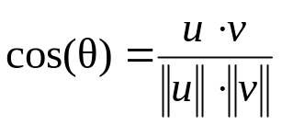
u
v
θ
u x v

