Slide 1
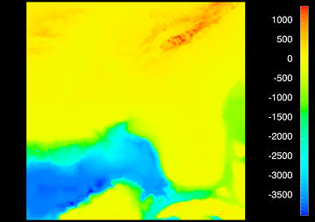
Representing Data With Color

Slide 2
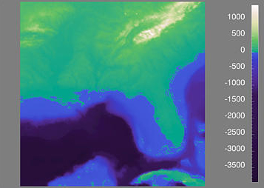
Representing Data With Color

Slide 3
(0,1,1)
(1,1,1)
colorbar path
(0,0,1)
(1,0,1)
(0,1,0.5)
Interpolated within
the 3D color cube
(0.5,0.75,0.25)
(0,1,0)
(1,1,0)
Interpolated within
the colorbar
(1,0.5,0)
(0,0,0)
(1,0,0)

