Slide 1
Are Mutants a Valid Substitute for Real Faults in Software Testing?
By René Just, Darioush Jalali, Laura Inozemtseva, Michael D. Ernst, Reid Holmes, and Gordon Fraser.
René Just, Darioush Jalali, Laura Inozemtseva, Michael D. Ernst, Reid Holmes, and Gordon Fraser. 2014. Are mutants a valid substitute for real faults in software testing?. In Proceedings of the 22nd ACM SIGSOFT International Symposium on Foundations of Software Engineering (FSE 2014). ACM, New York, NY, USA, 654-665. DOI: https://doi.org/10.1145/2635868.2635929
Notes:
Paper was presented in FSE’14:
22nd ACM SIGSOFT International Symposium on the Foundations of Software Engineering
Was described as foundational and won the distinguished paper award.
René Just – assist. prof. Paul G. Allen School of CS&Eng. and focuses on software correctness, robustness, security. He came up with most of the res. methodology.
Darioush Jalali – MSc. CS supervisor Michael Ernst. Now Software Engineer at Lyft
Laura Inozemtseva – PhD philosophy. Now startup founder of Ghost Locomotion, Volley Automaton.
Michael Ernst – prof. Paul G. Allen School of CS&Eng.
Reid Holmes – assoc. prof. Software Practices Lab in CS UBC.
Gordan Fraser – prof. CS Univ. of Passau, Germany.

Slide 2
Presentation
Paper borrows research done by René Just and Gordon Fraser.
René Just: Defects4J, MAJOR Mutation Framework
Gordon Fraser: EvoSuite
Notes:
Paper implicitly borrows research done by René Just and Gordon Fraser.
The details on how the mutation analysis is done exactly is in respective papers.
There is no mention on how EvoSuite works and how it is explicitly used in research methodology (EvoSuite has strong/weak mutation and branch test generators but no EvoSuite documentation on them).
Overall the paper expects readers to be knowledgeable on background (mutation testing, test generation) but also provides good explanation of research methodology (what/why/how)

Slide 3
Summary of Mutation Testing
Want: Measure test suite effectiveness
How: Mutation score as proxy measurement; measure test suite’s ability to distinguish original program from mutants under test
mutants: variants of original source code with artificial bugs
Mutation score: the % of mutants a test suite can distinguish from the original program.
Coupling effect: tests that distinguish correct programs from one with simple errors are so sensitive that it also implicitly distinguishes more complex errors.
Implies simple mutations can be used in place of complex mutations.
R. A. DeMillo, R. J. Lipton, and F. G. Sayward. 1978. Hints on Test Data Selection: Help for the Practicing Programmer. Computer 11, 4 (April 1978), 34-41. DOI: https://doi.org/10.1109/C-M.1978.218136
Notes:
We want to measure how well a test suite is at detecting real faults (programming errors in the software source code). However we don’t know what the actual faults in the software are.
Instead, we use a proxy measurement. First we create variants of original source code with single (or several) artificial bugs called mutants. Then we find the proportion of mutants that cause the test suite to fail versus the mutants that don’t.
Because mutation testing relies on coupling effect we don’t need advanced bugs; we only need simple bugs. coupling effect empirically studies by DeMillo states that they can be used in place of complex seeded bugs.
Subsequent research shows that this is real effect.

Slide 4
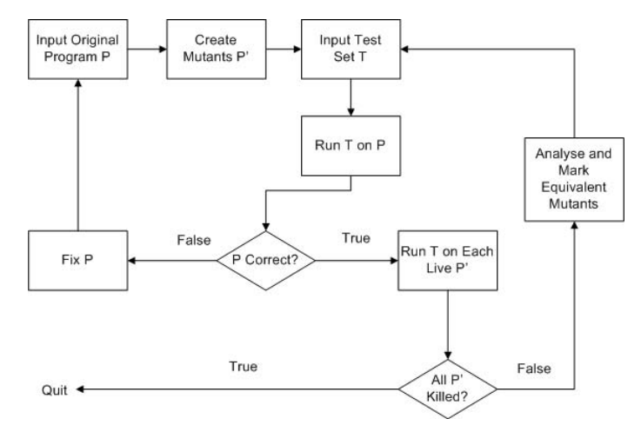
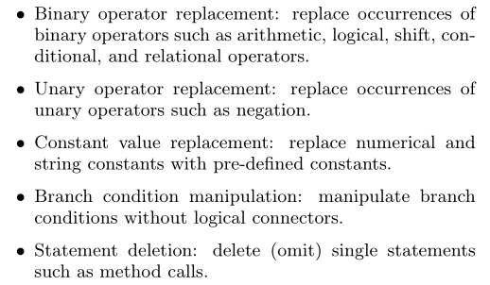
Summary of Mutation Testing
Generic process of mutation testing
Y. Jia and M. Harman, "An Analysis and Survey of the Development of Mutation Testing," in IEEE Transactions on Software Engineering, vol. 37, no. 5, pp. 649-678, Sept.-Oct. 2011. doi: 10.1109/TSE.2010.62
René Just. 2014. The major mutation framework: efficient and scalable mutation analysis for Java. In Proceedings of the 2014 International Symposium on Software Testing and Analysis (ISSTA 2014). ACM, New York, NY, USA, 433-436. DOI: https://doi.org/10.1145/2610384.2628053

Slide 5
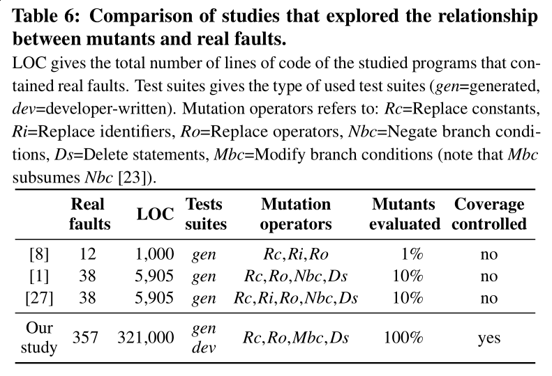
Problems
Assumes that mutants are a valid substitute for real faults.
Only 3 previous studies.
Still true for enterprise systems?
Real programs with actual faults?
J. H. Andrews, L. C. Briand and Y. Labiche, "Is mutation an appropriate tool for testing experiments? [software testing]," Proceedings. 27th International Conference on Software Engineering, 2005. ICSE 2005., Saint Louis, MO, USA, 2005, pp. 402-411.
doi: 10.1109/ICSE.2005.1553583
Murial Daran and Pascale Thévenod-Fosse. 1996. Software error analysis: a real case study involving real faults and mutations. In Proceedings of the 1996 ACM SIGSOFT international symposium on Software testing and analysis (ISSTA '96), Steve J. Zeil and Will Tracz (Eds.). ACM, New York, NY, USA, 158-171. DOI=http://dx.doi.org/10.1145/229000.226313
Akbar Siami Namin and Sahitya Kakarla. 2011. The use of mutation in testing experiments and its sensitivity to external threats. In Proceedings of the 2011 International Symposium on Software Testing and Analysis (ISSTA '11). ACM, New York, NY, USA, 342-352. DOI=http://dx.doi.org/10.1145/2001420.2001461
Notes:
There is little empirical evidence whether this is true. The researchers identified 3 empirical studies exploring this assumption.
These studies were limited in scope because they (1) involve small/few programs, (2) did not control for code coverage, and (3) evaluated few mutants generated.
Main challenge is to source real faults from real (enterprise) software. Not many benchmarks to pull real faults from.
Main source is Sieman’s benchmark suite and software-artifact infr. respository (SIR), which is poor quality (hand seeded faults, mutants, small programs, some actual faults).

Slide 6
Research Question
Are mutants a valid substitue for real faults?
3 Research Questions:
RQ1) Are real faults coupled to mutants generated by commonly used mutation operators?
RQ2) What types of real faults are not coupled to mutants?
RQ3) Is mutant detection correlated with real fault detection?
Notes:
(1) Coupling means tests that detect mutants also detect real faults

Slide 7
Research Result Summary
73% of real faults are coupled to mutants
17% not coupled to any mutants regardless of improvements in mutation testing
Mutation testing is positively correlated with real fault detection (indept. of code coverage)

Slide 8
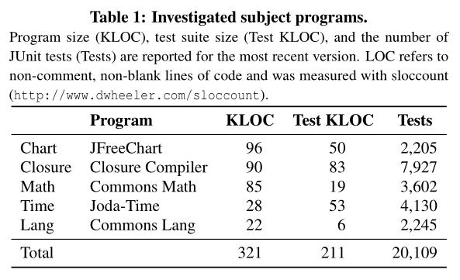
Software Subjects
5 Java programs (321K lines of code total)
357 real faults
230,000 mutants
Version control (git)
Bug tracking system (JIRA)
Full dev-written test suites
Notes:
[Compare this with prior studies]

Slide 9
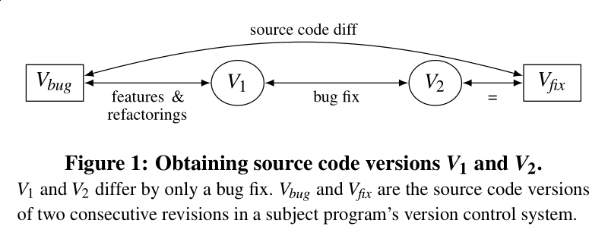
Methodology: Locating and Isolating Real Faults
Locate: Identify two source code versions V_{bug} and V_{fix} that differ by a bug fix.
Isolate: create a source code version V₁ that differs from V₂=V_{fix} by only the bug fix/patch.
357 < V₁ , V₂ > pairs
Notes:
They ran a script on JIRA to find source code versions in the vision control system (git) that explicitly mention a bugfix. For each, which we denote V_{fix}, we let the immediate previous version be V_{bug} .
Sometimes the diff between V_{bug} and V_{fix} only contains the bugfix and no other refactorings in which case we’ve isolated the bug.
Either way we create V₁ and V₂ where the single difference between these two versions is the inclusion of the bug/bugfix
example:
https://issues.apache.org/jira/browse/MATH-727
https://github.com/apache/commons-math/commit/d277738885e78a9339f12ebf10c3c26eb538c1cf

Slide 10
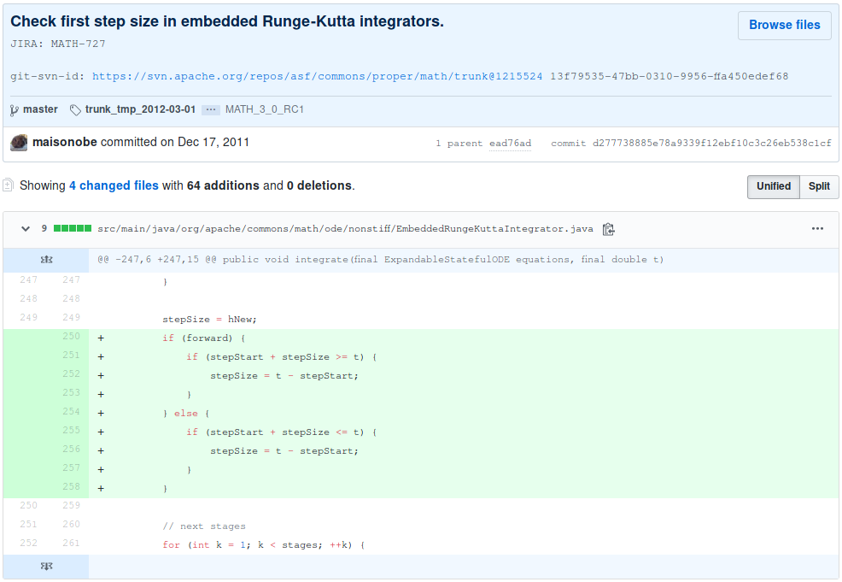

Slide 11
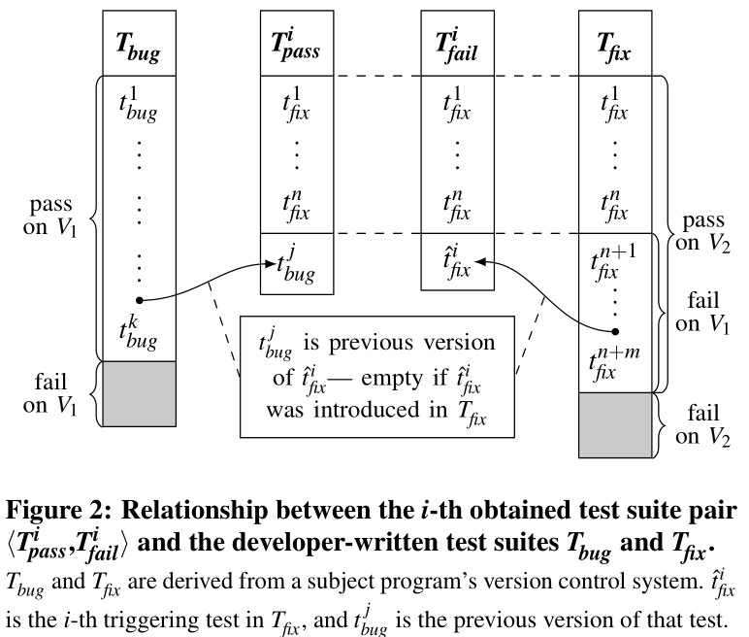
Methodology: Obtain Tests Developer-written Test Suites
Additional unit tests accompany V_{fix} to cover cases exposing bug.
T_{bug} – test suite for V_{bug}
T_{fix} – test suite for V_{fix}
For each unit test t_{i} in T_{fix} that passes on V_{fix} and fails on V_{bug}, create two test suites T^{i}_{pass} T^{i}_{fail}
480 <T_{pass} , T_{fail} > pairs
T_{pass} passes V₁ and V₂
T_{fail} fails on V₁ and passes on V₂
Notes:
Additional unit tests accompany V_{fix} to cover cases exposing bug. In otherwords, we now have tests that pass on V_{fix} and fail on V_{bug}. We want to isolate them since between the two s.c. versions there may be superfluous tests (i.e. tests that fail in both versions, irrelevant to fault).
T_{bug} – test suite for V_{bug}
T_{fix} – test suite for V_{fix}
For each unit test t_{i} in T_{fix} that passes on V_{fix} and fails on V_{bug}, create two test suites T^{i}_{pass} T^{i}_{fail} differing by 1 tests by editing out superfluous tests in T_{bug} and T_{fix}
T_{pass} passes V₁ and V₂
T_{fail} fails on V₁ and passes on V₂
example:
https://github.com/apache/commons-math/commit/d277738885e78a9339f12ebf10c3c26eb538c1cf

Slide 12
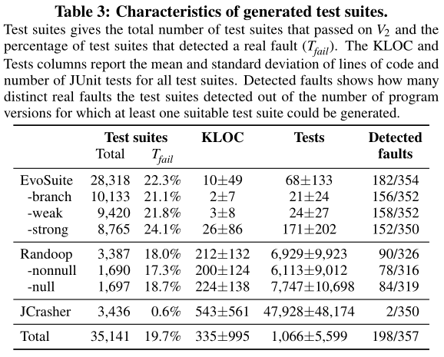
Methodology: Obtain Tests Auto-generated Test Suites
Tools: EvoSuite, Randoop, JCrasher
Create a test suite for each V₂ in < V₁ , V₂ > pair (must pass V₂).
For each generated test suite denote
T_{pass} if passes on V₁
T_{fail} if fails on V₁
Notes:
All generated tests must pass V₂
Evosuite has additional ability to generate tests suited for research purposes.
Weak/strong mutation testing is an option for Evosuite to generate tests specifically to detect simple mutations and obtain other metrics.

Slide 13
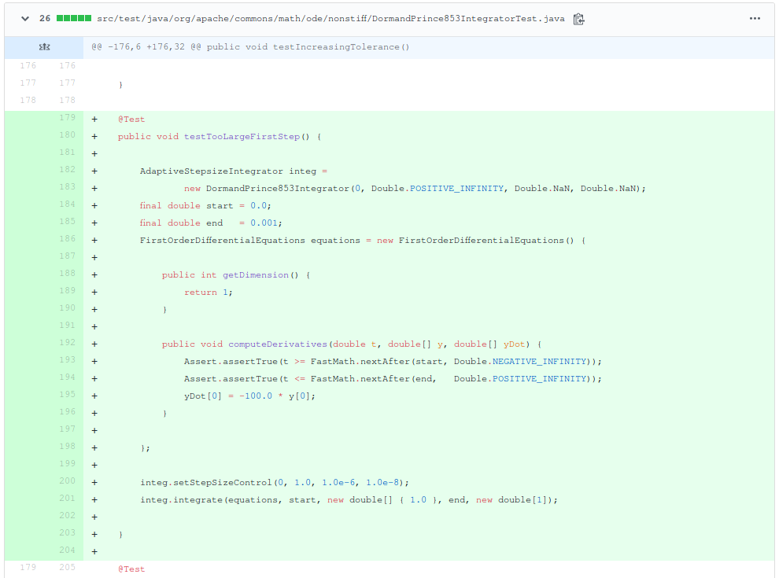
Notes:
example:
https://github.com/apache/commons-math/commit/d277738885e78a9339f12ebf10c3c26eb538c1cf

Slide 14
Methodology: Mutation Analysis
Tool: MAJOR mutation framework.
For each isolated bug, mutate the class containing the bugfix in version V₂
Run Developer-written Test Suite and Auto-generated Test Suite on mutants
Obtain mutation score from each test suite.

Slide 15
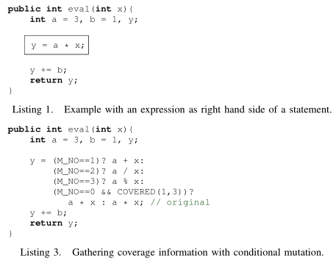
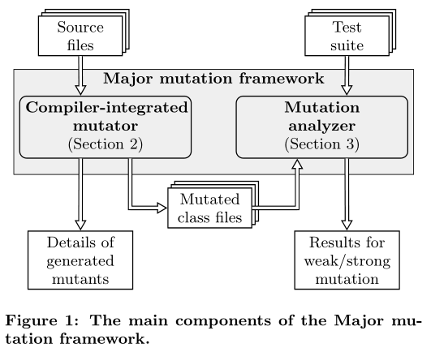
Methodology: MAJOR mutation framework
Mutation operations: replace constants, replace operators, modify branch conditions, delete statements.
René Just. 2014. The major mutation framework: efficient and scalable mutation analysis for Java. In Proceedings of the 2014 International Symposium on Software Testing and Analysis (ISSTA 2014). ACM, New York, NY, USA, 433-436. DOI: https://doi.org/10.1145/2610384.2628053
Notes:
Explain the code changes

Slide 16
Results Aside: statement coverage
T_{x} covers more code than T_{y}
➡ T_{x} has higher mutation score than T_{y}
Two measurements:
ignore code coverage
control for code coverage
Notes:
This is relevant because this is an extraneous variable which influences our measurement, and we only want to observe say the relationship between mutation score and say different software versions.

Slide 17
Results RQ1) Are real faults coupled to mutants generated by commonly used mutation operators?
Recall: For each unit test t in T_{fix} that passes on V_{fix} and fails on V_{bug}, create test suite pair < T_{pass} , T_{fail} >
Result: 262/357 (73%) of real faults coupled to mutants: for these faults we observe < T_{pass} , T_{fail} > where
(mutation score for T_{fail}) > (mutation score for T_{pass})
Notes:
Let’s focus exclusively on the developer-written Test Suites.
The way we test RS1 is we know T_{fail} has real fault detection as a test suite than T_{pass} since it fails in V₁ and passes on V₂ whereas T_{pass} passes on both V₁ and V₂ . If real faults are coupled to mutants then T_{fail} should have higher mutation score than T_{pass}.
In fact we see this is true generally. Out of 357 real faults/bugs researchers identified, when we compare the mutation scores of T_{pass} and T_{fail} , 262 real faults have tests suites where T_{fail} has a higher mutation score.
Mutation score: the % of mutants a test suite can distinguish from the original program; obtained using mutants of V₂

Slide 18
Results RQ1) Are real faults coupled to mutants generated by commonly used mutation operators?
Other result:
mutation score∝statement coverage
add new test ⇏ mutation score increase
Notes:
However most T_{fail} have greater coverage than T_{pass} which as the result of the same experiment. If mutation score is pos. corr. with statement coverage then we cannot conclude it is corr. with real fault detection.
Most T_{fail} have greater coverage than T_{pass} simply because bugfixes have accompanying tests that are specific to the bug. However adding additional tests themselves don’t lead to increases assuming coverage does not increase.

Slide 19
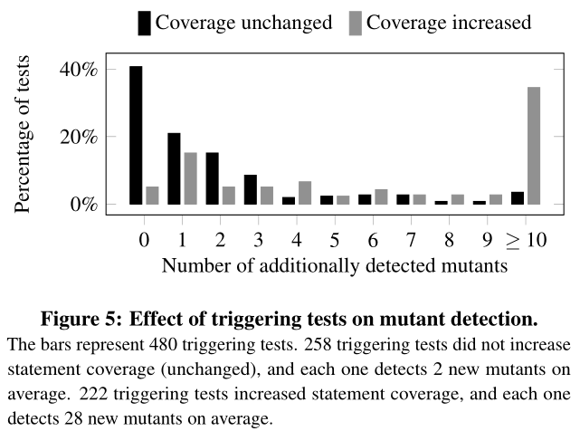
Results RQ1) Are real faults coupled to mutants generated by commonly used mutation operators?
Test suite pairs < T_{pass} , T_{fail} >
ignore code coverage:
362/480 (75%) test suite pairs have (mutation score for T_{fail}) > (mutation score for T_{pass})
control for code coverage
153/258 (59%) test suite pairs have (mutation score for T_{fail}) > (mutation score for T_{pass})
Notes:
Reading the details of the results for RS1, it becomes less clear what the conclusions the researchers are going with.
They state the coupling effects in RS1 is small. From 45% of the tests, 1-3 mutants are coupled to a real fault, and from 40% of the tests mutants are not coupled to any mutant, when controlling for code coverage.

Slide 20
Results RQ2) What types of real faults are not coupled to mutants?
Faults coupled to mutants with...
conditional operator replacement
relational operator replacement
statement deletion
Faults not coupled to mutants that have...
Notes:
We observe that these mutants are coupled to faults especially when under no coverage increase.

Slide 21
Results RQ2) What types of real faults are not coupled to mutants?
Faults not coupled to mutants have…
Algorithm is incorrect
Wrong method calls
Machine number representation
Violations of invariants
Notes:
Many of these faults relate to abstract bugs such as algorithm implementation
Wrong method calls can happen when class inheritance or overloading is implemented incorrectly.
Machine number representation can be due to overflow, underflow or bad handling of 0 or NaN.

Slide 22
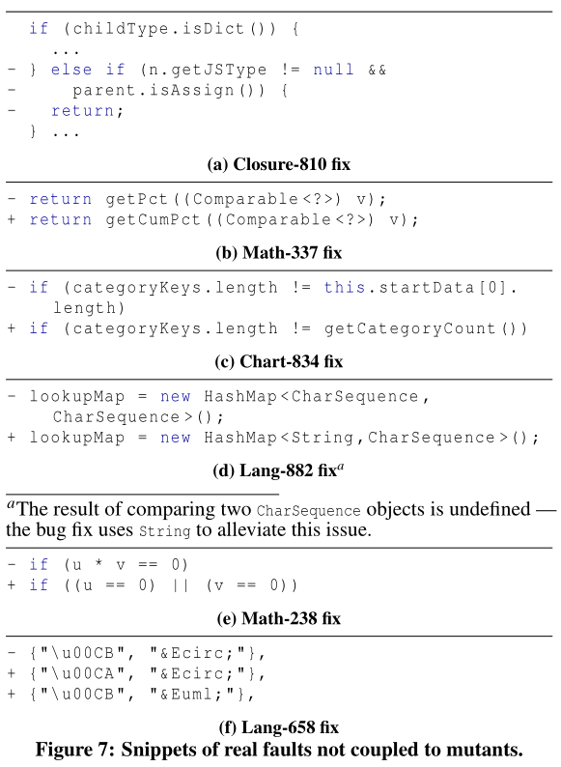
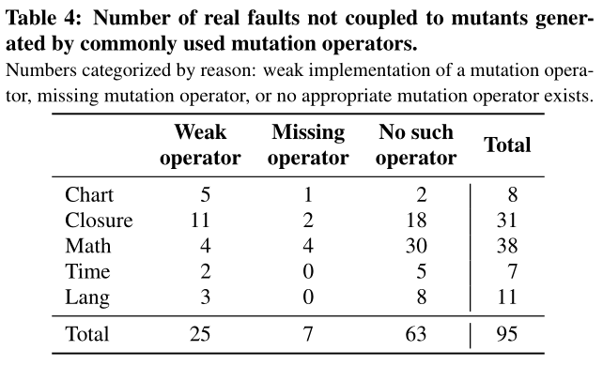
Results RQ2) What types of real faults are not coupled to mutants?

Slide 23
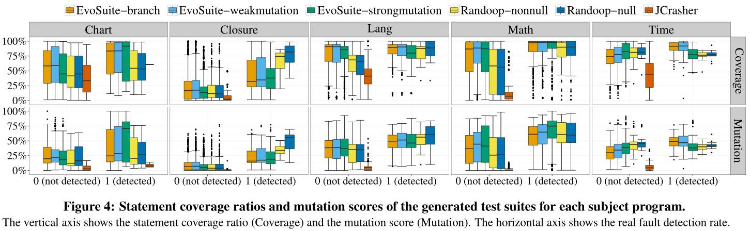
Results RQ3) Is mutant detection correlated with real fault detection?
Recall: auto-gen. test suite for each V₂ in < V₁ , V₂ > pair. Denote a test suite
T_{pass} if passes on V₁
T_{fail} if fails on V₁
Notes:
Let’s focus exclusively on the auto-generated Test Suites.
The T_{pass} that passes on V₁ is placed on 1 (detected) on the horizontal axis.
T_{fail} if fails on V₁ is place on 0 (not detected) on the horizontal axis.
For each auto-gen. test suite we create a candle chart of mutation scores and statement coverage ratios.

Slide 24
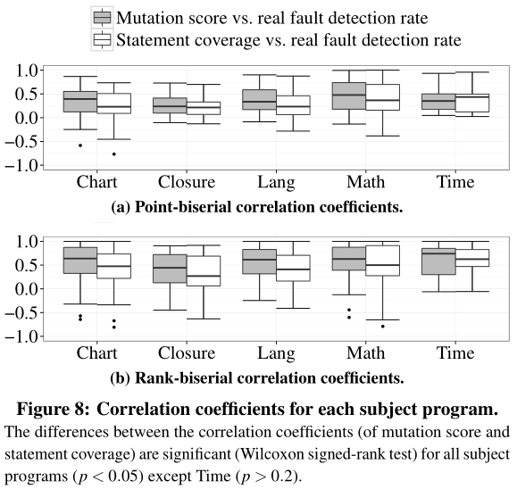
Results RQ3) Is mutant detection correlated with real fault detection?
Use point-biserial and rank-biserial correlation coefficients on candle chart.
Result: correlation between mutation score and real fault detection rate >> correlation between statement coverage and real fault detection rate (p < 0.05)
Notes:
Then they converted the data in the candle chart to point/rank-biserial correlation coefficients.

Slide 25
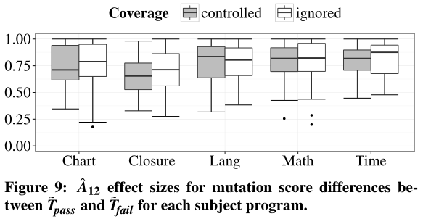
Results RQ3) Is mutant detection correlated with real fault detection?
Notes:
They claim that any effect size >= 0.71 is large.
Here we want to estimate the probability that a test suite with a higher fault detection rate has a higher mutation score as well.

Slide 26
Thoughts?
Notes:
- New ways to improve mutation analysis: strengthen existing mutation operations, introduce new mutation operations
- Some limitations to mutation analysis
Mutants can be used as substitute for real faults.
I consider this an engineering enterprise. Many software components/tools must come together.
Enterprise is very tedious. It requires (1) manual review of bugs/tests, (2) review process with >=2 people for individual source code versions.
Paper is not overly technical but dense. Required reading citations/outside sources to understand.

