Slide 1
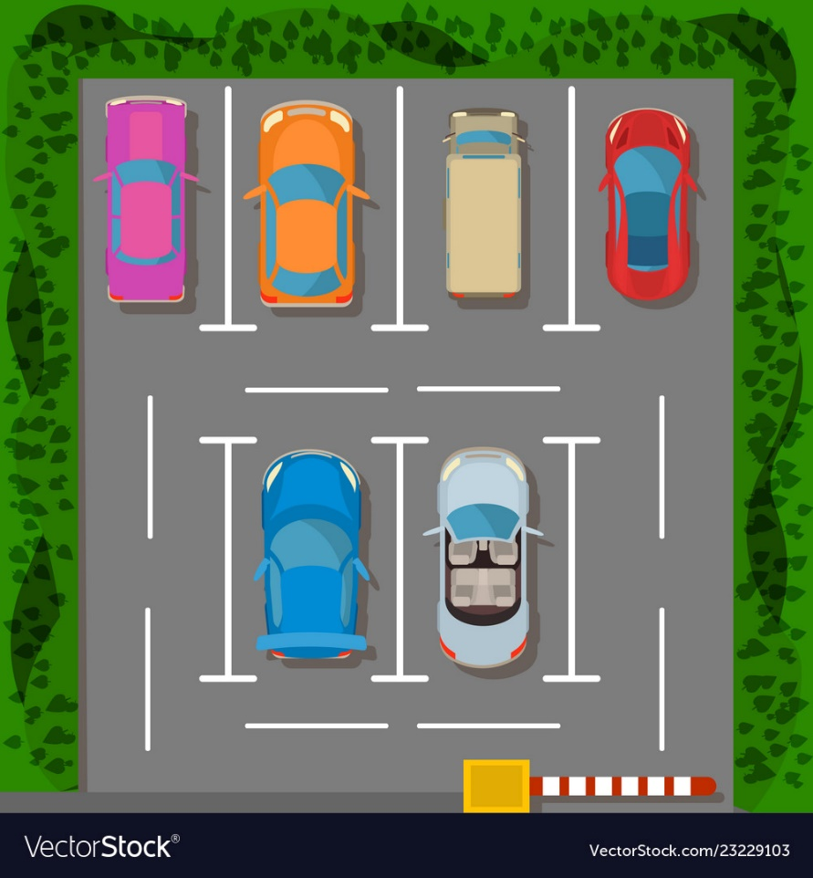
PARKING AND SPACE MANAGEMENT
Submitted By:-
Aditi Maheshwari(1900270120004)
Anany Srivastava(1900270120007)
Arpit Rajput(1900270120010)
Deepak Gupta(1900270120018)
Mentor:-
Mr. Anuj Kumar Dwivedi

Slide 2
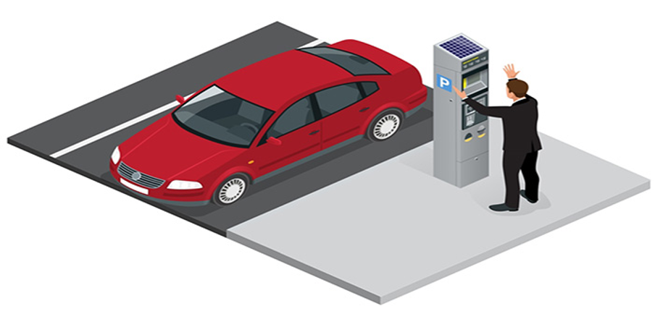
As urbanization continues to rise, the need for efficient and safe parking solutions has become more important. In recent years, automatic parking management systems have been developed to address this need. This presentation presents a comprehensive review of automatic parking management systems and possible solution for the same.

Slide 3
It discusses the various types of automatic parking systems, the components of an automatic parking management system, and the benefits of implementing such a system. It evaluates the effectiveness of the system and highlights the challenges faced during the implementation process. The results suggests that automatic parking management systems are an effective solution for managing parking in urban areas.

Slide 4
Types of Parking Systems :
There are several types of automatic parking systems available in the market. Some of the most common types of automatic parking systems are:
1. Fully Automated Parking System: This type of system uses sensors to detect the presence of a vehicle and then moves it to a designated parking spot using a robotic arm. This system is ideal for areas where space is limited.
2. Semi-Automated Parking System: This type of system requires the driver to park the vehicle on a platform, which is then moved to a designated parking spot using a robotic arm.
3. Mechanical Parking System: This type of system uses a series of lifts, conveyors, and turntables to move the vehicle to a designated parking spot.

Slide 5
Components of an Automatic Parking Management System :
An automatic parking management system consists of several components. Some of the most important components of an automatic parking management system are:
1. Parking Space Detection System: This system uses sensors to detect the presence of a vehicle in a parking spot.
2. Parking Guidance System: This system guides the driver to an available parking spot using LED lights or signage.

Slide 6
3. Payment System: This system allows the driver to make payment for parking using a variety of payment methods, such as credit card, cash, or mobile payment.
4. Parking Management System: This system manages the parking spaces and provides real-time information on the availability of parking spots.

Slide 7
Background and Context :
The concept of automated parking systems dates back to the early 1900s when the first automated parking garage was built in Paris. The garage used a series of lifts and conveyors to move vehicles to a designated parking spot. However, the system was not fully automated and required human operators to operate the machinery.
In the 1920s, a fully automated parking system was developed in the United States. The system used a series of lifts, conveyors, and turntables to move vehicles to a designated parking spot. The system was designed to be used in urban areas where space was limited.
In the 1950s, a mechanical parking system was developed in Japan. The system used a series of lifts and turntables to move vehicles to a designated parking spot. The system was designed to be used in high-density urban areas where space was at a premium.

Slide 8
In the 1970s, the first fully automated parking garage was built in Germany. The garage used a series of sensors and robotic arms to move vehicles to a designated parking spot. The system was designed to be used in areas where space was limited and parking was in high demand.
In the 1990s, automated parking systems became more popular in Japan. The systems were used in commercial buildings, shopping centers, and residential buildings. The systems were designed to be user-friendly and easy to operate.
In the 2000s, automated parking systems became more popular in other parts of the world, including Europe and North America. The systems were used in a variety of settings, including airports, train stations, and public parking garages.
Today, automated parking systems continue to evolve and improve. New technologies, such as autonomous vehicles and artificial intelligence, are being integrated into automated parking systems to make them more efficient and user-friendly. As urbanization continues to rise, automated parking systems will play an increasingly important role in managing parking in urban areas.

Slide 9
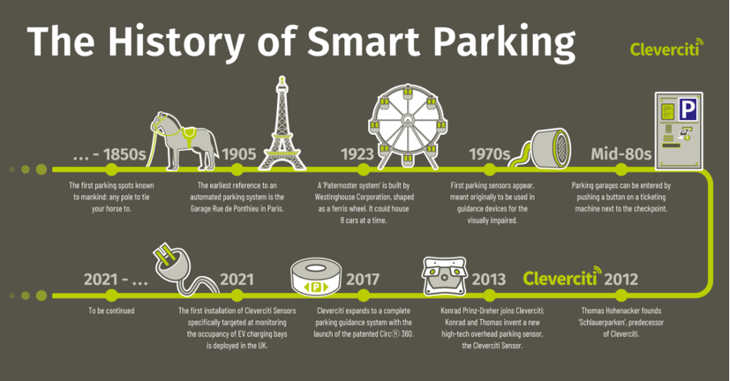

Slide 10




MOTIVATION AND PURPOSE
The basic motivation behind Parking management is efficient space management of the parking lot.
Robotics and smart systems are buzzing around all over the world.
Technologies like - Object tracking and Computer Vision reduces human efforts and provides efficiency.
One of the many so-called goals of ‘AI’ or machine learning is to describe a scene as precisely as a human being. One of the stepping stones towards this goal is object detection wherein the different objects of significance in the scene are detected and it is attempted to understand underlying semantics in the semantic.

Slide 11
This software will be extending to all types of parking having cameras and would be specifically focusing on large parking’s of MNCs as well as that of shopping malls. Besides parking it will be extending its roots in the warehouses of various Multinationals where efficient storage is a major issue for the higher turnover.
The project can be further extended to private parking as well when camera functioning is proper and certain costing are reduced with the help of advanced technologies and sensors.

Slide 12
Developments in Automated Parking Systems :
Automated parking systems have come a long way since the early 1900s, and today, they incorporate advanced technologies to provide more efficient and user-friendly parking solutions. Here are some of the recent developments in automated parking systems:
1. Smart Parking Systems: Smart parking systems use advanced technologies such as IoT (Internet of Things), cloud computing, and artificial intelligence to manage parking spaces. These systems use sensors and cameras to detect available parking spaces and provide real-time data to users. Smart parking systems also provide guidance to drivers, allowing them to quickly and easily find a parking spot.

Slide 13
2. Robotic Parking Systems: Robotic parking systems use robotic arms and conveyors to park vehicles. These systems are fully automated and require no human intervention. Robotic parking systems are ideal for areas where space is limited and parking is in high demand.
3. Automated Valet Parking: Automated valet parking systems use autonomous vehicles to park and retrieve cars. These systems are currently being tested in several locations around the world, and they have the potential to revolutionize the parking industry.
4. Multi-Level Parking Systems: Multi-level parking systems use a combination of lifts, conveyors, and turntables to park vehicles in multiple levels. These systems are ideal for areas where space is limited and parking is in high demand.

Slide 14
5. Solar-Powered Parking Systems: Solar-powered parking systems use solar panels to generate energy, which is then used to power the parking system. These systems are environmentally friendly and can help reduce energy costs.
6. Mobile Parking Applications: Mobile parking applications allow users to find and reserve parking spaces in real-time using their smartphones. These applications provide information on parking availability, pricing, and location, making it easier for drivers to find a parking spot.

Slide 15
INTRODUCTION OF OUR PROJECT :
It is an AI-based project which is basically aimed towards finding and allocating appropriate parking spaces to vehicles in a given area efficiently. It uses various domains of Artificial Intelligence such as- Computer Vision, Object Recognition and Object Tracking.
This Project is basically divided into three parts:-
1) Number Plate Recognition and Reading.
2) Storing details into the database.
3) Finding vacant spaces.
Number Plate Recognition and Reading :- A fixed camera adjusted at a suitable location will click the picture of the number plate of the vehicle which would be read and stored accordingly.
Storing details into the database :- The number plate of the vehicle along with other details of the vehicle owner such as - name, phone number etc. will be stored in the database.
Finding vacant space :- Efficient object tracking algorithms will be used to find the best and most efficient space for the vehicle in the parking lot.

Slide 16

FIRST AIM - NUMBER PLATE READING
Reading number plate of a vehicle includes the concept of Computer Vision.
Computer Vision enables computers and systems to derive meaningful information from digital images, videos and other visual inputs - and take actions based on that information.

Slide 17


PROPOSED WORK/METHODOLOGY
The algorithm used in this study is based on the Background Subtraction Object Tracking Algorithm. Background subtraction is both effective and reliable. It's a motion detection system which allow us to track in real-time object.
It is a technology that uses the difference of the current image and the background image to detect the motion region and it is generally able to provide data included object information.
The following points describe the algorithm used to construct this object tracking in static background:
Pre-processing
Image A and B are going to be sequential in time series. After that we have to convert these image in grayscale.
A
B

Slide 18


-
=
After gray scaling the image we can subtract B consecutive image from A to get the resultant image.
A
B
Resultant
Image sharpening
In this process the image sharpening refers to enhancement technique that highlights edges of area
of interest.
In our case, area of interest is position changing object in a sequential image.
For image sharpening we will use thresholding technique to reduce the noises which came in resultant while
proccessing the image. We use erosion and dilation techniques in subsequent manner.

Slide 19


Threshold image of the resultant image that we have got in after subtracting the two consecutive images.
c) Find and Draw contours
Contours are define as the line joining all the points along the boundary of an image that have the same
intensity.
Contours come handy in shape analysis, finding the shape of the object of interest and object detection.
The area of interest has highlighted boundary

Slide 20
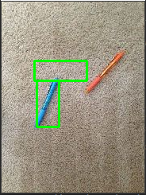
d) Draw the boundary box on the detected object
We iterate through all the contours and the find the area of contours to achieve accuracy by
removing small area and fixing the range of the area we can get area of interest.
After getting perfect area we have to place the bounding box on the last frame.
It represent the initial and final position of the pen in the first frame

Slide 21
Scope and Limitations :
While Automatic License Plate Reading (ALPR) technology has been successful in recognizing and reading license plates, there are some common problems that can affect the accuracy of the system. Here are some of the main problems in license plate reading:
1. Poor Image Quality: The accuracy of ALPR systems depends on the quality of the license plate image captured by the camera. Poor lighting conditions, image blur, and reflection can all affect the image quality and make it difficult for the software to read the license plate.
2. License Plate Obstruction: License plates can be obstructed by objects such as bike racks, trailer hitches, or even dirt or snow. When the license plate is partially or completely obstructed, it can be difficult for the software to read the plate accurately.

Slide 22
3. License Plate Location: The location of the license plate on a vehicle can also affect the accuracy of the system. If the license plate is located in an unusual position, such as on the front bumper or under a spoiler, it may be difficult for the software to recognize the plate.
4. License Plate Style: Different states and countries have different license plate styles and formats, which can affect the accuracy of the software. Some plates may have non-standard fonts or characters, making them more difficult to recognize.
5. Vehicle Speed: ALPR systems are designed to read license plates at high speeds, but excessive speed can still affect the accuracy of the software. If the vehicle is moving too quickly, the software may not have enough time to capture a clear image of the license plate.
6. Database Accuracy: The accuracy of the database used for comparison can also affect the accuracy of the ALPR system. If the database is outdated or incomplete, it may not be able to match the license plate accurately.

Slide 23
In conclusion, there are several challenges that can affect the accuracy of the ALPR system, including poor image quality, license plate obstruction, unusual plate locations, license plate styles, vehicle speed, and database accuracy. These problems can be mitigated by using high-quality cameras, updating the software regularly, and ensuring that the database is accurate and up-to-date.

Slide 24

SECOND AIM - STORING THE DATA/DETAILS INTO THE DATABASE
The data from the number plate of the vehicle is stored along with the other details of the vehicle owner such as - name, phone number etc.
This data is needed to be stored for future use by the admin(to get details regarding a particular vehicle standing in their parking lot) or the vehicle owner himself/herself(to keep track of their vehicle).

Slide 25


Slide 26
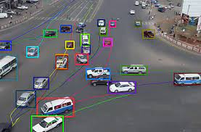
THIRD AIM - FINDING VACANT SPACE
Finding vacant space for a vehicle in a given parking lot uses the concept of Object Tracking.
Object tracking is the task of estimating and predicting the positions
and other relevant information of moving objects in a video. It usually
involves the process of object detection.

Slide 27
Object Tracking Algorithm :
This object tracking algorithm is called centroid tracking as it relies on the Euclidean distance between :
(1) existing object centroids (i.e., objects the centroid tracker has already seen before) and
(2) new object centroids between subsequent frames in a video.
The centroid tracking algorithm :
The centroid tracking algorithm is a multi-step process. We will review each of the tracking steps as explained below:

Slide 28
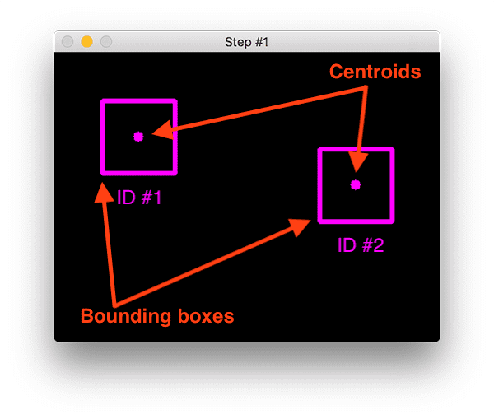
Step #1: Accept Bounding Box Coordinates and Compute Centroids

Slide 29
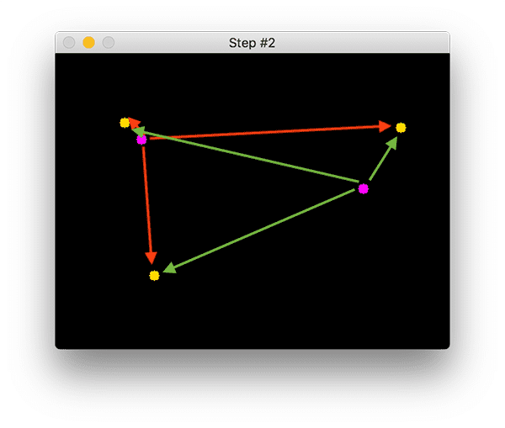
Step #2: Compute Euclidean distance between new Bounding Boxes and Existing Objects

Slide 30
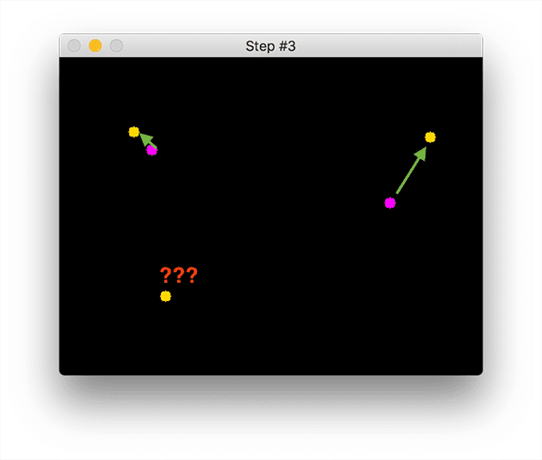
Step #3: Update (x,y) Coordinates of existing Objects :

Slide 31
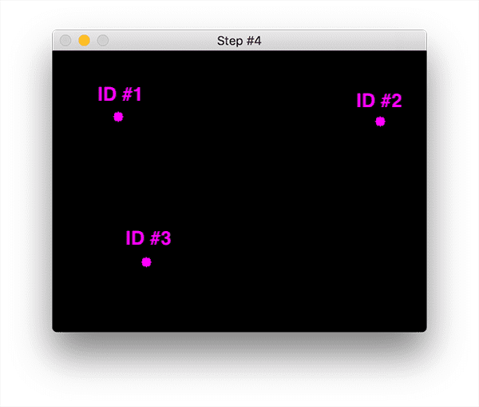
Step #4: Register new Objects

Slide 32
Step #5: Deregister Old Objects
Any reasonable object tracking algorithm needs to be able to handle when an object has been lost, disappeared, or left the field of view.
Exactly how you handle these situations is really dependent on where your object tracker is meant to be deployed, but for this implementation, we will deregister old objects when they cannot be matched to any existing objects for a total of N subsequent frames.

Slide 33






APPLICATIONS OF OBJECT TRACKING
1. Efficient Space Management.
2. Surveillance
3. Industrial inspection
4. Robotics
6. Human- computer interaction
7. Traffic control

Slide 34
Effectiveness and Need of Automated Parking :
Automated parking systems have become increasingly popular in recent years due to the benefits they offer. Here are some of the effectiveness and needs of automated parking:
1. Increased parking capacity: Automated parking systems can increase parking capacity in crowded urban areas. Since automated parking systems use a compact, vertical design, they require less space than traditional parking lots. This means that more vehicles can be parked in the same amount of space, increasing parking capacity.
2. Reduced labor costs: Automated parking systems require less labor than traditional parking lots. Since vehicles are parked and retrieved automatically, there is no need for parking attendants. This reduces labor costs and can result in significant cost savings for parking lot operators.

Slide 35
3. Improved efficiency: Automated parking systems are more efficient than traditional parking lots. Since vehicles are parked and retrieved automatically, the process is faster and more streamlined. This can reduce the amount of time it takes for drivers to park and retrieve their vehicles, resulting in a more pleasant parking experience.
4. Improved safety: Automated parking systems can improve safety in parking lots. Since there are no parking attendants, there is less risk of accidents or injuries involving parking attendants. Additionally, since the parking process is automated, there is less risk of damage to vehicles during the parking process.
5. Environmental benefits: Automated parking systems can have environmental benefits. Since they require less space than traditional parking lots, they can reduce the amount of land used for parking. Additionally, since they are more efficient, they can reduce the amount of time vehicles spend idling, resulting in reduced emissions.

Slide 36
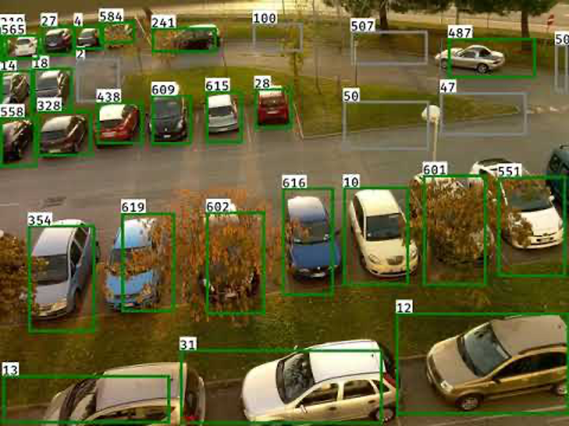
In conclusion, automated parking systems are effective and necessary in modern urban areas. They increase parking capacity, reduce labor costs, improve efficiency and safety, and offer environmental benefits. With the continued growth of urban areas and the increasing demand for parking, automated parking systems will continue to be an important part of parking management solutions.

Slide 37
Conclusion :
Automated parking systems are becoming increasingly popular as cities continue to grow and the need for efficient and effective parking solutions becomes more apparent. These systems offer a range of benefits, including increased parking efficiency, reduced congestion, and enhanced user experience. They also have the potential to provide valuable data insights that can inform future planning and decision-making.
From the analysis of various studies and research papers, it is evident that automated parking systems have already demonstrated their effectiveness in a range of settings. For example, they have been successfully implemented in residential and commercial buildings, as well as in public spaces such as airports and shopping centers. These systems have also been shown to improve accessibility for people with disabilities and reduce the time and effort required to park a vehicle.

Slide 38
Moreover, the development of autonomous vehicles and smart cities is likely to increase the demand for automated parking systems. This presents an exciting opportunity for further innovation and research in this area. For example, researchers could explore the potential of using artificial intelligence and machine learning to enhance the performance of automated parking systems. These technologies could be used to optimize the allocation of parking spaces, reduce waiting times, and improve the accuracy and reliability of the systems.
Another area of future research could be the integration of automated parking systems with existing infrastructure. Many cities already have established parking structures and systems in place, and there may be challenges associated with integrating automated systems with these existing structures. Further research is needed to address these challenges and ensure that automated parking systems can be seamlessly integrated into existing infrastructure.
In addition, the user experience of automated parking systems could be improved through the development of more intuitive and user-friendly interfaces.

Slide 39
Researchers could explore the potential of using augmented reality and other advanced technologies to enhance the user experience and provide more personalized and tailored parking solutions.
Finally, there is also a need for further research on the environmental impact of automated parking systems. While these systems can reduce congestion and improve parking efficiency, they also require significant amounts of energy to operate. Researchers could explore ways to reduce the energy consumption of these systems and minimize their environmental impact.
In conclusion, automated parking systems offer a range of benefits and have the potential to revolutionize parking and transportation systems. Further research and innovation in this area are needed to realize their full potential and address the challenges associated with their implementation. As the demand for efficient and effective parking solutions continues to grow, the development of automated parking systems will likely play a key role in meeting this need.

Slide 40

THANK YOU

