Slide 1
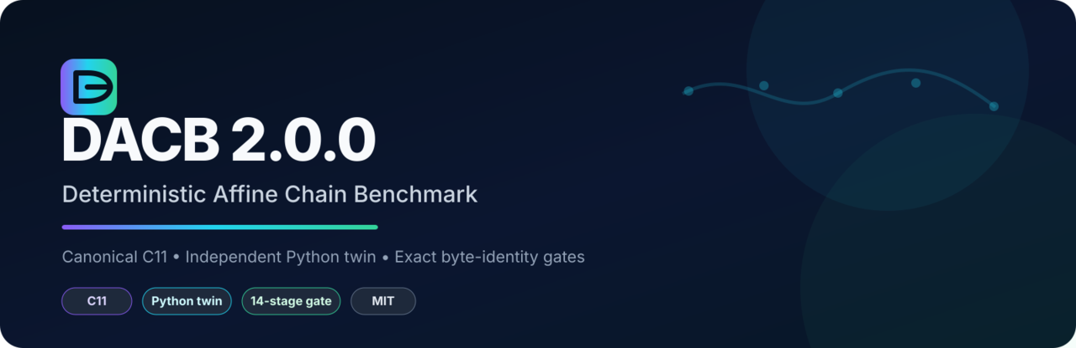
Technical overview & verification evidence
Canonical C11 · independent Python digital twin · exact report identity · bounded exhaustive verification
PORTABLE C11
PYTHON TWIN
14-STAGE GATE
MIT

Slide 2
What DACB verifies
A narrow correctness framework for long deterministic dependency chains.
The question
Canonical recurrence
Can an implementation preserve the program, execute the complete chain, respect exact arithmetic bounds, agree with independent mathematical oracles, detect semantic drift, and reject a confidently repeated wrong answer?
x[n+1] =
(1664525 · x[n] + 1013904223)
mod 2³²
x[0] = 1
DACB treats agreement as evidence only when the paths are independently computed. Two matching answers are not automatically proof.
Simple enough for exact algebraic oracles; deep enough to exercise long dependency chains.

Slide 3
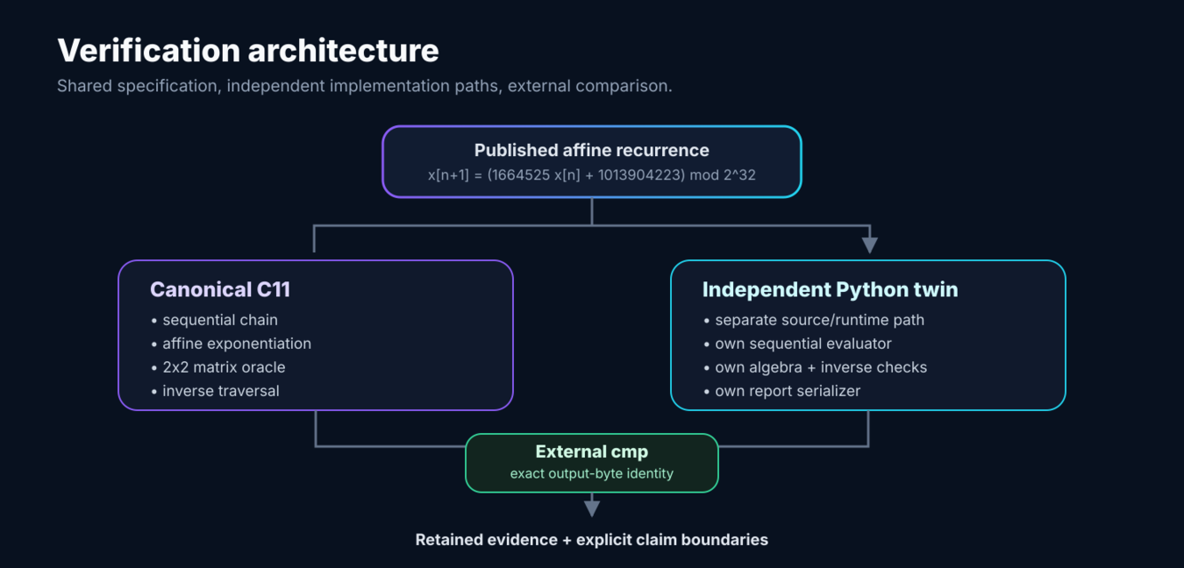
Independent paths, external comparison
The specification is shared. Runtime state and implementation code are not.

Slide 4
Four exact state checks
Each check attacks the same recurrence from a different computational path.
01
02
03
04
Sequential chain
Affine exponentiation
2×2 matrix oracle
Inverse traversal
Directly executes every transition.
Binary exponentiation of an affine transform.
Homogeneous matrix exponentiation.
Rewinds n steps and must recover the seed.
Forward checks must agree on final state
Reverse traversal must reconstruct x[0]
Unsigned arithmetic and explicit bounds keep the C11 semantics defined; the Python twin independently reproduces the published mathematics.

Slide 5
Retained release evidence
Results recorded by the DACB 2.0.0 release and reproduced by the included verifier.
5,596,492
22,377,804
1,000,000
20×
cross-language seed/step cases
extended C seed/step cases
dependent transitions in stress gate
repeat report identity
Canonical 5,000-step vector
Canonical report SHA-256
last 4125282121
sum_mod 585303980
weighted_mod 554861868
1d2ffc1bd5703d8514a62226e42bc007
798f454c9c935d974071d6add57d7679
Identical bytes: GCC C11 · Clang C11 · Python twin

Slide 6
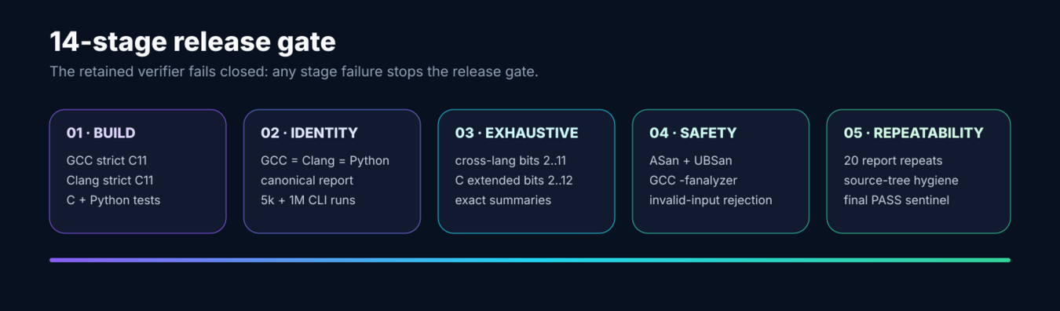
Release gate
The full verifier is executable, fail-closed and retained in the repository.
DACB_RELEASE_VERIFICATION_PASS
Run: bash scripts/verify_release.sh

Slide 7
Evidence boundary
The project is explicit about what the verification does - and does not - establish.
Supported by the release gate
Not claimed
✓
Deterministic C11 recurrence under unsigned semantics
—
Full 2³² × 2³² seed/step enumeration
✓
Known vectors reproduce
—
Cryptographic security or randomness quality
✓
Four state checks agree on tested workloads
—
Impossible checksum collisions
✓
Documented reduced domains are exhaustive
—
Byte-identical machine code
✓
GCC / Clang / Python canonical bytes agree
—
Deterministic wall-clock timing across machines
✓
Listed adversarial mutations are detected or rejected
—
Physical phase-transition meaning for the lattice fixture

Slide 8
Runnable repository
Source-first layout with retained evidence and reproducibility controls.
canonical_c11/
canonical library + CLI
Quick start
python_twin/
independent twin
make
make test
make cross
bash scripts/verify_release.sh
sha256sum -c MANIFEST.sha256
tests/
C, Python + adversarial fixtures
scripts/
release verifier + benchmark utility
docs/
math, architecture + boundaries
evidence/
sealed verification records
Offline · no credentials · no elevated privileges
provenance/
origin archive + original manifest record
DACB 2.0.0
Deterministic claims should stay as inspectable as the code that produces them.

