Slide 1


Introduction to Scraping in Python
By :-
Mayank Jain (firesofmay@gmail.com)
Gaurav Jain (grvmjain@gmail.com)
Code is available at
https://github.com/firesofmay/Null-Pune-Intro-to-Scraping-Talk-March-2012

Slide 2
Overview of the ”Presentation”
What is Scraping?
So what is this HTTP?
Tools of Trade
User Agents
Firebug
Using BeautfulSoup and Regular Expressions
Using Google Translator to post on Facebook in hindi
Shodan
Robots.txt

Slide 3
What is Scraping?
Web scraping/Web harvesting/Web data extraction is a computer software technique of extracting information from websites.

Slide 4
So what is this HTTP thing?
If you goto this page - http://en.wikipedia.org/wiki/Python_%28programming_language%29
To view the HTTP Requests being made we use a firefox Pluging called as LiveHTTPHeaders

Slide 5
----------Request From Client to Server----------
GET /wiki/Python_(programming_language) HTTP/1.1
Host: en.wikipedia.org
User-Agent: Mozilla/5.0 (X11; Linux i686; rv:7.0.1) Gecko/20100101 Firefox/7.0.1
Accept: text/html,application/xhtml+xml,application/xml;q=0.9,*/*;q=0.8
Accept-Language: en-us,en;q=0.5
Accept-Encoding: gzip, deflate
Accept-Charset: ISO-8859-1,utf-8;q=0.7,*;q=0.7
Connection: keep-alive
Referer: http://en.wikipedia.org/wiki/Python
Cookie: clicktracking-session=QgVKVqIpsfsgsgszgvwBCASkSOdw2O; mediaWiki.user.bucket:ext.articleFeedback-tracking=8%3Aignore; mediaWiki.user.bucket:ext.articleFeedback-options=8%3Ashow
----------End of Request From Client to Server----------

Slide 6
----------Response From Server to Client----------
HTTP/1.0 200 OK
Date: Mon, 10 Oct 2011 12:44:46 GMT
Server: Apache
X-Content-Type-Options: nosniff
Cache-Control: private, s-maxage=0, max-age=0, must-revalidate
Content-Language: en
Vary: Accept-Encoding,Cookie
Last-Modified: Sun, 09 Oct 2011 05:01:32 GMT
Content-Encoding: gzip
Content-Length: 47407
Content-Type: text/html; charset=UTF-8
Age: 10932
X-Cache: HIT from sq66.wikimedia.org, MISS from sq65.wikimedia.org
X-Cache-Lookup: HIT from sq66.wikimedia.org:3128, MISS from sq65.wikimedia.org:80
Connection: keep-alive
----------End of Response From Server to Client----------

Slide 7
Tools of Trade
Linux OS is prefered (Installations Command for Ubuntu Distro)
Dreampie IDE (For Quick Prototyping)
  $ sudo apt-get install dreampie
Python 2.x (Preferably 2.6+)
pip installter for python packages
  $ sudo apt-get install python-pip
Python requests: HTTP for Humans
  $ pip install requests
Python re Library for regular Expressions (Inbuilt)

Slide 8
LiveHTTPHeader Firefox Plugin
  https://addons.mozilla.org/en-US/firefox/addon/live-http-headers/
Firebug Firefox Plugin
  https://addons.mozilla.org/en-US/firefox/addon/firebug/?src=search
User Agent Switcher Firefox Plugin
  https://addons.mozilla.org/en-US/firefox/addon/user-agent-switcher/?src=search
BeautifulSoup Python Library
  http://www.crummy.com/software/BeautifulSoup/#Download

Slide 9
Fetching HTML Page (fetch.py)
import requests
url = 'http://en.wikipedia.org/wiki/Python_%28programming_language%29'
data = requests.get(url).content
f = open("debug.html", 'w')
f.write(data)
f.close()
#To Run
$ python fetch.py

Slide 10
Why Does User Agent Matter?
When software agent operates in a network protocol, it often identifies itself, its application type, operating system, software vendor, or software revision, by submitting a characteristic identification string to its operating peer.
In HTTP, SIP, and SMTP/NNTP protocols, this identification is transmitted in a header field User-Agent. Bots, such as Web crawlers, often also include a URL and/or e-mail address so that the Webmaster can contact the operator of the bot.

Slide 11
Demo of How Sites Behave Differently With Different UAs - I
https://addons.mozilla.org/en-US/firefox/addon/user-agent-switcher/
Visit the above site with UA (User Agent) as firefox

Slide 12
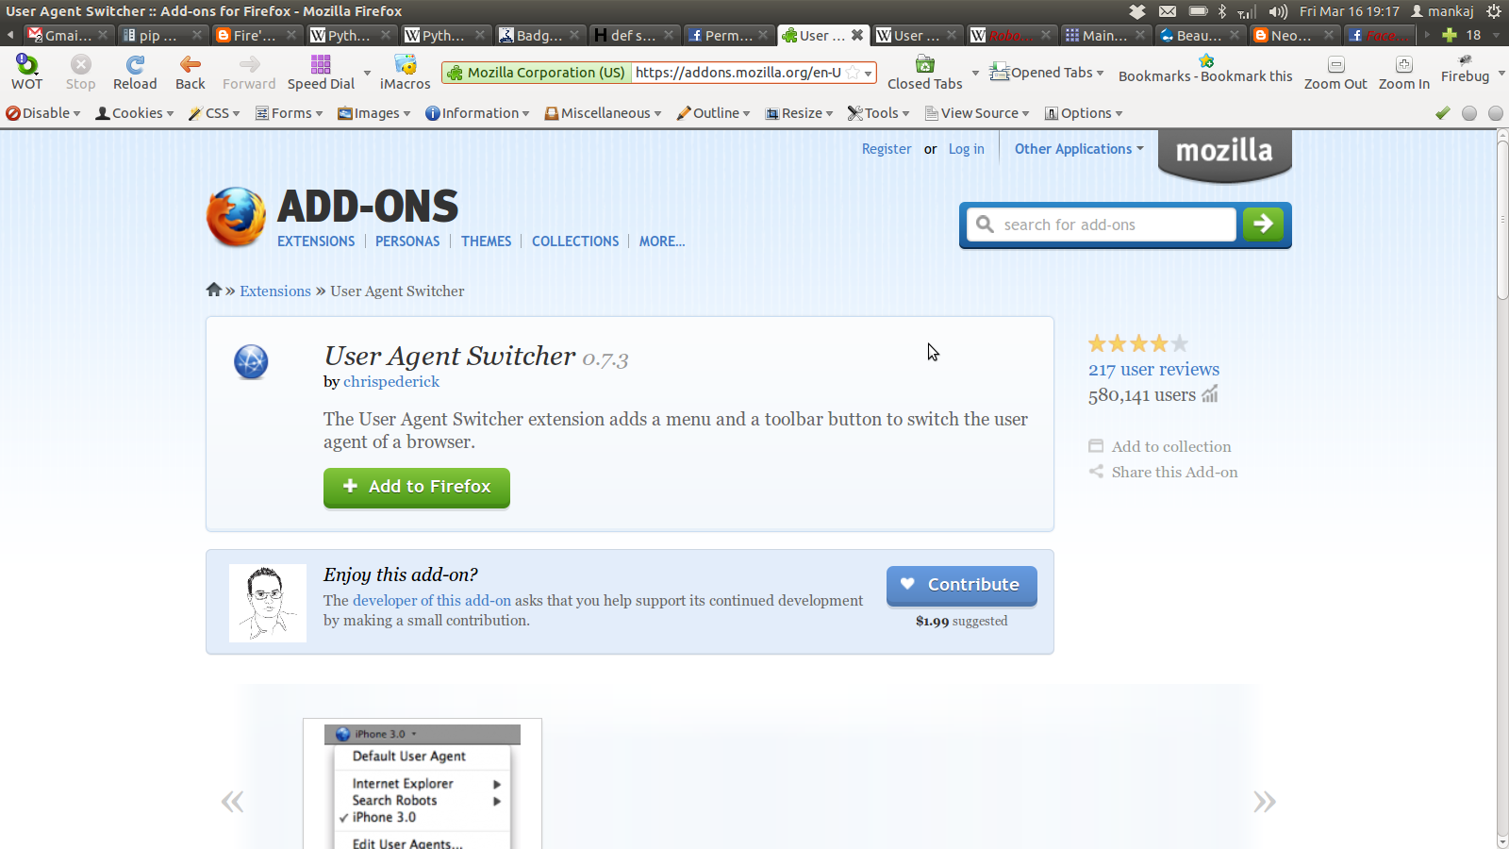

Slide 13
Demo of How Sites Behave Differently With Different UAs - I
https://addons.mozilla.org/en-US/firefox/addon/user-agent-switcher/
Now visit the above site with UA as IE
To switch your User Agent Use User Agent Switcher Addon.
Notice the new banner, asking you to install firefox even though you are using firefox (based on your user agent selected).

Slide 14
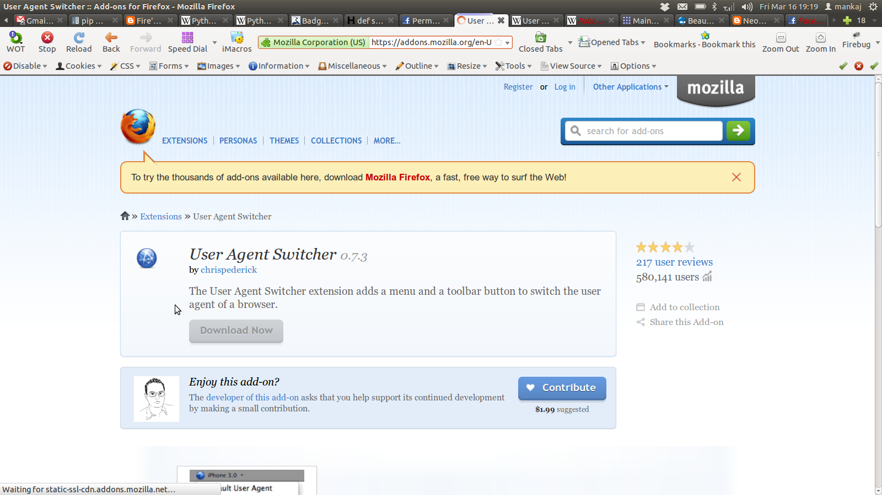

Slide 15
Demo of How Sites Behave Differently With Different UAs - II
https://developers.facebook.com/docs/reference/api/permissions/
Now visit the above site with UA as IE
  Asked for Login? But I don't want to Login!!!
Let's try a Google bot as UA
  Yayyy!!
Let's try a blank UA
  Yayy Again! :D

Slide 16
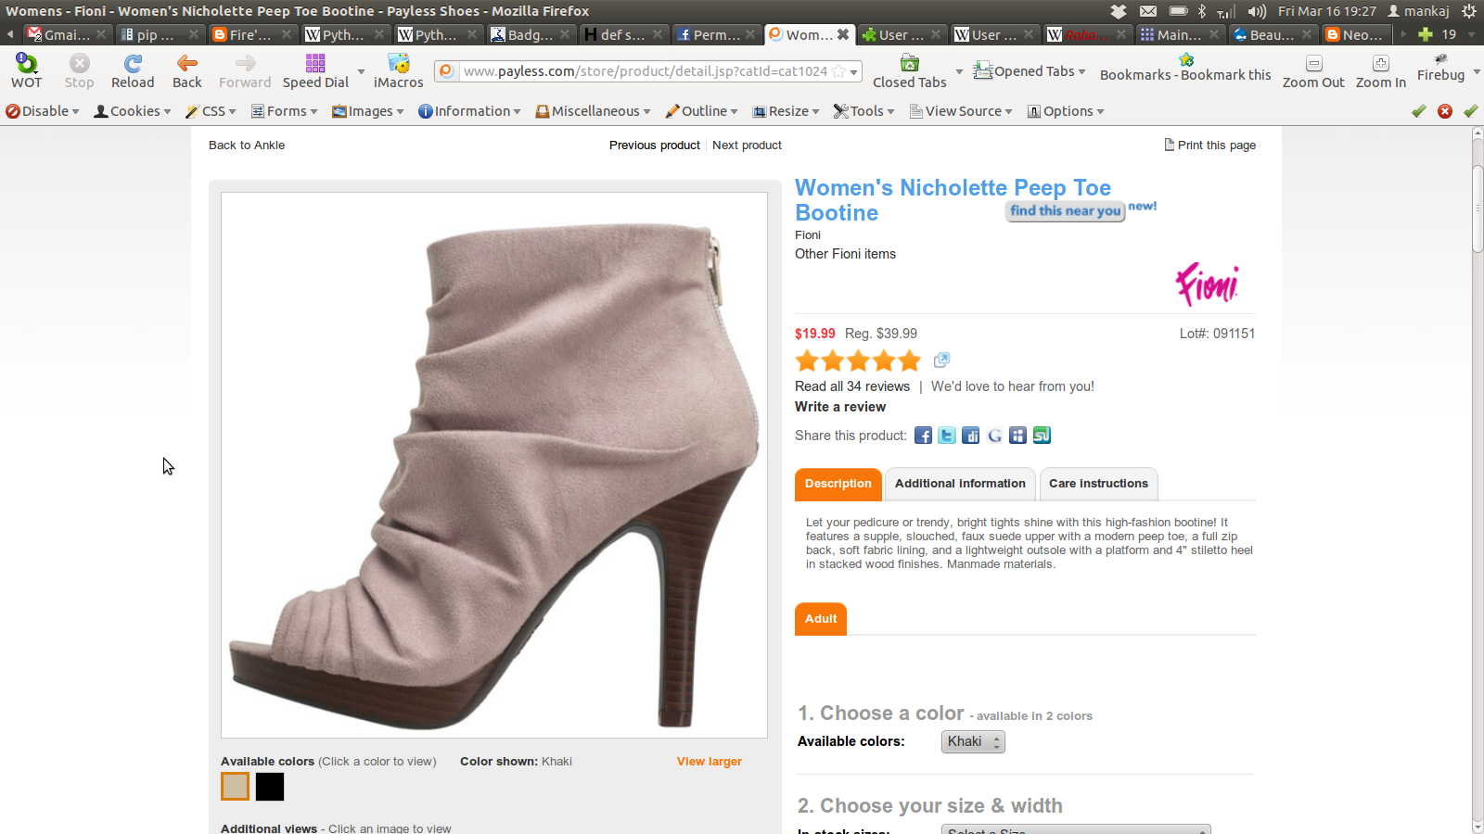

Slide 17
Inspecting Elements with Firebug
We want to fetch the Given Sale Price (19.99)
Goto this link - http://www.payless.com/store/product/detail.jsp?catId=cat10243&subCatId=cat10243&skuId=091151050&productId=68423&lotId=091151&category=
Right Click on $19.99 > Inspect Element with firebug

Slide 18
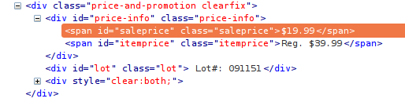
Inspecting Elements with Firebug

Slide 19
Demo Payless_Parser.py
Run the code
$ python Payless_Parser.py
Price of this item is 19.99
Modifiy The url variable to - http://www.payless.com/store/product/detail.jsp?catId=cat10088&subCatId=cat10243&skuId=094079050&productId=70984&lotId=094079&category=&catdisplayName=Womens
Why does this work? Try to understand.

Slide 20
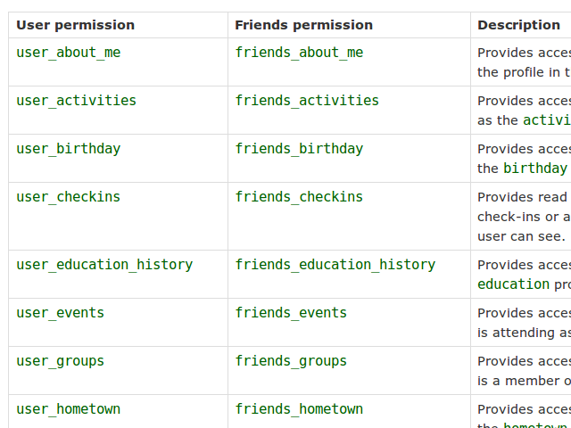
How about Extracting all the Permissions from this page?

Slide 21
Demo Extract_Facebook_Permissions.py
Url to extract from :
https://developers.facebook.com/docs/reference/api/permissions/
Check the next slide for Expected output and how to run the code

Slide 22
$ python Extract_Facebook_Permissions.py
['user_about_me', 'friends_about_me', 'about', 'user_activities', 'friends_activities', 'activities', 'user_birthday', 'friends_birthday', 'birthday', 'user_checkins', 'friends_checkins', 'user_education_history', 'friends_education_history', 'education', 'user_events', 'friends_events', 'events', 'user_groups', 'friends_groups', 'groups', 'user_hometown', 'friends_hometown', 'hometown', 'user_interests', 'friends_interests', 'interests', 'user_likes', 'friends_likes', 'likes', 'user_location', 'friends_location', 'location', 'user_notes', 'friends_notes', 'notes', 'user_photos', 'friends_photos', 'user_questions', 'friends_questions', 'user_relationships', 'friends_relationships', 'user_relationship_details', 'friends_relationship_details', 'user_religion_politics', 'friends_religion_politics', 'user_status', 'friends_status', 'user_videos', 'friends_videos', 'user_website', 'friends_website', 'user_work_history', 'friends_work_history', 'work', 'email', 'email', 'read_friendlists', 'read_insights', 'read_mailbox', 'read_requests', 'read_stream', 'xmpp_login', 'ads_management', 'create_event', 'manage_friendlists', 'manage_notifications', 'user_online_presence', 'friends_online_presence', 'publish_checkins', 'publish_stream', 'publish_stream', 'rsvp_event']

Slide 23
How about writing our version of Google Translate API?
Important: Google Translate API v2 is now available as a paid service only, and the number of requests your application can make per day is limited. As of December 1, 2011, Google Translate API v1 is no longer available; it was officially deprecated on May 26, 2011. These decisions were made due to the substantial economic burden caused by extensive abuse. For website translations, we encourage you to use the Google Website Translator gadget.

Slide 24
Let's understand how it works in background.
Use LiveHTTPHeaders To Understand this
Important Parameters that are passed
sl = en (Source Language = English)
tl = hi (Target Language = Hindi)
text = hello world
http://translate.google.com/?sl=en&tl=hi&text=hello+world#

Slide 25
How about we post this converted text to our facebook wall? :)
fbconsole
  Facebook Python API
  Simplifies things
  Very easy to install
  https://github.com/facebook/fbconsole
  $ sudo pip install fbconsole
We'll use the permissions we extracted in this script :)

Slide 26
Demo Google_Translator_With_FB_API.py
$ python Google_Translator_With_FB_API.py
Language to Convert from : en
Language to Convert to : hi
Text to Convert : wow
Converted Text : वाह
Check your facebook wall :)

Slide 27
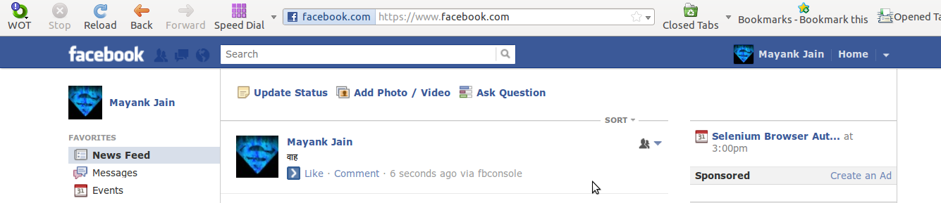
Translated Text Posted on my Facebook Wall

Slide 28
What is Shodan?
Web search engines, such as Google and Bing, are great for finding websites. But what if you're interested in finding computers running a certain piece of software (such as Apache)? Or if you want to know which version of Microsoft IIS is the most popular? Or you want to see how many anonymous FTP servers there are? Maybe a new vulnerability came out and you want to see how many hosts it could infect? Traditional web search engines don't let you answer those questions.

Slide 29
What is Shodan?
SHODAN is a search engine that lets you find specific computers (routers, servers, etc.) using a variety of filters.
Public port scan directory or a search engine of banners.

Slide 30
Scraping Shodan Data Preview
http://www.shodanhq.com/
Python API Is available - http://docs.shodanhq.com/
But you have to get the advanced features. :-/
By default, the following search filters for Shodan are disabled: net, country, before, after. To unlock those filters buy the Unlocked API Add-On. No subscription required!
http://www.shodanhq.com/data/addons

Slide 31
Demo shodanparser_New.py
$ python shodanparser_New.py
Query : country:IN HTTP/1.0 200 OK
3
98.146.42.77 United States
178.33.70.221 France
96.217.60.25 United States
115.133.223.66 Malaysia
218.250.60.122 Hong Kong
180.177.12.132 Taiwan
178.63.104.140 Germany
76.85.55.178 United States
67.159.200.99 United States
75.188.142.2 United States

Slide 32
robots.txt
The Robot Exclusion Standard, also known as the Robots Exclusion Protocol or robots.txt protocol, is a convention to prevent cooperating web crawlers and other web robots from accessing all or part of a website which is otherwise publicly viewable. Robots are often used by search engines to categorize and archive web sites, or by webmasters to proofread source code. The standard is different from, but can be used in conjunction with, Sitemaps, a robot inclusion standard for websites.

Slide 33
robots.txt
Despite the use of the terms "allow" and "disallow", the protocol is purely advisory. It relies on the cooperation of the web robot, so that marking an area of a site out of bounds with robots.txt does not guarantee exclusion of all web robots. In particular, malicious web robots are unlikely to honor robots.txt

Slide 34
facebook.com/robots.txt
User-agent: Googlebot
Disallow: /ac.php
Disallow: /ae.php
Disallow: /album.php
Disallow: /ap.php
Disallow: /autologin.php
Disallow: /checkpoint/
…............

Slide 35
Conculsion
Scraping has many usecases.
Most useful to write your own API if the website does not provide one or has limitations.
Very useful in combining Exiting APIs with websites that do not provide APIs
Be careful of How badly you hit a server.
Follow robots.txt or take permissions.

Slide 36
References

Slide 37
References
Advance Scraping Video -
  http://pyvideo.org/video/609/web-scraping-reliably-and-efficiently-pull-data
Google Python Class Intermediate
  http://code.google.com/edu/languages/google-python-class/set-up.html
  http://www.youtube.com/watch?v=tKTZoB2Vjuk&feature=plcp&context=C42cb319VDvjVQa1PpcFMzwqYlYKVxDoyEu1ISDDTjmz370vY8Xg4%3D

Slide 38
References
Python Absolute Begineer
  http://www.youtube.com/watch?v=4Mf0h3HphEA&feature=channel_video_title
Siddhant Sanyam's PyCon 11 Slides
  https://github.com/siddhant3s/PyCon11-Talk/tree/master/talk1_webscrapping

Slide 39
from BeautifulSoup import BeautifulSoup
import requests, sys
url = 'http://translate.google.com/?sl=en&tl=hi&text=Thank+you+Any+Questions?'
soup = BeautifulSoup(requests.get(url).content, convertEntities=BeautifulSoup.HTML_ENTITIES)
print soup.find('div', {'id' : 'gt-res-content'}).find('span', {'id':'result_box'}).text

Slide 40
शुक्रिया
कोई प्रश्न?

