Slide 1

Project Presentation
on CREDIT CARD FRAUD DETECTION
Presented by :
EKTA MANGAL
(1900950100028)
Under the Guidance of :
Name of Guide: NAVIN TRIVEDI
DEPARTMENT OF COMPUTER SCIENCE & ENGINEERING
MGM’s College of Engineering & Technology, Noida
December, 2022

Slide 2
OUTLINE
Technical Feasibility
Social Feasibility
Economical Feasibility
ER Diagram
DFD
Activity Diagram
Sequence Diagram
Use Case Diagram
Class Diagram
Modules

Slide 3
Technical Feasibility
SVM ( Support Vector Machines)
The SVM is a statistical learning method that is useful in credit card fraud detection if the test instance is with in the learned region it will be classed as normal and if it is outside this region it will be classed as anomalous.
This study is carried out to check the technical feasibility that is the technical requirements of the system. Any system developed must not have a high demand on the available technical resources this will lead to high demands on the technical resources.
The developed must have a modest requirement as only minimal or null changes are required for implementing the system.

Slide 4
Social Feasibility
The aspect of study is to check the level of acceptance of the system by the user. This includes the process of training the user to use the system efficiently. The user must not feel threatened by the system, instead must accept it as a necessity. The level of acceptance by the users solely depends on the methods that are employed to educate the user about the system and to make him familiar with it. His level of confidence must be raised so that he is also able to make some constructive criticism, which is welcomed, as he is the final user of the system.

Slide 5
Economical Feasibility
This study is carried out to check he economic impact that the system will have on the organization. The amount of fund that the company can pour into the research and development of the system is limited. The expenditures must be justified. Thus the developed system as well within the budget and this was achieved because most of the technologies used are freely available. Only the customized products had to be purchased.

Slide 6
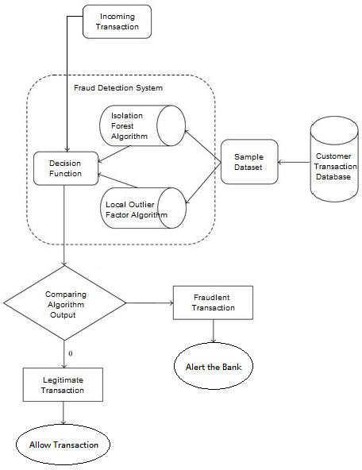
ER Diagram

Slide 7
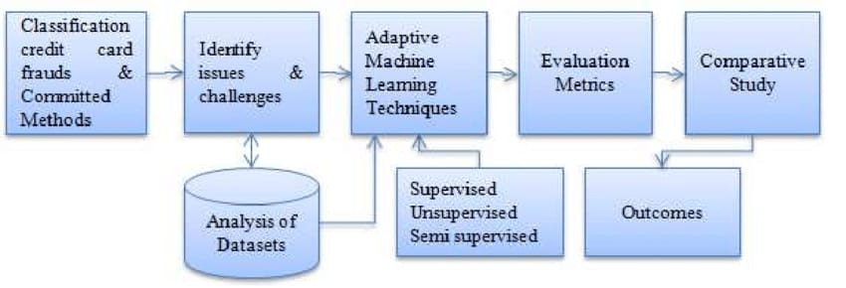
Data Flow Diagram

Slide 8
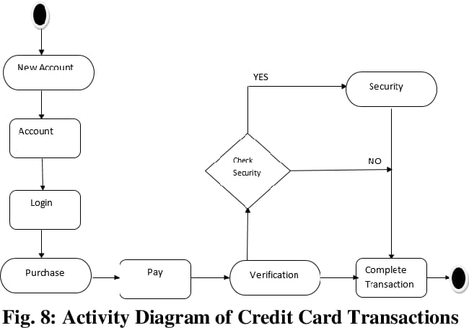
Activity Diagram

Slide 9
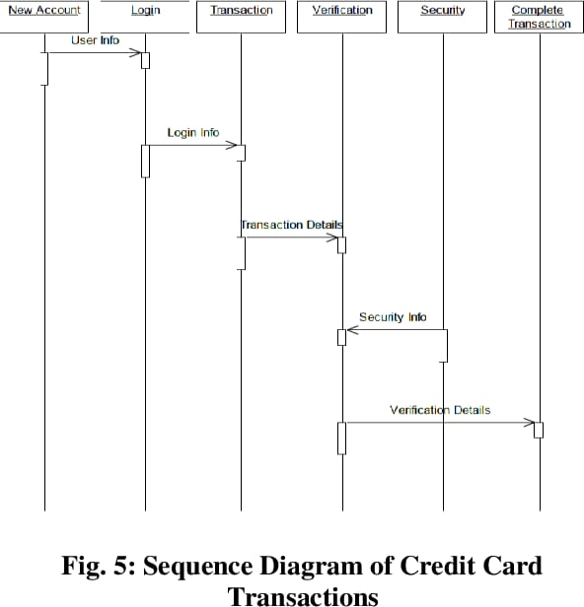
Sequence Diagram

Slide 10
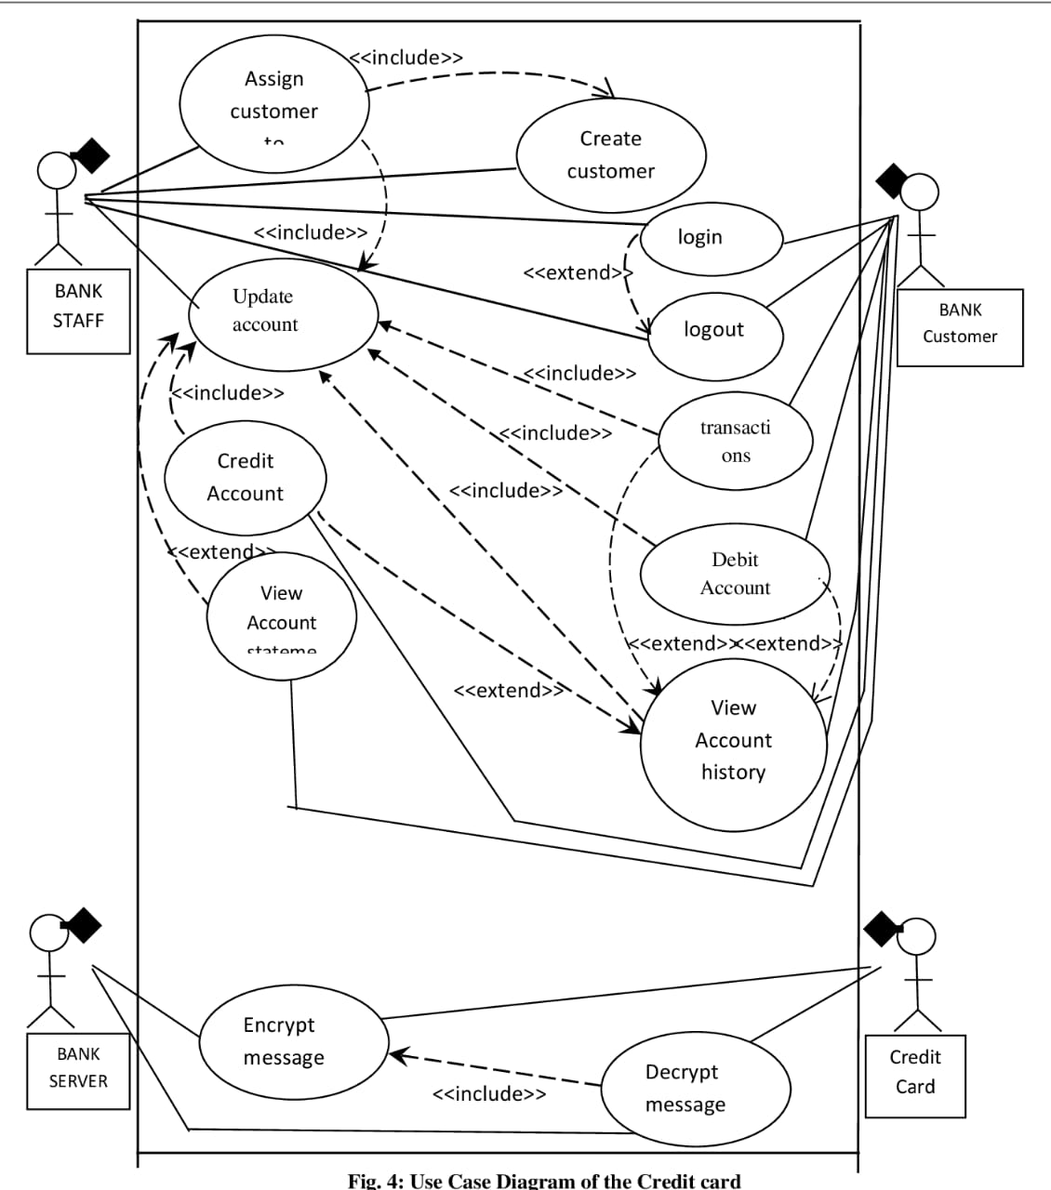
Use Case Diagram

Slide 11
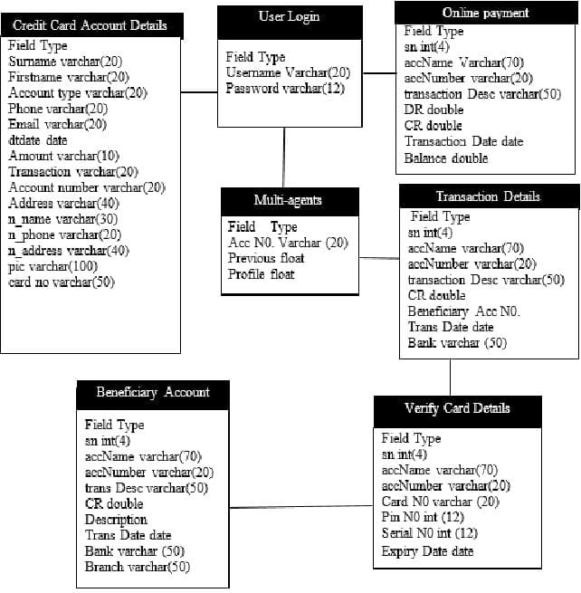
Class Diagram

Slide 12
Modules
1. Data Fetching , understanding and exploring
2. Data cleaning , Processing
• Handling missing values
• Outliers treatment
3. Exploratory data analysis
4. Prepare the data for modelling
• Split the data into train and test set
• Scale the data (normalization)
5. Model building
• Train the model with various algorithm such as Logistic regression, SVM, Decision Tree, Random forest, XGBoost etc.
6. Model evaluation
• As we see that the data is heavily imbalanced, Accuracy may not be the correct measure for this particular case
• We have to look for a balance between Precision and Recall over Accuracy
• We also have to find out the good ROC score with high TPR and low FPR in order to get the lower number of misclassifications.

