Slide 1
Natural Selection
Inspired by a true story.
(and wikipedia...)

Slide 2
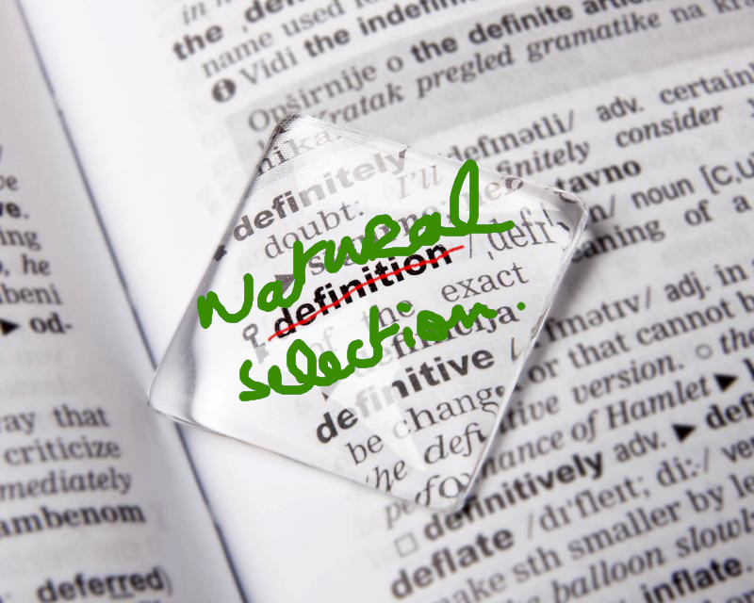

Slide 3
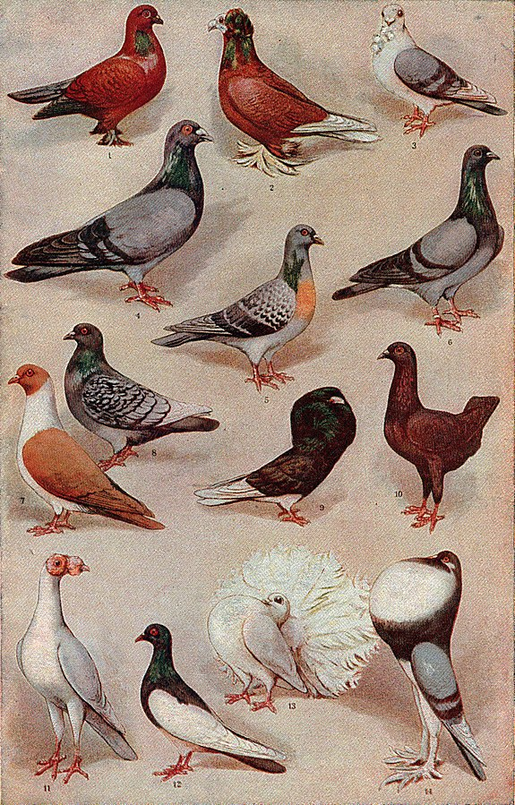

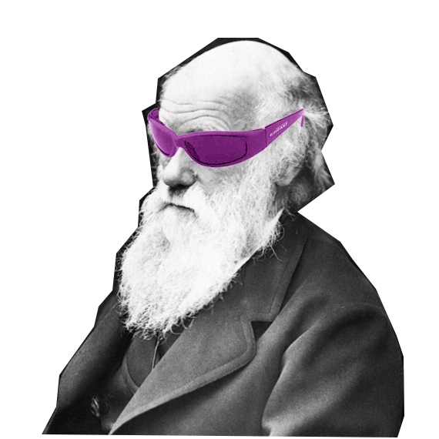
Definition
Aristotle :
  “The useful survives.”
Al-Jahiz :
  “Struggle for existence.”
Darwin :
  “principle by which each slight variation [of a trait], if useful, is preserved.”

Slide 4
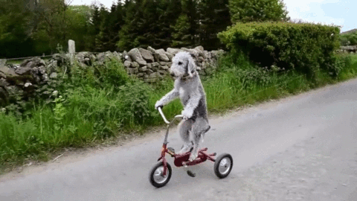
MECHANISMS

Slide 5
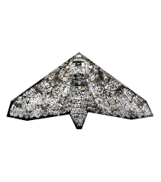
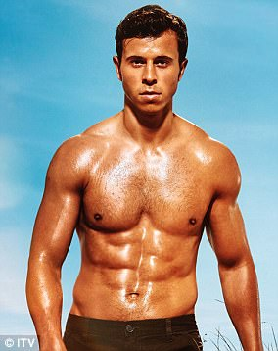
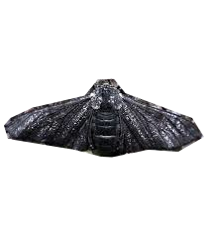
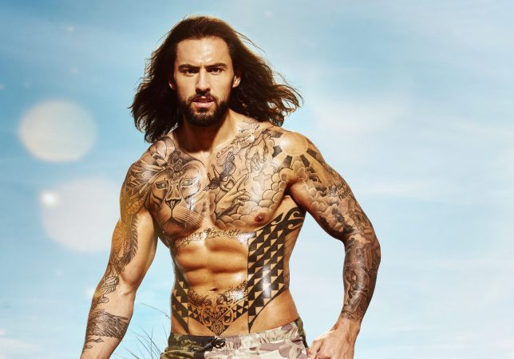
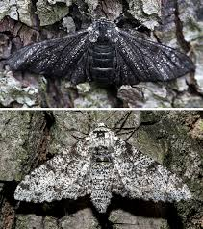
Mechanisms
Fitness
  “Survival of the fittest”

Slide 6
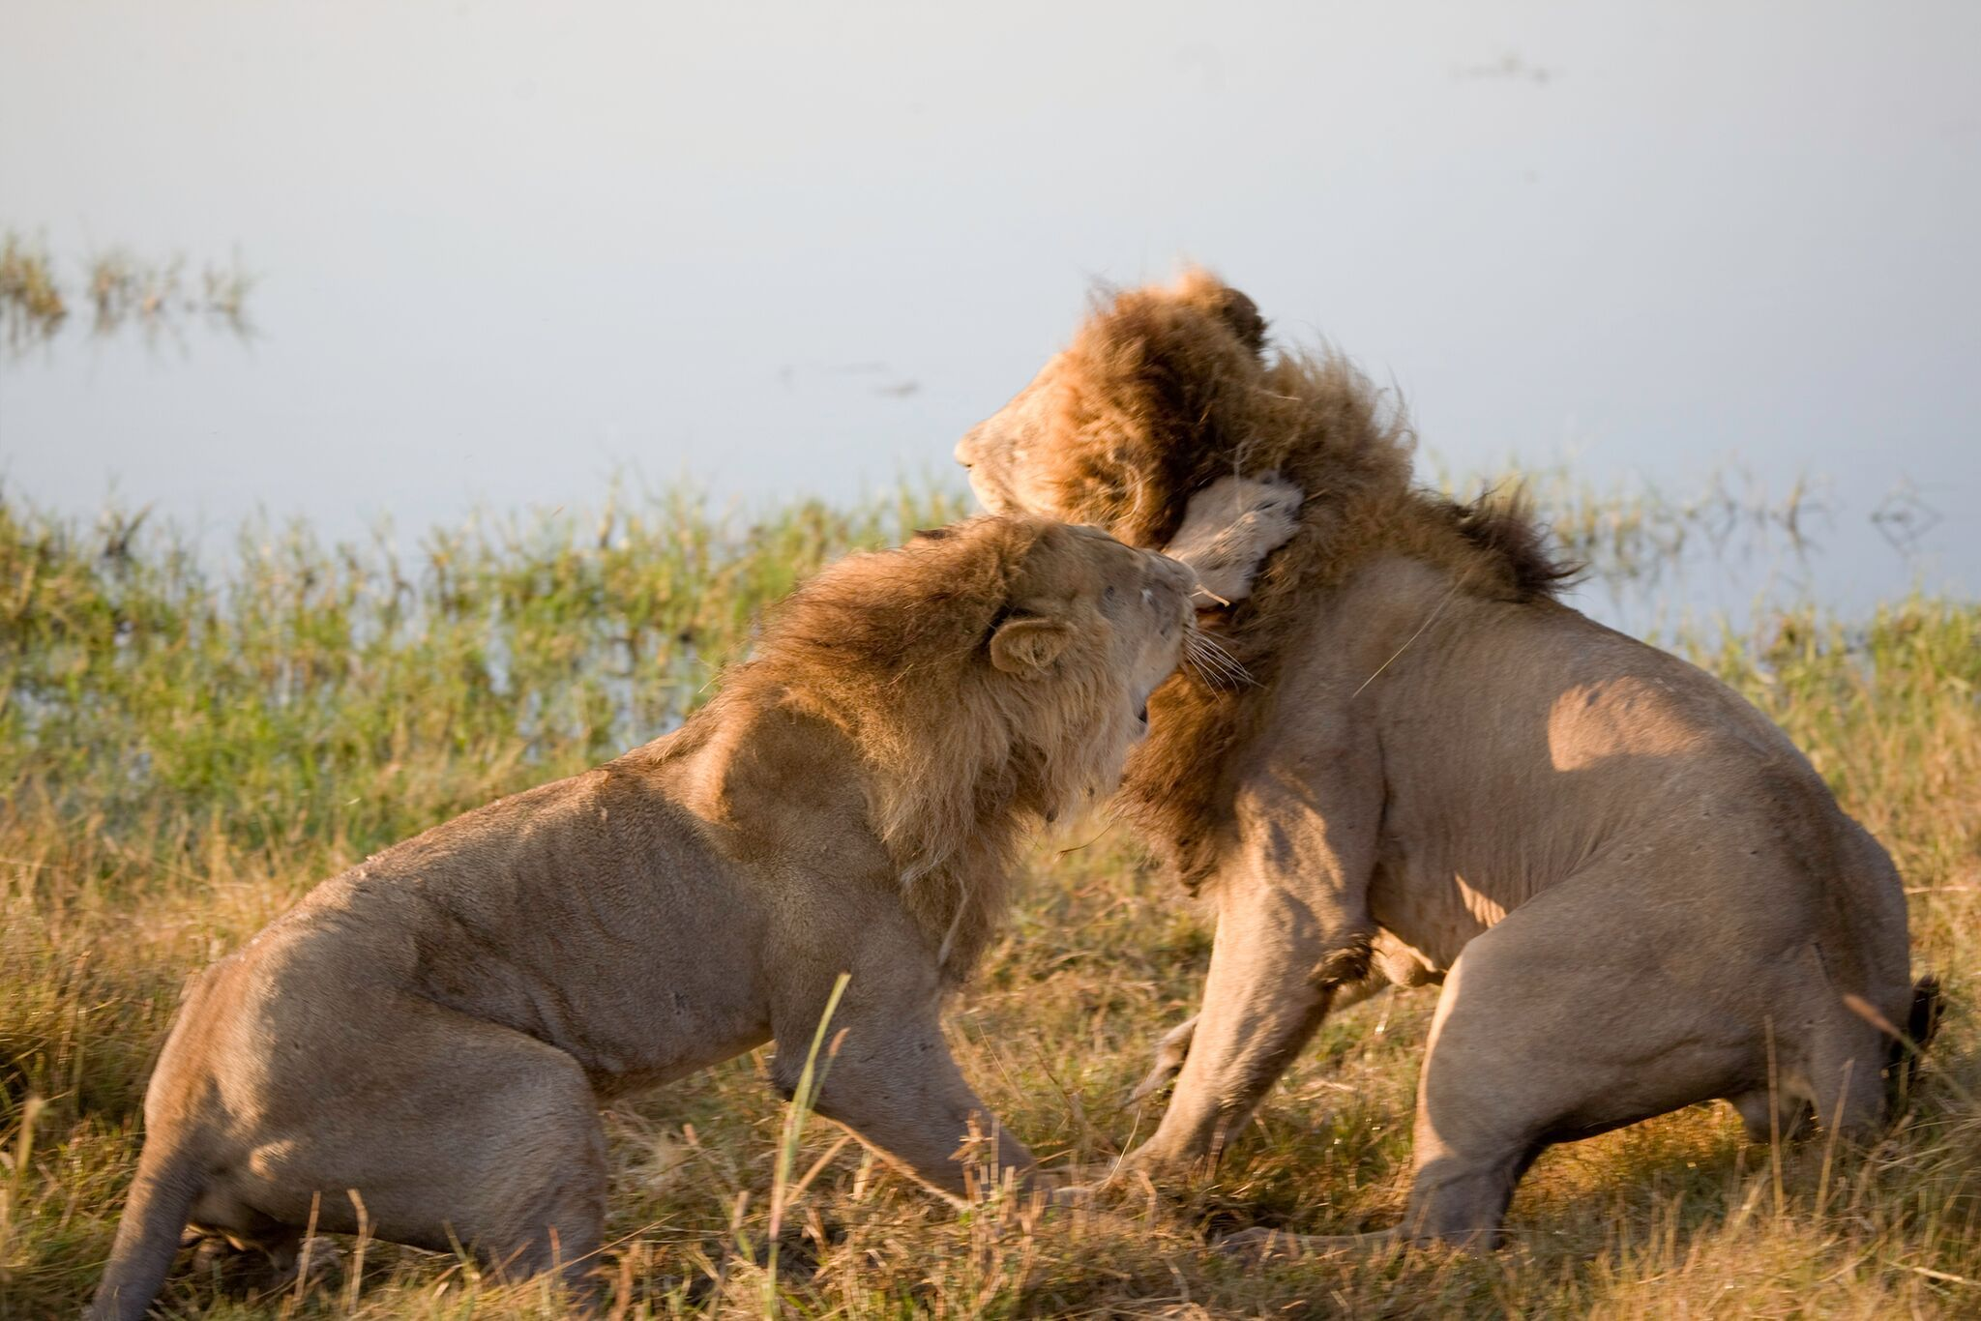

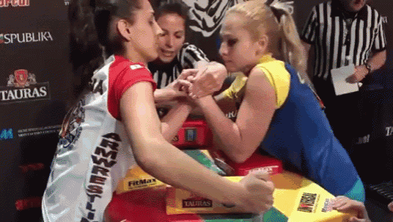
Mechanisms
Competition

Slide 7
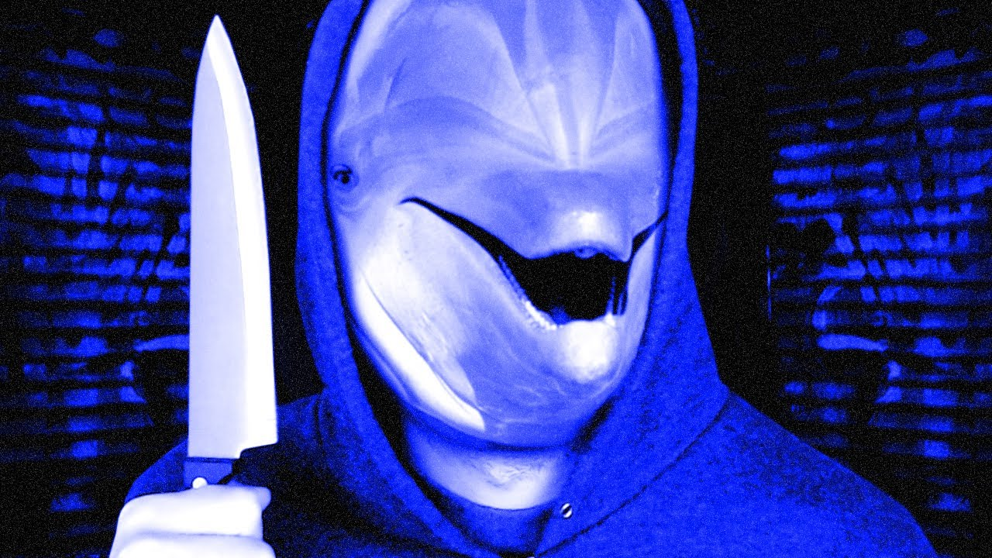

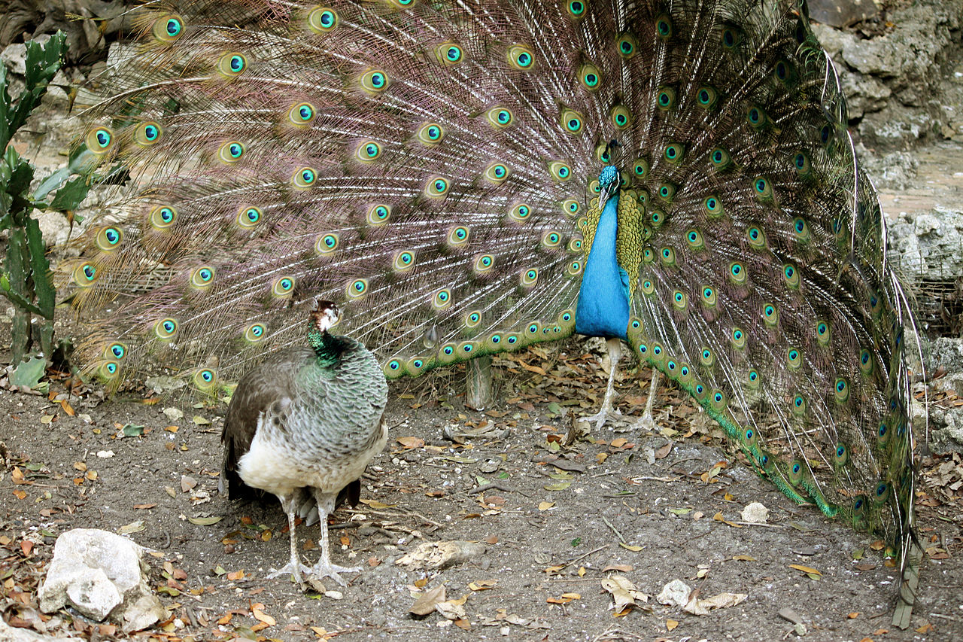
Mechanisms
(Sexual) Competition

Slide 8
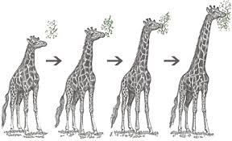
Mechanisms
Adaptation
  Ressource
  Isolation
  Crossover
  Mutation

Slide 9
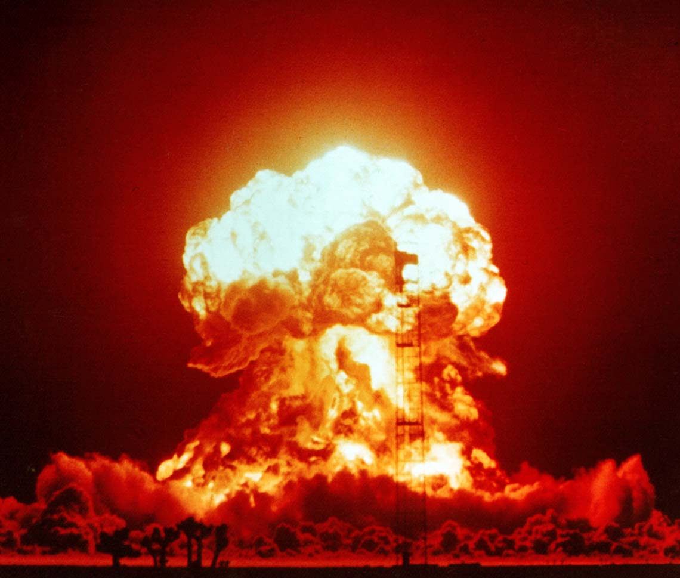
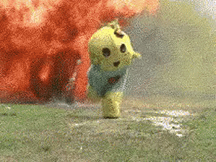
IMPACT

Slide 10
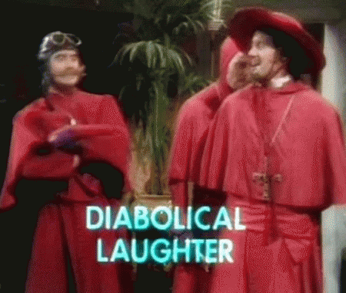
Impact
Origin of life

Slide 11
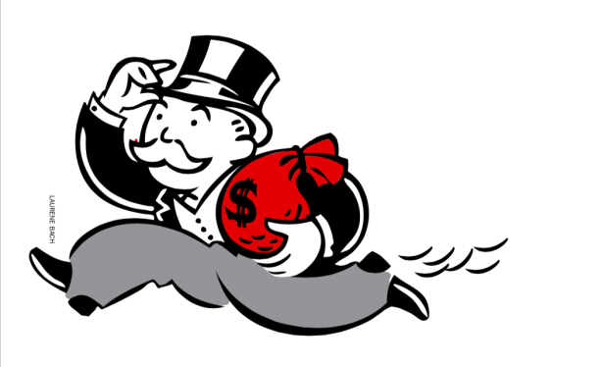
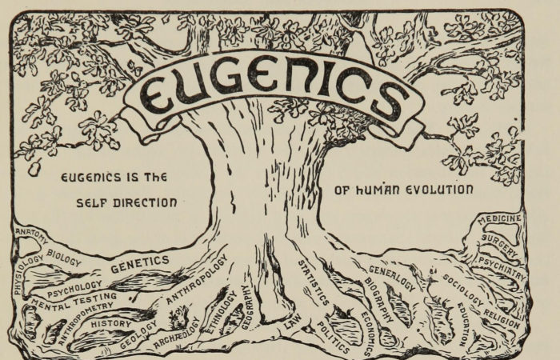
Impact
Social
  Pro-Capitalism argument
  Eugenics

Slide 12
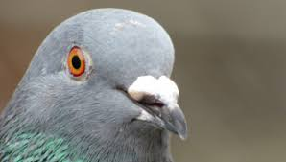
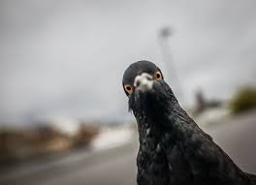
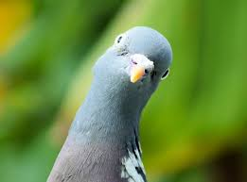
Impact
Information and systems theory
  Genetic algorithms
    Machine learning

Slide 13

INSPIRATION

Slide 14
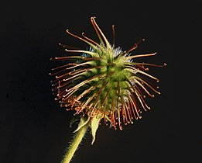
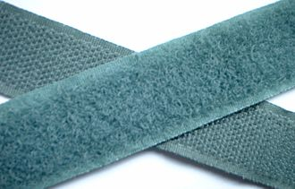
Inspiration
Biomimicry | Biomimetics
  Imitate the living
Practical solutions
  Not always the best.

Slide 15


