Slide 1

Kyambogo University
Faculty Of Engineering
Bachelor of Engineering in Telecommunication Engineering
Cyber security evaluation and mitigation for future wireless networks,
5G, IoT and cloud storage networks
(An Offensive and Defensive Technical Approach)
Final Year Project Proposal, EE421
by
Muhanguzi Tobias, 15/U/7774/ETE/PE
© Muhanguzi Tobias, 15/U/7774/ETE/PE, mztoby12@gmail.com, https://github.com/marydovika

Slide 2
Kyambogo University
Abstract
This project is a practical demonstration and research on all techniques in cyber security for wireless networks with focus on the 5G architecture which is assumed to have all the qualities of IoT, Smart-grid and Cloud storage networks, all these accrue to Big-Data, the massive amounts of data generated from IoT and other Communications, pose a security concern both in storage and transit, this report will review and demonstrate the following;
1. Encryption algorithms 2. History of hacking and Ethical hacking and Tools used in penetration testing, social engineering and vulnerability tests with kali linux for wireless networks 3. Security with python programming, MATLAB programming to develop munged passwords. 4. Security in the application layer and network layer (ipv4 and ipv6) analysis with wireshark, and methodologies and models of software development systems 5. 5G, IoT, NFC, Smart grid cyber security and cloud storage security concerns 6. Cyber security policies, including the GDPR, and future discussions.
© Muhanguzi Tobias, 15/U/7774/ETE/PE, mztoby12@gmail.com, https://github.com/marydovika

Slide 3
Kyambogo University
Background
It is worth acknowledging that, the high data rates required for the increasing demands for real-time communication, VR and AR, Big-data, NFC and IoT, not forgetting streaming services have been achieved, and will be even better in the near future. As I speak, 5G is on trial in most parts of Africa. However, to a narrow view, there are three-four fundamental requirements for a modern communication network, which include, Data rate/throughput capacity, Processing power of network equipment, Redundancy and ether channels, and cyber-security that contribute to QoS Realization. I have singled out cyber-security to be my center of discussion, all said, the security of the huge amounts of data put on the network; in transit, and in cloud and other storage servers on the network has to be handled with great concern.
© Muhanguzi Tobias, 15/U/7774/ETE/PE, mztoby12@gmail.com, https://github.com/marydovika

Slide 4
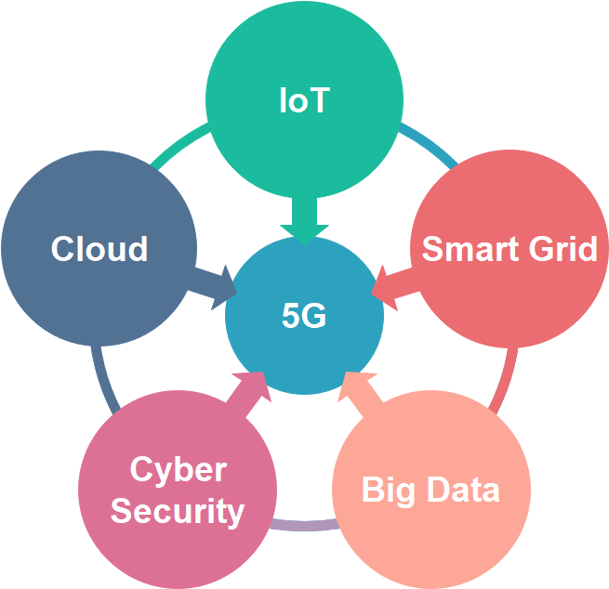
Kyambogo University
Background…cont’d
© Muhanguzi Tobias, 15/U/7774/ETE/PE, mztoby12@gmail.com, https://github.com/marydovika

Slide 5
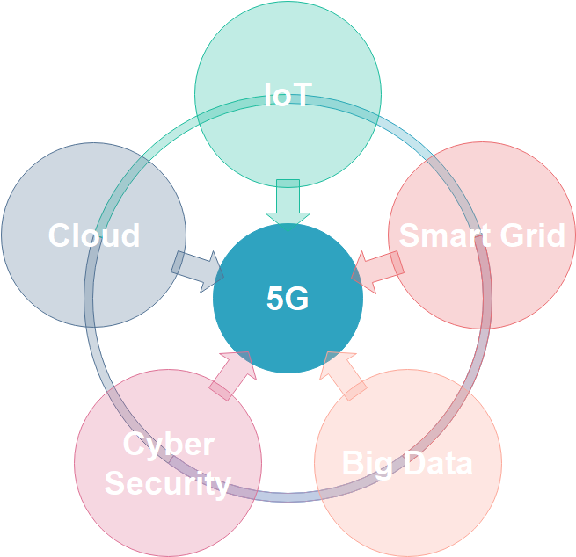
Kyambogo University
Background…cont’d
Insert some details on 5G
© Muhanguzi Tobias, 15/U/7774/ETE/PE, mztoby12@gmail.com, https://github.com/marydovika

Slide 6
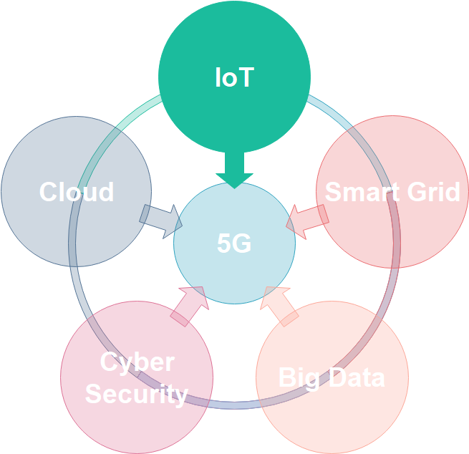
Kyambogo University
Background…cont’d
© Muhanguzi Tobias, 15/U/7774/ETE/PE, mztoby12@gmail.com, https://github.com/marydovika

Slide 7
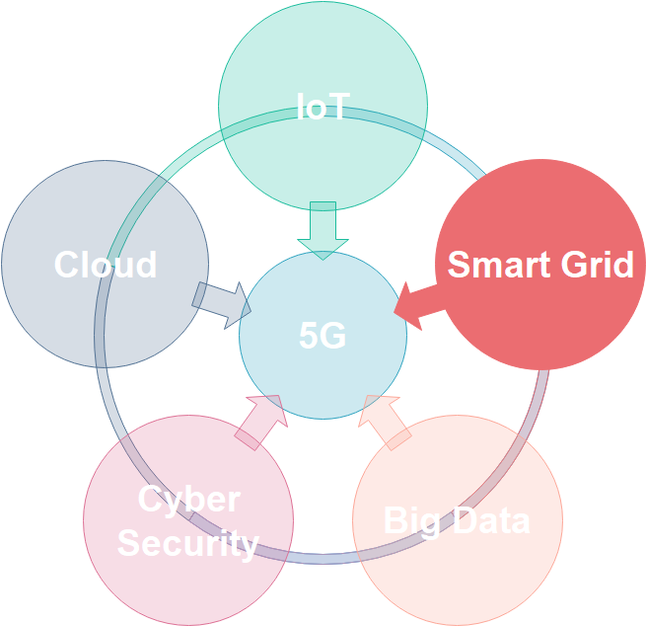
Kyambogo University
Background…cont’d
© Muhanguzi Tobias, 15/U/7774/ETE/PE, mztoby12@gmail.com, https://github.com/marydovika

Slide 8
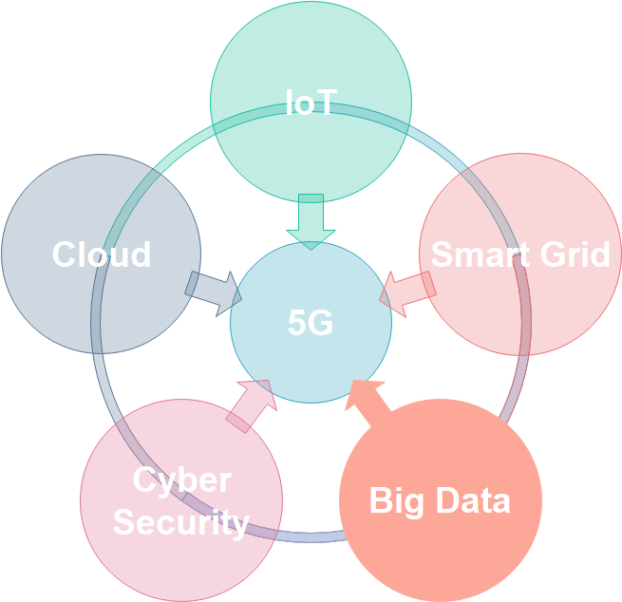
Kyambogo University
Background…cont’d
Insert Your data for cisco
© Muhanguzi Tobias, 15/U/7774/ETE/PE, mztoby12@gmail.com, https://github.com/marydovika

Slide 9
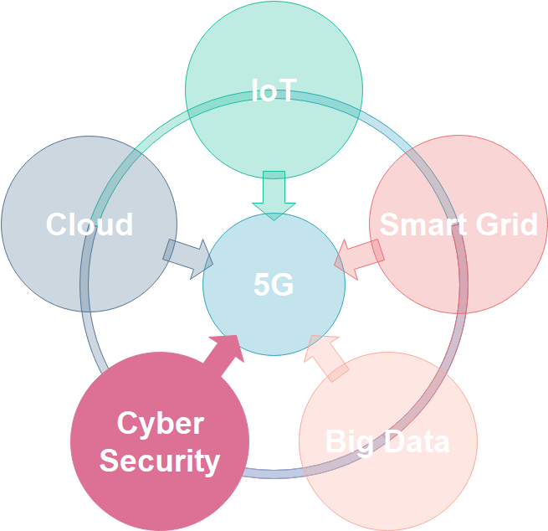
Kyambogo University
Background…cont’d
© Muhanguzi Tobias, 15/U/7774/ETE/PE, mztoby12@gmail.com, https://github.com/marydovika

Slide 10
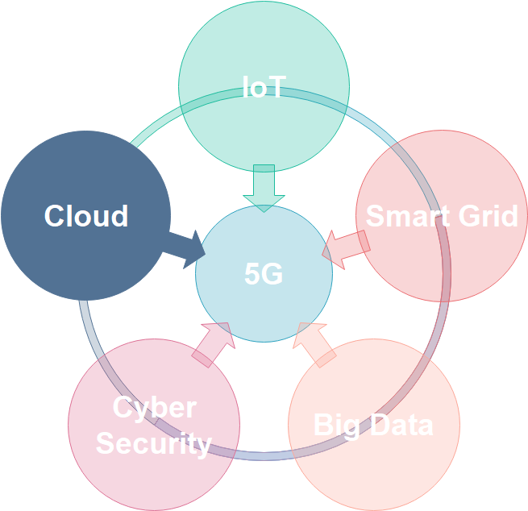
Kyambogo University
Background…cont’d
© Muhanguzi Tobias, 15/U/7774/ETE/PE, mztoby12@gmail.com, https://github.com/marydovika

Slide 11
Kyambogo University
Problem statement
The increasing demands for real-time communication/ streaming services , VR and AR, NFC, smart grid and IoT/ IoE that put all kinds of data on a network from health, agriculture, education, etc and the effort of the government to digitize all communication, and aslo the increasing electronic money transfers, all these generate huge amounts of data, hence Big-data, this poses a problem that preambles security of networks, I have singled out cyber-security to be my center of my discussion, research and inquiry, all said, the security of the huge amounts of data put on the network; in transit, and in cloud and other storage servers on the network has to be handled with great concern.
© Muhanguzi Tobias, 15/U/7774/ETE/PE, mztoby12@gmail.com, https://github.com/marydovika

Slide 12
Kyambogo University
Objectives
General Objectives;
Cyber security evaluation and mitigation for future wireless networks, 5G, IoT and cloud storage networks (an Offensive and Defensive Technical Approach)
Specific Objectives;
To develop two MATLAB Applications; one that hinds the characters of a password on login, and another that generates munged passwords
To carry out research on encryption algorithms of wireless networks
To carry out research on 5G, IoT and Cloud network architecture.
To carry out research on cyber security policies.
To
© Muhanguzi Tobias, 15/U/7774/ETE/PE, mztoby12@gmail.com, https://github.com/marydovika

Slide 13
Kyambogo University
Justification
I have taken on the challenge to evaluate, and make an inquiry in possible cyber security mitigation in wireless networks and cloud systems, with emerging IoT systems, automation of different activities in health, agriculture, government, mobile banking/mobile money and education(e-learning platforms ), all of which require internet connectivity, security of data transfers should be ensured, hackers can cost a company a great deal of money, reputation, and test its competence to protecting the information of its customers.
© Muhanguzi Tobias, 15/U/7774/ETE/PE, mztoby12@gmail.com, https://github.com/marydovika

Slide 14
Kyambogo University
Significance of the study
Creating a general but practical understanding of cyber security, policies and practices that accrue to computer security, for the future wireless networks that carry customer critical data used and generated by IoE, IoT,
© Muhanguzi Tobias, 15/U/7774/ETE/PE, mztoby12@gmail.com, https://github.com/marydovika

Slide 15
Kyambogo University
Scope of the project
The following practical activities will be carried out during the course of the project:
Wireless Encryption algorithms, munged passwords with MATLAB
History of hacking and Ethical hacking.
Tools used in penetration testing, social engineering and vulnerability tests with kali linux for wireless networks.
Security models with GNS3 simulation
Security with python programming.
Security in the application layer and network layer (ipv4 and ipv6) analysis with wireshark, (software systems security).
Tools and remedies to secure hardware systems (Unix, Cisco, Juniper and Hauwei hardware systems).
5G, IoT, NFC, Smart grid cyber security and cloud storage security concerns.
Cyber security policies, including the GDPR. And UGCERT activity review
© Muhanguzi Tobias, 15/U/7774/ETE/PE, mztoby12@gmail.com, https://github.com/marydovika

Slide 16
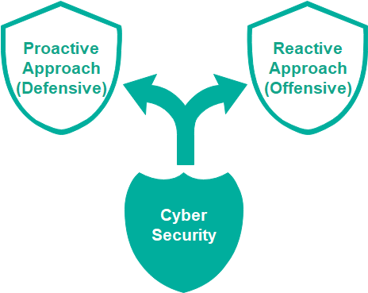
Kyambogo University
Methodology
© Muhanguzi Tobias, 15/U/7774/ETE/PE, mztoby12@gmail.com, https://github.com/marydovika

Slide 17
Kyambogo University
Defensive cyber security approach
Wireless encryption techniques and algorithms with MATLAB
Security models for software system development and industrial standards demonstration using GNS3
Review of mobile money security system, and smart grid.
Password hardening through character substitution and munged password application with python and MATLAB
Hardware security configurations, and network security
Wireshark and Snort as Intrusion Prevention and Intrusion Detection tools
© Muhanguzi Tobias, 15/U/7774/ETE/PE, mztoby12@gmail.com, https://github.com/marydovika

Slide 18
Kyambogo University
Defensive cyber security approach …Cont’d
Proposed 5G architecture, and implementation
5G services (IoT, and Cloud)
5G security architecture according to simaliance
IoT-cloud computing architecture (meeting point for IT and OT)
Near Field Communications-NFC
Smart grid security protocols
© Muhanguzi Tobias, 15/U/7774/ETE/PE, mztoby12@gmail.com, https://github.com/marydovika

Slide 19
Kyambogo University
Offensive cyber security approach
Types of Cyber security Threats and Attacks
Ethical hacking and tools with Kali Linux
Contracting (ROE) and Red Team organisation
Vulnerability testing
Pen-testing
Social engineering
© Muhanguzi Tobias, 15/U/7774/ETE/PE, mztoby12@gmail.com, https://github.com/marydovika

Slide 20
Kyambogo University
Law and policy for Cyber security
Attack history statistics and their impact
Cert operations
GDPR
Other policies, relating to cyber security in Uganda, and a model country
© Muhanguzi Tobias, 15/U/7774/ETE/PE, mztoby12@gmail.com, https://github.com/marydovika

Slide 21
Kyambogo University
Expected Results of the project
Proactive results
5G architecture according to simaliance and other vendors
Security Modeling with GNS3
Wireless Encryption with MATLAB
Character substitution in MATLAB
Munged password in python
Intrusion detection demo with Snort, and Wireshark
Tools use by cert to monitor security
© Muhanguzi Tobias, 15/U/7774/ETE/PE, mztoby12@gmail.com, https://github.com/marydovika

Slide 22
Kyambogo University
Reactive results
Sample of an ROE.
Ethical hacking.
Kali Linux tools for wireless offensive security; NMAP, etc.
Vulnerability assessment for wireless networks
Penetration testing
Social Engineering
© Muhanguzi Tobias, 15/U/7774/ETE/PE, mztoby12@gmail.com, https://github.com/marydovika

Slide 23
Kyambogo University
Regulation and policies presentation
Operation of cert
Information policy of Uganda
Hacking impact in the recent past, and its damage
Other policies relating to cyber security, GDPR, IEEE Regulations, etc
© Muhanguzi Tobias, 15/U/7774/ETE/PE, mztoby12@gmail.com, https://github.com/marydovika

Slide 24
Kyambogo University
Estimated budget for the project
The following will be incurred as the project goes on to completion
© Muhanguzi Tobias, 15/U/7774/ETE/PE, mztoby12@gmail.com, https://github.com/marydovika

Slide 25
Kyambogo University
Proposed project schedule
2018/2019 | 2018 |  |  |  |  | 2019
 | Aug | Sept | Oct | Nov | Dec | Jan | Feb | March | April | May
Research
Matlab programming
Proposal writing
Presentation of Topic
Introduction to Cyber security
Python programming
Kali Linux
Policy research
Presentation
Report Writing
© Muhanguzi Tobias, 15/U/7774/ETE/PE, mztoby12@gmail.com, https://github.com/marydovika

Slide 26
Kyambogo University
References
https://www.offensive-security.com/kali-linux-arm-images/
https://github.com/offensive-security/kali-arm-build-scripts
© Muhanguzi Tobias, 15/U/7774/ETE/PE, mztoby12@gmail.com, https://github.com/marydovika

Slide 27
Kyambogo University
Thank you
© Muhanguzi Tobias, 15/U/7774/ETE/PE, mztoby12@gmail.com, https://github.com/marydovika

