Slide 1


Kyambogo University
Faculty Of Engineering
Department Of Electrical And Electronics Engineering
Bachelor Of Engineering In Telecommunication Engineering
Cyber security evaluation and mitigation for future wireless networks,5G, IoT and cloud storage networks
(An Offensive and Defensive Technical Approach)
Final Year Project Proposal, EE421
Muhanguzi Tobias, 15/U/7774/ETE/PE
Supervisor: Mr. Kitone Isaac

Slide 2
Kyambogo University
Abstract
This project is a practical demonstration and research on cyber security techniques for wireless networks with focus on the 5G architecture which is assumed to have all the qualities of IoT, Smart-grid and Cloud storage networks, all these accrue to Big-Data, the massive amounts of data generated from IoT and other Communications, pose a security concern both in storage and transit, this report will review and demonstrate the following;
1. Encryption algorithms 2. History of hacking and Ethical hacking and Tools used in penetration testing, social engineering and vulnerability tests with Kali Linux for wireless networks 3. Security with python programming, MATLAB programming to develop munged passwords. 4. Security in the application layer and network layer (ipv4 and ipv6) analysis with Wireshark, and methodologies and models of software development systems 5. 5G, IoT, NFC, Smart grid cyber security and cloud storage security concerns 6. Cyber security policies, including the GDPR, and future discussions.
© Muhanguzi Tobias, 15/U/7774/ETE/PE, https://github.com/marydovika

Slide 3
Kyambogo University
Background
It is worth acknowledging that, the high data rates required for the increasing demands for real-time communication, VR and AR, Big-data, NFC and IoT, not forgetting streaming services have been achieved, and will be even better in the near future. As I speak, 5G is on trial in most parts of Africa. However, to a narrow view, there are three-four fundamental requirements for a modern communication network, which include, Data rate/throughput capacity, Processing power of network equipment, Redundancy and ether channels, and cyber-security that contribute to QoS Realization. I have singled out cyber-security to be my center of discussion, all said, the security of the huge amounts of data put on the network; in transit, and in cloud and other storage servers on the network has to be handled with great concern.
© Muhanguzi Tobias, 15/U/7774/ETE/PE, https://github.com/marydovika

Slide 4
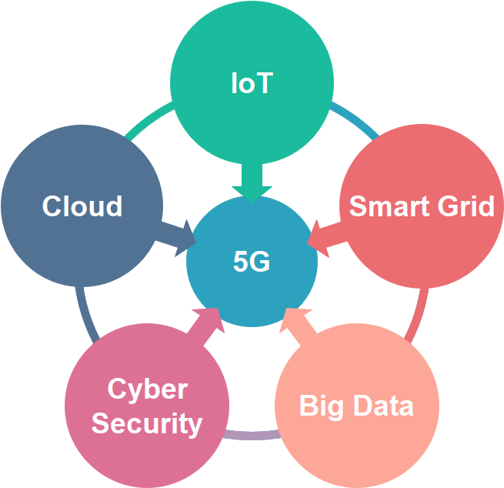
Kyambogo University
Background…cont’d
© Muhanguzi Tobias, 15/U/7774/ETE/PE, https://github.com/marydovika

Slide 5
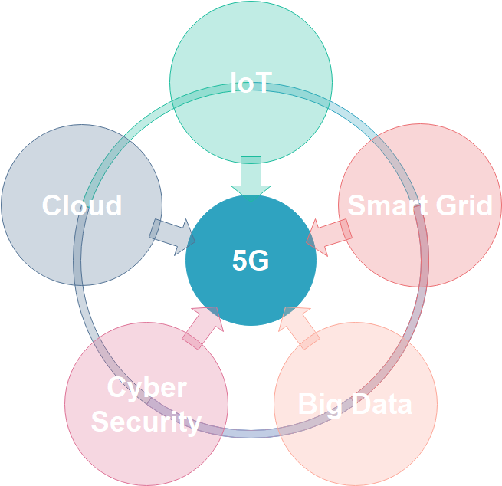
Kyambogo University
Background…cont’d
Insert some details on 5G
© Muhanguzi Tobias, 15/U/7774/ETE/PE, https://github.com/marydovika

Slide 6
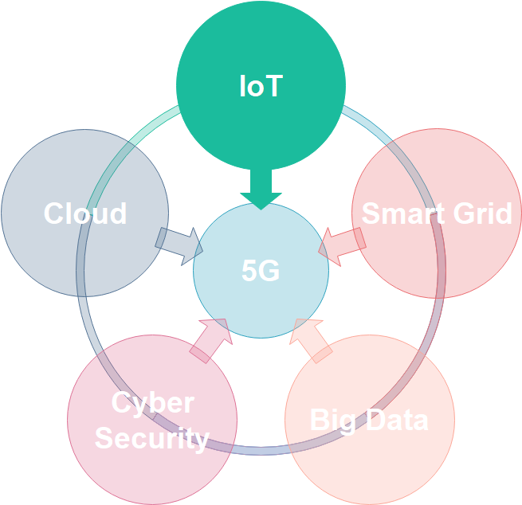
Kyambogo University
Background…cont’d
© Muhanguzi Tobias, 15/U/7774/ETE/PE, https://github.com/marydovika

Slide 7
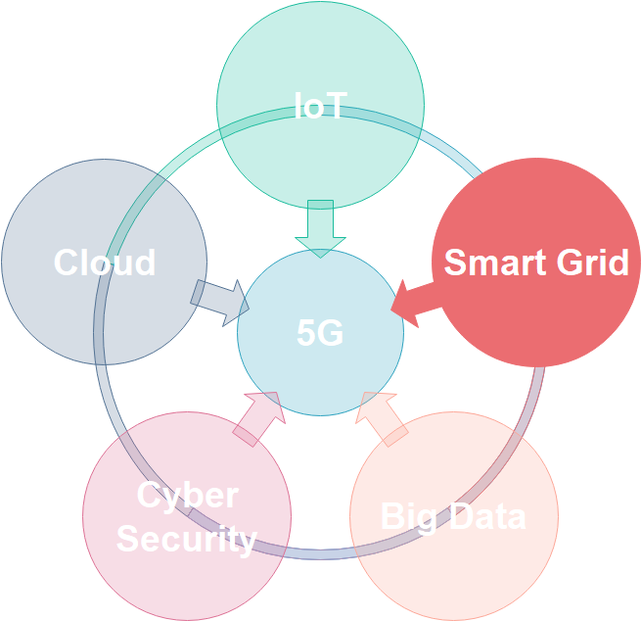
Kyambogo University
Background…cont’d
© Muhanguzi Tobias, 15/U/7774/ETE/PE, https://github.com/marydovika

Slide 8
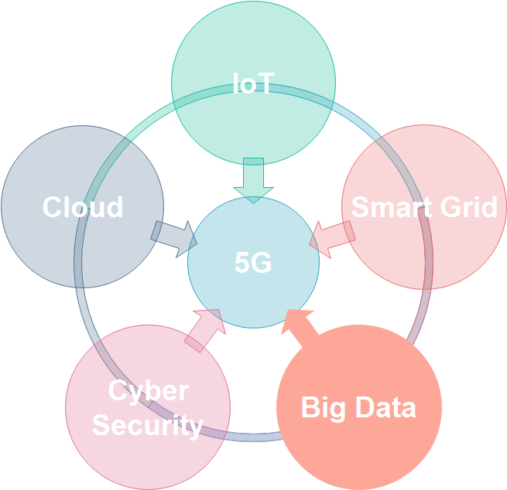
Kyambogo University
Background…cont’d
Insert Your data for cisco
With the emergence of the Internet of Things (IoT), there is a lot more data to manage and secure. IoT is a large network of physical objects, such as sensors and equipment that extend beyond the traditional computer network. All these connections, plus the fact that we have expanded storage capacity and storage services through the cloud and virtualization, lead to the exponential growth of data. This data has created a new area of interest in technology and business called “Big Data". With the velocity, volume, and variety of data generated by the IoT and the daily operations of business, the confidentiality, integrity and availability of this data is vital to the survival of the organization.
© Muhanguzi Tobias, 15/U/7774/ETE/PE, https://github.com/marydovika

Slide 9
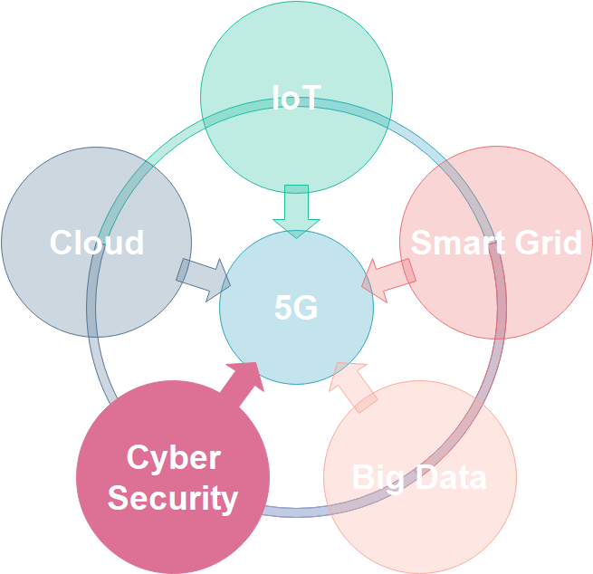
Kyambogo University
Background…cont’d
© Muhanguzi Tobias, 15/U/7774/ETE/PE, https://github.com/marydovika

Slide 10
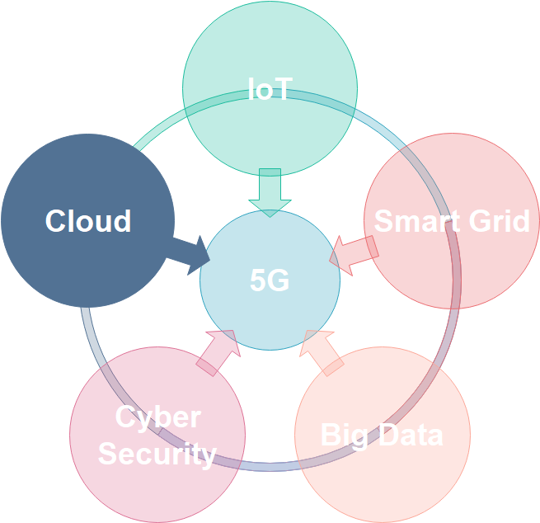
Kyambogo University
Background…cont’d
© Muhanguzi Tobias, 15/U/7774/ETE/PE, https://github.com/marydovika

Slide 11
Kyambogo University
Problem statement
The increasing demands for real-time communication/ streaming services , VR and AR, NFC, smart grid and IoT/ IoE that put all kinds of data on a network from health, agriculture, education, etc. and the effort of the government to digitize all communication, and also the increasing electronic money transfers, all these generate huge amounts of data, hence Big-data, this poses a problem that preambles security of networks, I have singled out cyber-security to be my center of my discussion, research and inquiry, all said, the security of the huge amounts of data put on the network; in transit, and in cloud and other storage servers on the network has to be handled with great concern.
© Muhanguzi Tobias, 15/U/7774/ETE/PE, https://github.com/marydovika

Slide 12
Kyambogo University
Objectives
General Objectives;
Cyber security evaluation and mitigation for future wireless networks, 5G, IoT and cloud storage networks (an Offensive and Defensive Technical Approach)
Specific Objectives;
To develop two MATLAB Applications; one that hinds the characters of a password on login, and another that generates munged passwords
To carry out research on encryption algorithms of wireless networks
To carry out research on 5G, IoT and Cloud network architecture.
To carry out research on cyber security policies.
© Muhanguzi Tobias, 15/U/7774/ETE/PE, https://github.com/marydovika

Slide 13
Kyambogo University
Justification
I have taken on the challenge to evaluate, and make an inquiry in possible cyber security threats and mitigation in wireless networks and cloud systems, with emerging IoT systems, automation of different activities in health, agriculture, government, mobile banking/mobile money and education(e-learning platforms ), power grid, etc, all of which require internet connectivity, security of data transfers should be ensured, hackers can cost a company a great deal of money, reputation, and test its competence to protecting the information of its customers.
© Muhanguzi Tobias, 15/U/7774/ETE/PE, https://github.com/marydovika

Slide 14
Kyambogo University
Significance of the study
Creating a general but practical understanding of cyber security, policies and practices that accrue to computer security, for the future wireless networks that carry customer critical data used and generated by IoE, IoT.
© Muhanguzi Tobias, 15/U/7774/ETE/PE, https://github.com/marydovika

Slide 15
Kyambogo University
Scope of the project
The following practical activities will be carried out during the course of the project:
Wireless Encryption algorithms, munged passwords with MATLAB
History of hacking and Ethical hacking.
Tools used in penetration testing, social engineering and vulnerability tests with kali linux for wireless networks.
Security models with GNS3 simulation
Security with python programming.
Security in the application layer and network layer (ipv4 and ipv6) analysis with wireshark, (software systems security).
Tools and remedies to secure hardware systems (Unix, Cisco, Juniper and Hauwei hardware systems).
5G, IoT, NFC, Smart grid cyber security and cloud storage security concerns.
Cyber security policies, including the GDPR. And UGCERT activity review
© Muhanguzi Tobias, 15/U/7774/ETE/PE, https://github.com/marydovika

Slide 16
Kyambogo University
Methodology
Cyber security concept research
Network cyber security
5G
IoT
Cloud computing
Counter measures
Proactive/ Defensive tools
Reactive/ Offensive tools
Law and policy for Cyber security
© Muhanguzi Tobias, 15/U/7774/ETE/PE, https://github.com/marydovika
Notes:
Technical research Cyber security general approach Cyber security mind map CBK Encryption ACs models Cyber Theats Software Dev't Life Cycle security Software assurance Risk management Competency Models, Roadmaps, and Framework s for security Infosec and DevOps Vulnerability assessment, and artifact handling. Network security Understanding the physical network/ topology Device configuration for security Disable some inactive protocols Security attack window for 5G, IoT and Cloud computing. Hardware and software security tools:: honey pots, DMZ Fire Walls, IDS +IPS, VPNs, and VLANs, IPsec... Recovery handling 5G study 5G architecture according to 5GPPP 5G players :: | ITU | |3GPP| |5GPPP| |China mobile| |AT&T| |Korea| Major enablers :: SDN-slicing & it's need :: NFV-virtualization & it's need :: IoT, RFID, NFC and bigdata dilemma 5G security architecture Construction model according to 5GPPP New attack window due to NFV, and SDN + threats Counter measures Encryption techniques for 5G Cloud computing study Cloud computing architecture Enablers Construction model Cloud computing security architecture Construction model Threats and attack window Counter measures and policy regulations Incidences of attacks IoT study IoT architecture Enablers Construction model approaches:: service--PaaS, SaaS, XaaS, development--public, private, hybrid IoT security architecture Construction model Threats and attack window Counter measures and policy regulation Incidences Practical activity Cyber Security Tools, counter measures Proactive/ defensive tools :: according to cert.ug cc :: Security Audits or Assessments, according to guidelines :: character substitution password login application Infosec :: encryption algorithms for wireless networks :: pin hardening transportation application. online protection :: malware script for phishing Configuration and Maintenance of Security Development of Security Tools :: munged password application in python Intrusion Detection Services using snort, wireshark Security-Related Information Dissemination. Reactive/ Offensive tools Kali Linux operating system tools/ "backtrack" Social Engineering Alerts and Warnings:: pentesting models Incident Handling, Incident analysis, Incident response support, Incident response coordination, Incident response on site Vulnerability Handling, Vulnerability analysis, Vulnerability response, Vulnerability response coordination

Slide 17
Kyambogo University
cyber security concept research
Cyber security general approach Cyber security mind map
The orange book
X.800 CBK-Common Body of Knowledge-CISSP, Encryption, ACs models Cyber Theats Software Dev't Life Cycle security Software assurance, Risk management, Competency, Models, Roadmaps, and Frameworks Infosec and DevOps, Vulnerability assessment, patch management, and artifact handling.
© Muhanguzi Tobias, 15/U/7774/ETE/PE, https://github.com/marydovika

Slide 18
Kyambogo University
Network cyber security
Network cyber security Understanding the physical network/ topology Device configuration for security Disable some inactive protocols Security attack window for 5G, IoT and Cloud computing. Hardware and software security tools:: honey pots, DMZ Fire Walls, IDS +IPS, VPNs, and VLANs, IPsec...
© Muhanguzi Tobias, 15/U/7774/ETE/PE, https://github.com/marydovika

Slide 19
Kyambogo University
5G
5G architecture according to 5GPPP 5G players :: | ITU | |3GPP| |5GPPP| |China mobile| |AT&T| |Korea| Major enablers :: SDN-slicing & it's need :: NFV-virtualization & it's need :: IoT, RFID, NFC and bigdata dilemma 5G security architecture Construction model according to 5GPPP New attack window due to NFV, and SDN + threats Counter measures Encryption techniques for 5G
© Muhanguzi Tobias, 15/U/7774/ETE/PE, https://github.com/marydovika

Slide 20
Kyambogo University
IoT
IoT architecture Enablers Construction model IoT security architecture Construction model Threats and attack window Counter measures and policy regulation Incidences
© Muhanguzi Tobias, 15/U/7774/ETE/PE, https://github.com/marydovika

Slide 21
Kyambogo University
Cloud computing
Cloud computing architecture Enablers Construction model approaches:: service--PaaS, SaaS, XaaS, deployment--public, private, hybrid Cloud computing security architecture Construction model Threats and attack window Counter measures and policy regulations Incidences of attacks
© Muhanguzi Tobias, 15/U/7774/ETE/PE, https://github.com/marydovika

Slide 22
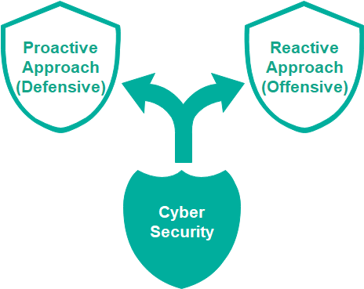
Kyambogo University
Counter measures
© Muhanguzi Tobias, 15/U/7774/ETE/PE, https://github.com/marydovika
Notes:
Technical research Cyber security general approach Cyber security mind map CBK Encryption ACs models Cyber Theats Software Dev't Life Cycle security Software assurance Risk management Competency Models, Roadmaps, and Framework s for security Infosec and DevOps Vulnerability assessment, and artifact handling. Network security Understanding the physical network/ topology Device configuration for security Disable some inactive protocols Security attack window for 5G, IoT and Cloud computing. Hardware and software security tools:: honey pots, DMZ Fire Walls, IDS +IPS, VPNs, and VLANs, IPsec... Recovery handling 5G study 5G architecture according to 5GPPP 5G players :: | ITU | |3GPP| |5GPPP| |China mobile| |AT&T| |Korea| Major enablers :: SDN-slicing & it's need :: NFV-virtualization & it's need :: IoT, RFID, NFC and bigdata dilemma 5G security architecture Construction model according to 5GPPP New attack window due to NFV, and SDN + threats Counter measures Encryption techniques for 5G Cloud computing study Cloud computing architecture Enablers Construction model Cloud computing security architecture Construction model Threats and attack window Counter measures and policy regulations Incidences of attacks IoT study IoT architecture Enablers Construction model approaches:: service--PaaS, SaaS, XaaS, development--public, private, hybrid IoT security architecture Construction model Threats and attack window Counter measures and policy regulation Incidences Practical activity Cyber Security Tools, counter measures Proactive/ defensive tools :: according to cert.ug cc :: Security Audits or Assessments, according to guidelines :: character substitution password login application Infosec :: encryption algorithms for wireless networks :: pin hardening transportation application. online protection :: malware script for phishing Configuration and Maintenance of Security Development of Security Tools :: munged password application in python Intrusion Detection Services using snort, wireshark Security-Related Information Dissemination. Reactive/ Offensive tools Kali Linux operating system tools/ "backtrack" Social Engineering Alerts and Warnings:: pentesting models Incident Handling, Incident analysis, Incident response support, Incident response coordination, Incident response on site Vulnerability Handling, Vulnerability analysis, Vulnerability response, Vulnerability response coordination

Slide 23
Kyambogo University
Cyber security counter measures
Proactive/ Defensive tools
Security Audits or Assessments, according to guidelines :: character substitution password login application Infosec :: encryption algorithms for wireless networks :: pin hardening tranlation application. online protection :: malware script for phishing Configuration and Maintenance of Security Development of Security Tools :: munged password application in python Intrusion Detection Services using snort, wireshark Security-Related Information Dissemination.
© Muhanguzi Tobias, 15/U/7774/ETE/PE, https://github.com/marydovika

Slide 24
Kyambogo University
Reactive/ Offensive tools
Kali Linux operating system tools/ "backtrack" Social Engineering Alerts and Warnings:: pen-testing models Incident Handling, Incident analysis, Incident response support, Incident response coordination, Incident response on site Vulnerability Handling, Vulnerability analysis, Vulnerability response, Vulnerability response coordination Recovery handling
© Muhanguzi Tobias, 15/U/7774/ETE/PE, https://github.com/marydovika

Slide 25
Kyambogo University
Law and policy for Cyber security
Attack history statistics and their impact
Ug-Cert operations
GDPR
Other policies, relating to cyber security in Uganda, and a model country
© Muhanguzi Tobias, 15/U/7774/ETE/PE, https://github.com/marydovika

Slide 26
Kyambogo University
Estimated budget for the project
The following will be incurred as the project goes on to completion
Item | Amount (Uganda Shillings)
LAPTOP | 2,400,000
TEXT BOOKS | 220,000
SOFTWARE | 300,000
Total | 559,500
© Muhanguzi Tobias, 15/U/7774/ETE/PE, https://github.com/marydovika

Slide 27
Kyambogo University
Proposed project schedule
2018/2019 | 2018 |  |  |  |  | 2019
 | Aug | Sept | Oct | Nov | Dec | Jan | Feb | March | April | May
Research
Matlab programming
Proposal writing
Presentation of Topic
Introduction to Cyber security
Python programming
Kali Linux
Policy research
Presentation
Report Writing
© Muhanguzi Tobias, 15/U/7774/ETE/PE, https://github.com/marydovika

Slide 28
Kyambogo University
References
https://www.offensive-security.com/kali-linux-arm-images/
https://github.com/offensive-security/kali-arm-build-scripts
© Muhanguzi Tobias, 15/U/7774/ETE/PE, https://github.com/marydovika

Slide 29
Kyambogo University
Thank you
© Muhanguzi Tobias, 15/U/7774/ETE/PE, https://github.com/marydovika

