Slide 1


Kyambogo University
Faculty Of Engineering
Department Of Electrical And Electronics Engineering
Bachelor Of Engineering In Telecommunication Engineering
Cyber security evaluation and mitigation for future wireless networks, 5G for IoT and cloud computing networks
Final Year Project Proposal, EE421
By: Muhanguzi Tobias, CCNA, IEEE, ISOC.
15/U/7774/ETE/PE
Supervisor: Mr. Kitone Isaac

Slide 2
Kyambogo University
Abstract
5G is proposed to be launched by 2020. 5G and other subsequent next generation networks will be characterized by; low latency, improved throughput, low transmit-recieve power, and consequently improved QoS. mmwave, MU-MIMO, SDR(C-RAN), MEC, NFV, and SDN are the technologies that have been proposed , with IoT and Cloud computing as the major enablers. Due to softwarization (SDN), and network slicing(NFV), new cyber security threat vectors, are introduced. For 5G to be cloud native and support IoT, will require a proper security architecture be developed to ensure total QoS. In this paper, I will cover; (1) The basic cyber security concepts, like; risk management, assurance, secSDLC models, encryption and ACs models, the 5G, IoT and Cloud computing security architectures/frameworks, and cyber policy of Uganda, and the USA. (2) For each of the architectures, I shall demonstrate the countermeasures to the threat vectors cited, demonstrate network security techniques , and encryption algorithms. The former will be theoretical, while the latter will be a practical demo of cyber security tools, ie Defensive (Proactive), and Offensive (Reactive).
Key terms: secSDLC, 5G, 3GPP, 5GPPP, mmwave, MEC, NFV, SDN, SDR, IoT, ACs, eMBB, mMTC, uRLLC, PaaS, IaaS, SaaS, smart city, smart grid, smart home, etc
© Muhanguzi Tobias, 15/U/7774/ETE/PE, https://github.com/marydovika

Slide 3
Kyambogo University
Background
The development in IoT and Cloud services have raised the need for a network the can support theses services, 2G, 3G and 4G where not developed for these future QoS demands. The major enablers for 5G are; cloud computing and IoT. 5G is on trial in most parts of Africa, including Uganda, as per the time of carrying out this research(2018). There are four fundamental requirements for a modern communication network, which include, Data rate/throughput capacity, Processing power of network equipment, Functional Redundancy and ether channels, and most importantly cyber-security, all of which contribute to QoS Realization. Security of huge amounts of data (big data) on 5G, IoT, and Cloud computing networks, should be handled with great concern. Due to the rise of cyber crimes , the field of cyber security has grown in the recent years, with well defined CBK, and approaches.
© Muhanguzi Tobias, 15/U/7774/ETE/PE, https://github.com/marydovika

Slide 4
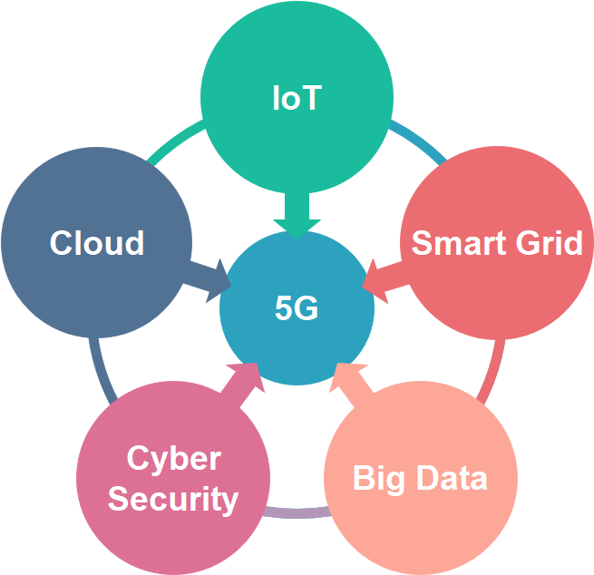
Kyambogo University
Background cont’d | Big picture
IoT is the network of physical objects not limited to devices, vehicles, buildings, and other items embedded with electronics, software, sensors, and network connectivity that enables these objects to collect and exchange data[4]
A Smart Grid is an electricity network that can intelligently integrate the actions of all users connected to it - generators, consumers and those that do both in order to efficiently deliver sustainable, economic and secure electricity supplies [5]
Internet of Things (IoT), creates a lot more data to manage and secure, plus the fact that we have expanded storage capacity and storage services through the cloud and virtualization, this has led to the exponential growth of data. This data has created a new area of interest in technology and business called “Big Data".[6]
The fundamental efforts of cyber security practices, are Confidentiality, Integrity, and Availability (CIA Triad)
Picture source, 5GPPP [1]
[2]
.5G
uRLLC
Source [3]
eMBB
mMTC
. Cloud computing is a model for enabling convenient, on-demand network access to a shared pool of configurable computing resources (e.g., networks, servers, storage, applications, and services) that can be rapidly provisioned and released with minimal management effort or service provider interaction. [7]
© Muhanguzi Tobias, 15/U/7774/ETE/PE, https://github.com/marydovika
Others

Slide 5
Kyambogo University
Problem statement
The increasing demands for real-time communication/ streaming 4k videos, gaming , VR, MR and AR and IoT (smart home, smart grid, smart city, v2x) that put a constraint on traditional storage, raising need for cloud computing. The data on a network includes personal health data, agriculture, education, e-government, e-commerce including, the increasing electronic money transfers etc, with the effort of the government to digitize all communication. All these services , and efforts generate huge amounts of data, Big-data, this poses a problem ensuring cyber security. I have singled out cyber-security to be the focus of this paper. The security of data on the network both in transit, and in cloud has to be handled with great concern. 5G is proposed to be rolled-out by 2020, I advocate for a secure architecture, by reviewing the security frameworks and models.
© Muhanguzi Tobias, 15/U/7774/ETE/PE, https://github.com/marydovika

Slide 6
Kyambogo University
Objectives
General Objectives;
To carry out Cyber security evaluation and mitigation for future wireless networks, 5G for IoT and cloud computing networks.
Specific Objectives;
To carry out research on cyber security risk management, models, frameworks, and roadmap.
To carry out research on encryption algorithms of wireless networks, and Access control models.
To carry out research on 5G, IoT and Cloud network architecture.
To develop two MATLAB Applications; one that hinds the characters of a password on login and implements minimum login requirements , and another that generates munged passwords to ensure password hardening.
To perform network security hardening and monitoring.
To carry out research on cyber security policies both national and international.
© Muhanguzi Tobias, 15/U/7774/ETE/PE, https://github.com/marydovika

Slide 7
Kyambogo University
Justification
The two major enablers for 5G are NFV, and SDN, and is the ideal network for IoT and cloud computing networks. The network virtualization and softwarization introduces new attack vectors, that will require different Countermeasures. Therefore it is worth it, to review the proposed 5G security architecture. Uganda is currently in 5G trial stages. Most start-ups are implementing cloud systems, and IoT systems, like automation of different activities in health, agriculture, power grid, government( CCTV public surveilance cameras) and mobile banking/mobile money and education(e-learning platforms ) all of which require a fast connectivity achieved by 5G cellular networks. Security of data should be ensured, hackers can cost a company a great deal of money, reputation, and test its competence to protecting the information of its customers.i
i.https://en.wikipedia.org/wiki/Sony_Pictures_hack
© Muhanguzi Tobias, 15/U/7774/ETE/PE, https://github.com/marydovika

Slide 8
Kyambogo University
Significance of the study
This study will create a practical understanding of cyber security, policies and practices that include Computer security, Security Systems Software Development Life Cycle (secSDLC), and Network security for the future wireless networks (IoT and Cloud)
© Muhanguzi Tobias, 15/U/7774/ETE/PE, https://github.com/marydovika

Slide 9
Kyambogo University
Scope of the project
The following activities will be carried out during the course of the project:
Cyber security concept research
Research about (secSDLC), ACs and Cyber Security risk management models
Demonstration of Wireless Encryption algorithms, and MUNGED passwords with MATLAB
Cyber security policies, including the GDPR, and CERT.UG activity review
5G, IoT cyber security and cloud computing network security concerns and countermeasures with focus on; SDN, and Virtualization security
5G security architecture, Cloud computing security architecture, IoT security architecture
Network cyber security
Penetration testing, social engineering and vulnerability tests with kali linux for wireless networks (Ethical hacking).[8][9]
Security in the network layer with wireshark, Snort (IDS/IPS, honey pots, DNZ ) with GNS3 simulation
python programming for Security
© Muhanguzi Tobias, 15/U/7774/ETE/PE, https://github.com/marydovika

Slide 10
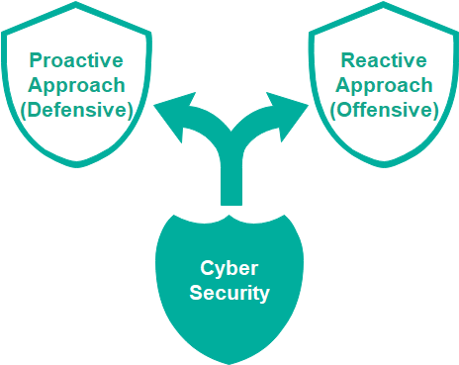
Kyambogo University
Scope of the project cont’d
Counter measures
© Muhanguzi Tobias, 15/U/7774/ETE/PE, https://github.com/marydovika

Slide 11
Kyambogo University
Methodology
Summary of methods
Objectives | Method | Description
To carry out research on cyber security risk management, models, frameworks, and roadmap | Text books, cyber security websites, consultations | Cyber Security Engineering by Nancy R. Mead and Carol C. Woody
To carry out research on encryption algorithms of wireless networks, and Access control models. | Text books, cyber security websites, consultations | Cyber Security Engineering by Nancy R. Mead and Carol C. Woody
To carry out research on 5G, IoT and Cloud network architecture. | Text books, cyber security websites, tutorials, | Accessing the 5GPPP, 3GPP websites
To develop two MATLAB Applications; one that hinds the characters of a password on, and another that generates munged passwords | Text books, and website, tutorials, consultations | Accessing the MATWORKS website
To perform network security hardening and monitoring. | Tutorials, surfing internet | Simulation using Kali Linux, Snort, Wireshark and GNS3
To carry out research on cyber security policies both national and international. | Trainings, workshops, meetups, tutorials, consultations, questionnaires | Carrying out apprenticeship at CERTUganda CERT (NITA-Uganda, CERT/CC) and (UCC CERT)
© Muhanguzi Tobias, 15/U/7774/ETE/PE, https://github.com/marydovika

Slide 12
Kyambogo University
Methodology cont’d
Research phase:
Information about Cyber security orange book, X.800, CBK-Common Body of Knowledge, Encryption, ACs models, Security Software Development Life Cycle. Software assurance, Competency levels, and Risk management Models, Roadmaps, and Framework. Infosec and DevOps, Vulnerability assessment, patch management, and artifact handling. Cyber Threats. and information about 5G, IoT and Cloud security architectures will be gathered from text books, and online CERT websites and 5GPPP, 3GPP etc.
Information about Attack history statistics and their impact, Law and policy for Cyber security will be got from Uganda CERT (NITA-Uganda, CERT/CC) and (UCC CERT on their website and by carrying out apprenticeship at CERT
Attack history and public security information dissemination with include; Incident Handling, Incident analysis, Incident response support, Incident response coordination, Incident response on site, Vulnerability Handling, Vulnerability analysis, Vulnerability response, Vulnerability response coordination (Alerts and Warnings, to customers), Recovery handling
© Muhanguzi Tobias, 15/U/7774/ETE/PE, https://github.com/marydovika

Slide 13
Kyambogo University
Methodology cont’d
Simulation and design phase:
Simulation of security network architectures will be done using GNS3, to ..demonstrate honey pots, DMZ, Fire Walls, VPNs, and VLANs [10]
Snort will be used to demonstrate IDS and IPS to secure networks
Wireshark will be used as a security monitoring tool for network monitoring
© Muhanguzi Tobias, 15/U/7774/ETE/PE, https://github.com/marydovika

Slide 14
Kyambogo University
Methodology cont’d
Application development phase:
Developing a Character substitution and Pin hardening on login pages for cloud and IoT APIs with Matlab and python. Development of Security Tools; MUNGED passwords application with Matlab and python.
© Muhanguzi Tobias, 15/U/7774/ETE/PE, https://github.com/marydovika

Slide 15
Kyambogo University
Estimated budget for the project
The following will be incurred as the project goes on to completion, source of income is from Indian Women Association Uganda, my sponsors who gave me 2million Uganda shillings.
Item | Amount (Uganda Shillings)
LAPTOP | 1,400,000
TEXT BOOKS | 220,000
SOFTWARE | 300,000
Total | 1,920,000
© Muhanguzi Tobias, 15/U/7774/ETE/PE, https://github.com/marydovika

Slide 16
Kyambogo University
Proposed project schedule
2018/2019 | 2018 |  |  |  |  | 2019
 | Aug | Sept | Oct | Nov | Dec | Jan | Feb | March |  | April | May
Research/ Title selection
Title submission/ Approval
Proposal writing
Proposal Presentation
Literature Review
Programming
Kali Linux tool practice
Policy Research
Program Testing
Report Writing
Presentation
© Muhanguzi Tobias, 15/U/7774/ETE/PE, https://github.com/marydovika

Slide 17
Kyambogo University
References
[1] https://5g-ppp.eu/white-papers/
[2] http://www-file.huawei.com/-/media/CORPORATE/PDF/white%20paper/
….5g_security_architecture_white_paper_en-v2.pdf?la=en
[3] https://www.huawei.com/en/press-events/news/2016/2/Demonstrate-5G-E2E-Network-Slicing-Technology
[4] https://www.survivingwithandroid.com/2016/06/iot-project-tutorial-smart-plant-system.html
[5] https://en.wikipedia.org/wiki/European_Technology_Platform_for_the_Electricity_Networks_of_the_Future
[6] Big Data For Dummies by Judith Hurwitz, Alan Nugent, Dr. Fern Halper, and Marcia Kaufman
[7] https://www.nist.gov/
[8] https://github.com/offensive-security/kali-arm-build-scripts
[9] https://www.offensive-security.com/kali-linux-arm-images/
[10] Handbook Of Security And Networks, editors Yang Xiao, Frank H Li, Hui Chen ISBN-13 978-981-4273-03-9
[11] Cyber Security Engineering A Practical Approach for Systems and Software Assurance, Nancy R. Mead and …...Carol C. Woody, ISBN-13: 978-0-134-18980-2
© Muhanguzi Tobias, 15/U/7774/ETE/PE, https://github.com/marydovika

Slide 18
Kyambogo University
Thank you
© Muhanguzi Tobias, 15/U/7774/ETE/PE, https://github.com/marydovika

