Slide 1


Kyambogo University
Faculty Of Engineering
Department Of Electrical And Electronics Engineering
Bachelor Of Engineering In Telecommunication Engineering
Cyber security evaluation and mitigation for future wireless networks,5G, IoT and cloud storage networks
(An Offensive and Defensive Technical Approach)
Final Year Project Proposal, EE421
By: Muhanguzi Tobias, CCNA, IEEE, ISOC. 15/U/7774/ETE/PE
Supervisor: Mr. Kitone Isaac

Slide 2
Kyambogo University
Abstract
In the near future, after, 2020 when 5G has been launched, 5G and the next generation networks will be characterized by; low latency, improved throughout, low transmit-recieve power, and * consequently improved QOS. This has been proposed to be achieved by, mmwave, MU-MIMO, SDR(C-RAN), MEC, NFV, and SDN, with IoT and Cloud computing as major enablers. Due to softwarization ie SDN, and network slicing ie NFV, new cyber security threat vectors, are introduced. On that issue, 5G will be the cellular radio for IoT, and cloud computing networks to ensure total QoS, a proper security architecture should be developed. In this paper, I will cover; (1) The basic cyber security concepts, like; risk management, assurance, secSDLC models, encryption and ACs models, the 5G, IoT and Cloud computing security architectures/frameworks, and cyber policy of Uganda, and the USA. (2) For each of the architectures, I shall demonstrate the countermeasures to the threat vectors cited, demonstrate network security techniques , and encryption algorithms. Part (1) will be theoretical, and Part (2) will be a practical demo of cyber security tools, ie Defensive (Proactive), and Offensive (Reactive).
Key terms: secSDLC, 5G, 3GPP, 5GPPP, mmwave, MEC, NFV, SDN, SDR, IoT, ACs, eMBB, mMTC, uRLLC, PaaS, IaaS, SaaS, smart city, smart grid, smart home, etc
© Muhanguzi Tobias, 15/U/7774/ETE/PE, https://github.com/marydovika

Slide 3
Kyambogo University
Background
5G will be the network for the future QoS demands, with the major enablers being; cloud services and IoT. 5G is on trial in most parts of Africa, including Uganda as per the time of carrying out this research(2018). There are four fundamental requirements for a modern communication network, which include, Data rate/throughput capacity, Processing power of network equipment, Functional Redundancy and ether channels, and most importantly cyber-security, all of which contribute to QoS Realization. Security of huge amounts of data (big data) on 5G, IoT, and Cloud computing networks and storage, should be handled with great concern. However, the field of cyber security has grown in the recent years, due to the rise of cyber crimes with well defined CBK, and approaches.
© Muhanguzi Tobias, 15/U/7774/ETE/PE, https://github.com/marydovika

Slide 4
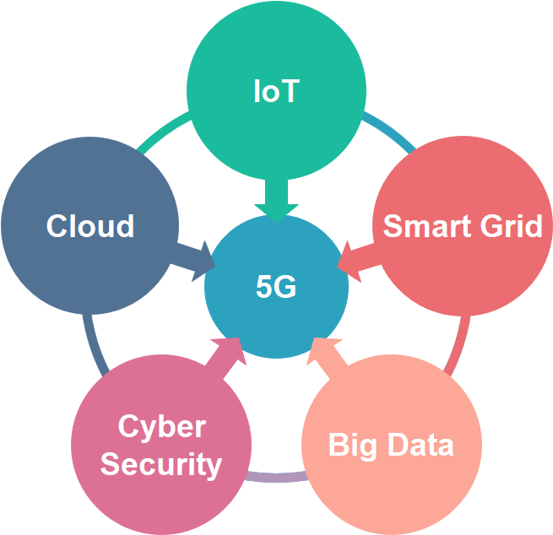
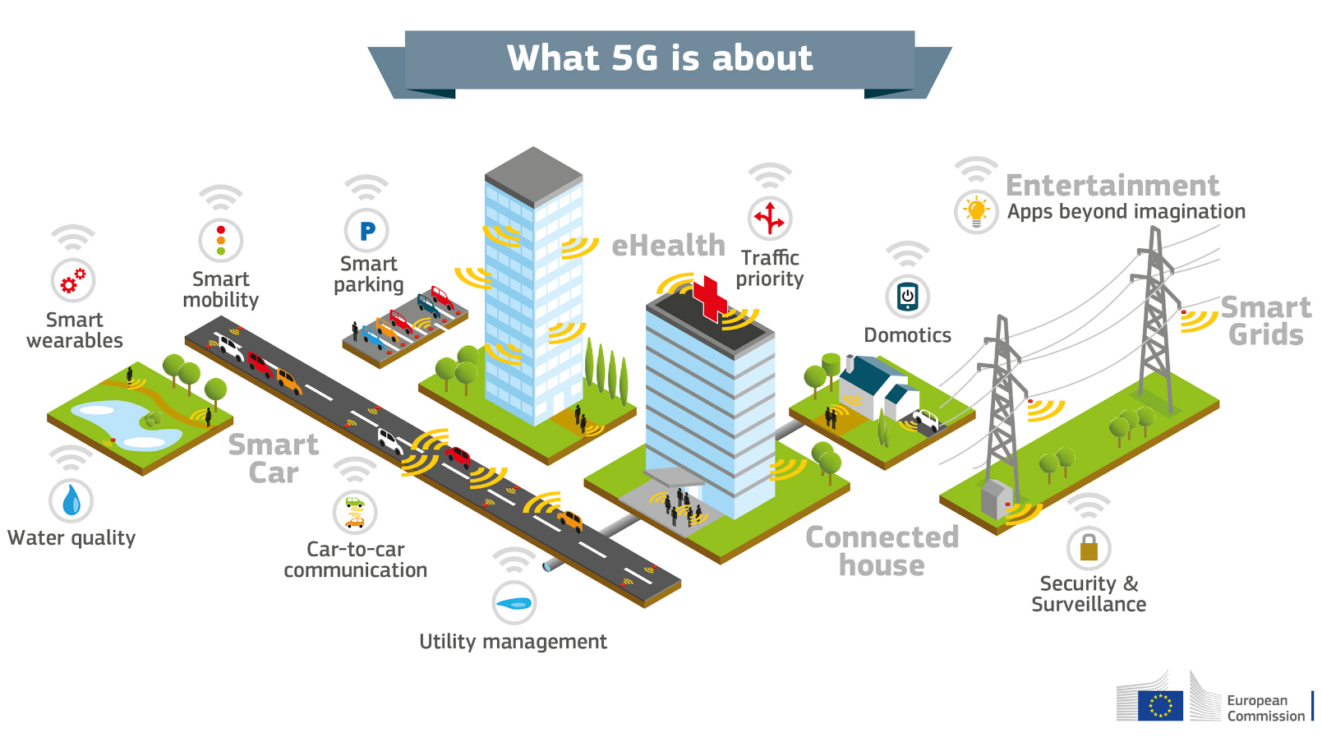
Kyambogo University
Background | Big picture
Picture source, 5GPPP [1]
© Muhanguzi Tobias, 15/U/7774/ETE/PE, https://github.com/marydovika

Slide 5
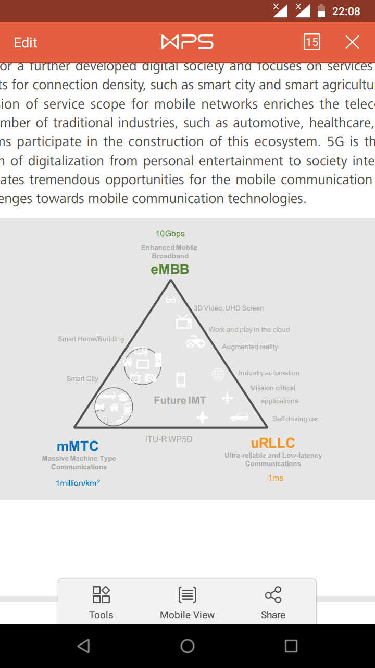
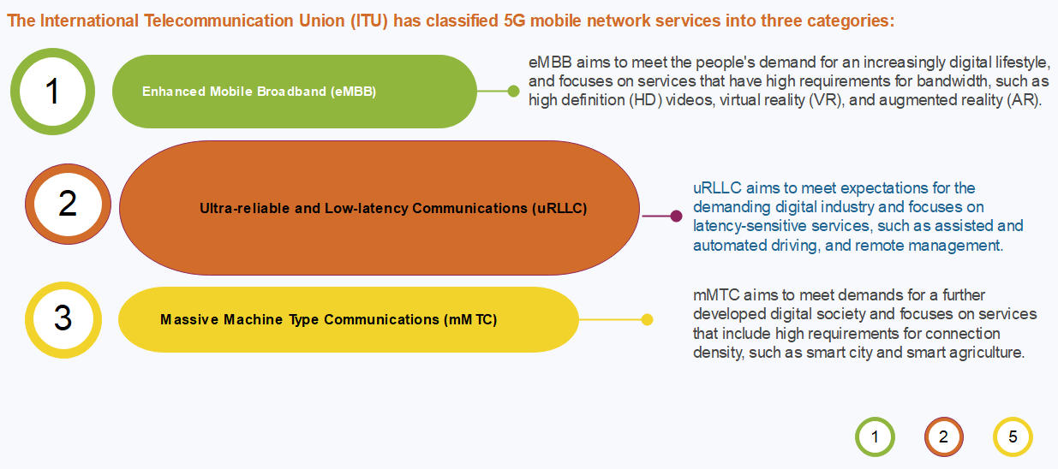
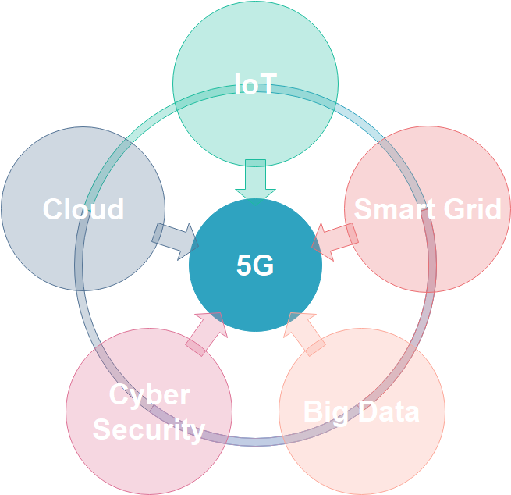
Kyambogo University
Background | Big picture…cont’d
Insert some details on 5G
mMTC
mMTC
uRLLC
Source, [3]
IEEE 802.11ac, Picture source Huawei corporation [2]
Others
© Muhanguzi Tobias, 15/U/7774/ETE/PE, https://github.com/marydovika

Slide 6
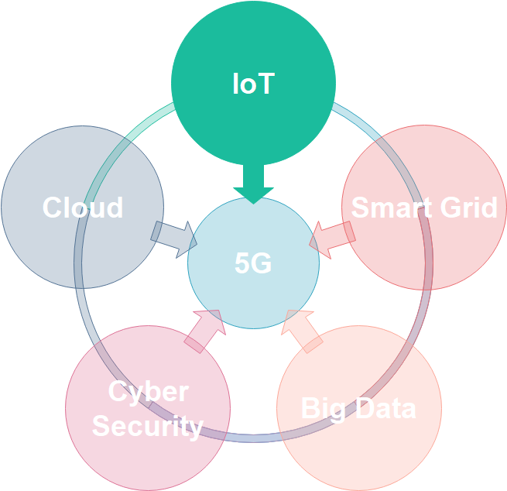
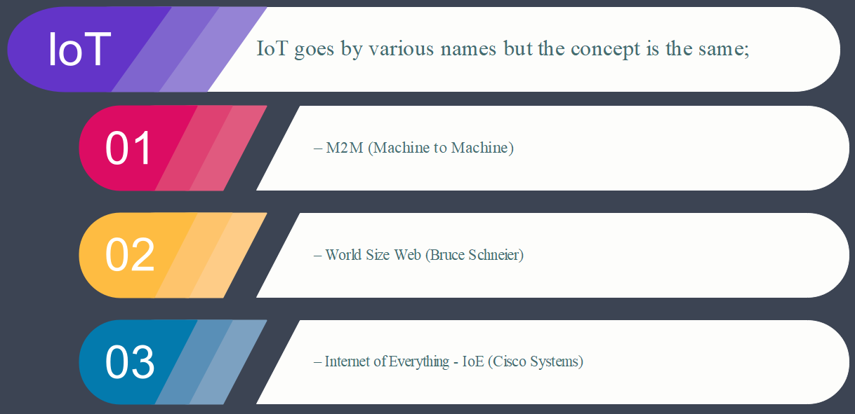
Kyambogo University
Background | Big picture…cont’d
IoT is the network of physical objects not limited to devices, vehicles, buildings, and other items embedded with electronics, software, sensors, and network connectivity that enables these objects to collect and exchange data[4]
© Muhanguzi Tobias, 15/U/7774/ETE/PE, https://github.com/marydovika

Slide 7
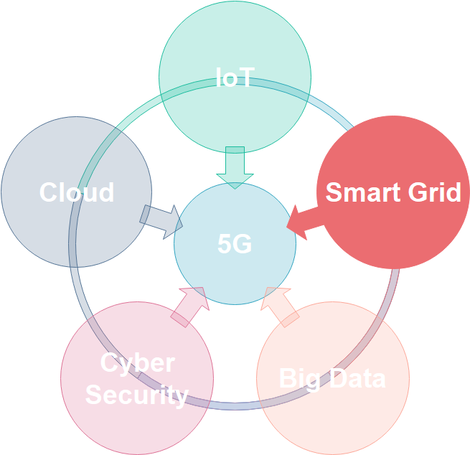
Kyambogo University
Background | Big picture…cont’d
A Smart Grid is an electricity network that can intelligently integrate the actions of all users connected to it - generators, consumers and those that do both—in order to efficiently deliver sustainable, economic and secure electricity supplies [5]
© Muhanguzi Tobias, 15/U/7774/ETE/PE, https://github.com/marydovika

Slide 8

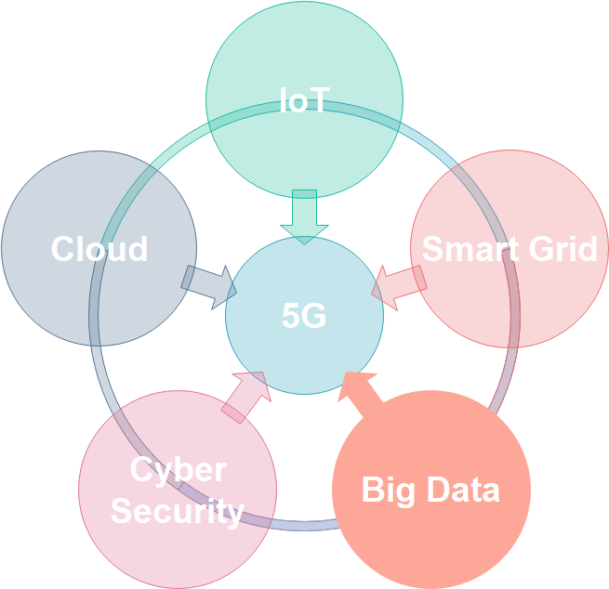
Kyambogo University
Background | Big picture…cont’d
With the emergence of the Internet of Things (IoT), there is a lot more data to manage and secure, plus the fact that we have expanded storage capacity and storage services through the cloud and virtualization, this has led to the exponential growth of data. This data has created a new area of interest in technology and business called “Big Data". With the velocity, volume, and variety of data generated by the IoT and the daily operations of business, the confidentiality, integrity and availability of this data is vital to the survival of the organization.[6]
© Muhanguzi Tobias, 15/U/7774/ETE/PE, https://github.com/marydovika

Slide 9
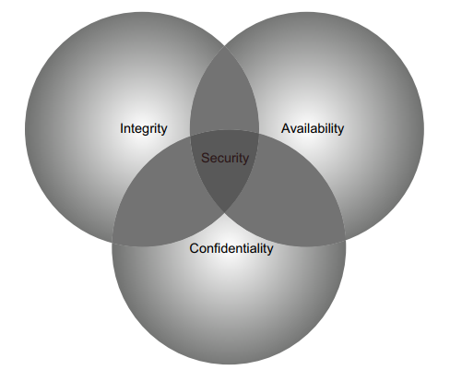
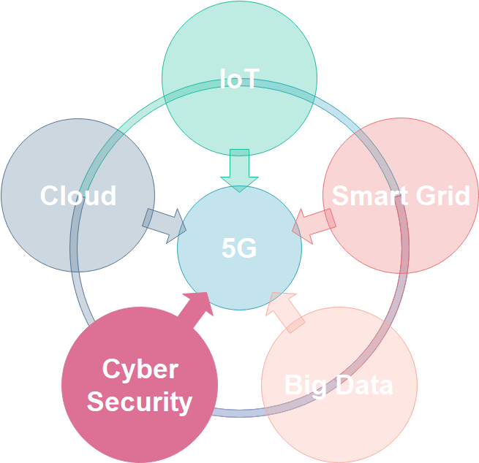
Kyambogo University
Background | Big picture…cont’d
© Muhanguzi Tobias, 15/U/7774/ETE/PE, https://github.com/marydovika

Slide 10
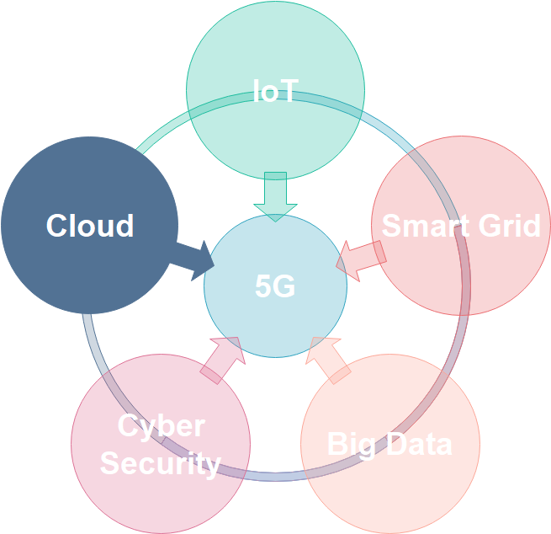
Kyambogo University
Background | Big picture…cont’d
Definition from NIST (National Institute of Standards and Technology) Cloud computing is a model for enabling convenient, on-demand network access to a shared pool of configurable computing resources (e.g., networks, servers, storage, applications, and services) that can be rapidly provisioned and released with minimal management effort or service provider interaction. This cloud model promotes availability and is composed of five essential characteristics, three service models, and four deployment models.[7]
© Muhanguzi Tobias, 15/U/7774/ETE/PE, https://github.com/marydovika

Slide 11
Kyambogo University
Problem statement
The increasing demands for real-time communication/ streaming 4k videos, gaming , VR, MR and AR and IoT/ IoE (smart home, smart grid, smart city, v2x) that put a constraint on traditional storage, raising need for cloud computing. The data on a network includes personal health data, agriculture, education, e-government, e-commerce including, the increasing electronic money transfers etc. All together with the effort of the government to digitize all communication, all these services , and efforts generate huge amounts of data, Big-data, this poses a problem ensuring security, CIA Triad. I have singled out cyber-security to be the focus of this paper. All said, the security of data put on the network; in transit, and in cloud and other storage servers has to be handled with great concern. With the proposed 5G network to be rolled-out by 2020, I advocate for a secure architecture, by reviewing the security layers.
© Muhanguzi Tobias, 15/U/7774/ETE/PE, https://github.com/marydovika

Slide 12
Kyambogo University
Objectives
General Objectives;
Cyber security evaluation and mitigation for future wireless networks, 5G, IoT and cloud storage networks (an Offensive and Defensive Technical Approach)
Specific Objectives;
To carry out research on cyber security risk management, models, frameworks, and roadmap.
To carry out research on encryption algorithms of wireless networks, and Access control models.
To carry out research on 5G, IoT and Cloud network architecture.
To develop two MATLAB Applications; one that hinds the characters of a password on login and implements minimum login requirements , and another that generates munged passwords to ensure password hardening.
To carry out research on cyber security policies.
© Muhanguzi Tobias, 15/U/7774/ETE/PE, https://github.com/marydovika

Slide 13
Kyambogo University
Justification
5G has two major enablers which are NFV, and SDN, and is the idle network for IoT and cloud storage networks. The network virtualization and softwarization introduces new attack vectors, that will require different Countermeasures, like Authentication, Access control models, etc. Therefore it is worth it, to review the proposed 5G security architecture. Considering the fact that Uganda is preparing for 5G roll out, currently in trial versions, Start-ups are implementing cloud systems, and IoT systems, like automation of different activities in health, agriculture, power grid, government( CCTV public surveilance cameras) and mobile banking/mobile money and education(e-learning platforms ) all of which require internet connectivity (cellular 5G connectivity) , security of data transfers should be secured, hackers can cost a company a great deal of money, reputation, and test its competence to protecting the information of its customers.
© Muhanguzi Tobias, 15/U/7774/ETE/PE, https://github.com/marydovika

Slide 14
Kyambogo University
Significance of the study
This study will Create a practical understanding of cyber security, policies and practices that accrue to Computer security, Security Systems Software Development Life Cycle (secSDLC), Network security for the future wireless networks that carry customer critical data used and generated by IoE, IoT, and in the Cloud.
© Muhanguzi Tobias, 15/U/7774/ETE/PE, https://github.com/marydovika

Slide 15
Kyambogo University
Scope of the project
The following practical activities will be carried out during the course of the project:
Wireless Encryption algorithms, munged passwords with MATLAB
History of hacking and Ethical hacking.
Tools used in penetration testing, social engineering and vulnerability tests with kali linux for wireless networks.[8][9]
Cyber Security management models with GNS3 simulation (secSDLC)
Security with python programming.
Security in the application layer and network layer (ipv4 and ipv6) analysis with wireshark, Snort (Network security systems, IDS/IPS, honey pots, DNZ, TLS, NTPSec, IPSec, DNSSec).
5G, IoT (NFC, Smart grid) cyber security and cloud storage security concerns and countermeasures
Cyber security policies, including the GDPR. And UGCERT activity review
© Muhanguzi Tobias, 15/U/7774/ETE/PE, https://github.com/marydovika

Slide 16
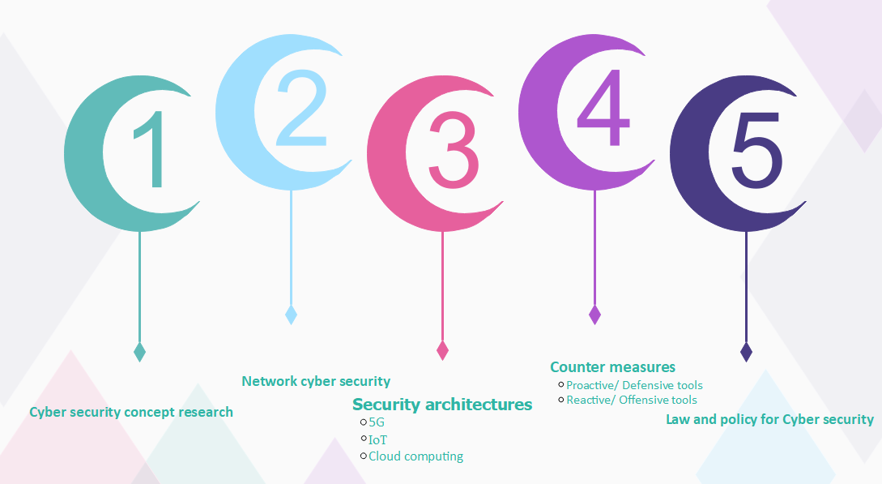
Kyambogo University
Methodology
© Muhanguzi Tobias, 15/U/7774/ETE/PE, https://github.com/marydovika

Slide 17
Kyambogo University
cyber security concept research
Cyber security mind map
The orange book
X.800 CBK-Common Body of Knowledge-CISSP, Encryption, ACs models Security Software Development Life Cycle. Software assurance, Risk management, Competency, Models, Roadmaps, and Framework. Infosec and DevOps, Vulnerability assessment, patch management, and artifact handling.
Cyber Theats.
© Muhanguzi Tobias, 15/U/7774/ETE/PE, https://github.com/marydovika

Slide 18
Kyambogo University
Network cyber security
Understanding the physical network/ topology Device configuration for security, and disabling inactive protocols Security attack window for 5G, IoT and Cloud computing. Hardware and software security tools; honey pots, DMZ, Fire Walls, IDS +IPS, VPNs, and VLANs, IPsec... [10]
© Muhanguzi Tobias, 15/U/7774/ETE/PE, https://github.com/marydovika

Slide 19
Kyambogo University
5G
5G architecture according to 5GPPP 5G players; ITU, 3GPP, 5GPPP, China mobile, AT&T, Korea Major enablers
SDN-slicing & it's need
NFV-virtualization & it's need
IoT, RFID, NFC and bigdata dilemma
5G security architecture Construction model according to 5GPPP New attack vectors due to NFV, and SDN + threats Counter measures Encryption techniques for 5G
© Muhanguzi Tobias, 15/U/7774/ETE/PE, https://github.com/marydovika

Slide 20
Kyambogo University
IoT
IoT architecture Enablers Construction model
IoT security architecture Construction model Threats and attack window Counter measures and policy regulation Incidences
© Muhanguzi Tobias, 15/U/7774/ETE/PE, https://github.com/marydovika

Slide 21
Kyambogo University
Cloud computing
Cloud computing architecture Enablers Construction model approaches:
service model--PaaS, SaaS, IaaS, XaaS
deployment model--public, private, hybrid
Cloud computing security architecture Construction model Threats and attack window Counter measures and policy regulations Incidences of attacks
© Muhanguzi Tobias, 15/U/7774/ETE/PE, https://github.com/marydovika

Slide 22
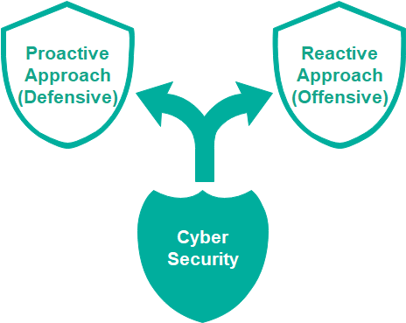
Kyambogo University
Counter measures
© Muhanguzi Tobias, 15/U/7774/ETE/PE, https://github.com/marydovika

Slide 23
Kyambogo University
Cyber security counter measures
Proactive/ Defensive tools
Infosec; Encryption algorithms, and 0auth. for wireless networks(WPA3)
Character substitution and Pin hardening on login pages. Online protection: Malware script for phishing, and batch programming Configuration and Maintenance and Risk management for Cyber Security Development of Security Tools; MUNGED passwords application in python Intrusion Detection and Prevention using snort, wireshark Security Related Information Dissemination by Cert.
© Muhanguzi Tobias, 15/U/7774/ETE/PE, https://github.com/marydovika

Slide 24
Kyambogo University
Reactive/ Offensive tools
Kali Linux operating system tools/ "backtrack“[8] [9] Social Engineering Pen-testing models Incident Handling, Incident analysis, Incident response support, Incident response coordination, Incident response on site Vulnerability Handling, Vulnerability analysis, Vulnerability response, Vulnerability response coordination (Alerts and Warnings, to customers) Recovery handling
© Muhanguzi Tobias, 15/U/7774/ETE/PE, https://github.com/marydovika

Slide 25
Kyambogo University
Law and policy for Cyber security
Attack history statistics and their impact
Ug-Cert operations
GDPR
Other policies and risk management, relating to cyber security in Uganda, and a model country[11]
© Muhanguzi Tobias, 15/U/7774/ETE/PE, https://github.com/marydovika

Slide 26
Kyambogo University
Estimated budget for the project
The following will be incurred as the project goes on to completion, source of income is from IWAUganda, my sponsors who gave me 2million Uganda shillings.
Item | Amount (Uganda Shillings)
LAPTOP | 1,400,000
TEXT BOOKS | 220,000
SOFTWARE | 300,000
Total | 1,920,000
© Muhanguzi Tobias, 15/U/7774/ETE/PE, https://github.com/marydovika

Slide 27
Kyambogo University
Proposed project schedule
2018/2019 | 2018 |  |  |  |  | 2019
 | Aug | Sept | Oct | Nov | Dec | Jan | Feb | March |  | April | May
Research/ Title selection
Title submission/ Approval
Proposal writing
Proposal Presentation
Literature Review
Programming
Kali Linux tool practice
Policy Research
Program Testing
Report Writing
Presentation
© Muhanguzi Tobias, 15/U/7774/ETE/PE, https://github.com/marydovika

Slide 28
Kyambogo University
References
[1] https://5g-ppp.eu/white-papers/
[2] http://www-file.huawei.com/-/media/CORPORATE/PDF/white%20paper/
….5g_security_architecture_white_paper_en-v2.pdf?la=en
[3] https://www.huawei.com/en/press-events/news/2016/2/Demonstrate-5G-E2E-Network-Slicing-Technology
[4] https://www.survivingwithandroid.com/2016/06/iot-project-tutorial-smart-plant-system.html
[5] https://en.wikipedia.org/wiki/European_Technology_Platform_for_the_Electricity_Networks_of_the_Future
[6] Big Data For Dummies by Judith Hurwitz, Alan Nugent, Dr. Fern Halper, and Marcia Kaufman
[7] https://www.nist.gov/
[8] https://github.com/offensive-security/kali-arm-build-scripts
[9] https://www.offensive-security.com/kali-linux-arm-images/
[10] Handbook Of Security And Networks, editors Yang Xiao, Frank H Li, Hui Chen ISBN-13 978-981-4273-03-9
[11] Cyber Security Engineering A Practical Approach for Systems and Software Assurance, Nancy R. Mead and …...Carol C. Woody, ISBN-13: 978-0-134-18980-2
© Muhanguzi Tobias, 15/U/7774/ETE/PE, https://github.com/marydovika

Slide 29
Kyambogo University
Thank you
© Muhanguzi Tobias, 15/U/7774/ETE/PE, https://github.com/marydovika

