Slide 1
Genetic bicycle
Gonzalo
Morad
Kazem
Mina

Slide 2
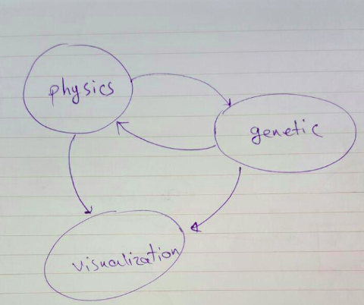
partitions
Physics
genetic
visualization

Slide 3
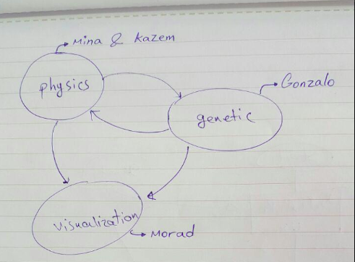

Slide 4
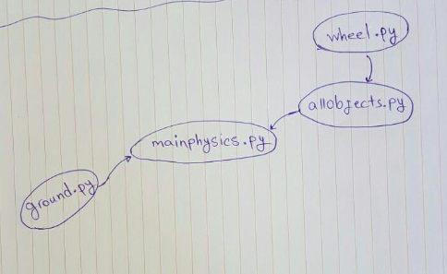
Physics

Slide 5
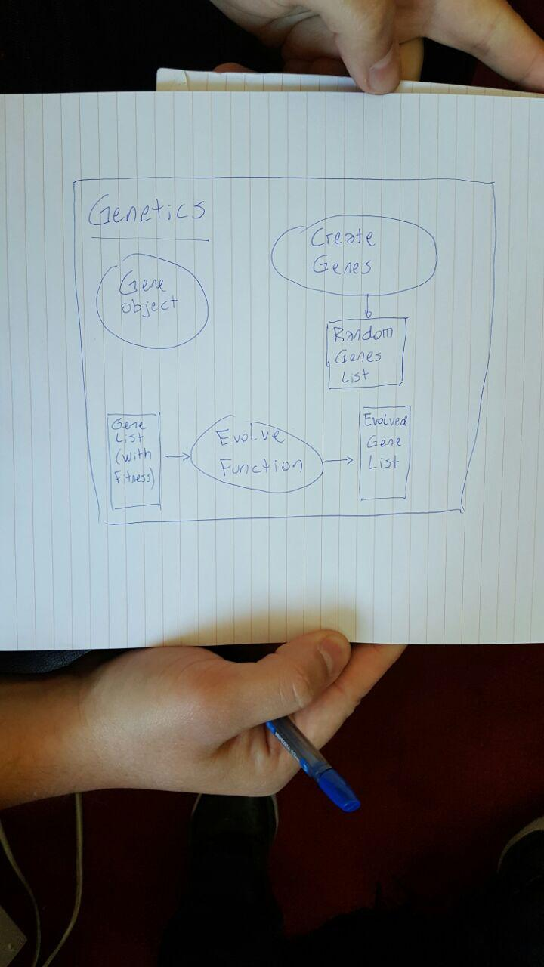
genetic

Slide 6
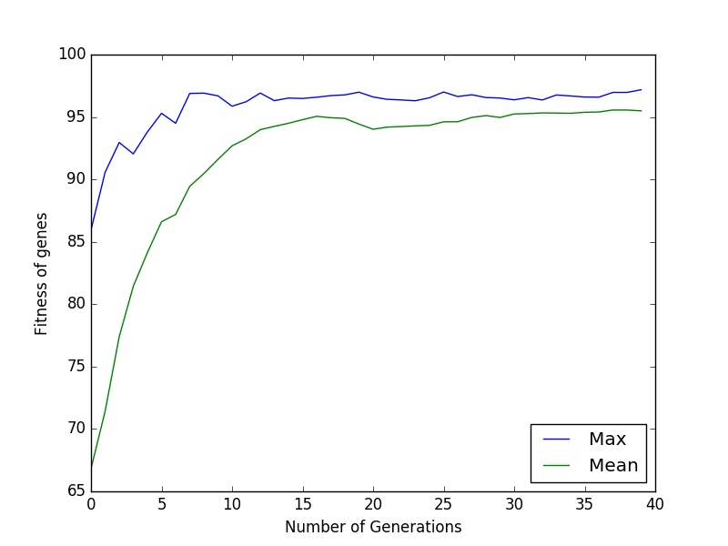
Evolve algorithm example

Slide 7
Repository
https://github.com/minazamani/geneticbicycleproject

Slide 8
