Slide 1

NORTHWIND WAREHOUSE AND PROCUREMENT ANALYSIS REPORT
NORTHWIND

Slide 2
Optimizing Procurement and Inventory Management: A Comprehensive Analysis and Strategic Insights
We will be focusing on
Proper balanced inventory levels
Discontinued products
Not moving & Over stocked products
Irregularities in order placements
Summary
Recommendations
Conclusion
NORTHWIND

Slide 3
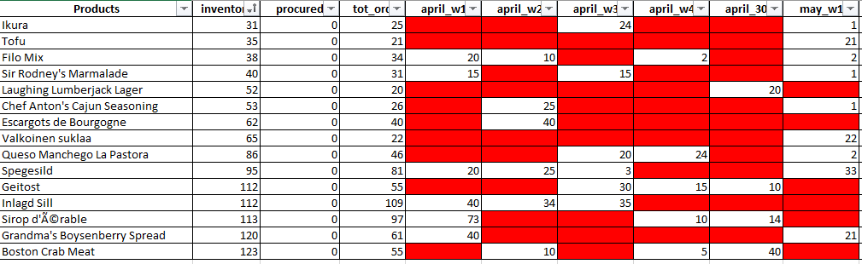
Proper and balanced inventory level
Total of 15 products found as perfectly fine to match the ongoing demand.
The sad part is that out of 74 products only 15 products are meeting the ongoing demand.
This is only 20.27% of the whole inventory.
NORTHWIND

Slide 4
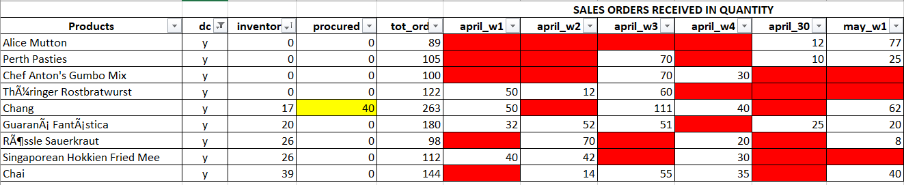
DISCONTINUED PRODUCTS
Total of 9 products found discontinued.
Is there any alternate options available to meet the ongoing demand?
Assuming that the marked 40 quantity is the last shipment and after that the product will be discontinued.
NORTHWIND

Slide 5
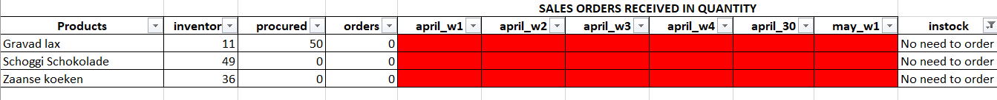
NO SALES ORDERS IN LAST 6 WEEKS
Total of 3 products found as no sales orders.
Are these products expired, missing or bad quality?
There are no demand of these products and 1 product is procured.
NORTHWIND

Slide 6
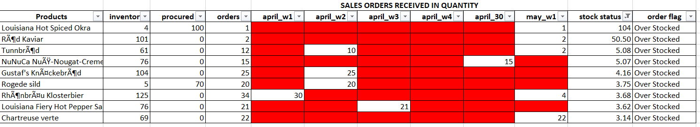
OVER STOCKED PRODUCTS
Total of 9 products found as over stocked.
The inventory levels in these products are more than 3 times of the demand.
1 product in the list is more than 100 times and 1 product is more than 50 times of the demand.
NORTHWIND

Slide 7
MIS PROCUREMENT
After closely watching data of procurement these 2 products were found mis procured.
NORTHWIND

Slide 8
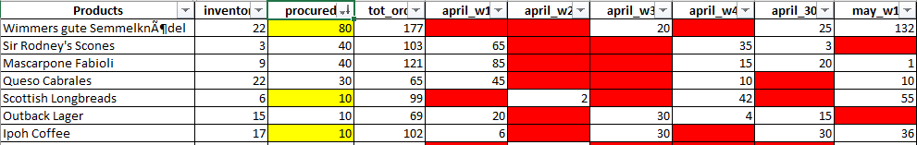
Procurement doesn’t meet the demand
Total of 7 products found as randomly procured and not keeping demand and orders in mind.
There is ongoing need of these products but not enough supplies to match the demand?
Yellow highlighted numbers are supplies on the way and it is an evidence of the point above of supplies not meeting demand. There are more orders than the supplies.
NORTHWIND

Slide 9
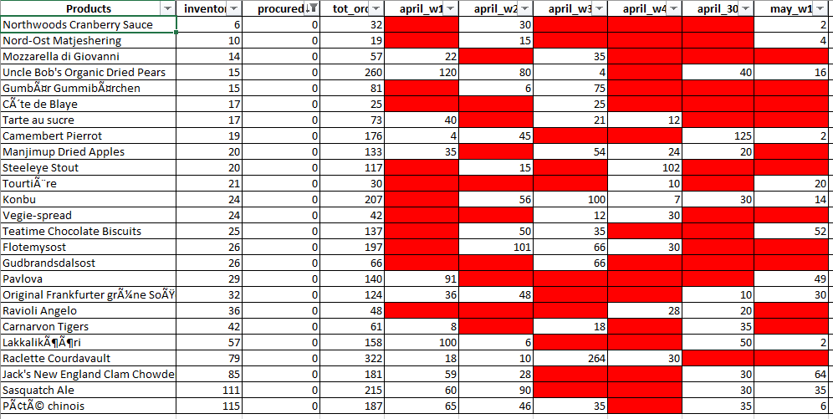
Procurement doesn’t meet the demand
This slide is the continuation of previous slide. In this slide there is urgent requirement to procure products.
Total of 25 products found as to procure urgently to meet the ongoing demand.
This is the high time to reorganize the reorder levels system as it seems that the current system is not working efficiently.
NORTHWIND

Slide 10
summary
Only 15 out of 74 products (20.27%) meet ongoing demand.
Supply shortage, random procurement and inadequate inventory levels affecting 43.24% of supplies.
Urgent need to procure 25 products to meet the demand.
9 over stocked products.
9 discontinued products and not sure if alternates are available.
NORTHWIND

Slide 11
recommendations
Utilize technology and automation tools for better demand forecasting and inventory tracking.
Strengthen supplier management and collaboration.
Reorganize the reorder levels system for more efficient operations.
Optimize reorder points and quantities to balance inventory levels and customer demand.
NORTHWIND

Slide 12
conclusion
Current procurement and inventory management practices are inadequate.
Improvements are necessary to meet customer demand, avoid revenue losses, and enhance efficiency.
Implementing recommended changes will lead to improved operations, customer satisfaction, and profitability.
NORTHWIND

Slide 13
Thank you!!
I appreciate your time and attention. For any further questions or inquiries, please feel free to reach out.
[Firoz Nagaria]
NORTHWIND

