Slide 1
AA
Notes:
© 2006 Capgemini - All rights reserved
0

Slide 2
Objective
To understand the creation of an AA Deposit Product
Creation of properties using existing Property Classes
Input an arrangement for our Deposit product

Slide 3
PRODUCT DESIGN OF AA DEPOSIT

Slide 4
Business Design
Customer Products Department has approved launch of various products based on LD module which is added to our T24 environment
Hence it is directed to set up the following basic parameters for all applications linked to this module

Slide 5
Execution of Business Design
Now let us see how we can deliver this product through AA
For this purpose, Temenos have set Product lines
For those Products can be created
Product lines available in R10 are:
Accounts
Deposits
Internet Services
Lending
Proxy Services
Other
Savings

Slide 6
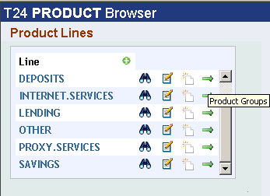
Execution of Business Design
Our requirement is to create a deposit product
Use the following link
Admin Menu -> product Builder -> Products -> (select) Deposit

Slide 7
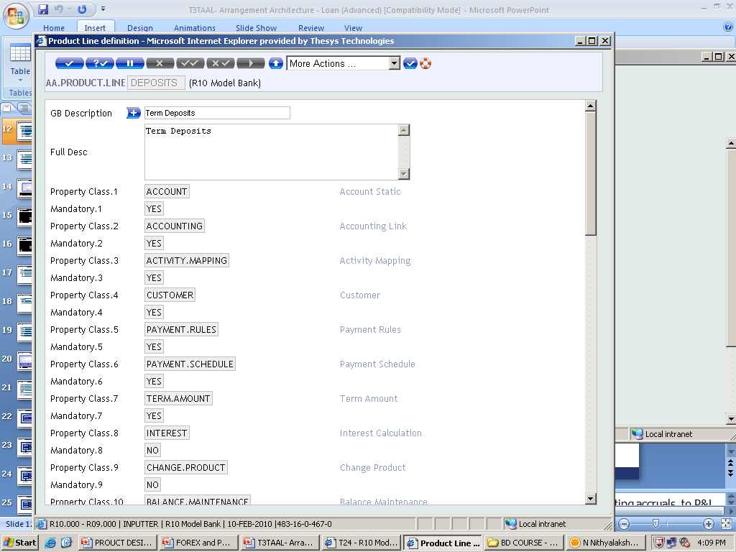
Execution of Business Design Product Line
Before we create a product, let us see the details of Product line (AA.PRODUCT.LINE)

Slide 8
Execution of Business Design Product Line
This table is hard coded by Temenos
Conditions necessary to built a deposit are defined
These condition are defined in the table Property class (AA.PROPERTY.CLASS)
Another important field defined in Product line is
Mandatory, defines whether the Property class specified is compulsory or not

Slide 9
Execution of Business Design Product Line
This depicts a deposit must have conditions like
Accounting, Interest, Payment Schedule, Tenor details (Term Amount), Customer, Account, etc
Other conditions like rollover (Change Product), Charges, etc are optional

Slide 10
Execution of Business Design Property Class
In the previous slides, we have pointed out about the Property classes
Let us discuss about them in brief
Property classes (AA.PROPERTY.CLASS) are also released by TEMENOS
Used to define Actions and Attributes for any underlying Property and Product condition

Slide 11
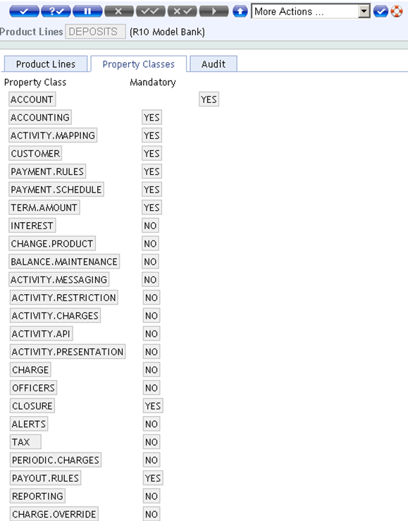
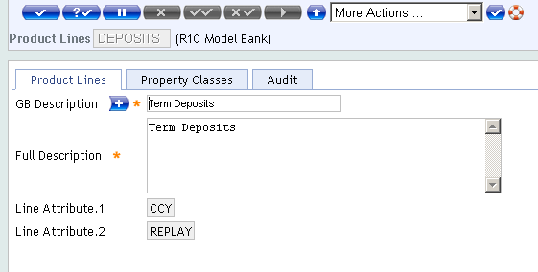
Execution of Business Design Property Class

Slide 12
Execution of Business Design Property Class
Officers
Closure
Alerts
Tax
Periodic Charges
Charge
Reporting
Charge Override
Interest
Payout Rules

Slide 13
Execution of Business Design Property Class
Property classes highlighted in Red are compulsory, without these classes, its impossible to built a deposit
Account
Accounting
Activity Mapping
Customer
Payment Rules
Payment Schedule
Term Amount
Change Product
Balance Maintenance
Activity Messaging
Activity Restriction
Activity Charges
Activity API
Activity Presentation

Slide 14
Execution of Business Design Property Class - Customer
Customer Property class is mandatory
CUSTOMER Property Class is Dated and Non-Tracking type
The Customer Property Class is used to specify the involved parties of an Arrangement and their respective roles
Customer Property Class is primarily an Arrangement level class
Values are input at an Arrangement level
Therefore, at Product Level, Customer is configured as fully negotiable

Slide 15
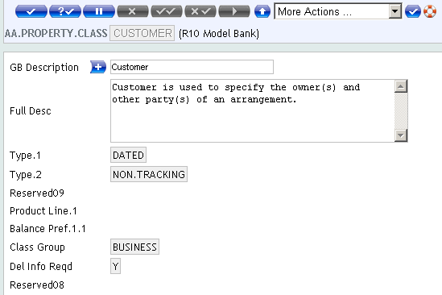
Execution of Business Design Property Class - Customer

Slide 16
Execution of Business Design Property Class - Account
ACCOUNT is also a mandatory Property Class of DEPOSIT Product Line
ACCOUNT Property Class is Dated
Account property class holds principal balances of an arrangement
When an Arrangement is created for a Deposit Product, T24 will automatically create an Account, which will be used to maintain the balances of the Arrangement

Slide 17
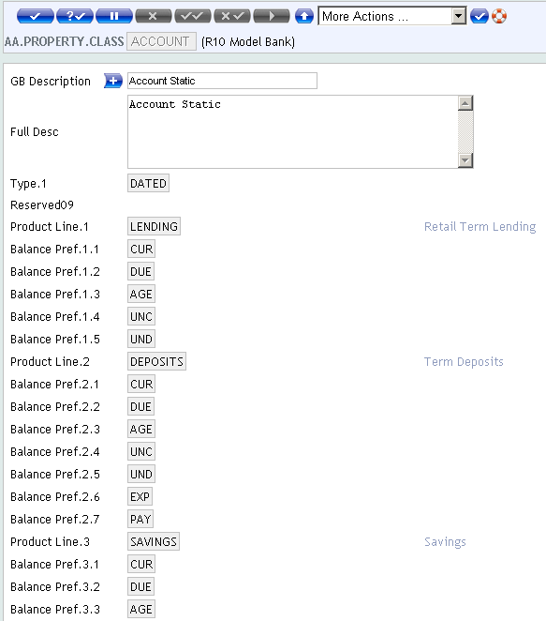
Execution of Business Design Property Class - Account

Slide 18
Execution of Business Design Property Class – Term Amount
Term Amount property class represents both the amount committed within the Arrangement and the term of that Commitment
Controls the commitment made by the bank and the customer
Term Amount is Currency specific
Its necessary to create Product condition for each allowed Currency of the Product

Slide 19
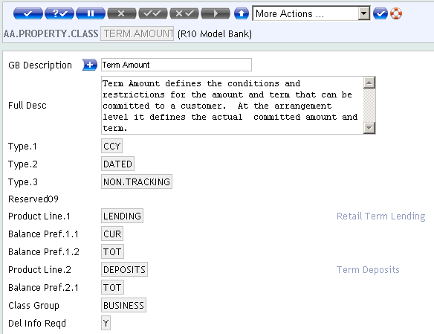
Execution of Business Design Property Class – Term Amount

Slide 20
Summary
Now you have an idea about
Product Line
Property Classes

Slide 21
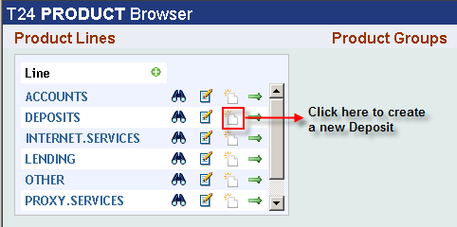
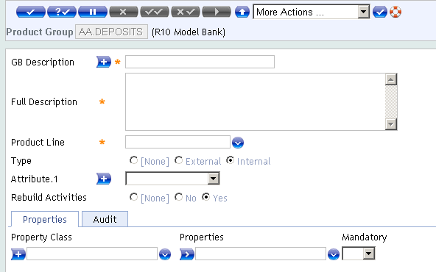
Execution of Business Design Product Group
Let us create an Product group for Deposits

Slide 22
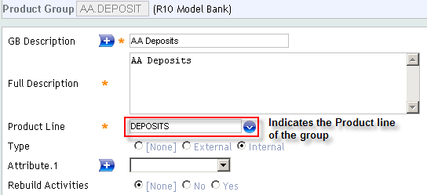
Execution of Business Design Product Group
Enter the mandatory fields required for Deposit Product group

Slide 23
Execution of Business Design Product Group
Groups of Product are formed from Product Lines
Each Product group has a number of Properties associated with it
Gives a basic shape to associated products
Properties can be specified as Mandatory or not at this level
Each Product Group must have atleast one mandatory Property for each of the mandatory Property Classes of its Product Line
A mandatory Property should be necessarily defined at Product Level

Slide 24
Execution of Business Design Product Group
Possible to indicate Internal or External as the Group Type
Product Groups of Bank’s own Products marked as Internal and Groups of other Banks’ Products as External
External group products used for comparative analysis
When a Property is added to a Product Group, Activities for the Property are generated automatically
REBUILD.ACTIVITIES Field to be set as YES

Slide 25
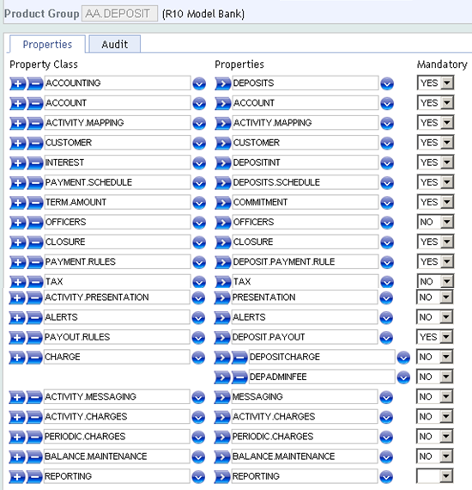
Execution of Business Design Product Group
These are the Properties associated with AA Deposit
These are the Property classes required to built a Deposit, defined in Product line.
We have already discussed about Property Classes
It is compulsory to have at least one Property for ‘Mandatory’ Property classes

Slide 26
Execution of Business Design Properties
As you have seen earlier, you can attach multiple properties to a Property Class in a Product Group, provided it is allowed in the Property Class
AA.PROPERTY is the T24 application that is used to create properties

Slide 27
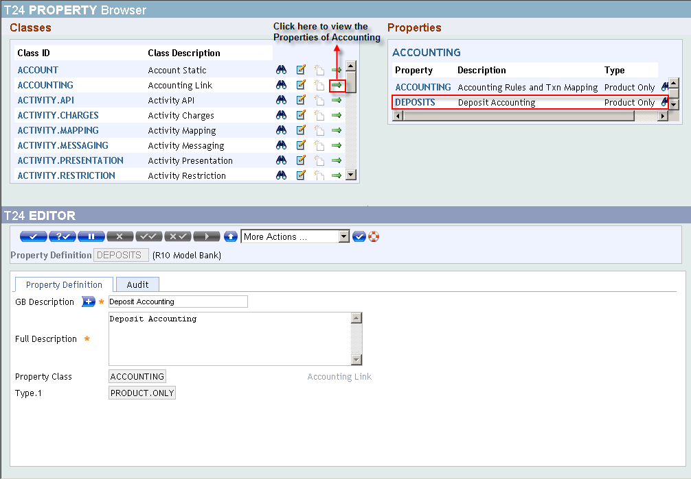
Execution of Business Design Properties
Let us discuss about few Properties defined in the Deposit Product group
Let’s discuss on the Property ‘Deposit’ for the Property class – Accounting
Notes:
To create a Product, we require Properties
In AA we can create instances of a Property Class which are known as PROPERTIES

Slide 28
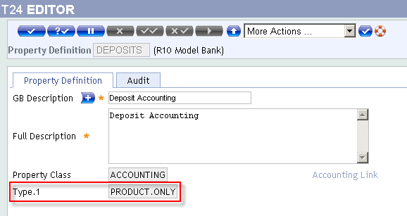
Execution of Business Design Properties
The field ‘Type’ have following options, they are
NULL
PRODUCT.ONLY
SUSPEND and
SUSPEND.OVERDUES

Slide 29
Execution of Business Design Properties
PRODUCT.ONLY - Details for this Property are defined only at product level and cannot be viewed or edited Warrangement level
ACCOUNTING - It is highly unlikely that the user would need to define or modify accounting rules for each arrangement
SUSPEND – The property would be allowed to suspend
Only INTEREST and CHARGE properties can be suspend
SUSPEND.OVERDUE - Any overdues in the property will also be suspended when property is suspend
To define SUSPEND.OVERDUE, the property should already be set to SUSPEND
Notes:
Hence defining them at the product would suffice.

Slide 30
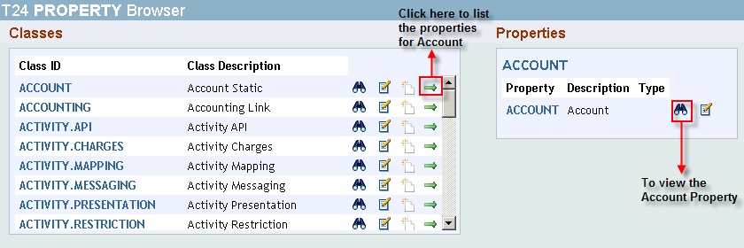
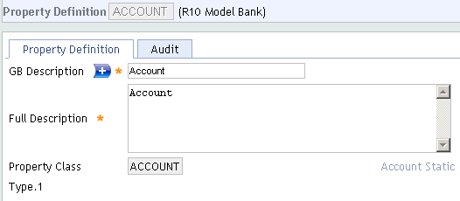
Execution of Business Design Properties
Property ‘Account’ for the Property class – Account
Similarly, create properties for all the Property classes related to Deposit

Slide 31
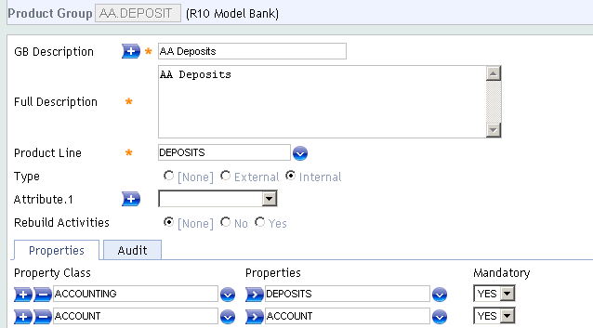
Execution of Business Design Properties
Once Product Group is set up, ‘n’ number of Deposit products can be created

Slide 32
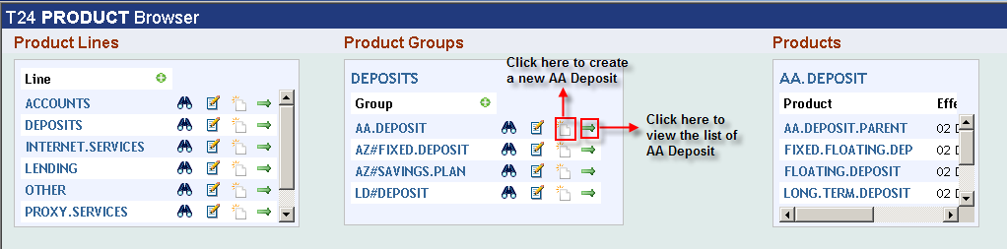
Execution of Business Design Product Designer
Let us create a new Deposit
Application used to create a product is AA.PRODUCT.DESIGNER

Slide 33
Execution of Business Design Product Designer
Products are designed from Product Group through this table
Each Product to have all the mandatory Properties and any of the optional Properties associated with its Group
For each Property, Product condition should also be defined
Possible to link more than one product condition to a Property
User to define period after which additional conditions to be effective
Can be defined in Days, Weeks, Months or Years
Notes:
INHERITANCE.ONLY : T24 product builder follows a structured way of defining products. In addition to this structural hierarchy, the Product Builder enables the definition of “families” of products through Product Inheritance. This allows for a derivative of a product to be defined by simplyspecifying a “parent” product and any different conditions.
Inheritance Only products do not undergo full proofing validations nor are they available for sale on their own. They are only abstract definition of a product which should be derived down the hierarchy to define the product in its entirety.
EFFECTIVE Field represents the effective period after which the new property condition comes into effect. In addition to dated changes of a single Defined Property, the Product designer also allows a Product to be defined with “timed” changes of its conditions. These timed changes may be defined as “condition changes” (i.e. a standard product property is linked to one Defined Property and after a period of time switches to a different Defined Property.

Slide 34
Execution of Business Design Product Designer
Products for Inheritance only
Non Saleable and acts only as Parent
Do not undergo Proofing and Publishing validations
Child Product
PARENT.PRODUCT Field defines Parent to the Current product
Will inherit properties from the Parent product defined in the field
Notes:
INHERITANCE.ONLY : T24 product builder follows a structured way of defining products. In addition to this structural hierarchy, the Product Builder enables the definition of “families” of products through Product Inheritance. This allows for a derivative of a product to be defined by simplyspecifying a “parent” product and any different conditions.
Inheritance Only products do not undergo full proofing validations nor are they available for sale on their own. They are only abstract definition of a product which should be derived down the hierarchy to define the product in its entirety.
EFFECTIVE Field represents the effective period after which the new property condition comes into effect. In addition to dated changes of a single Defined Property, the Product designer also allows a Product to be defined with “timed” changes of its conditions. These timed changes may be defined as “condition changes” (i.e. a standard product property is linked to one Defined Property and after a period of time switches to a different Defined Property.

Slide 35
Execution of Business Design Product Designer
Product Currency
Currencies in which the product is available to be indicated through multi value field
Currency related product conditions should be available for each of the Product currency
Calculation related features
Some properties may require calculations for them
Interest and charges may be calculated as percentage of a specified balance
User to define source balance or source property for calculation
Notes:
CURRENCY field indicates the currency(ies) that are possible within this product. The input must be a valid record from the CURRENCY table.
This is a multi value field.
CALC.PROPERTY: Some properties require calculations for them. For example, a Current Interest property may have to accrue interest at a specific rate on a specified amount. The base amount on which such calculations should happen is stated here. The field is associated with SOURCE.TYPE, SOURCE.BALANCE and SOURCE.PROPERTY fields.
The property stated here would be validated in the proofing stage to verify if they actually belong to this product.

Slide 36
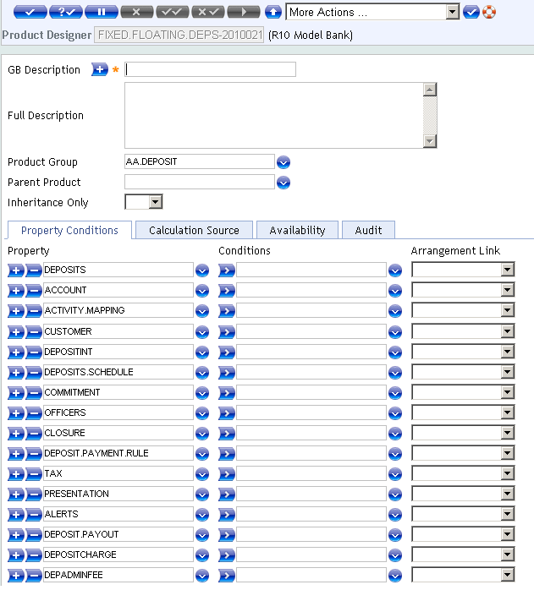
Execution of Business Design Product Designer
New Product will be defaulted with the Properties defined in Product Group
Define Property Conditions for these Properties

Slide 37
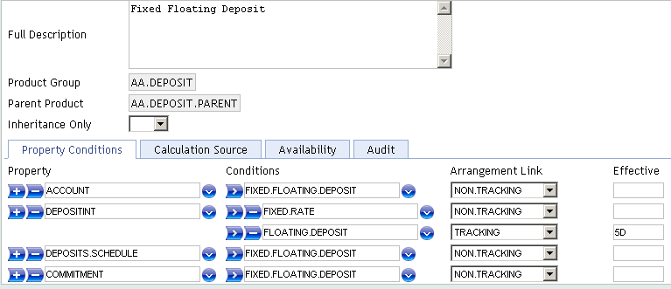
Execution of Business Design Product Designer
Remove the properties not required for Fixed Floating Deposit
Properties mandatory for our Deposit are ACCOUNT, DEPOSITINT, DEPOSIT.SCHEDULE and COMMITMENT

Slide 38
Execution of Business Design Product Designer
Another important field in the Designer is
Arrangement Link have three options
Non-Tracking
Tracking
Custom Tracking

Slide 39
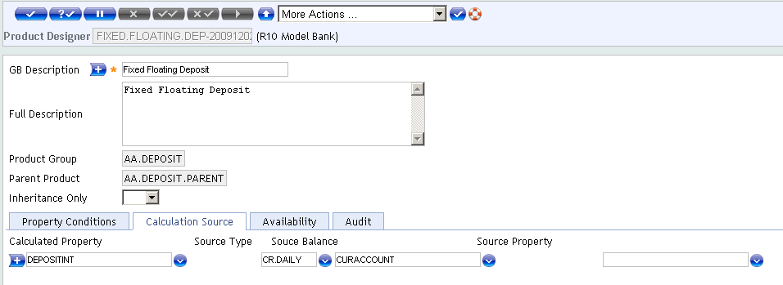
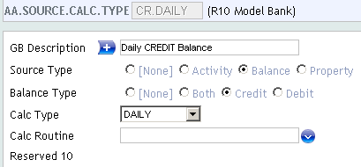
Execution of Business Design Product Designer
In the Calculation Source, we specify the property which requires interest calculation
Source Type value is obtained from AA.SOURCE.CALC.TYPE
Source Balance value is obtained from AC.BALANCE.TYPE
Notes:
Some properties require calculations for them. For example, a Current Interest property may have to accrue interest at a specific rate on a specified amount. The base amount on which such calculations should happen is stated here. The field is associated with SOURCE.TYPE, SOURCE.BALANCE and SOURCE.PROPERTY fields.

Slide 40
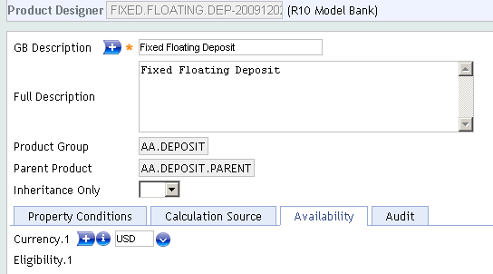
Execution of Business Design Product Designer
This denotes, the deposit product is available only for the currency ‘USD’
Using the Multi-value, ‘n’ number of Currencies can be included

Slide 41
Execution of Business Design Product Condition
Property conditions are derived from PROPERTY.CLASS
Property Classes are used to define a Product.
Eg: For a product Personal loan, “Interest”, “Tenor”, “Schedule”, etc are all Property classes.

Slide 42
Execution of Business Design Product Condition
Let us discuss about the Product conditions allocated for the properties
Product conditions are defined in the table AA.PRD.DES.XXXX where XXXX denotes the Property Classes like
ACCOUNT
TERM.AMOUNT
INTEREST
ACCOUNTING
CUSTOMER, etc

Slide 43
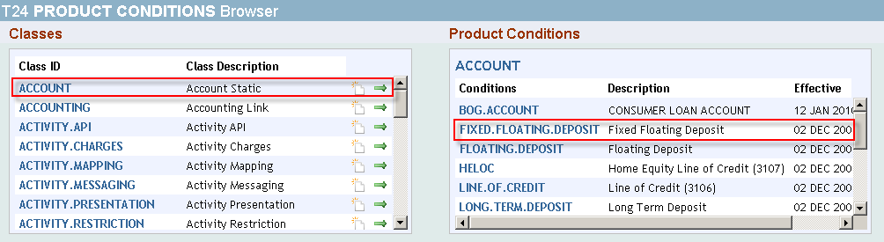
Execution of Business Design Product Condition - Account
Let us discuss about the condition FIXED.FLOATING.DEPOSIT
This is defined in the Product condition AA.PRD.DES.ACCOUNT

Slide 44
Execution of Business Design Product Condition - Account
Category
Accounts use Customer type of Account Category codes
Range 1000 to 9999
Must be Non-contingent, avoid ranges meant for Nostro, Vostro
Usually set as Non-Negotiable
Account Title, Short Title and Mnemonic
Account Title for descriptive details
Short title used for enrichment
Mnemonic is used as alternate Id
Bus Day Centres
Holiday table of country / region to determine non-working days
Notes:
When you open a Customer Account in T24, three fields are mandatory which are Customer, Category and Currency. Of these the Customer and Currency will be supplied by the mandatory values input first for a Lending Arrangement. So only Category needs to be specified for an Arrangement once it is validated with the Customer and Currency values.
A T24 Customer Account can be opened only in the Category range of 1000-9999.
Category, which is used to distinguish T24 Products, is an important field of Account, and financial reporting is usually based on T24 Product Categories. Some of the Account Categories are reserved for Nostro, Vostro Accounts. Hence, normally the Category will be set as a non-negotiable attribute in an ACCOUNT. Product Condition, with a default value i.e. Category value will be defaulted in the Arrangement and User cannot modify it. This will help to group AA Lending Products in a meaningful manner for financial reporting. Of course, though any Category in the range 1000 to 9999 can be specified here, care should be taken to avoid Categories, which are reserved for other types of Accounts like Vostro, Nostro, etc.
Finally, you can see that all other attributes have been set to be negotiable i.e. User can input own values for other attributes of Account in an Arrangement.
Pre defined Posting restrictions can be used. Debits or Credits or all transactions could be set to attract overrides

Slide 45
Execution of Business Design Product Condition - Account
Posting Restrict
Pre defined Posting restrictions used
Debits or Credits or all transactions could be set to attract overrides
Currency
Currency of Arrangement
Defaulted from Currency of New Arrangement Activity
Cannot be changed after authorisation of arrangement
Base Date Type
Option to determine calculation start date
Agreement - will start calculations from date of arrangement
Start - will start calculation from first disbursement date
Notes:
CURRENCY Field indicates the currency of the account and all entries posted to this account are in this currency. Value in this field is defaulted with currency of New arrangement activity. Once arrangement is authorised, value in this field cannot be changed.
BASE.DATE.TYPE Field is a no change field at the arrangement level. It indicates if Anniversary field should be from agreement date or from first disbursement date(start). If Start is selected, then system will maintain the MMDD of the arrangement start date in Anniversary until the first disbursement happens and then overwrites Anniversary with the MMDD of first disbursed date. Option AGREEMENT would commence calculation from date of arrangement. Option START would commence calculation from first disbursal date.

Slide 46
Execution of Business Design Product Condition- Account
Date Convention
Schedule for non-working days
Forward; Backward; Forward Same Month; Calendar
Date Adjustment
Value - All schedule events calculated on VALUE Date of Arrangement
Period - Every schedule event calculated on previous schedule date
Not applicable when Date Convention is Calendar

Slide 47
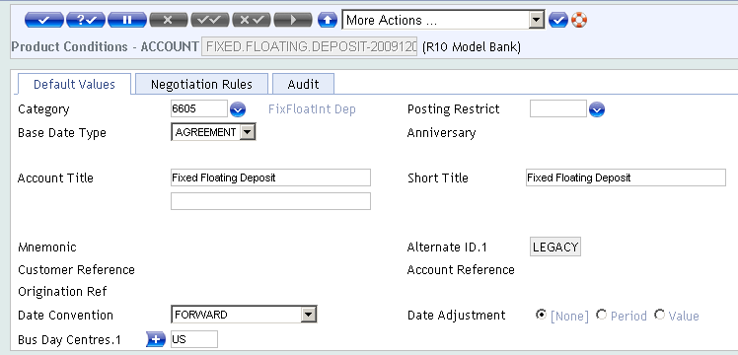
Execution of Business Design Product Condition- Account

Slide 48
Execution of Business Design Product Condition- Account
Account is required for all financial Arrangements
Holds the Principal balance of the Arrangement
Allows changes to the following Account attributes:
Account Title
Short Title
Posting Restriction
Mnemonic

Slide 49
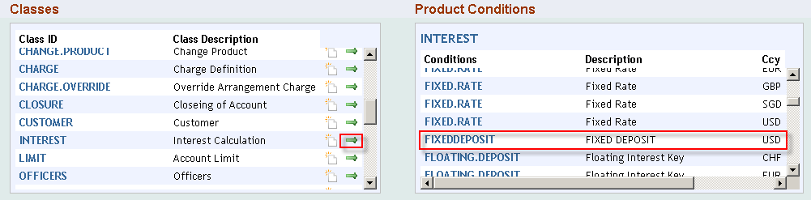
Execution of Business Design Product Condition- Interest
Next Product condition to be defined is FIXED.RATE
This is defined in the table AA.PRD.DES.INTEREST

Slide 50
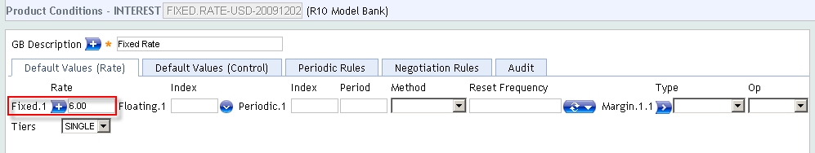
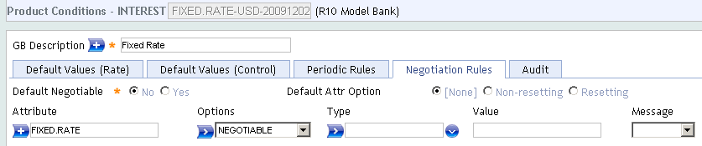
Execution of Business Design Product Condition- Interest

Slide 51
Execution of Business Design Product Condition- Interest
Interest Types
Fixed interest
Interest Rate to be specified
Floating interest
Id of BASIC.RATE.TEXT table to be specified
Periodic interest
Id of PERIODIC.INTEREST table to be input
Interest rate is defaulted for the TERM of the arrangement
Interest rate for TERM falling between periods defined in the table can be interpolated
If user inputs a rate, system will not default rates from BASIC.INTEREST Table or PERIODIC.INTEREST Table
Periodic Interest can be reset at predefined frequency

Slide 52
Execution of Business Design Product Condition- Interest
Tiered interest Rates
Interest rates can be defined as a single tier, or multiple tiers
With multiple tiers, rate varies according to balance amount
Level – rate is level across the whole balance
Banded – rate varies between bands
Mixed – combination of LEVEL and BAND for different balance amounts
e.g. Level rate of 5% upto 50000
Level rate of 5.5.% upto 100000
Band Rate of 6% after 100000
Each tier can have a different rate type
Each tier can have different margins
Minimum and Maximum rates for each tier can be defined
Notes:
T24 allows for the definition of tiers of interest rates. Each tier is specified by defining the amount up to which the interest rate applies. Additionally, each tier can be of a different interest rate type (i.e. fixed, floating, or periodic). There are three type of tiers. RATE.TIER.TYPE Field has 3 options – Single, Level and Banded.
Single Rate - When a single rate tier type is specified a single nominal interest rate will apply for the entire balance amount.
Level Rate - This will calculate interest at different rates depending on the balance amount.
Banded Rate - Banded tier interest will typically result in a “blended” interest rate. This is similar to Level tiers, but allows for the interest rate of each tier to be applied to the portion of the balance that falls within the tier. Compounding not permitted for this.
Margins, Minimum rate and Maximum Rate for each tier can be specified.

Slide 53
Execution of Business Design Product Condition- Interest
Tier Amount
Relates to RATE.TIER.TYPE Field
Amounts can be entered if either BAND or LEVEL selected
Tier Percent
Allows a percentage of the principal to be allocated a specific rate or be linked to a rate table
Either Tier Amount or Tier Percentage can be opted for Band based calculation, not both
Notes:
We can calculate interest using a banded method where the bands are identified by a percentage of the principal. This defines the percentage split of the interest band tiers.
TIER.AMOUNT Field - The tier amount relates to the field RATE.TIER.TYPE and amounts can be entered if either BAND or LEVEL are selected.
Different interest rates can be defined for different amounts, indicating Level or Band calculation.
TIER.PERCENT Field – This allows a percentage of the principal to be allocated a specific rate or be linked to a rate table.
Different interest rates can be defined for different percentage amounts, indicating Level or Band calculation.
System will allow band based interest calculation on TIER.PERCENT or TIER.AMOUNT, but not both.

Slide 54
Execution of Business Design Product Condition- Interest
Interest Day Basis
To calculate interest based upon several different day basis types
Each T24 Interest Day Basis type is represented as a numerator and denominator
A (360/360); B (366/360); C (366/366); D (360/366); ……
Accrual Rule
Include first day for interest accrual
Include last day for interest accrual
Include first and last days for interest accrual
Compounding
DAILY, WEEKn, Mnn, TWMTH, Nnnn
Notes:
53
AA uses the INTEREST.DAYS.BASIS for determining numerator and denominator for interest calculations.
The Accrue activity calculates the accrued interest amount up to the effective date and posts the amount using the associated accounting rule.
Interest could be set to compound every day, weeks (say every week, every 2 weeks etc); monthly (every nMonths); twice a month and specified number of times in a year.
Balance calculation stipulates the daily or average or highest or lowest balance on which interest to accrue.
Compounding not allowed when Interest is banded.

Slide 55
Execution of Business Design Product Condition- Interest
Calculation Threshold
Maximum Debit balance for which interest will not be calculated
Negative Rate
User can set negative interest or may result by higher negative spread
Option to set negative interest rate on accounts in credit
If set to NO or NONE and interest rate falls below “0”, Zero interest will be accrued
Periodic period
Interest period to be used for linking Periodic Interest
Defaults to Term from Term amount property, if left blank
Notes:
54
CALC.THRESHOLD Field is used to specify that interest will only be calculated if a balance threshold is surpassed. For debit interest, the user can specify the maximum debit balance for which interest will not be calculated.
NEGATIVE.RATE Field is used to set negative interest rates on accounts in credit. To do this, the NEGATIVE.RATE Field must be set to “Yes”. If the field is set as either “No” or left unpopulated, then when interest rates fall below 0, zero interest will be accrued. Negative interest rates may occur either as a result of a negative rate being specified or as the result of the rate minus any margin which is specified.
PERIODIC.PERIOD - Defines the interest period to be used when linking to PERIODIC.INTEREST. This will default to TERM if a Term Amount Property exists. When a period is stated in Years or Weeks, they would be converted to Months and Days respectively and then located on the PI table Interest period to be used for linking Periodic Interest.

Slide 56
Execution of Business Design Product Condition- Interest
Each interest component is represented by an Interest Property
Principal interest
Penalty interest
Accrue
Calculates accrued interest, posts amount using associated accounting rule
Periodic Reset
Fixes the rate according to current Periodic Interest conditions
May cause interest recalculation and change to payment schedule
Scheduled or manual
Change
Manual change to any of the Interest attributes may cause interest recalculation, may cause Payment Schedule to change
Notes:
The Interest Property Class is used for all interest definition and processing in AA. A T24 product defined and processed in AA can have multiple interest properties defined. The number of interest properties is determined by the users defining the products. The Interest Property Conditions are currency specific.
The Accrue activity calculates the accrued interest amount up to the effective date and posts the amount using the associated accounting rule.
PERIODIC.RESET Field indicates the reset period of the index stated. System would automatically reset the PERIODIC.RATE at the frequency stated in this field. Periodic index may still be used without this field, it does not reset the computed rate.
Changes to any of the Interest attributes may result in interest to be recalculated and may cause update the Payment Schedule. An important feature in annuity (constant) calculation type Arrangement is that if the interest amount for a certain period is greater than annuity amount, then Interest amount equal to the annuity amount calculated is made due for the period.

Slide 57
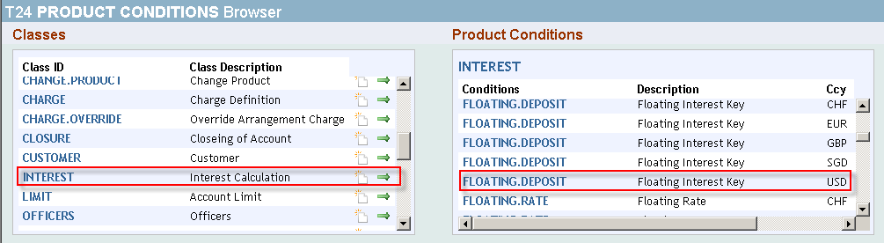
Execution of Business Design Product Condition- Interest
Similarly, create Product condition for FLOATING.DEPOSIT

Slide 58
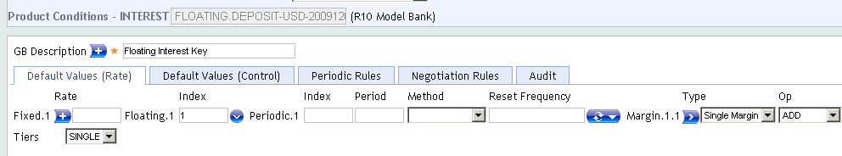
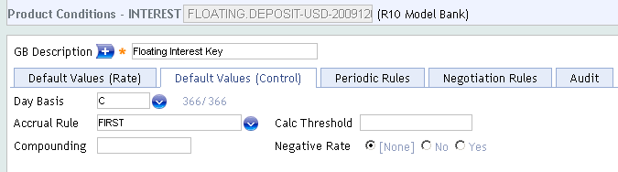
Execution of Business Design Product Condition- Interest

Slide 59
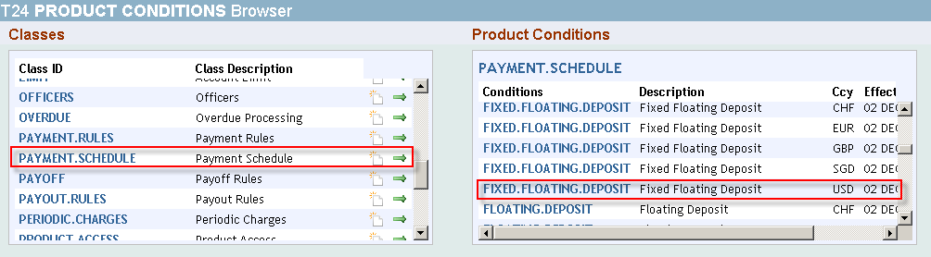
Execution of Business Design Product Condition- Payment Schedule
Next product condition is to be defined for Schedule
Application to be used to define schedule is AA.PRD.DES.PAYMENT.SCHEDULE

Slide 60
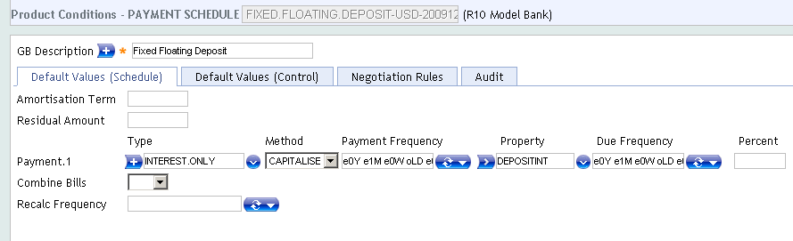
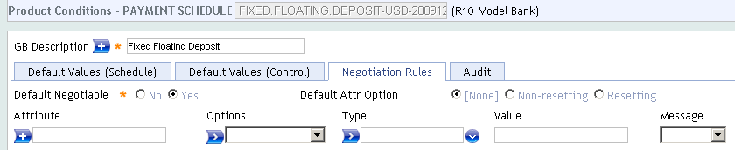
Execution of Business Design Product Condition- Payment Schedule

Slide 61
Execution of Business Design Product Condition- Payment Schedule
Payment Type
ACTUAL
Repayment of calculated property classes - Interest, charge
CONSTANT
Used for Annuity Arrangements, Requires both a Term amount and
Interest Property to be specified
LINEAR
Requires a term amount property for fixed term amount
OTHER
User defined
Payments Method - can be made due or capitalised
Possible to define a residual amount to be paid on last payment date
Notes:
PAYMENT.TYPE Field denotes different types of calculated payments that could be applied. This field is Mandatory. Should be a valid record in AA.PAYMENT.TYPE File. T24 supports four types of calculated payments:
• Constant – results in equal repayments. This is used for ‘Annuity’ arrangements and requires both a Term Amount and Interest property to be specified.
• Linear – Term Amount repayment remains fixed over the life of the arrangement. Optional properties such as Interest, Charge, and Tax may be included. The actual amounts calculated by these properties will be added to the fixed Term Amount repayment.
• Actual – is used for repayment of calculated property classes (i.e. Interest, Charge, and Tax) and will be determined on each payment schedule date.
• Other – user defined
PAYMENT.METHOD : Once the Payment Type has been specified, the user can specify whether the amount will be Due (to or from the customer) or Capitalised.
It is possible to define a RESIDUAL.AMOUNT at the maturity date of a term product to be paid on the last payment date of the arrangement. This can be specified by entering an AMORTISATION.TERM with which T24 can calculate payments and any residual or by entering a RESIDUAL.AMOUNT directly.

Slide 62
Execution of Business Design Product Condition- Payment Schedule
Payment frequency
Frequency at which payments will be made due
Applicable for Payment Type
Due frequency
Frequency at which payments needs to be made due
Applicable for properties within a Constant payment type
Principal and interest frequency should be the same as that of Payment frequency
Charge property can have different frequency
Payment frequency is defaulted when due frequency is null
Notes:
PAYMENT.FREQ field indicates frequency at which payments will be made due.
Example:
a) M 01 31. M = Monthly. 01 = one monthly intervals. 31 = the last day of the month, b) M 03 31 M = Monthly. 03 = three monthly intervals. 31 = the last day of the month. c) M 01 10 M=Monthly, 01 = at monthly intervals10 = 10th of the month, d) 31 MAR 2006 W , where W= weekly. In this case, the first schedule would fall on 31March 2006, e) 31 Mar 2006 BSNSS, where BSNSS = every business day. In this case, the first schedule would fall on 31March 2006.
DUE.FREQ Field indicates actual frequency when payment needs to be made due. Due frequency is defined for each payment property under a payment type.
Payment frequency is defaulted when due frequency is null. Generally both payment and due frequency has same value. When multiple properties are defined for a given payment type, due frequency of one of the properties can de different from payment frequency.
Deferred Periodic Charges need to be defined in the Payment Schedule to mention when the charges will be collected. On this date, system will check the AA.CHARGE.DETAILS with APP.METHOD as DEFER. Then system will do an ISSUEBILL for all the Deferred charges that are yet to be collected.

Slide 63
Execution of Business Design Product Condition- Payment Schedule
Billing
Make due activity
Generate bill on due date or in advance by a specified no of days
Combine bills falling on same due date
Repayment amounts can be specified as percentage of Outstanding Amount
Different payment types can be specified for different periods
Start Date and End Date for each period should be specified
Within a period, number of payments can be restricted
User can also specify amount of repayment
When amount is manually input, system will not calculate repayment amount
Notes:
In AA, Payment Schedules generate Bills, when a schedule amount is not capitalised and made due.
Unlike other T24 contract applications, when a scheduled amount is made due, the processing i.e. debiting the related liquidation account will not automatically happen.
It has to be processed outside AA. Bills for a payment, can be generated on the due date or by certain specified days in advance by specifying number of advance days in BILL.PRODUCED Field.
When more than one payment falls due on the same date, user can opt for combining the bills. For example, user can combine the interest and charges which have same frequencies and falling on same dates.
PERCENTAGE Field allows the user to define a percentage that would be applied on the outstanding balances and made due. Only the percentage of the amount would be issued in the bill and Made due. The remaining amount would remain on their respective balances and any further calculation would be based on this balance.
Would only be allowed for ACCOUNT and INTEREST properties. The payment type should belong to CALCULATED type with the CALC.TYPE set as ACTUAL. Should be in the range of 0 to 100.
Different payment types can be specified for different periods. When user inputs the repayment amount, system will not calculate the repayment amount.

Slide 64
Execution of Business Design Product Condition- Payment Schedule
Recalculating Payment Schedule
Possible to be scheduled
Possible due to occurrence of certain activities
Scheduled Recalculation - RECALC.FREQUENCY Field
Automatically at predefined frequency
weekly, monthly, yearly, etc
Activity to trigger recalculation – ON.ACTIVITY Field
Activities like Disburse, Repay, Change in Interest
Recalculation types – RECALCULATE Field
Payment – payment amount will be changed
Term – term of the arrangement will be altered
Residual – residual amount will be changed
Nothing – payments, term, and residual will be unchanged. Recalculation frequency should be specified
Notes:
You may need to revise your repayment schedule when loan amount, or interest rate or term changes. You can specify which activity should result in recalculation of repayment schedule.
ON.ACTIVITY Field to state a list of activities during which payment schedule is to be recalculated. When those activities are performed, system would automatically recalculate the payment schedule. For example, the following Activity Classes may require a recalculation:
UPDATE – CHARGE, CHANGE – INTEREST, CHANGE– PAYMENT.SCHEDULE, CHANGE.TERM – TERM.AMOUNT, INCREASE – TERM.AMOUNT, DECREASE -TERM.AMOUNT. For each of these activities, the resulting recalculation types must be specified in the associated field - RECALCULATE.
More than one activity may be stated for recalculation. But there should be no duplication. Should be a valid entry in AA.ACTIVITY file.
For a scheduled recalculation RECALC.FREQUENCY Field must be defined at weekly, monthly, yearly frequency etc. If RECALCULATE Field has recalculation type as ‘nothing’ for any of the activities, automatic recalculation to be scheduled for this.

Slide 65
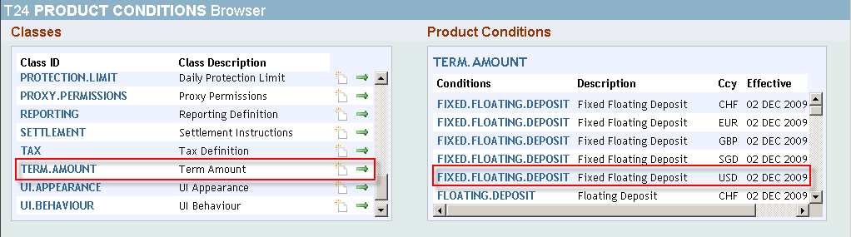
Execution of Business Design Product Condition- Term Amount
Next product condition to be defined is for Commitment
This is defined the application AA.PRD.DES.TERM.AMOUNT

Slide 66
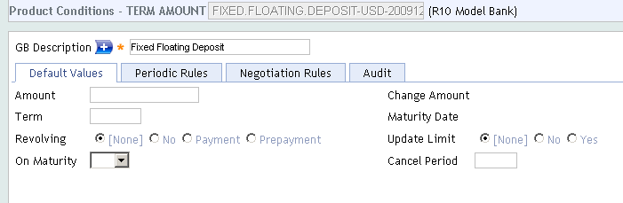
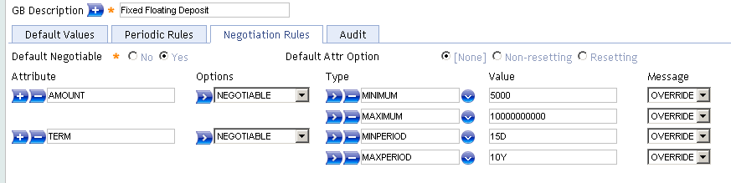
Execution of Business Design Product Condition- Term Amount

Slide 67
Execution of Business Design Product Condition- Term Amount
Committed Amount
Amount to be lent
Change amount
For increasing or decreasing commitment amount, at arrangement level
Repayment Term
Period of time over which amount is expected to be repaid
Maturity Date
Date on which term ends
Calculated from Agreement Date and Repayment Term
Notes:
In an Arrangement, the AMOUNT Field is used to enter the total amount called commitment amount which will be lent. The amount can be restricted in the Product Condition through appropriate negotiation rules (e.g. >5000 and < 25000).
The TERM field determines the period of time by which the amount must be repaid. It is common to specify a default value for this in the Product Condition, for example 25Y for a long term Mortgage. The term can be entered as a number of Days (D), Weeks (W), Months (M), or Years (Y).
The MATURITY.DATE at the Arrangement level is calculated. This is based upon the Arrangement Effective Date and Term. User can also manually enter the MATURITY.DATE instead of defining the TERM of the arrangement.
Unlike other T24 Contract applications TERM will be applied on the first repayment date to arrive at the last repayment date, and the Maturity Date will not be last repayment date.
CHANGE.AMOUNT Field, in arrangement, is used to increase or decrease the commitment amount. Original commitment amount can be increased or decreased using INCREASE or DECREASE action, in an arrangement. For increase action, input in this field should be greater than zero.
For decrease action input in this field should be less than zero.

Slide 68
Execution of Business Design Product Condition- Term Amount
Amount on Maturity
On Maturity of arrangement , to keep remaining amount as Due or Outstanding
Revolving
Choices to restore available commitment amount on repayment of loans
No - available amount will not increase when any payments are made
Payment – all repayments against principal cause available amount to
increase
Prepayment – repayment of due principal does not increase available
amount; repayment of principal not yet due increases available
Amount
Updating Limits with commitment amount
To update or not, the LIMIT record, with commitment amount
Notes:
Available amount is the committed amount less all disbursements.
This is controlled by the Revolving Attribute.
The effect of a revolving product is to increase the available amount from which a customer may drawdown as a result of certain payments. If a user wishes to have a revolving loan or line of credit there are two possible revolving types.
With a PAYMENT type, any payment against the outstanding amount, whether due or not due, will result in the available amount increasing.
With a PREPAYMENT type, only repayments against the outstanding amounts not yet due will result in the available amount increasing.
UPDATE.COMMT.LIMIT Field - attribute for lending products allows a user to specify whether the commitment amount of an Arrangement’s LIMIT record needs to be updated, for an Arrangement. This setting will not have any effect on the update of available amount of the Limit.
ON.MATURITY Field determines whether on Maturity Date of the arrangement, the remaining amount in outstanding balance to be kept as Due or Outstanding.

Slide 69
Execution of Business Design Product Condition- Term Amount
Disbursement not automatic
Cannot be run directly from the Arrangement
Transfers funds from a Lending Arrangement to a specified account
Triggered from a transaction with a ‘disbursement’ transaction code
FT, Teller, Cash Pooling
Subject to sufficient committed amount remaining and Activity Restriction
Notes:
68
Disbursement is the process to part with the committed loan amount in full or in part. Unlike some contract applications of T24 like MG, MM, etc. disbursement is not automatically done when an Arrangement is created. It cannot be also done directly from the Arrangement similar to other Activities like increase Term Amount.
The disbursement can be made to a specified Account or it can be even in cash.
The disbursement can be triggered from a transaction with a disbursement transaction code. We will learn more about configuring the transaction codes to use with AA later. A Lending Arrangement can be disbursed through FT, Teller, Cash Pooling.
It also validates the disbursement against the committed amount, the current outstanding amount and any applicable Activity Restriction. Please note that an Arrangement Account will not show any working balance when an Arrangement is created, since amount is only committed. Only when a disbursement is made, the Arrangement Account will be debited and its working balance will be updated.

Slide 70
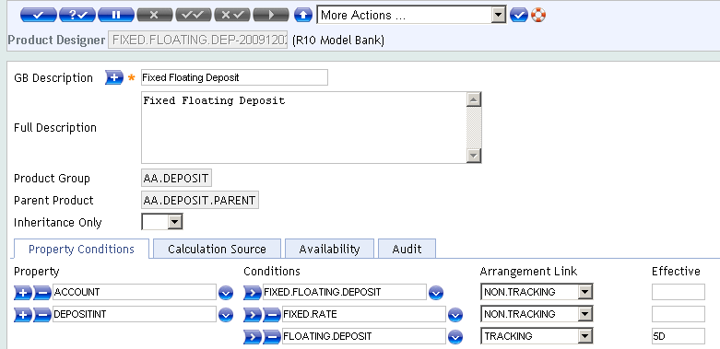
Execution of Business Design
We have defined all the Product conditions required for our product ‘Fixed Floating Deposit’
Save and Authorize the record

Slide 71
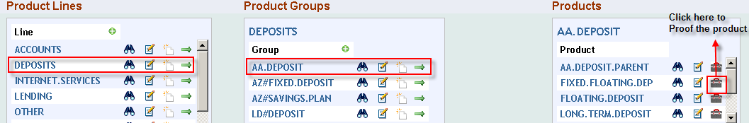
Execution of Business Design Proofing and Publishing
Let us Proof and Publish the product ‘Fixed Floating Deposit’

Slide 72
Execution of Business Design Proofing and Publishing
Building a Product in AA is a three stage process
Designing
Proofing
Publishing
In the design stage, the designers make use of available components to design – their actions have no effect on the live products
To make the new product available to operational staff, it needs to be made available in Product Catalog
The designer must Proof the product to check that there are no errors in the design (particularly where hierarchies are involved)
It should then be duly published to be included in Catalog
Proofing and publishing will perform processing from parent down to all children

Slide 73
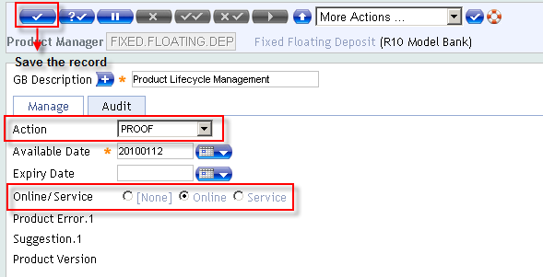
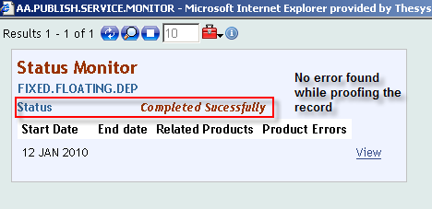
Execution of Business Design Proofing and Publishing
Select the field ‘Action’ as Proof
Save the record

Slide 74
Execution of Business Design Proofing and Publishing
Let us publish the product
A product will be available for market only after publishing the record

Slide 75
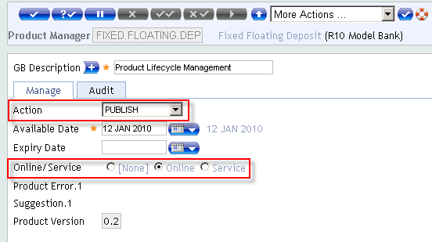
Execution of Business Design Proofing and Publishing
Select Publish and save the record

Slide 76
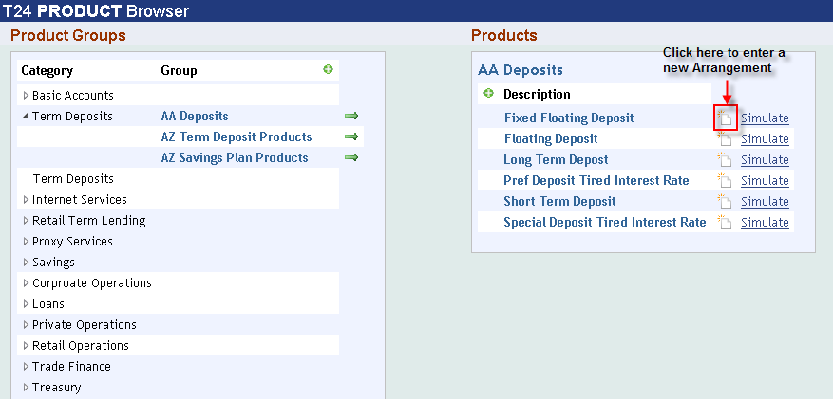
Execution of Business Design Input an Arrangement
Select User menu> Product Catalog to input an Arrangement

Slide 77
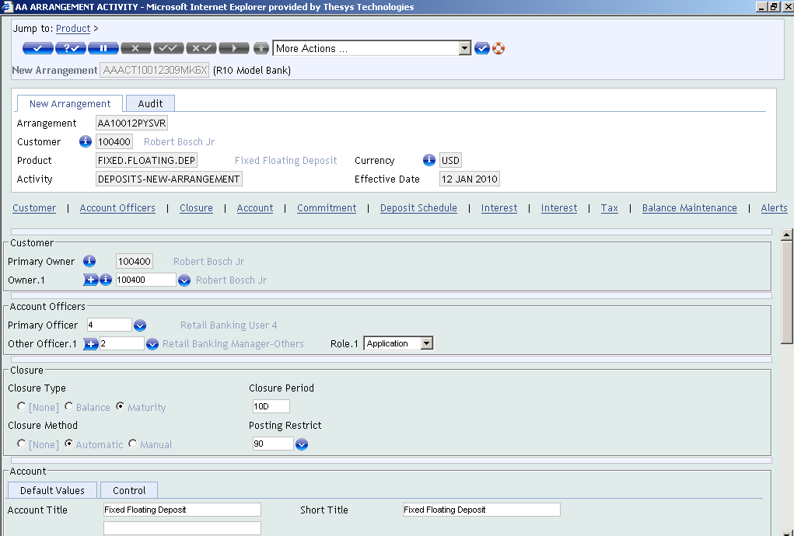
Execution of Business Design Input an Arrangement
New Arrangement

Slide 78
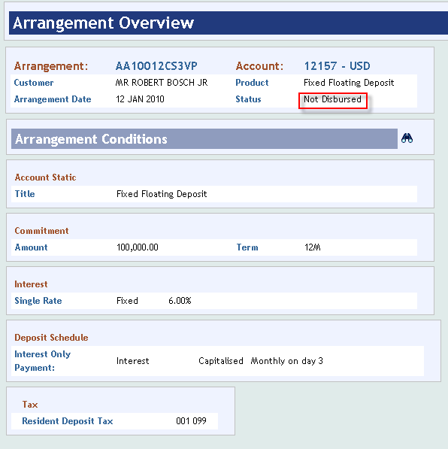
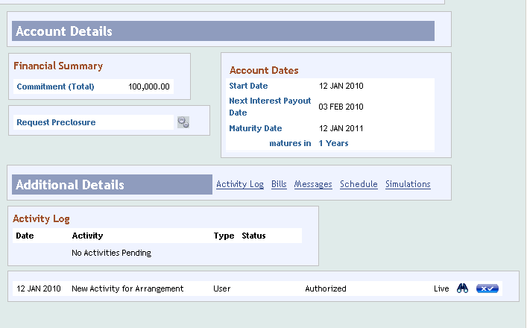
Execution of Business Design Input an Arrangement

Slide 79
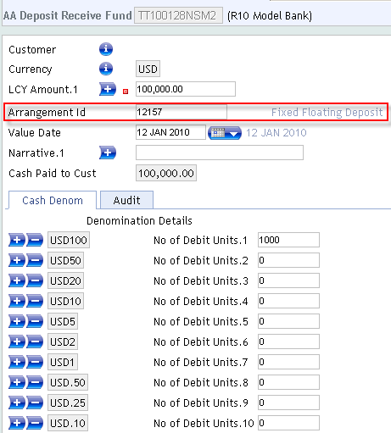
Execution of Business Design Input an Arrangement
Disbursement through Teller
Arrangement ID -12157

Slide 80
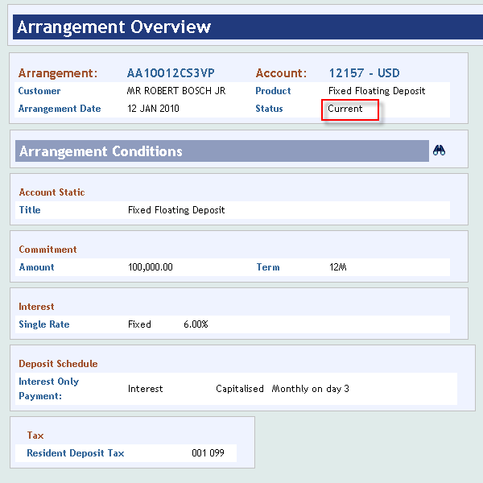
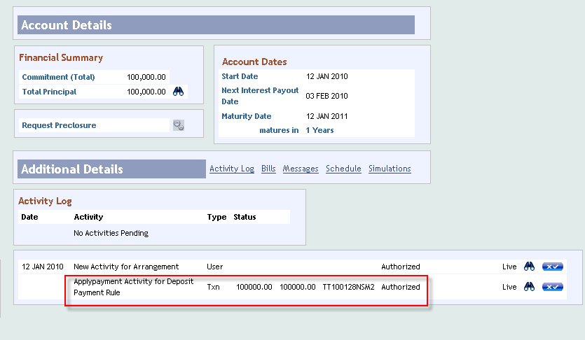
Execution of Business Design Input an Arrangement
After disbursement, status changes to Current

Slide 81
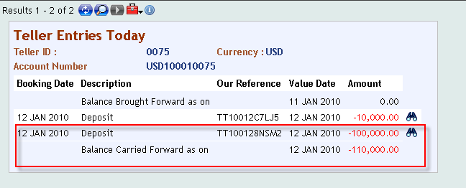
Execution of Business Design Input an Arrangement
Showing the till balance

Slide 82
Summary
Now we have understood the flow in creation of a Deposit Product
We have also learnt to create properties using existing Property Classes

Slide 83


www.capgemini.com/financialservices

