Slide 1
HackOSsim-FreeRTOS
By
Alessandro Amoretti, Manuel Firrera,
Alessandro Mulassano, Simone Sampognaro

Slide 2

Introduction
Why hackOS? Interesting and challenging
Why FreeRTOS? Free, well supported, enriched with documentations
Qemu: hardware emulator on which we based the entire work with this OS

Slide 3
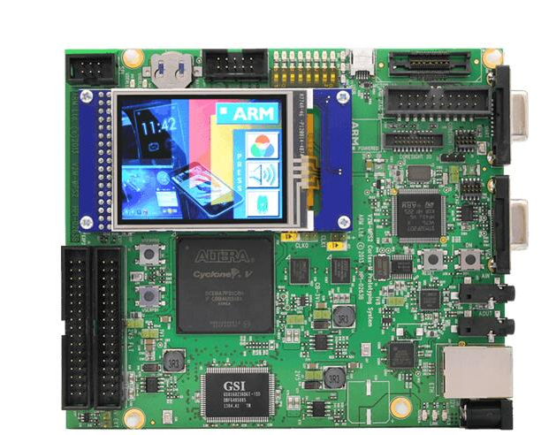
Installation
Installation and setting of QEMU
Installation and building of FreeRTOS
Tutorial for Windows and Linux
Arm Cortex-M3 mps2-an385 QEMU mode

Slide 4
Exercises

Slide 5
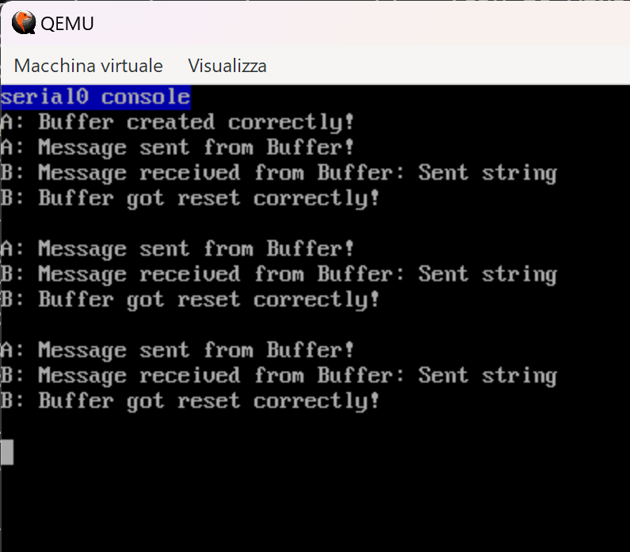
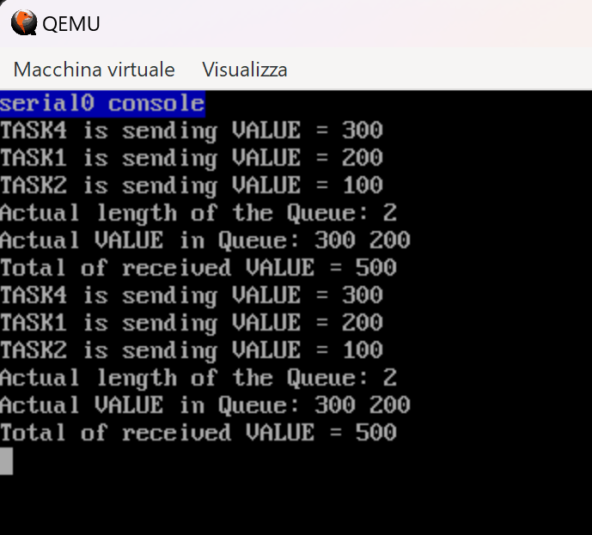
MessageBuffer
2 Tasks
xMessageBufferCreate()
xMessageBufferSend()
xMessageBufferReceive()
xMessageBufferReset()
Queue
4 Tasks
Queue of length 2
xQueueSendToBack()
xQueueReceive()

Slide 6
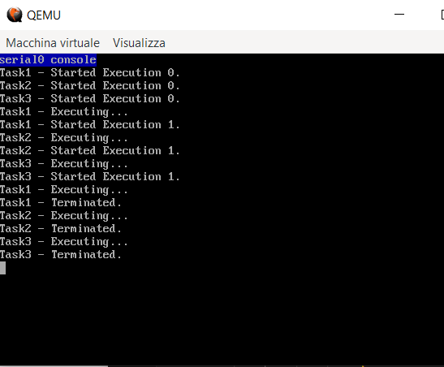
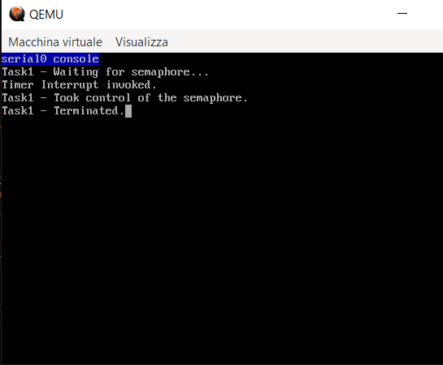
Priorities
3 Tasks
Each task prints on the screen
Executions sorted by the scheduler
Timer-Interrupt Service Routine
xSemaphoreCreateCounting()
Task 1 awaits release of the semaphore
xTimerStart()
xSemaphoreGiveFromISR()
xSemaphoreTake()

Slide 7
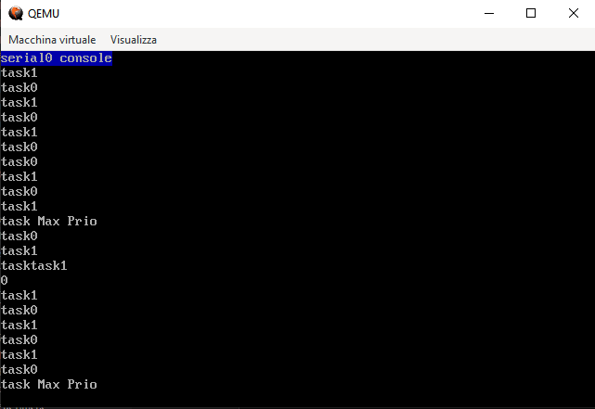
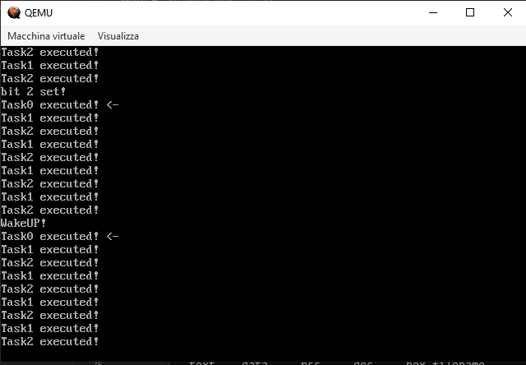
Round Robin
3 Tasks
Each task prints on the screen
2 of them share the same priority
Event Groups
xEventGroupCreate()
xEventGroupSetBits()
Task 0 awaits bit 2 of the event group
xEventGroupWaitBits()
Wake up timer

Slide 8
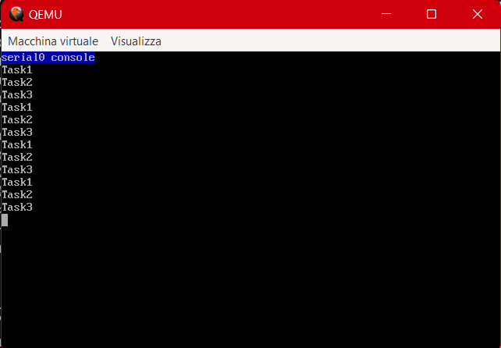
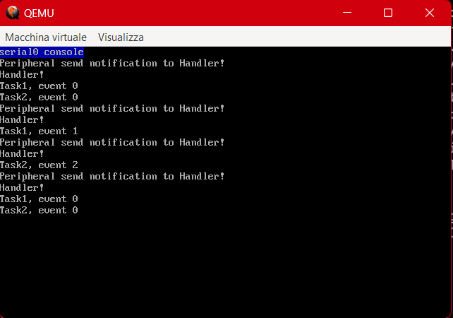
Semaphores
3 Tasks
xSemaphoreCreateBinary()
xSemaphoreGive()
xSemaphoreTake()
Notifications
Peripheral and Handler
xTaskNotifyWait()
xTaskNotifyGive()

Slide 9
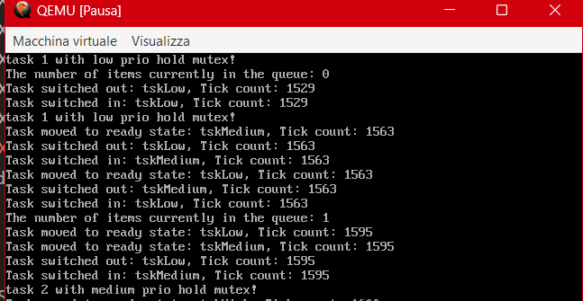
Mutexes
3 Tasks
Mutual exclusion
xSemaphoreCreateMutex()
Priority inversion
Tracing Macros

Slide 10
Customizations and evaluations

Slide 11

Aging
Prioritized Preemptive Scheduling with Time Slicing
Motivations
How it works?
Reset Priority

Slide 12
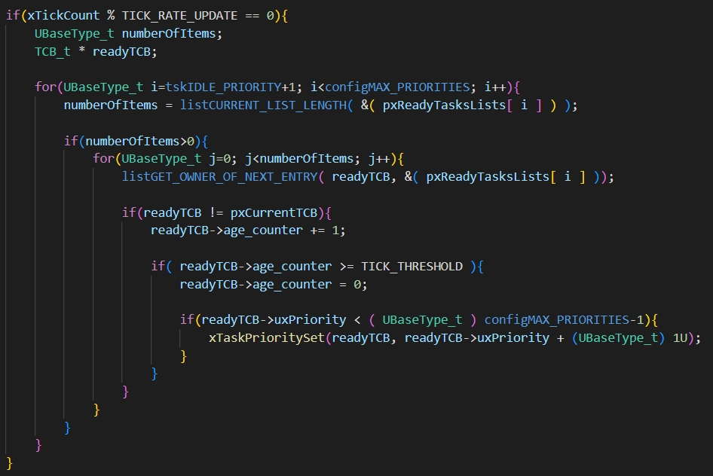
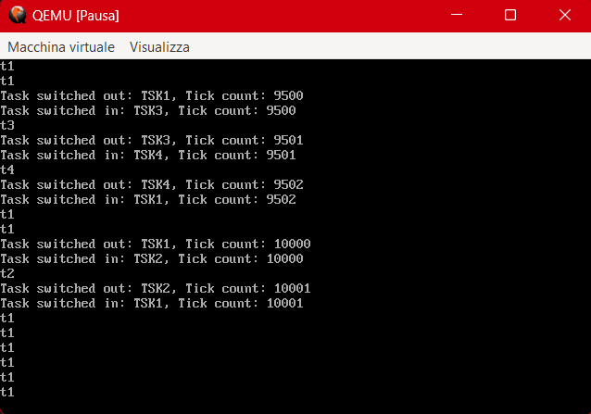
Aging in action

Slide 13

Observations​
Advantages
Improved responsiveness
Fairness
Dynamic adaptation to workload changes
Disadvantages
Increased resource usage
Performance overhead
Difficulty in tuning parameters

Slide 14

Worst Fit
Linked list of free blocks
Looking for the biggest free block
Coalescence
Give more alternatives to the developers
Performance evaluation
Questa foto di Autore sconosciuto è concessa in licenza secondo CC BY.

Slide 15
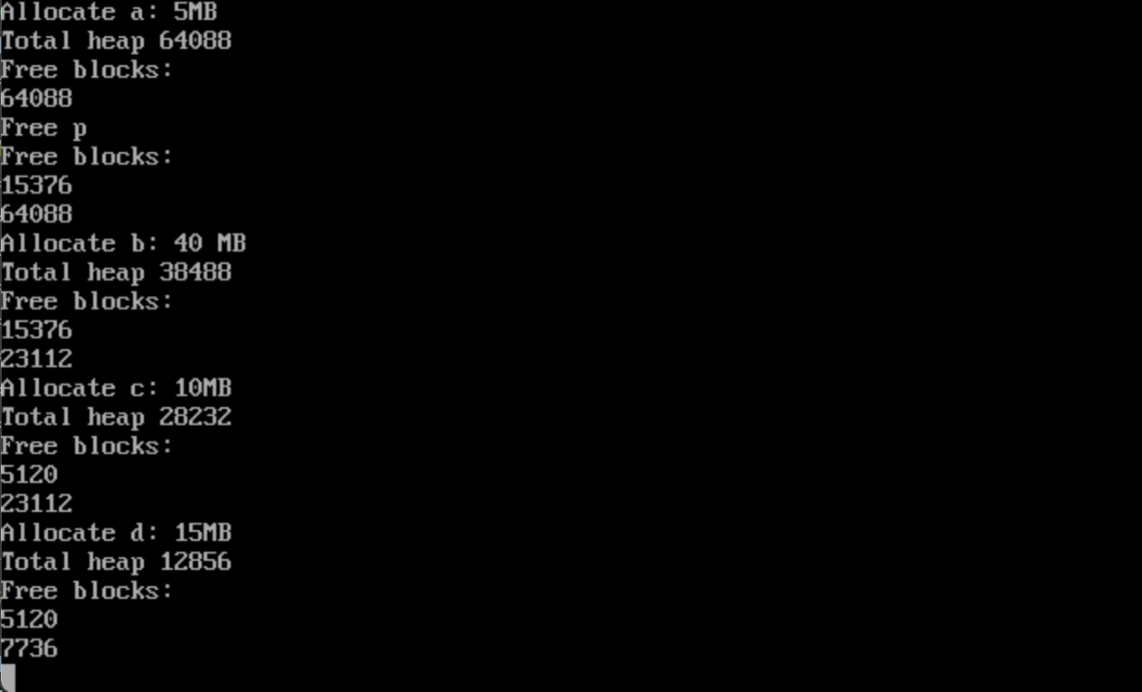
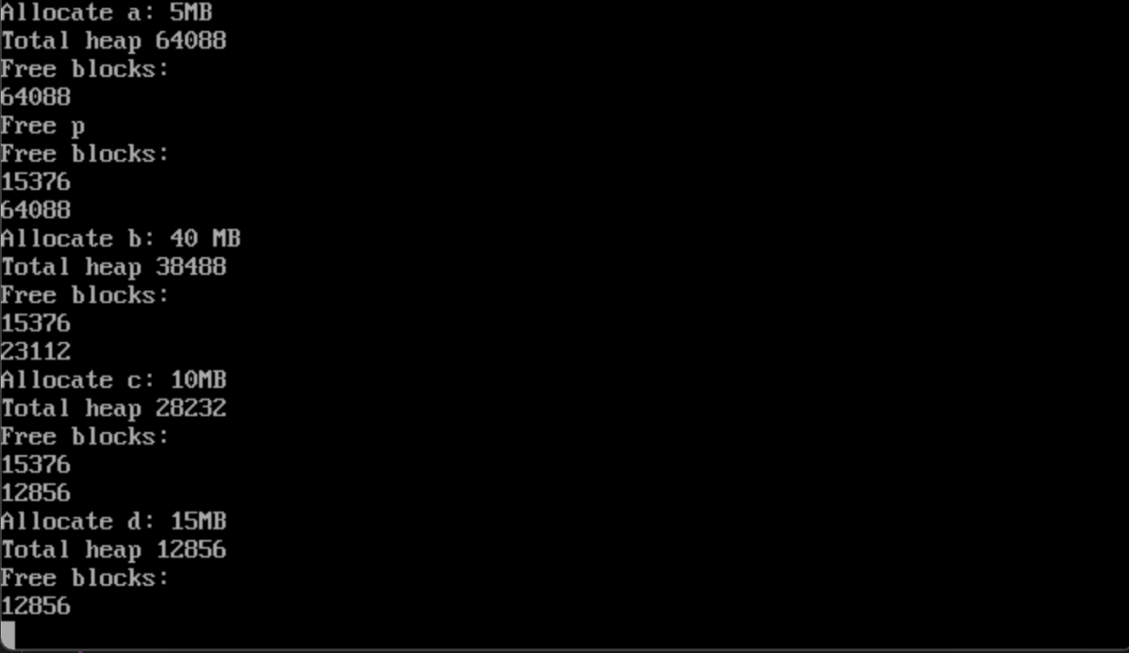
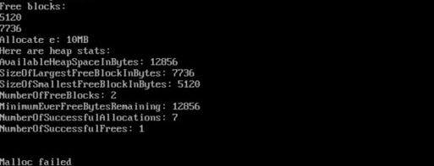
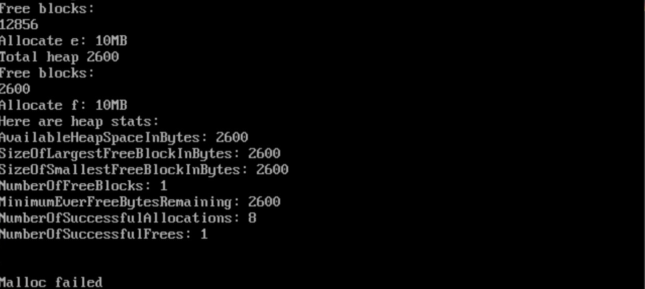
First fit (FreeRTOS default)
Worst fit

Slide 16
Observations
Advantages
Simple implementation
Better suited for certain workloads
Disadvantages
External fragmentation
Poor memory utilization

Slide 17

Buddy system
Power-of-two allocation method
Why?
How it works
Linked list of free blocks

Slide 18
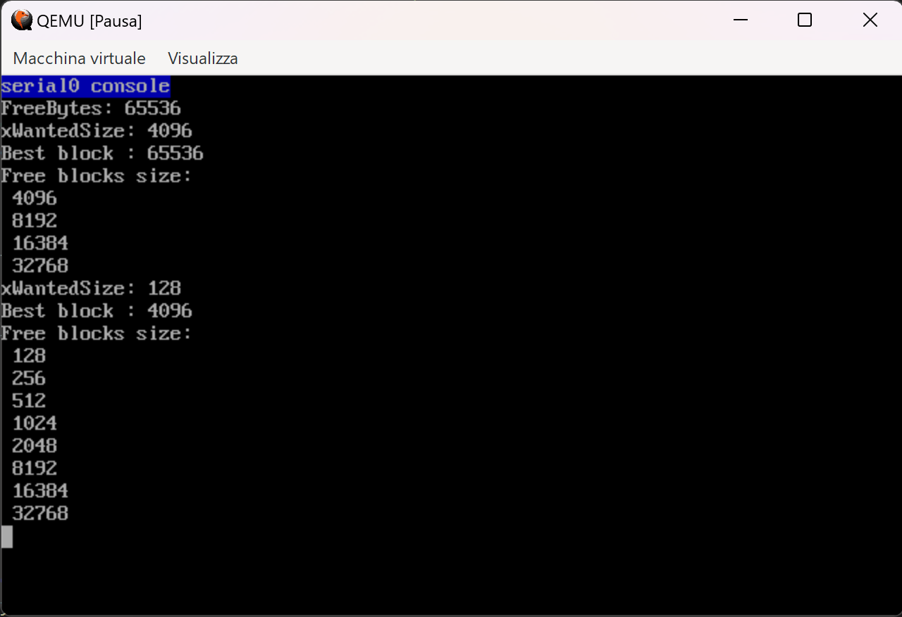
Buddy system in action
Heap initialization
Allocation of different-sized blocks

Slide 19
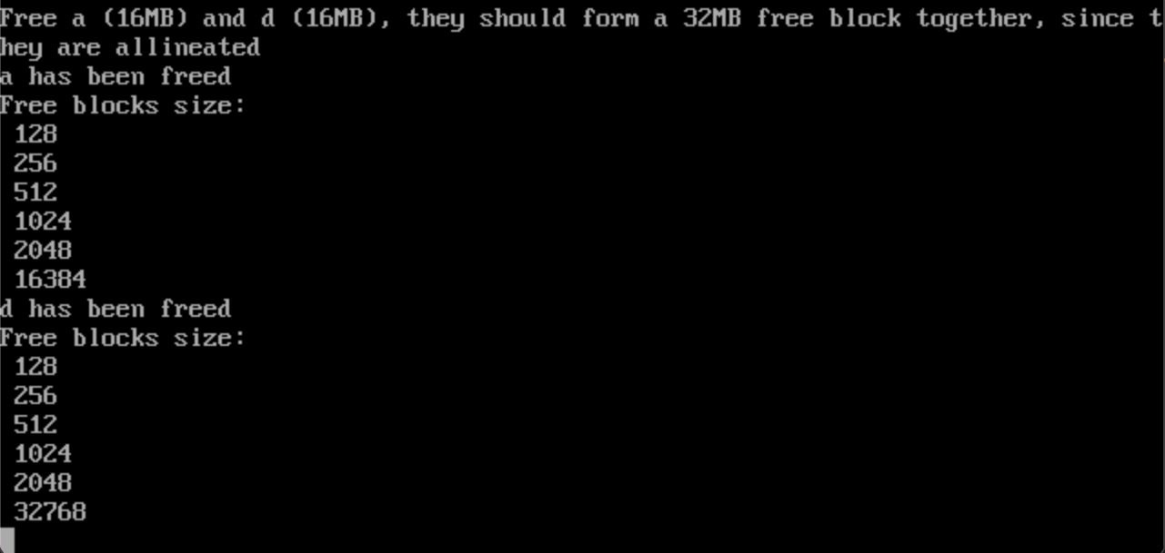
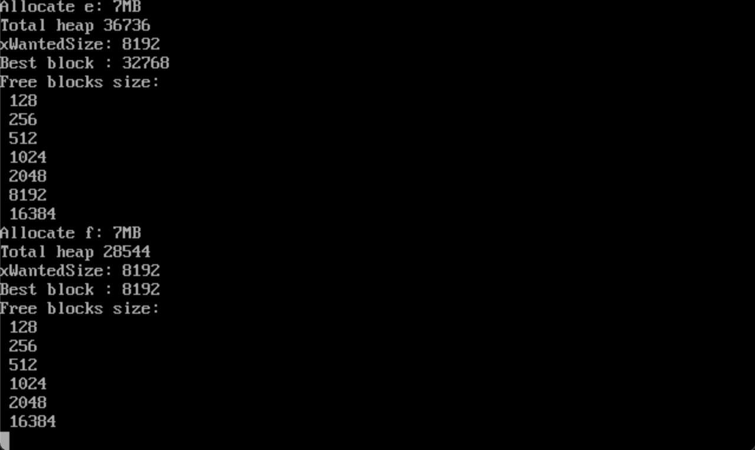
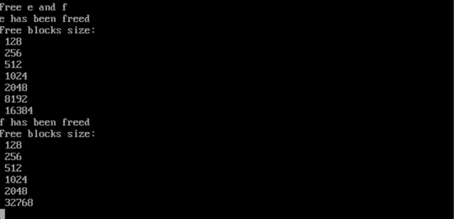
Buddy s​ystem in action cont.
Deallocation of contiguous blocks
Coalescence

Slide 20
Observations
Advantages
Good memory utilization
Reduced fragmentation
Disadvantages
Implementation complexity
Management overhead

Slide 21
Thank you! Any questions?

