Slide 1



How to get rich fast – the turkish way
Forecasting the intraday electricity market in Turkey

Slide 2
Introduction to our project
Forecast the ID3 price of the turkish intraday electricity market
Intraday market
ID3 price

Slide 3



Introduction to our project
Forecast the ID3 price of the turkish intraday electricity market
Intraday market
Producer A sells 10 MW/h for 1 pm – 2 pm
in the Day Ahead Market
Needs to buy 1 MW/h
Wind is not that strong,
Producer A will only produce 9 MW/h

Slide 4
Introduction to our project
Forecast the ID3 price of the turkish intraday electricity market
Intraday market
buy / sell energy during the day
to avoid imbalance costs
ID3 price

Slide 5



Introduction to our project
Forecast the ID3 price of the turkish intraday electricity market
ID3 price
Producer
Market
Market license is expensive
Not necessary to have an own trader when you are a small company

Slide 6

Introduction to our project
Forecast the ID3 price of the turkish intraday electricity market
ID3 price
Producer
Trading
Company
Market
„Please sell 1 MW/h for
hour 1 pm – 2 pm, because
we will produce more than we predicted“
Trader „buys“ 1 MW/h for the
ID3 price from the producer.
Trader tries to sell 1 MW/h
for more than the ID3 price.

Slide 7
Introduction to our project
Forecast the ID3 price of the turkish intraday electricity market
ID3 price
Producer
Trading
Company
Market
Get average price from all trades (<3h before delivery)
If Trader performs better than average he earns money, if not, he loses money

Slide 8




Introduction to our project
Forecast the ID3 price of the turkish intraday electricity market
Intraday market
buy / sell energy during the day
to avoid imbalance costs
ID3 price
averaged price from all trades 3h
before delivery
Agenda
01. Data and features
02. Model fitting
03. Model evaluation
04. Apply trading strategy

Slide 9



01. Data and features
Forecast ID3 price of hour 12 – 1 pm
EPIAS, accessable through API
01.01.2021 – 31.12.2023
Trading window
12
1
26.304 hours, 91 possible features,
appr. 21 mio. trading orders
Data we will use
9
3
6

Slide 10

01. Data and features
Forecast ID3 price of hour 12 – 1 pm
EPIAS, accessable through API
Difference between real
and planned production
01.01.2021 – 31.12.2023
For different power plant types
12
1
26.304 hours, 91 possible features,
appr. 21 mio. trading orders
9
3
Forecasted wind for 8 – 9:
10 MW
8
Real wind for 8 – 9:
15 MW
6

Slide 11

01. Data and features
Forecast ID3 price of hour 12 – 1 pm
EPIAS, accessable through API
Power plant failure
Planned & unplanned failure
01.01.2021 – 31.12.2023
12
1
26.304 hours, 91 possible features,
appr. 21 mio. trading orders
9
3
Information at 8:45:
„Power plant XY will be off for
appr. 4 h“
or
„Production capacity is 50 %
lower as normal for the day“
Difference between real
and planned production
6

Slide 12



01. Data and features
Forecast ID3 price of hour 12 – 1 pm
EPIAS, accessable through API
System direction
01.01.2021 – 31.12.2023
12
1
26.304 hours, 91 possible features,
appr. 21 mio. trading orders
Up / Down regulation
9
3
Difference between real
and planned production
6
Power plant failure
Trade volatility, count, volume
…

Slide 13



02. Model fitting
Forecast the ID3 price of the turkish intraday electricity market
Models:
Random Forest & Boosted Tree Regression
Random Forest & Boosted Tree Classification
Naive Model: ID3 price from day before
Train methods:
Weekdays
Hours
Weekdays & Hours
Idea how to use classification:
Notes:
Training Methoden:
Weekdays : Montage werden mit Montagen traininert, Dienstage mit Dienstagen etc., d.h. wir erhalten für eine Woche 7 Modelle
Hours: Stunde 0-1 wird mit Stunde 0-1 traininert etc., d.h. wir erhalten für jeden Stunde ein Modell, d.h. insgesamt 24 Modelle
Weekdays & Hours: Stunde 0-1 von Montagen wird nur mit Stunde 0-1 von Montagen trainiert etc., d.h. wir erhalten 7*24 Modelle
Classification:
Wir unterteilen die Verteilung der Preise für spezigische Stunden / Wochentage / Wochentagee und Stunden so ein, dass wir 5 % Abstände haben. Die erste Klasse geht dann z.B. von 0- 500 Lira, weil dort 5 % aller Daten sind. Die zweite klasse dann z.B. von 500 – 600 Lira, weil dodrt die nächsten 5 % aller Daten sind und so weiter. Damit sind die Sprünge ziwschen den Preisen bei besonders hohen preisen größer, da es dort auch noch 5 % Klassen sind.
Man hätte auch kleinere Klassen nehmen können, aber damit erhöht sich natürlich die Komplexität

Slide 14
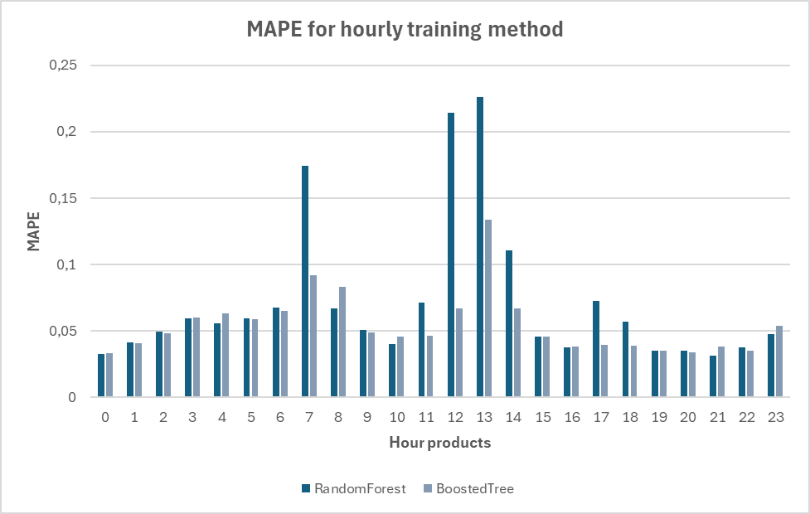
03. Model evaluation Regression (Mean Absolute Percentage Error „MAPE“)
Weekday training method
Hourly training method
Random Forest
Boosted Tree
Monday
4.64 %
8.2 %
Tuesday
3.33 %
3.5 %
Wednesday
3.19 %
3.59 %
Thursday
3.69 %
3.75 %
Friday
3.86 %
3.98 %
Saturday
4.4 %
4.5 %
Sunday
6.67 %
7.12 %
Average
4.25 %
4.95 %
Random Forest
Boosted Tree
Average
7.2 %
5.46 %
Notes:
Weekday training methode:
Sonntage deutlich schlechter, warum: geringere Handelsaktivität, dadurch weniger Daten und schwieriger vorherzusagen
Stündliche Trainingsmethode:
Stunde 7-8, 12-13 und 13-14 höhere fehler bei beiden modellen, da dort volatilität am höchsten ist, da dort am meisten getradet wird.

Slide 15

03. Model evaluation (MAPE)
Random Forest
Boosted Tree
Regression Weekday + Hour
24.64 %
18.5 %
Classification Weekday
25.72 %
23.58 %
Naive method (ID3 price from day before)
39.52 %
Best model: regression with weekday training method
(Mondays are trained with Mondays, …)
Notes:
Weekday + Stunde schlechte ergebnisse, weil: zu wenig Daten
Classification so schlechte accuracy: wissen wir nicht, wegen schlechter genauigkeit (nur ca. ¾ aller klassen werden korrekt zugeordnet) wird die methode nicht weiter verfolgt
Naive modell: fehler von 39.52 % sehr hoch
Mit dem besten modell werden wir jetzt unsere trading srategie anwenden

Slide 16
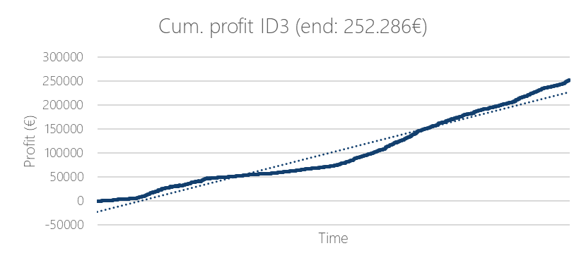
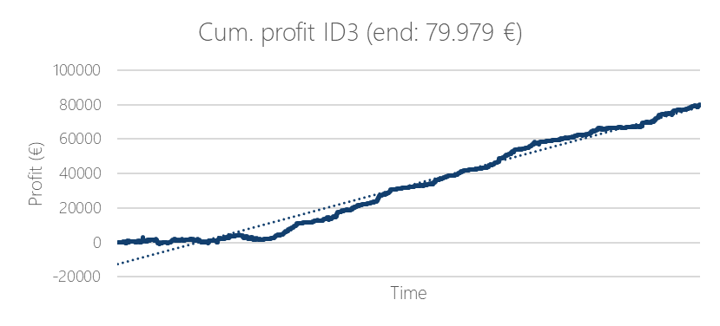
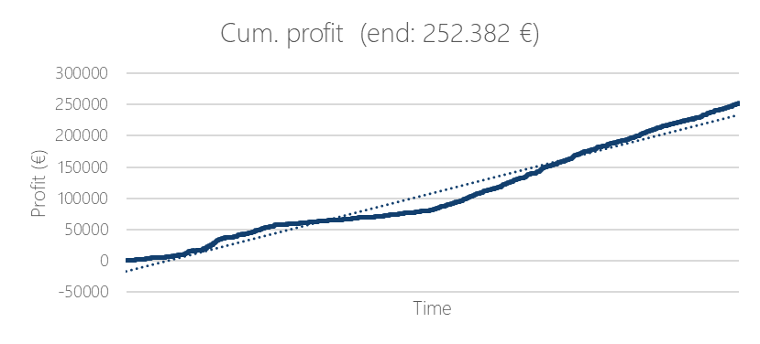
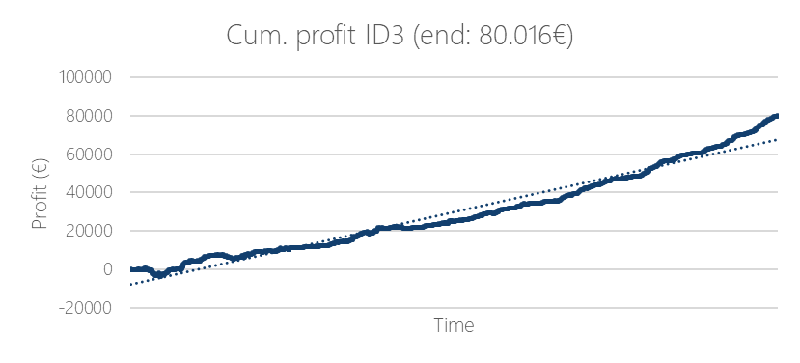
04. Apply trading strategy (buy/sell everything that is lower/higher than pred. ID3)
Random Forest (weekday training method)
Naive method
Buy
Sell
Notes:
Wenn wir selber kaufen wollen, dann kaufen wir alles, was unter dem ID3 Preis liegt (weil wir dann zum ID3 Preis das an unseren Kunden verkaufen und damit geld machen)
Wenn wir verkaufen wollen, dann kaufen wir zum ID3 Preis vom Kunden ab und wollen dann über dem ID3 preis verkaufen, damit wir gewinn machen
Aus einfachheit: nehme an, dass wir einfach alles am markt kaufen / verkaufen können und dafür immer einen abnehmer hätten
Sehen: Naive Methode volatiler und bringt nicht so viel gewinn
Warum sind Preise bei buy und sell so ähnlich:
Weil ID3 Preis ein Mittelwert ist, der aber sehr nah an den Median kommt. Orders sind ähnlich verteilt um den ID3 in beiden richtungen (höher und niedriger), deswegen sehr ähnliche preise. Umrechnung zu Euro von Lira macht den unterschied dann noch kleiner

Slide 17


Thank you for your attention!
Any questions?

Slide 18
Backup slides
About the intraday and day ahead market
Electricity market comparison
Trade information
Example ID3 calculation
Model evaluation Regression (MAPE) 2 hours prior
Features
Feature importance

Slide 19


About the intraday and day ahead market
Day Ahead Market
Intraday Market
11 am
Market opening
2 pm (DA)
Market opening
until 12:30
Bid submission
until 1 pm (ND)
Real- time bid submission,
modification and cancellation
Order book system for
price determination
12:30 – 13:00
Market equilibrium and pricing
13:00
Publication

Slide 20




Electricity market comparison [1], [2], [3]
98,2 GW
235 GW
52,3 %
60 %
ca. 100
ca. 2000
9,4 TWh
80 TWh
1 h
5 min

Slide 21



Trade information
ID3
No ID3
Av. number of trades
279
202
Larger quantities are traded
in the noon hours
If you take the pre ID3 value as estimator, then you get an error of 1.96 %

Slide 22

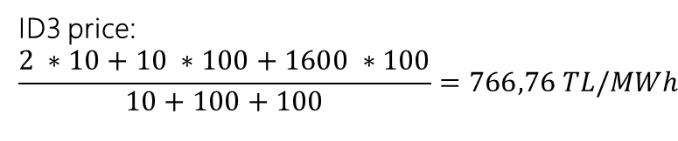
Example ID3 calculation (for hour 12 – 1 pm)
1600 Lira, 100 MW
10 Lira, 100 MW
12
1
2 Lira, 10 MW
9
3
20 Lira, 1 MW
6
120 Lira, 10 MW
80 Lira, 200 MW
100 Lira, 2 MW
ID3 price:
$$\frac{2 ∗10+10 ∗100+1600 ∗100}{10+100+100}=766,76 TL/MWh$$

Slide 23
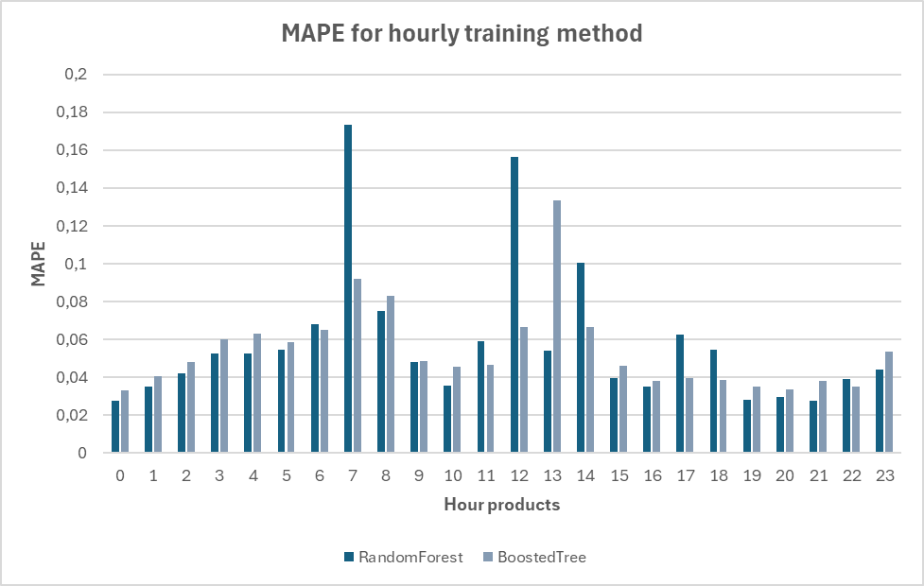
Model evaluation Regression (MAPE) 2 hours prior
Weekday training method
Hourly training method
Random Forest
Boosted Tree
Monday
4.44 %
8.09 %
Tuesday
2.96 %
3.42 %
Wednesday
2.74 %
3.52 %
Thursday
3.17 %
3.41 %
Friday
3.35 %
3.71 %
Saturday
4.07 %
4.77 %
Sunday
5.99 %
9.3 %
Average
3.83 %
5.17 %
Random Forest
Boosted Tree
Average
5.8 %
5.96 %

Slide 24
Features
Calender data
YEAR
WEEKDAY
MONTH
HOUR
DUMMY_WEEKDAY
Planned Production for
different production types
PL_PR_TOTAL
PL_PR_GAS
PL_PR_WIND
PL_PR_LIGNITE
PL_PR_BC
PL_PR_IC
PL_PR_OIL
PL_PR_GEO
PL_PR_HYDRO
PL_PR_NAPHTA
PL_PR_BIO
PL_PR_RIVER
PL_PR_OTHER
Difference between total production and real production
H hours prior to our delivery date
DIFFERENZ_PR_INJ_TOTAL_{H}_h
DIFFERENZ_PR_INJ_GAS_{H}_h
DIFFERENZ_PR_INJ_WIND_{H}_h
DIFFERENZ_PR_INJ_LIGNITE_{H}_h
DIFFERENZ_PR_INJ_BC_{H}_h
DIFFERENZ_PR_INJ_IC_{H}_h
DIFFERENZ_PR_INJ_OIL_{H}_h
DIFFERENZ_PR_INJ_GEO_{H}_h
DIFFERENZ_PR_INJ_HYDRO_{H}_h
DIFFERENZ_PR_INJ_NAPHTA_{H}_h
DIFFERENZ_PR_INJ_BIO_{H}_h
DIFFERENZ_PR_INJ_RIVER_{H}_h
DIFFERENZ_PR_INJ_OTHER_{H}_h
Averaged difference from last 3 hours H hours prior to del. date
ROLLING_WINDOW_DIFFERENZ_PR_INJ_TOTAL_{H}_h
ROLLING_WINDOW_DIFFERENZ_PR_INJ_GAS_{H}_h
ROLLING_WINDOW_DIFFERENZ_PR_INJ_WIND_{H}_h
ROLLING_WINDOW_DIFFERENZ_PR_INJ_LIGNITE_{H}_h
ROLLING_WINDOW_DIFFERENZ_PR_INJ_BC_{H}_h
ROLLING_WINDOW_DIFFERENZ_PR_INJ_IC_{H}_h
ROLLING_WINDOW_DIFFERENZ_PR_INJ_OIL_{H}_h
ROLLING_WINDOW_DIFFERENZ_PR_INJ_GEO_{H}_h
ROLLING_WINDOW_DIFFERENZ_PR_INJ_HYDRO_{H}_h
ROLLING_WINDOW_DIFFERENZ_PR_INJ_NAPHTA_{H}_h
ROLLING_WINDOW_DIFFERENZ_PR_INJ_BIO_{H}_h
ROLLING_WINDOW_DIFFERENZ_PR_INJ_RIVER_{H}_h
ROLLING_WINDOW_DIFFERENZ_PR_INJ_OTHER_{H}_h
Trading data
TRADE_COUNT_{H}_h
TRADE_VOLATILITY_{H}_h
TRADE_VOLUME_{H}_h
PRE_ID3_{H}_h
AV_TRADE_COUNT_{H}_h
AV_TRADE_VOLATILITY_{H}_h
AV_TRADE_VOLUME_{H}_h
AV_PRE_ID3_{H}_h
Day Ahead information
DA_PRC_DAY_BEFORE
DA_AV_PRC_3_DAYS
DA_PRC_SAME_DAY
DA_VOL_DAY_BEFORE
DA_VOL_SAME_DAY
DA_AV_VOL_3_DAYS
Additional injection data
INJ_SUN_{H}_h
INJ_ASPHAL_{H}_h
INJ_LNG_{H}_h
INJ_II_{H}_h
INJ_IE_{H}_h
ROLLING_WINDOW_INJ_SUN_{H}_h
ROLLING_WINDOW_INJ_ASPHAL_{H}_h
ROLLING_WINDOW_INJ_LNG_{H}_h
ROLLING_WINDOW_INJ_II_{H}_h
ROLLING_WINDOW_INJ_IE_{H}_h
Balance market data
SYSTEM_DIRECTION_{H}_h
ROLLING_WINDOW_PAST_SYS_DIR_{H}_h
UP_REG_{H}_h_0
UP_REG_{H}_h_1
UP_REG_{H}_h_2
DOWN_REG_{H}_h_0
DOWN_REG_{H}_h_1
DOWN_REG_{H}_h_2
Wind data
FORECAST_LOAD_SAME_DAY
ROLLING_WINDOW_DIFF_LOAD{H}_h
DIFF_FOR_GEN_WPP_{H}_h
GENERATION_WPP_{H}_h
FORECAST_WPP
Failure Information
PL_FI_LOAD
UNPL_FI_LOAD_{H}_h
ROLLING_WINDOW_UNPL_FI_LOAD{H}_h
POWER_FI_{H}_h
ROLLING_WINDOW_POWER_FI{H}_h

Slide 25
Feature importance (Tuesday, RF, test size: 0.2, estimators: 100, max_depth: 10, min_samples_leaf: 2)
Feature names | Relative percentage
PRE_ID3_3_h | 0.992570
DOWN_REG_3_h_0 | 0.000955
TRADE_VOLATILITY_3_h | 0.000570
DA_PRC_SAME_DAY | 0.000531
DA_VOL_SAME_DAY | 0.000453
PL_PR_BIO | 0.000301
UP_REG_3_h_0 | 0.000280
PL_PR_GAS | 0.000262
DIFF_FOR_GEN_WPP_3_h | 0.000234
PL_PR_IC | 0.000185
ROLLING_WINDOW_DIFFERENZ_PR_INJ_OTHER_3_h | 0.000162
AV_TRADE_VOLATILITY_3_h | 0.000136
ROLLING_WINDOW_PAST_3_h_SYSTEM_DIRECTION_3_h | 0.000134
DA_VOL_DAY_BEFORE | 0.000124
SYSTEM_DIRECTION_3_h | 0.000111
PL_PR_LIGNITE | 0.000107
DA_PRC_DAY_BEFORE | 0.000106
ROLLING_WINDOW_PAST_3_h_POWER_FI_3_h | 0.000100
DA_AV_PRC_3_DAYS | 0.000097
DA_AV_VOL_3_DAYS | 0.000091

Slide 26
Sources
[1] Electricity Market Report 2023 – Analysis – IEA
[2] Research on energy efficiency, CO2 emissions, energy consumption, forecast (enerdata.net)
[3] Overview of the Turkish Electricity Market (pwc.com.tr)

