Slide 1
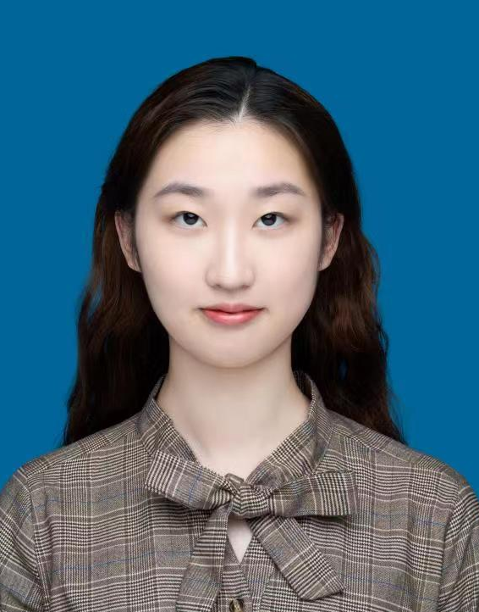
ZHANG Wenxuan
MPhil student (2023. Sep-)
B.S., Southern University of Science and Technology

