Slide 1


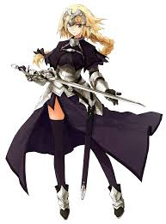
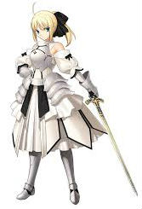




HOME
ABOUT
CHESS
Ruler
Saber
Assasin
Archer
There are new things here!
There are new things here!
There are new things here!
There are new things here!
Design by NTUT

Slide 2
設計理念
由於版面跟大版的差距不是很多，於是沒有使用漢堡，把上面的導覽變少一些，讓畫面可以更快的看到重點。

