Slide 1
SW4-to-ESSI
Arthur Rodgers
LLNL
May 3, 2019

Slide 2
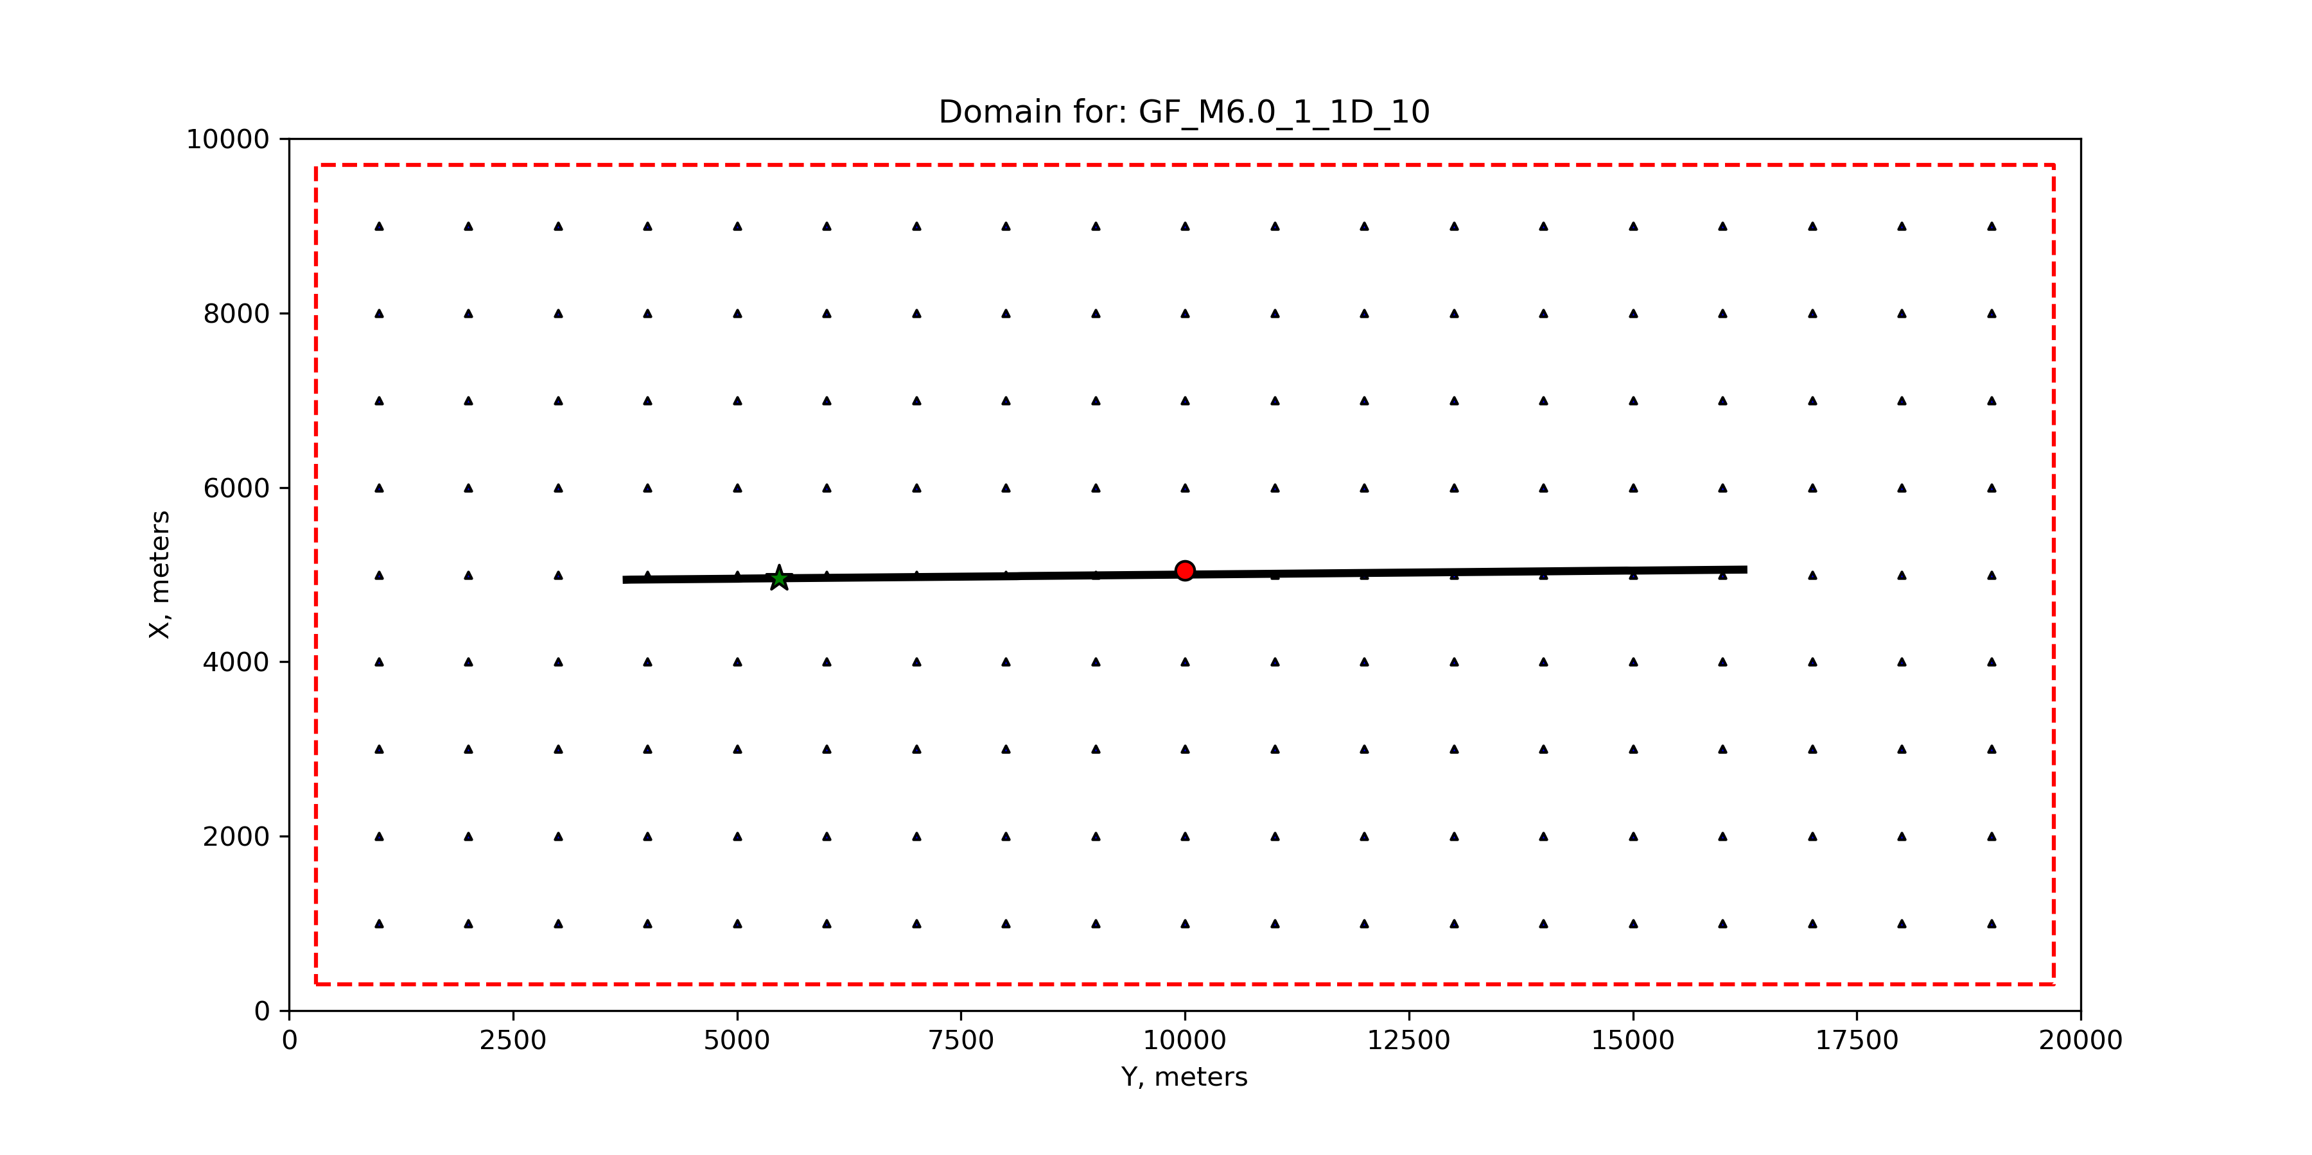
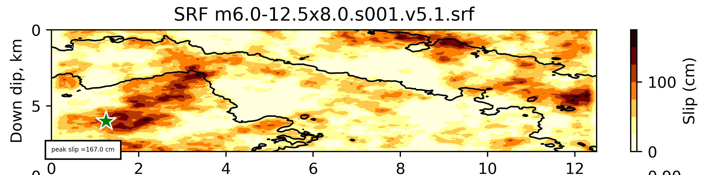
Simple test case: Mw 6.0, vertical strike slip earthquake
Syntax:
essioutput file=M6.0_ESSI_SRF_X xmin=6000 xmax=6240 ymin=10000 ymax=10040 depth=120
ESSI domain
Approx. ESSI location
Slip distribution

Slide 3
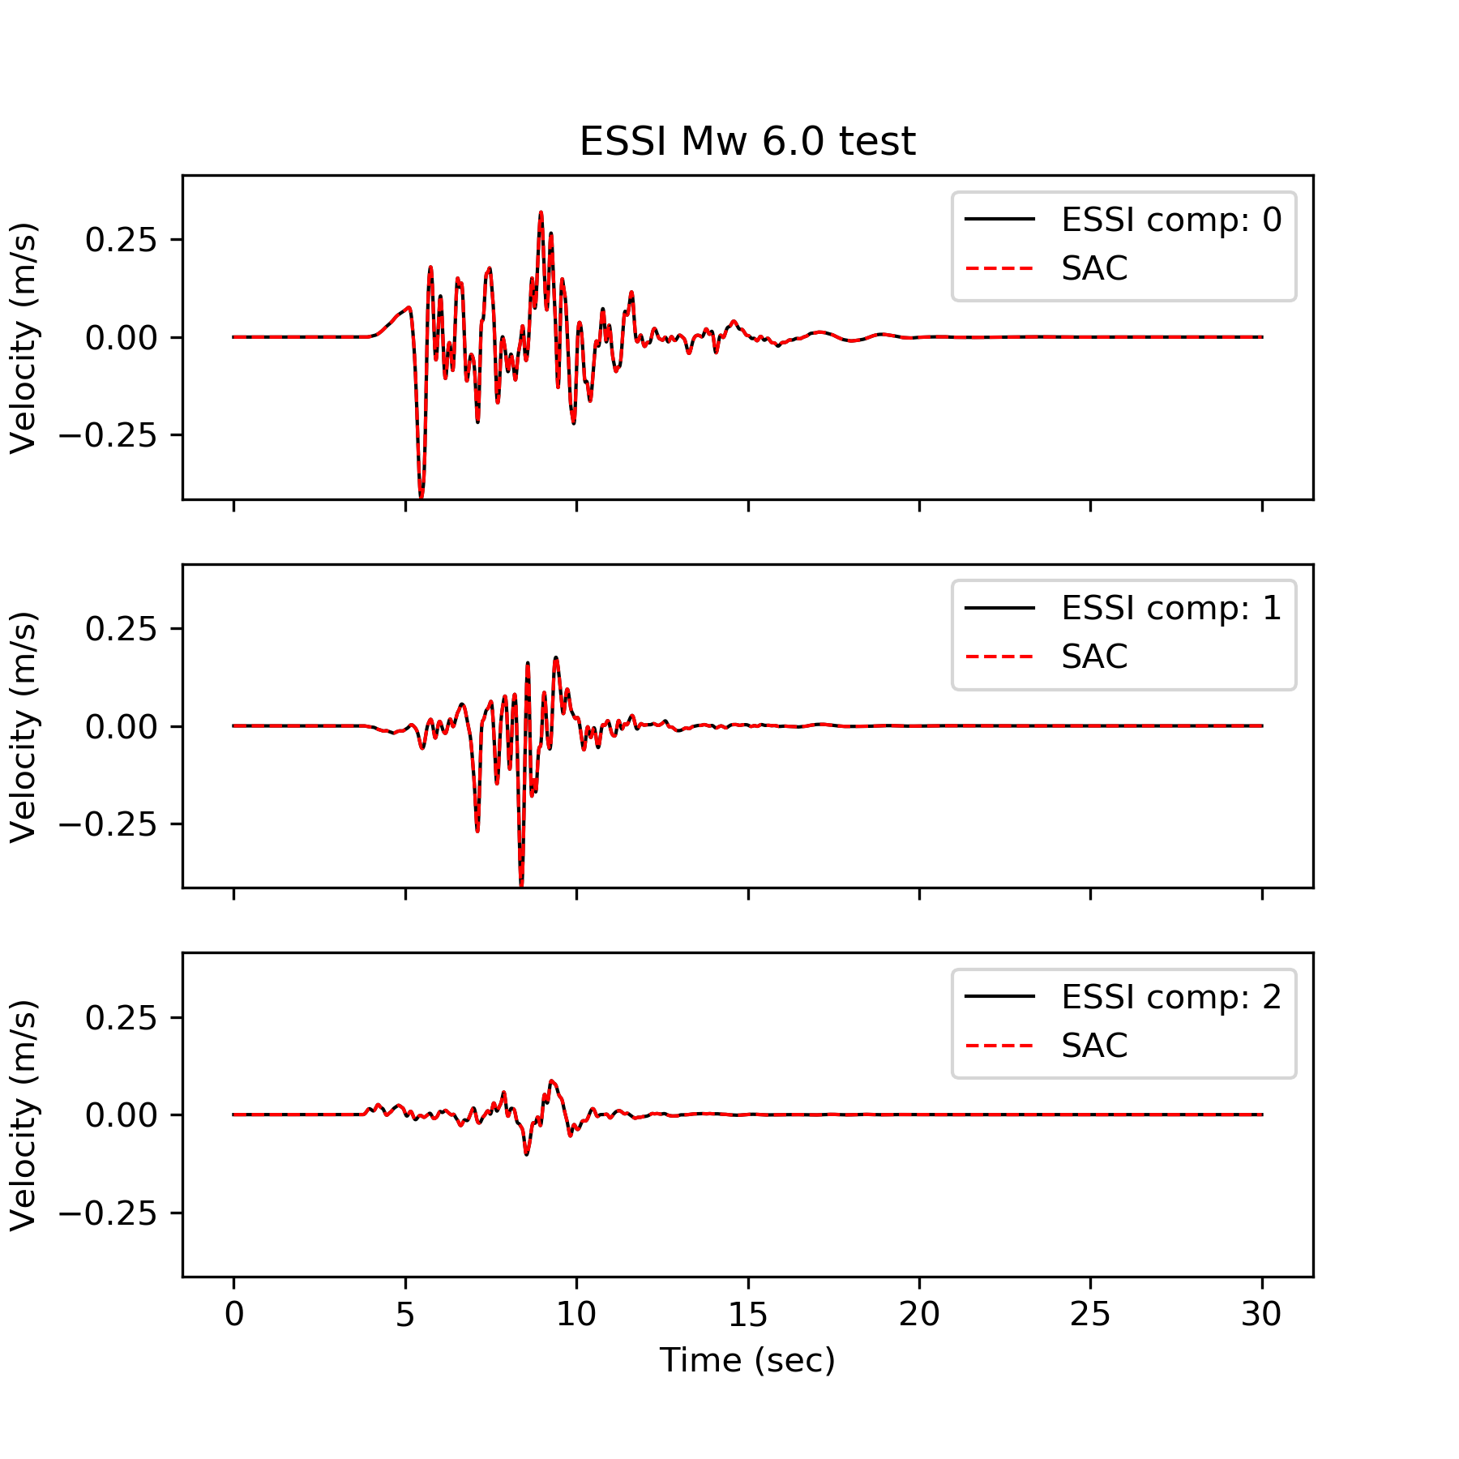
Verification: compare essioutput HDF5 with SAC
Point located at ESSI origin
X = 6000 m
Y = 10000 m
Ground velocity in m/s

Slide 4
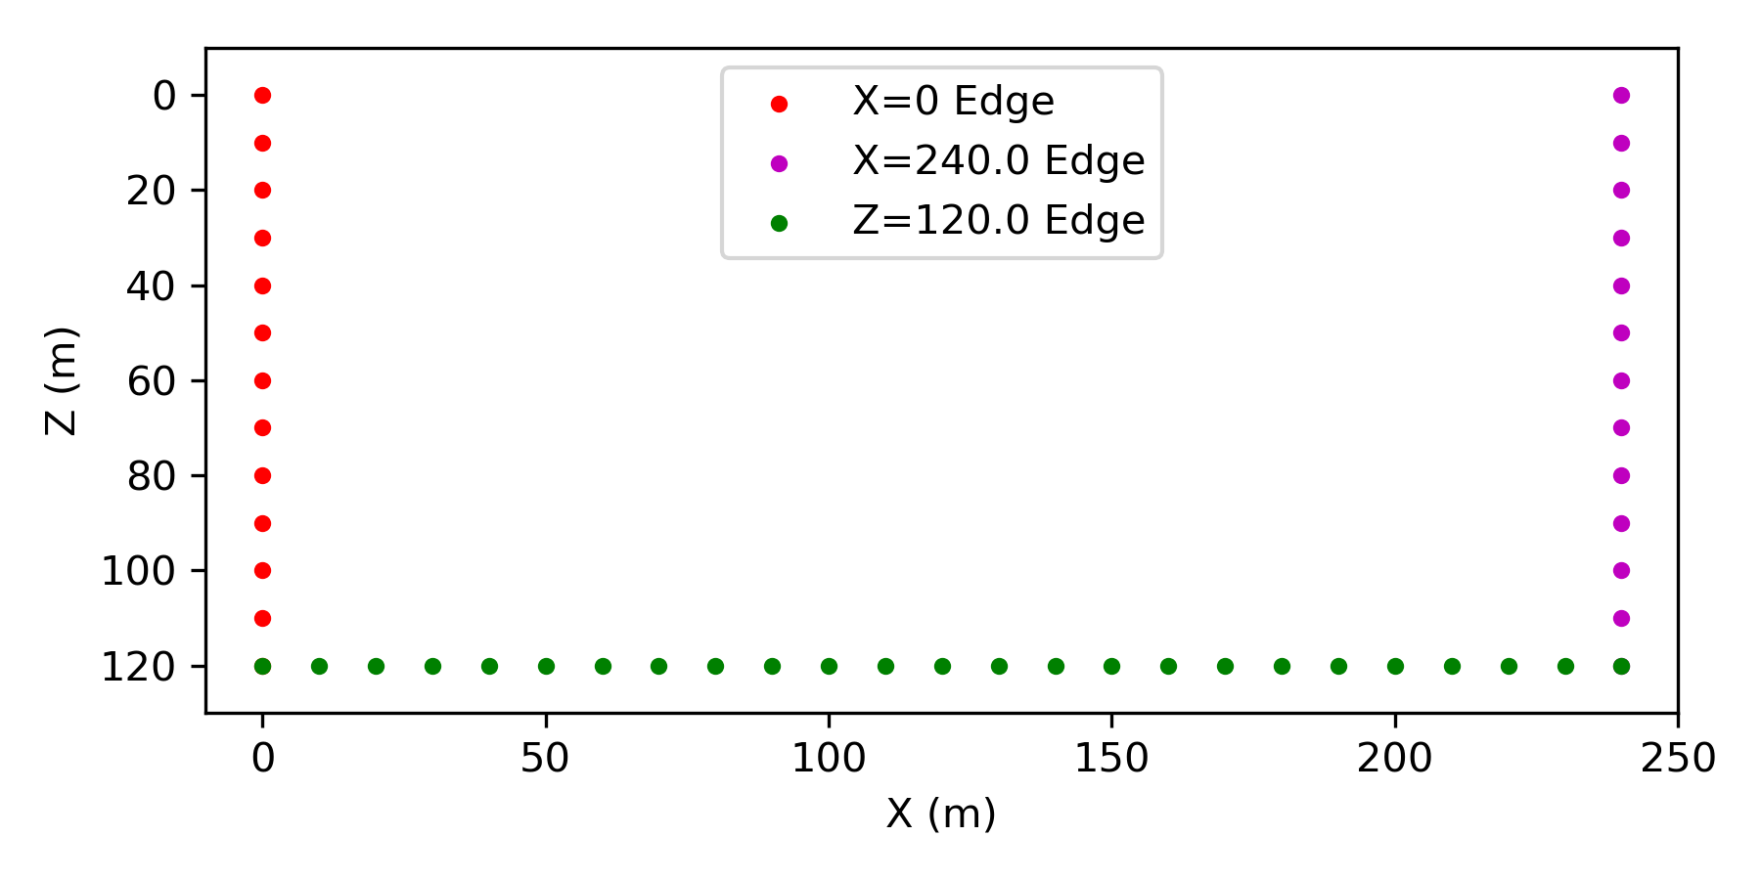
Visualization of essioutput HDF5
Suiwen interested in 2D planar data
For the case I ran, we only consider the Y=0 plane and points along the edges (right)
Dimensions:
X: 240 m
Y: 40 m
Z: 120 m
﻿import h5py
﻿﻿filename = 'M6.0_ESSI_SRF_X.cycle=00000.essi'
f = h5py.File(filename, 'r')
# List all groups
print("Keys: %s" % f.keys())
a_group_key = list(f.keys())[0]

Slide 5
Python h5py package makes it easy to access and manipulate HDF5 data
import h5py
﻿﻿filename = 'M6.0_ESSI_SRF_X.cycle=00000.essi'
f = h5py.File(filename, 'r')
# List all groups
print("Keys: %s" % f.keys())
a_group_key = list(f.keys())[0]
# Get parameter values from HDF5 data
h = f['ESSI xyz grid spacing'].value[0]
x0 = f['ESSI xyz origin'][0]
y0 = f['ESSI xyz origin'][1]
z0 = f['ESSI xyz origin'][2]
print ('grid spacing, h: ', h)
print ('ESSI origin x0, y0, z0: ', x0, y0, z0)
t0 = f['time start'].value[0]
npts = f['cycle start, end'][1]
dt = f['timestep'].value[0]
t1 = dt*(npts-1)
nx = f['vel_0 ijk layout'].shape[0]
ny = f['vel_0 ijk layout'].shape[1]
nz = f['vel_0 ijk layout'].shape[2]
time = np.linspace(t0, t1, npts+1)
t1 = time[-1]
v = np.zeros((3,npts+1))
v[0,:] = f['vel_0 ijk layout'][0,0,0,:]
v[1,:] = f['vel_1 ijk layout'][0,0,0,:]
v[2,:] = f['vel_2 ijk layout'][0,0,0,:]
vmax = max( np.abs(v.min()), np.abs(v.max()) )

Slide 6
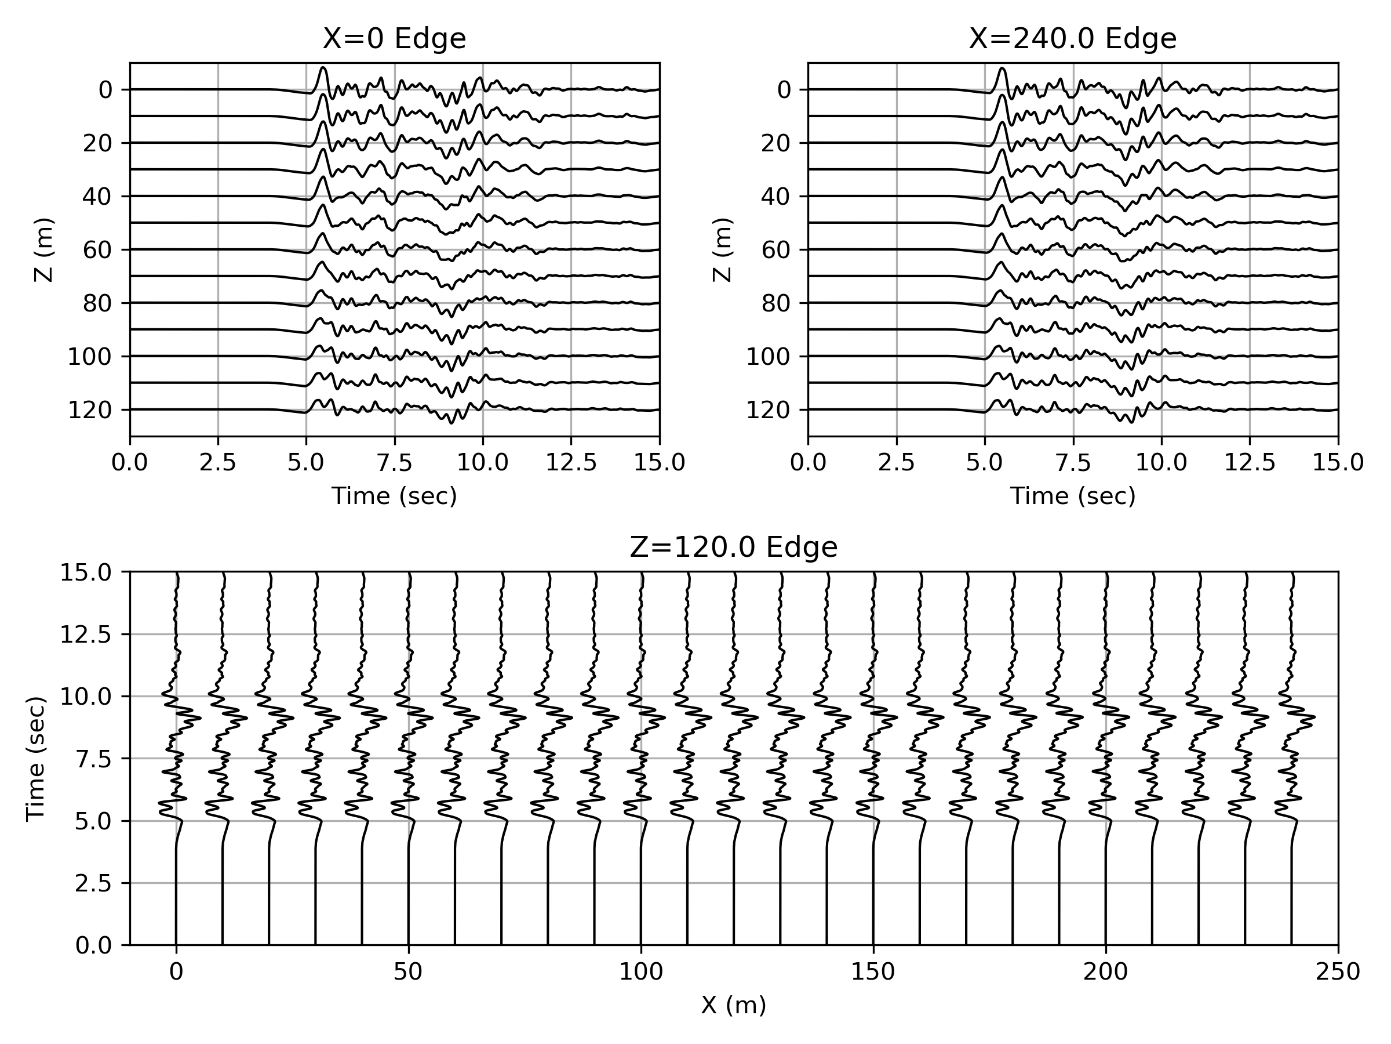
Visualization of essioutput HDF5: X-component (fault-normal)

Slide 7
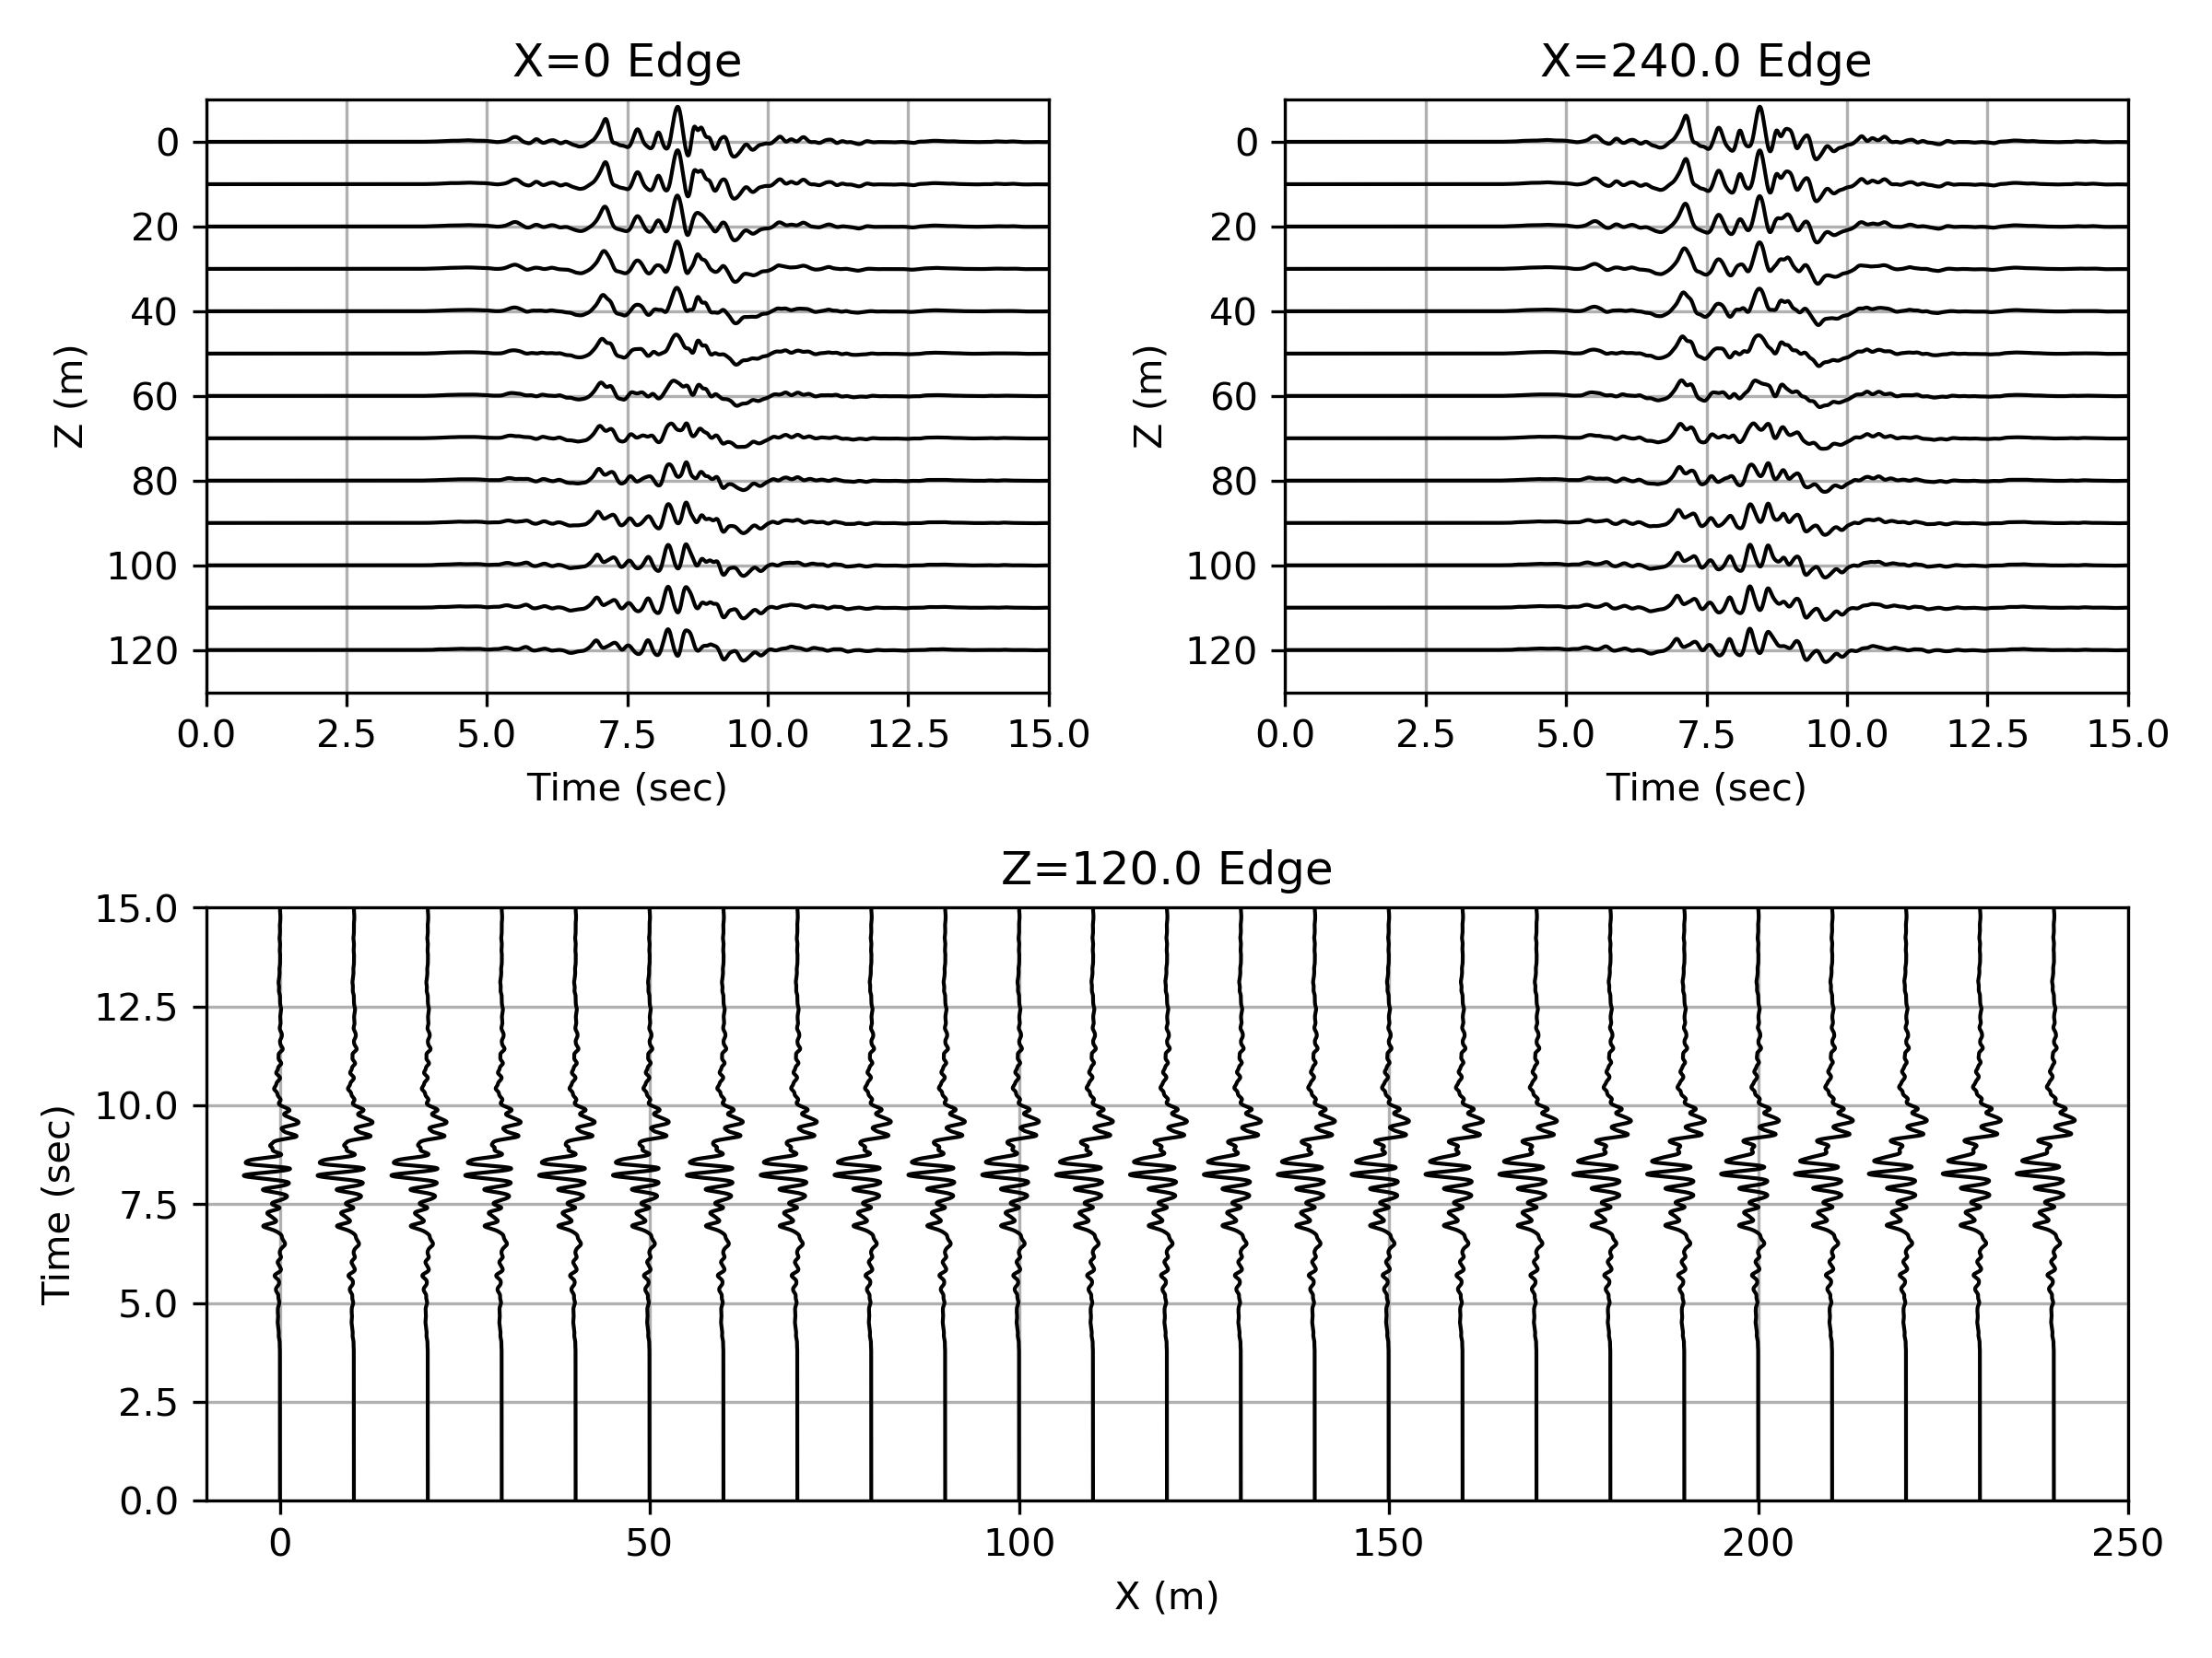
Visualization of essioutput HDF5: Y-component (fault-parallel)

Slide 8
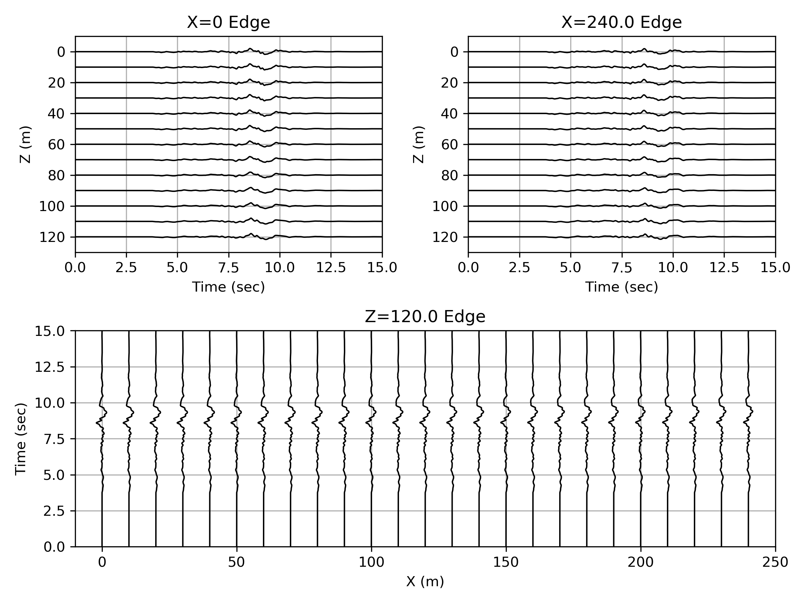
Visualization of essioutput HDF5: Z-component (vertical)

