Slide 1

FILTER FUNCTIONS POWER BI
VIZAG

Slide 2
IMPORTANT FILTER FUNCTIONS IN DAX
1) Calculate
2) Calculatetable
3) Filter
4) ALL
5) ALLexpect
6) ALLSelected
7) Remove filters
8) KeepFilters
9) Lookupvalues

Slide 3
Difference between
sum() and calculate()
No difference between these two functions.
But as a syntax wise difference is there,
In sum function there is no expression.
But in calculate function , thru expression you can calculate.
In calculate function, you can use it filters,
In syntax filter1,filter 2, like that you can use it any number of filters, but it is optional.
In previous slide what are the filter commands are there, those commands we are using in calculate function.

Slide 4
Examples:
Take Measure column
Total sales=sum(sales)
Examples:
Take Measure column
Total sales=calculate(sum(sales))

Slide 5
Examples:
Take Measure column
Total sales=calculate(sum(sales),and(customer country="india",channel type="post"))
Examples:
Take Measure column
Total sales=calculate(sum(sales),or(customer country="india",channel type="post"))

Slide 6
What is the difference between calculate and calculatetable.
Both are all most same.
But calculate returns scalar value(single value),
Where as calculatetable returns table value. Ie is the difference of both.
Example1:
Take table column
Table calculatetable = CALCULATETABLE(financials,financials[Country]="germany")

Slide 7
Example2:
Take table column
Table calculatetable = CALCULATETABLE(financials,and(financials[Country]="germany",financials[Discount Band]="high"))

Slide 8
FILTER :
FILTER function is just like a CALCULATETABLE , both functions retuns table type.
Example 1:
Select table in measure, column and table options
country fileter = FILTER(financials,financials[Country]="canada")
Example 2:
country fileter = FILTER(financials,
and(financials[Country]="canada",financials[Month Name]="december"))

Slide 9
I want to use Filter in Calculate function
Example: in column option
Column calculate fileter = CALCULATE(sum(financials[ Sales]),FILTER(financials,and(financials[Country]="canada",financials[Discount Band]="high")))

Slide 10
ALL
Using ALL remove filters from table or column.
To create a DUPLICATE TABLE.
EXAMPLE 1: select TABLE column
Table all duplicate = all(financials) ----->it creates duplicate table.

Slide 11
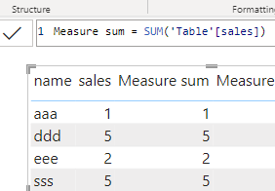
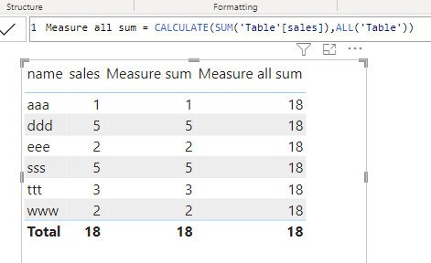
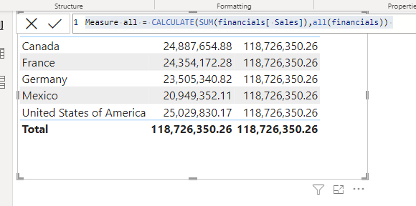
ALL
EXAMPLE 2 :
Measure all = CALCULATE(SUM(financials[ Sales]),all(financials))
FOLLOWING example, using measure column calculate the sum of total , originally it displays, row wise sum,
But here it displayed overall sum of sales, that means here it not included filter ,it removes the filter and display overall sum of sales.
In ALL function should be define the TABLE NAME.

Slide 12
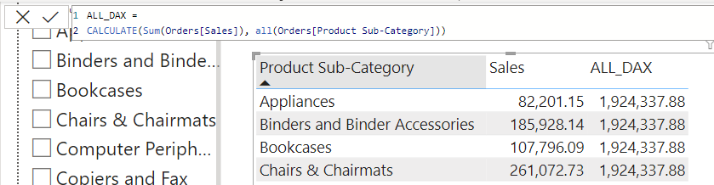
ALL
Example 3: excel file : file
ALL_DAX =
CALCULATE(Sum(Orders[Sales]), ALL(Orders[Product Sub-Category]))

Slide 13
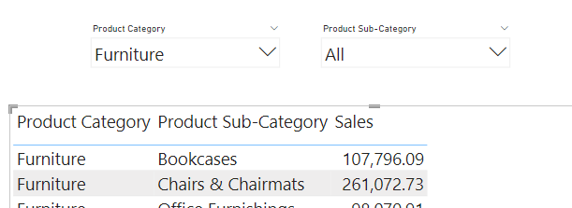
ALLEXCEPT
EAMPLE: excel file : file
Drag
Drag Table & 2 Slicers from visualization Pane.
Drag
Slicers: Drag Product Category in first slicer & Product sub category in second slicer
Table
Table: Drag three fields in table, Product Category, Product Sub Category & Sales from Orders Dataset

Slide 14
ALLEXCEPT
EAMPLE: excel file : file
Create MEASURE column and write DAX formula for ALLEXCEPT function.
ALLEXCEPT_SALES =
CALCULATE(
SUM(Orders[Sales]),
ALLEXCEPT(Orders,Orders[Product Category])
)

Slide 15
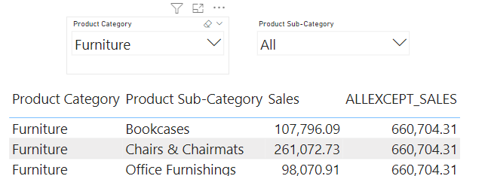
ALLEXCEPT
EAMPLE: excel file : file
Now Drag ALLEXCEPT_SALES measures into table

Slide 16
ALLEXCEPT
EAMPLE: excel file : file
Now put filter on Product Category & see the measure ALLEXCEPT_SALES result, it is returning Total Sales sum of Furniture.
Now put filters on both slicers and see the result

Slide 17
ALLSELECTED
EAMPLE: excel file : file
Repeat the same procedure of the previous function, except slicers.
Here take one slicer and table.
ALLSELECTED_DAX =
CALCULATE(Sum(Orders[Sales]),ALLSELECTED(Orders[Product Sub-Category]))

Slide 18
REMOVEFILTERS
EAMPLE: excel file : file
Removes the specified column filter.
Measure totalsales allremove = CALCULATE(sum(Orders[Sales]),REMOVEFILTERS(Orders[Product Category]))

Slide 19
KEEPFILTERS
EAMPLE: excel file : file
It keeps the specified column filter.
Measure totalsales keepfilers = CALCULATE(sum(Orders[Sales]),KEEPFILTERS(Orders[Sales]))

