Slide 1
INTELLIGENCE FUNCTIONS
vizag

Slide 2
CLOSINGBALANCEMONTH | Evaluates the expression at the last date of the month in the current context.
CLOSINGBALANCEQUARTER | Evaluates the expression at the last date of the quarter in the current context.
CLOSINGBALANCEYEAR | Evaluates the expression at the last date of the year in the current context.

Slide 3
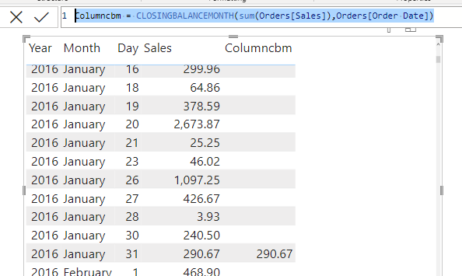
CLOSINGBALANCEMONTH
Evaluates the expression at the last date of the month in the current context.
Example Excel File : Sample - Superstore
Take TABLE tool, drag order date and sales.
In date remove 'quarter '.
In sales select don't summarize.
Create 'NEW COLUMN'.
Column cbm=C CLOSINGBALANCEMONTH(sum(Orders[Sales]),Orders[Order Date])
Here it displays month ending total sales.

Slide 4
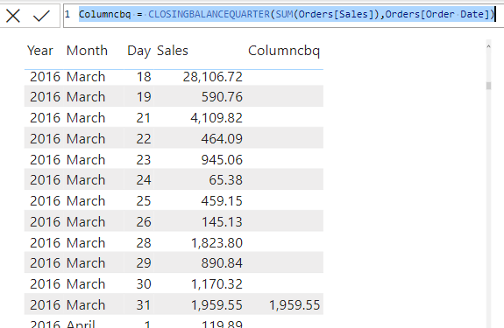
CLOSINGBALANCEQUARTER
The last date of the quarter in the current context
Example Excel File : Sample - Superstore
Take TABLE tool, drag order date and sales.
In date remove 'quarter '.
In sales select don't summarize.
Create 'NEW COLUMN'.
Columncbq = CLOSINGBALANCEQUARTER(SUM(Orders[Sales]),Orders[Order Date])
Here it displays quarter ending total sales.

Slide 5
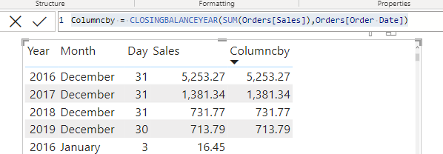
CLOSINGBALANCEYEAR
The last date of the YEAR in the current context
Example Excel File : Sample - Superstore
Take TABLE tool, drag order date and sales.
In date remove 'quarter '.
In sales select don't summarize.
Create 'NEW COLUMN'.
Columncby = CLOSINGBALANCEYEAR(SUM(Orders[Sales]),Orders[Order Date])
Here it displays YEAR ending total sales.

Slide 6
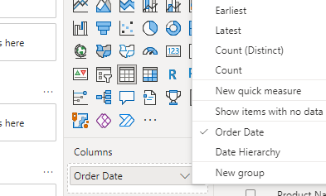
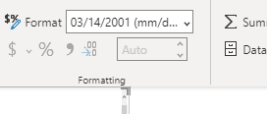
OPENINGBALANCEMONTH
the first date of the month in the current context
Example Excel File : Sample - Superstore
Take TABLE tool from visualization , drag order date and sales.
In date remove 'quarter '.
In visualization under values click order date,
Select order date instead of data hierarchy.
Then select order date and in format menu change the date format (mm/dd/yyyy) .

Slide 7
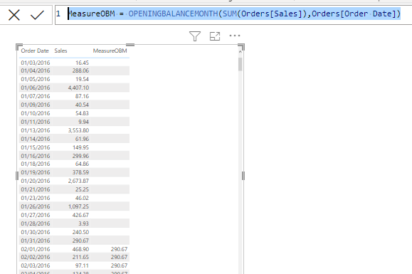
OPENINGBALANCEMONTH
Right click on table name and select NEW MEASURE. Type following formulae
MeasureOBM = OPENINGBALANCEMONTH(SUM(Orders[Sales]),Orders[Order Date])

Slide 8
OPENINGBALANCEQUARTER
Repeat the previous steps same here also.
MeasureOBQ = OPENINGBALANCEQUARTER(SUM(Orders[Sales]),Orders[Order Date])
OPENINGBALANCEYEAR
Repeat the previous steps same here also.
MeasureOBY = OPENINGBALANCEYEAR(SUM(Orders[Sales]),Orders[Order Date])

Slide 9
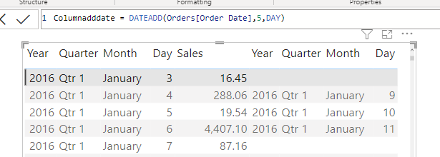
DATEADD
Returns a table that contains a column of dates, shifted either forward or backward in time by the specified number of intervals from the dates in the current context.
Example Excel File : Sample - Superstore
Select table tool from visualization
Select order date and sales from 'ORDERS' table.
Select sales also from 'ORDERS' table.
Columnadddate = DATEADD(Orders[Order Date],5,DAY)

Slide 10
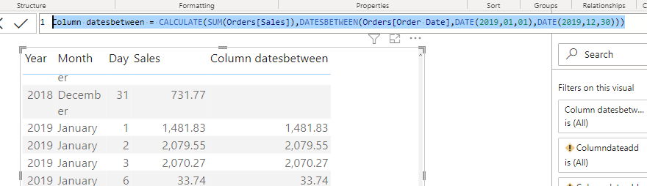
DATESBETWEEN
DATESBETWEEN function allows you to calculate amounts between two dates you specify.
Example Excel File : Sample - Superstore
Repeat the same steps of previous slide.
Column datesbetween = CALCULATE(SUM(Orders[Sales]),DATESBETWEEN(Orders[Order Date],DATE(2019,01,01),DATE(2019,12,30)))
In before dates there is no data.

Slide 11
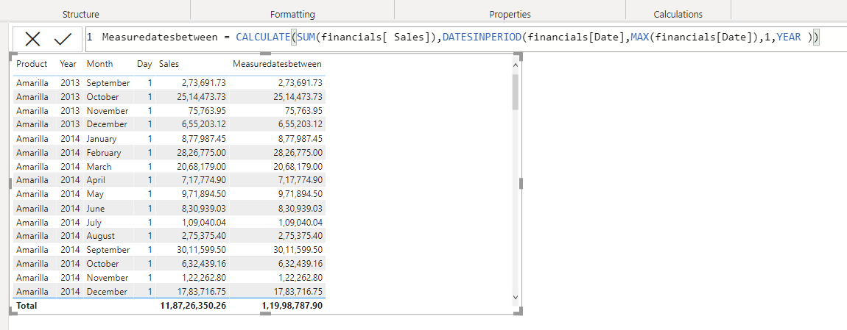
DATESINPERIOD
Returns a table that contains a column of dates that begins with a specified start date and continues for the specified number and type of date intervals.
This function is suited to pass as a filter to the CALCULATE function. Use it to filter an expression by standard date intervals such as days, months, quarters, or years.

Slide 12
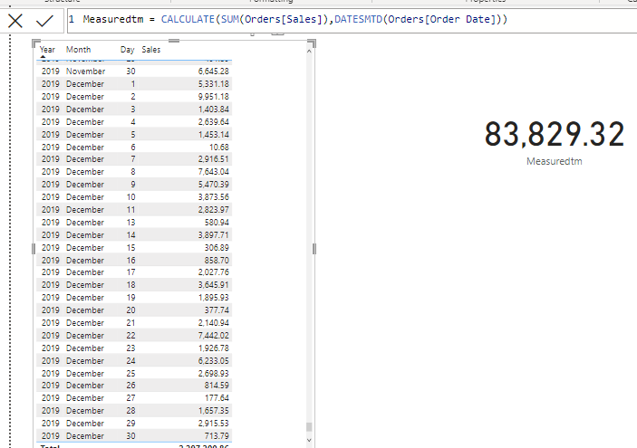
DATESMTD
Returns a table that contains a column of the dates for the month to date, in the current context.
It returns the last year last month total.
Example :
12/31/2019 is the last date of the data.
It gives the 12/01/2019 to 12/31/2019 this month and last year total.
Data file is :Sample – Superstore
Open the file in excel
And to find the last month sum,
Using sum function in excel.
That result should be equal to
In card result then it is corrent.

Slide 13
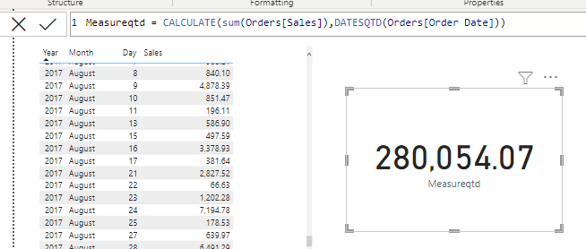
DATESQTD
Returns a table that contains a column of the dates for the quarter to date, in the current context.
It returns the last year last month total.
Example :
12/31/2019 is the last quarter of the data.
It gives the 10/01/2019 to 12/31/2019 this quarter and last year total.
Data file is :Sample – Superstore
Open the file in excel
And to find the last quarter sum,
Using sum function in excel.
That result should be equal to
In card result then it is correct.

Slide 14
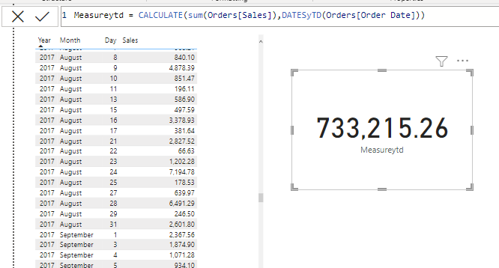
DATESYTD
Returns a table that contains a column of the dates for the year to date, in the current context.
It returns the last year last year total.
Example :
12/31/2019 is the last quarter of the data.
It gives the 01/01/2019 to 12/31/2019 this year and last year total of the data.
Data file is :Sample – Superstore
Open the file in excel
And to find the last year sum,
Using sum function in excel.
That result should be equal to
In card result then it is correct.

Slide 15
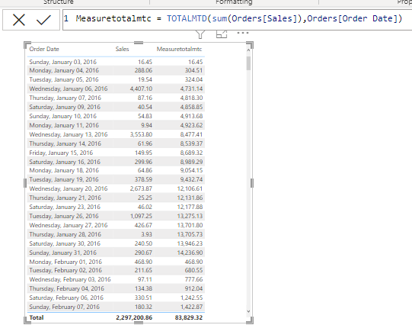
TOTALMTD
Evaluates the value of the expression for the month to date, in the current context.
It returns the every month cumulative sum .
Example :
01/01/2016 this month sum , then second month sum , then third like that.
Data file is :Sample – Superstore

Slide 16
TOTALQTD
the value of the expression for the dates in the quarter to date, in the current context.
It returns the every quarter cumulative sum .
Example :
First quarter sum , then second quarter sum , then thrid like that.
Data file is :Sample – Superstore

