Slide 1
Ionic Framework

Slide 2
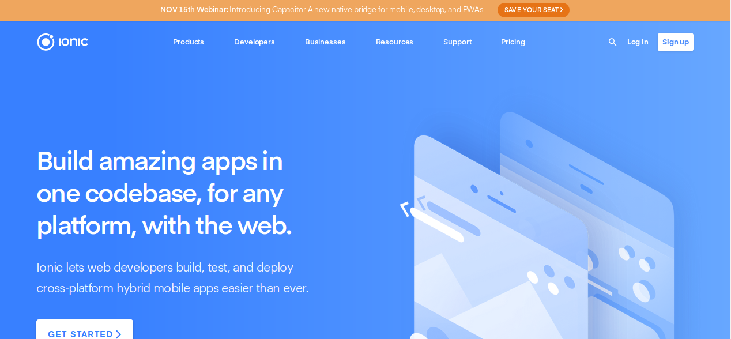
Ionic

Slide 3
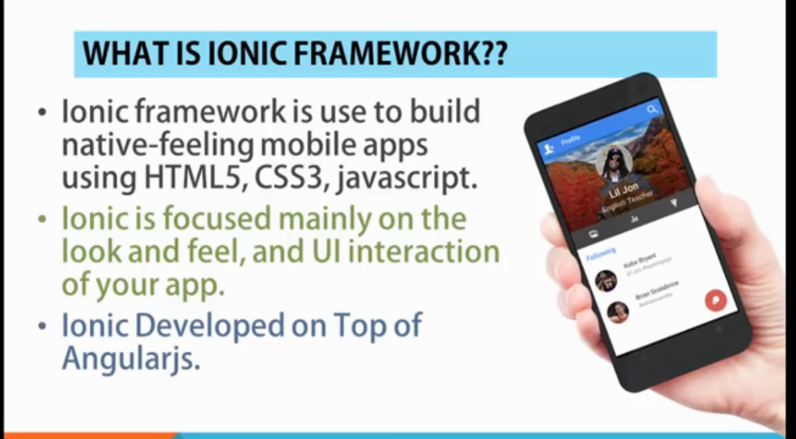
What is IONIC Framwork

Slide 4
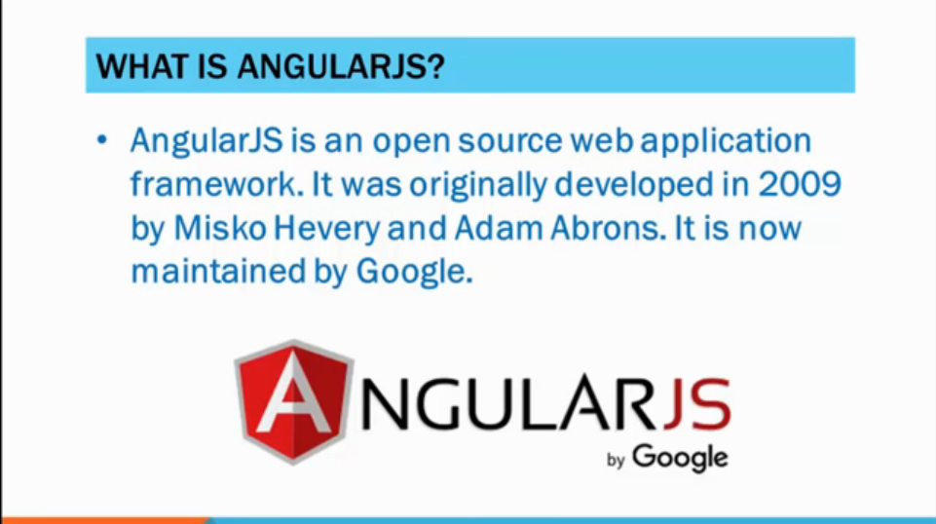
What is Angular js

Slide 5
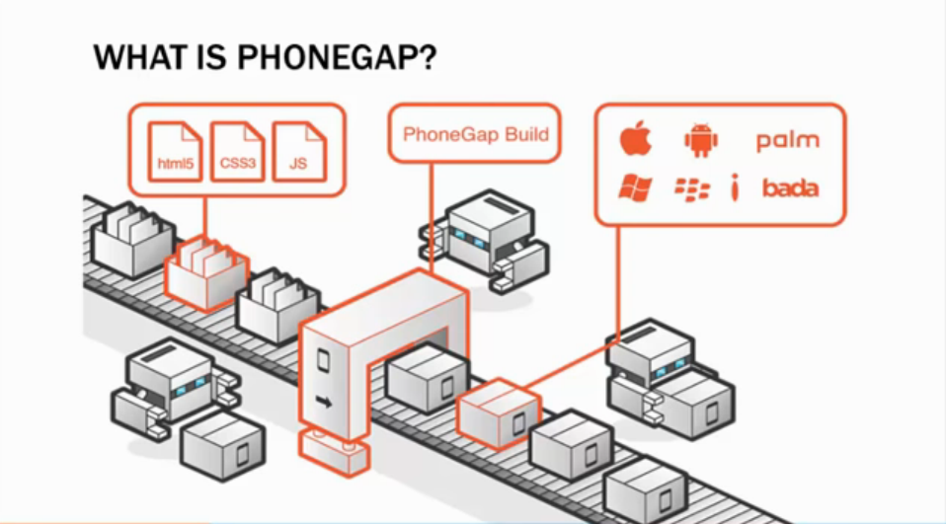
What is PHONEGAP?

Slide 6
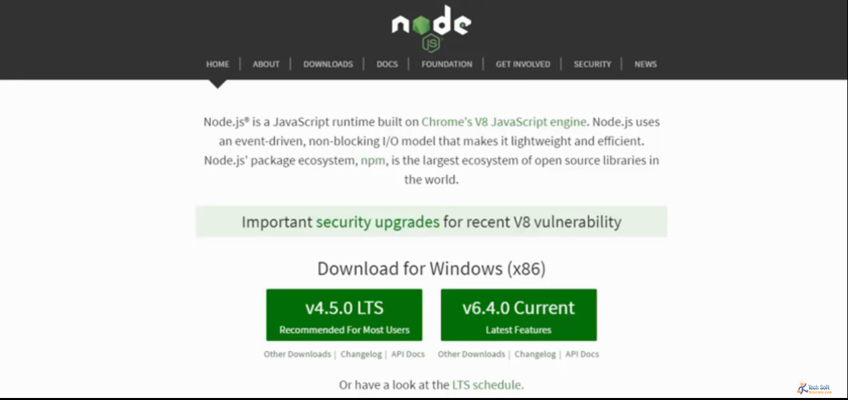
Install Ionic Framework

Slide 7
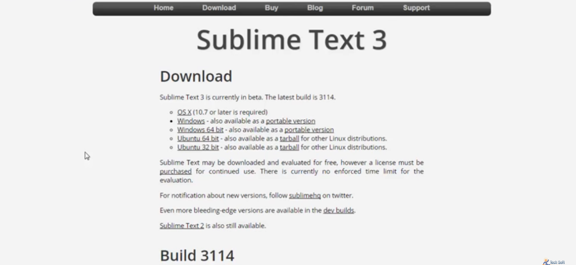
Install Ionic Framework

Slide 8
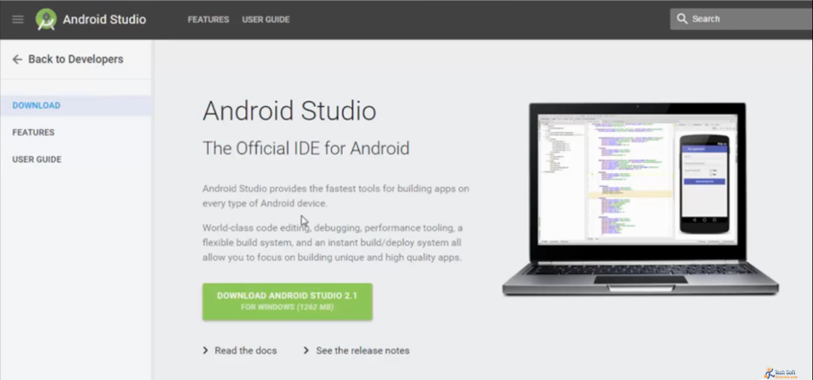
Install Ionic Framework

Slide 9
Ionic Install
1. Node js install
2. sudo npm install ionic cordova -g
3. node -v
4. ionic
5. ionic start myApp blank
6. ionic start myApp tabs
7. ionic start myApp sidemenu

Slide 10
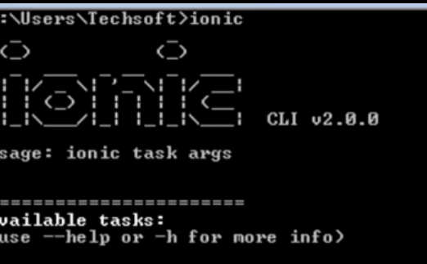
Install Ionic

Slide 11
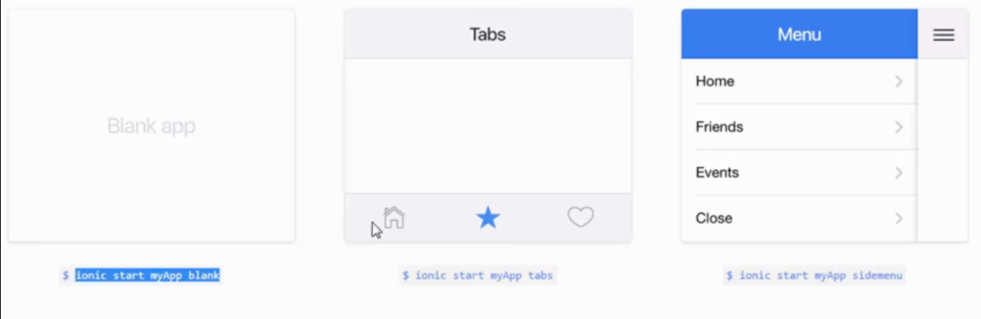
Start an app

Slide 12
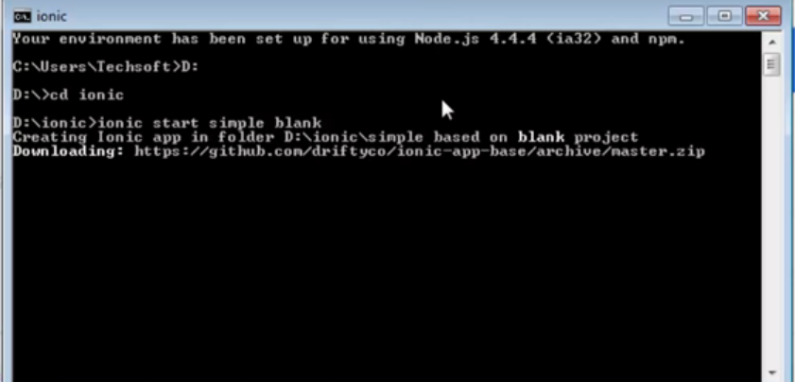
Start an app

