Slide 1
Laravel

Slide 2
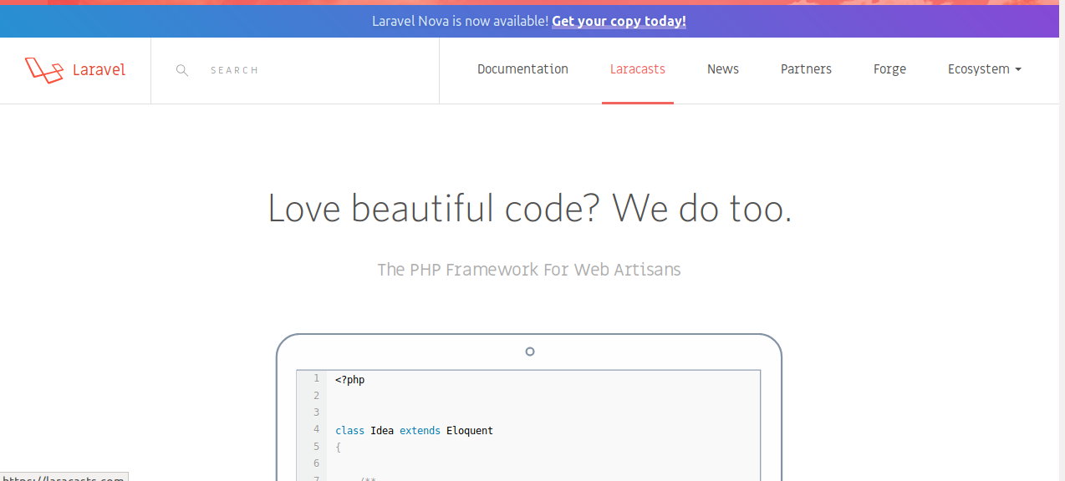

Slide 3
Laravel
Laravel is a free, open-source PHP web framework, created by Taylor Otwell and intended for the development of web applications following the model–view–controller (MVC) architectural pattern and based on Symfony. Some of the features of Laravel are a modular packaging system with a dedicated dependency manager, different ways for accessing relational databases, utilities that aid in application deployment and maintenance, and its orientation toward syntactic sugar.

Slide 4
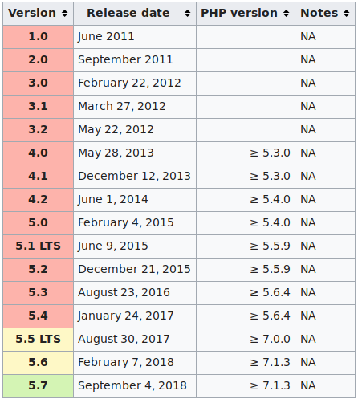

Slide 5

Why LARAVEL is the best

Slide 6
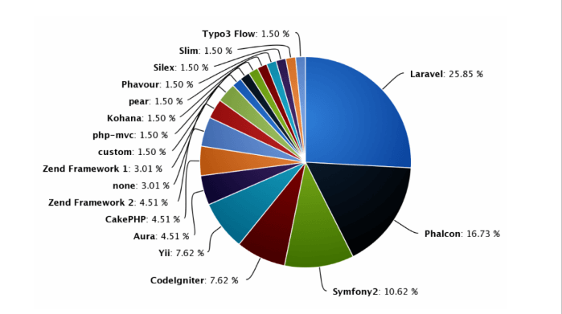

Slide 7
Find features of best php laravel
Template Engine
Artisan
Eloquent ORM (object-relational mapping)
Libraries & Modular:
MVC Architecture Support
Migration system for databases
Unit-Testing
Security

Slide 8
Install Laravel
php -v
sudo apt install php7.2-cli
sudo apt install hhvm
Php -m
sudo apt-get install php-mbstring
sudo apt-get install php-xml

Slide 9
App Folder
App:-Application Controller Folder
Controller:- app->Http->Controllers->new file create(hellocontroller.php)
Http:-Middleware
Kernel.php :-Middleware ko load karati hai
Php artisan make:model demo
Bootstrap :Dependency load autoload

Slide 10
laravel
Php artisan tinker
Blade: templete engine file

Slide 11
New softawre open karna
cd /opt/lampp/htdocs/myProject
Code .

Slide 12
Laravel start
View (itm.blade.php)
Controller (php artisan make: controller a)
Route :- Route ::get(‘itm’,’itmcontroller’);

Slide 13
Pass data to view(parameter send)
Way TO SEND VALUES TO VIEWS
1.using array function : array()
2.using compact function : compact()
3.using with : with( [] )
4.using withVariablename : withName()

Slide 14
using array function : array()
public function array()
{
$users = ["vikas","mohit","rahul"];
$name ="PNINFOSYS"
return view('include.array', array("users"=>$users , "name=>$name"));
}

Slide 15
channel Name: {{{$name}}<br/><br/>
@foreach($users as $user)
{{ $user}}<br/>
@endforeach
Foreach($users as $user)
echo $user
print_r

Slide 16
using compact function : compact()
return view('include.array', compact("users","name"));
return view('include.array')->with(["users"=>$users, "name"=>$name]);
return view('include.array')->withUsers($users)->withname($name);

Slide 17
Master layout file (fixed layout)
@yield :- <title>@yield(“title”)</title>
@section :- @section(“body”)
@show
@yield :jaha hamko values ko rendar karna ho.
@section : jaha hamko html ko rendar karna ho.

Slide 18
Master layout
@extends("layouts.master")
@section("title", "team is good");
@section("body")
Product
<p>Team my</p>
@endsection

Slide 19
Adding css/js files to layout files
Css link:-public->css->new file(master.css)
<link href=”public/css/master.css”>
Js link :- public->js->newfile (master.js)
<script type="text/javascript" src="public/js/master.js"></script>
href="{{ URL::to('/') }}/public/css/master.css"
<li><a href="{{ url('/download')}}">Download</a></li>

Slide 20
Convert HTML single page web site
Move asset files to /public folder
Make a New Controller
Make all required methods within controller
Make a fixed layout for site
Make view files for all methods to be redirection by extending layout
Configure routes

Slide 21
Conditional statements in Laravel
@if
@else
@elseif
@isset
@empty
@unless

Slide 22
@if and @else
{{ strlen($name) }}
@if(strlen($name) > 0)
String has lenght>0
@else
string has lenght =0
@endif

Slide 23
@elseif
@if(strlen($name) < 5)
String has lenght>0
@elseif(strlen($name)> 5 && strlen($name) < 10)
strlen length within 5 to 10
@elseif(strlen($name) >10)
string has length>10
@else
string has lenght =0
@endif

Slide 24
Isset function
@isset($name)
variable is set {{$name}}
@endisset
Variable is not found

Slide 25
@empty
@isset($name)
@empty($name)
Value is empty
@endempty
{{$name}}
@endisset

