Slide 1
Veu Js

Slide 2
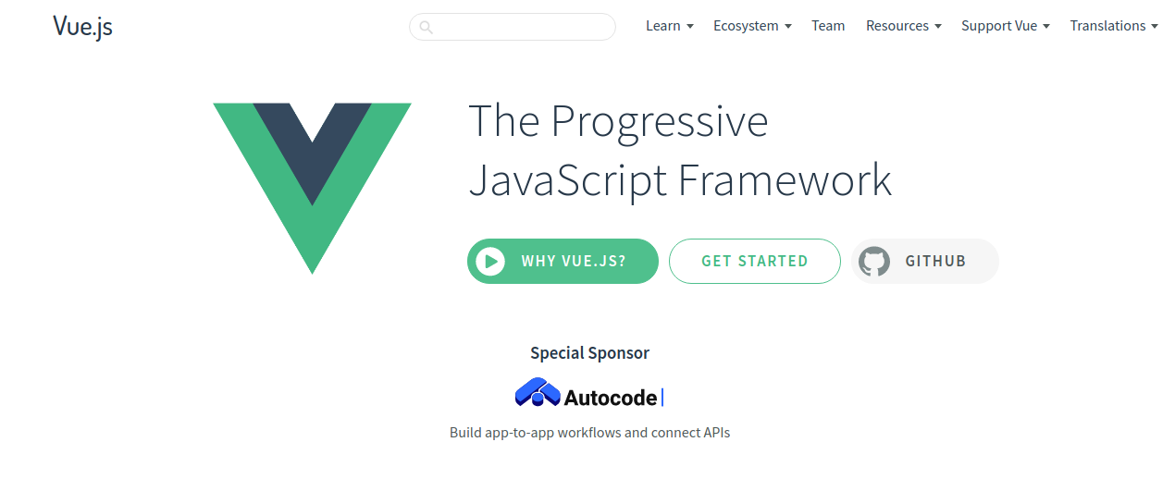

Slide 3
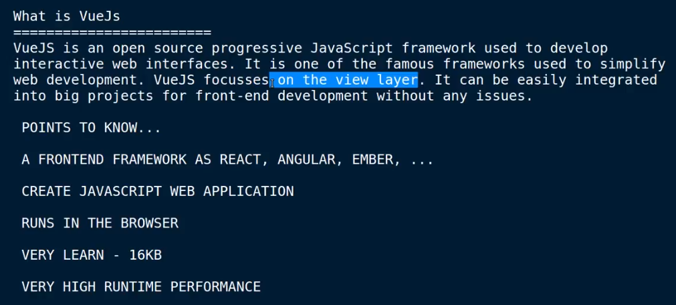
What is Vuejs

Slide 4
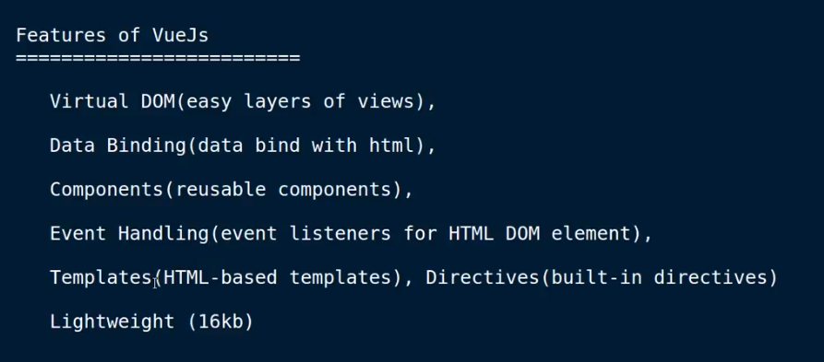
Features of vueJs

Slide 5
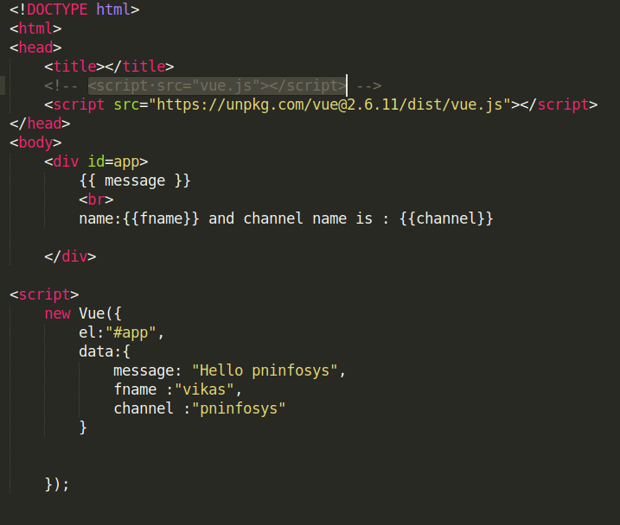
First Code vue js

Slide 6
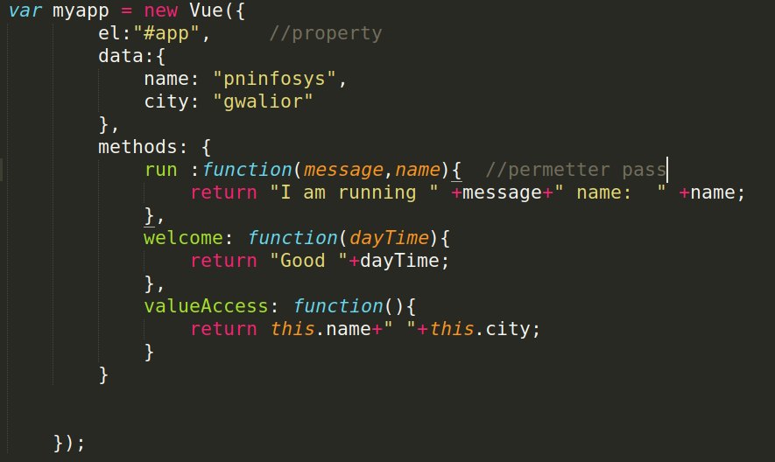
Methods Vue Js

Slide 7
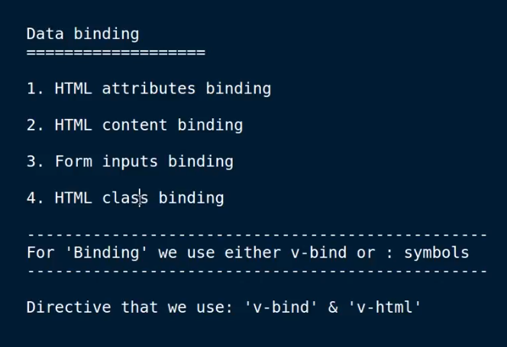

Slide 8
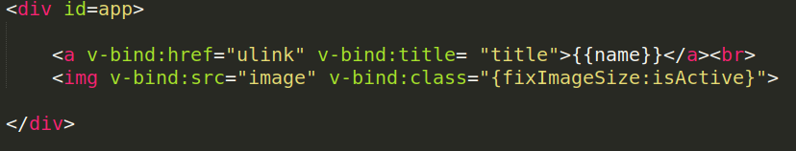
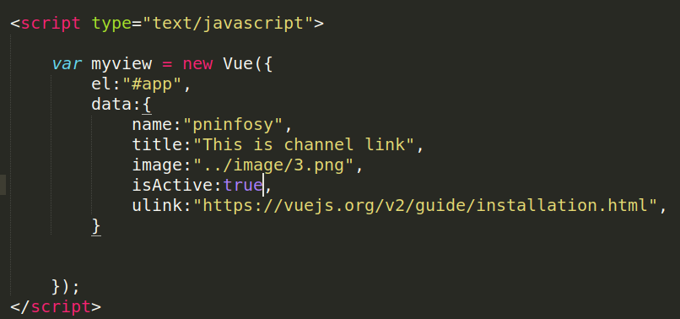
HTML Attributes & Class binding

Slide 9
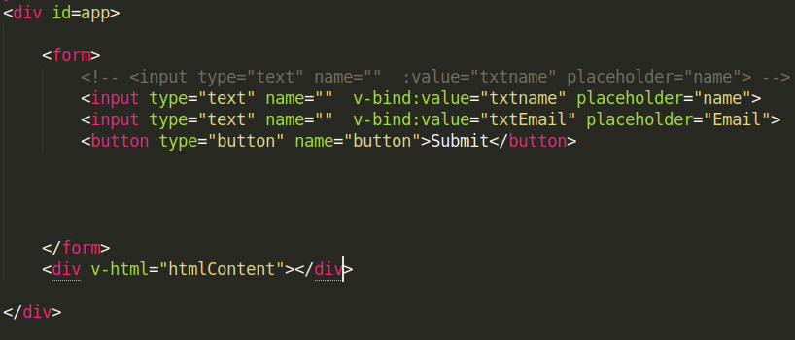
Form Input & Content binding

Slide 10
Event Handling
Click & Double click event
Mousemove , Mouseout , Mouseover
Keypress , Keyup, keydown

Slide 11
Event Modifiers
Once ,Prevent , Stop , capture

Slide 12
Event Handling In Veu js
1. Click and Double click event
2. Mouseover, Mouseout, Mousemove

Slide 13
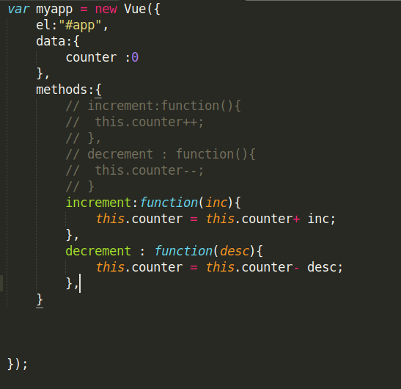
Click &Double event

Slide 14
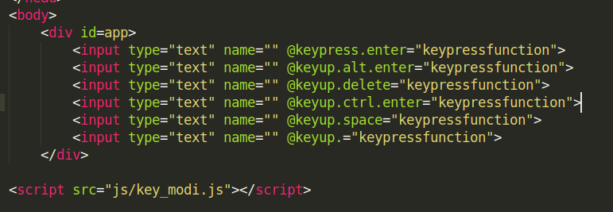
Key Modifiers

Slide 15
Two way data Binding
V-MODE

Slide 16
Computed properties

Slide 17
Add Dynamic classes

Slide 18
Conditional Statement
v-If
v-else-if
v-Show
v-for

Slide 19
Multipal Instances

Slide 20
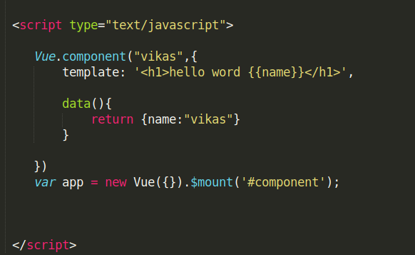

Components

Slide 21
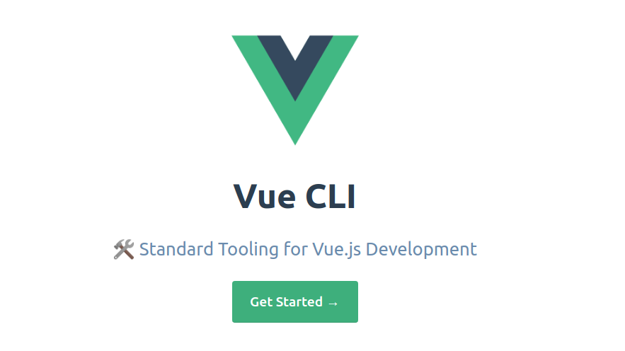
Vue CLI

Slide 22
Node Install
npm install -g @vue/cli
Creating a Project
vue create hello-world
Npm run serve
http://localhost:8080/

Slide 23
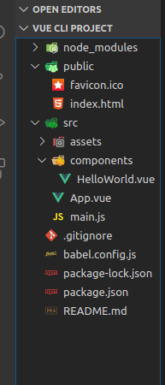

Slide 24
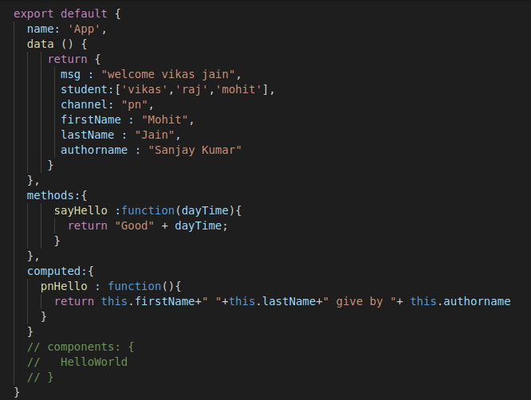

Slide 25
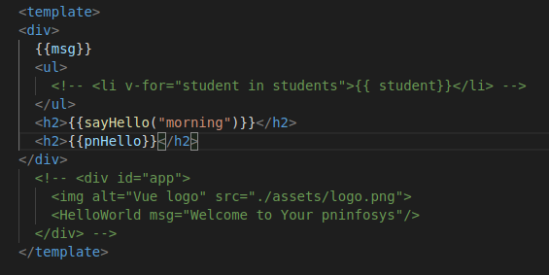

Slide 26
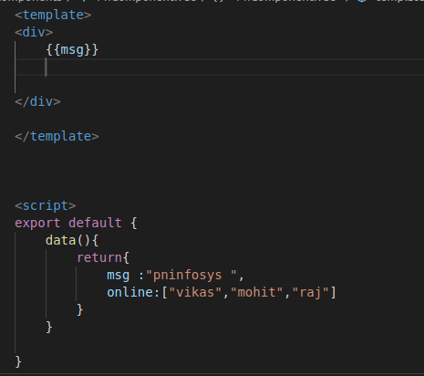
Componet CLI Veu js

Slide 27

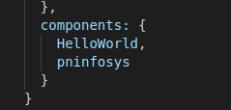

App.js

Slide 28
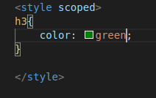
Scoped css

Slide 29
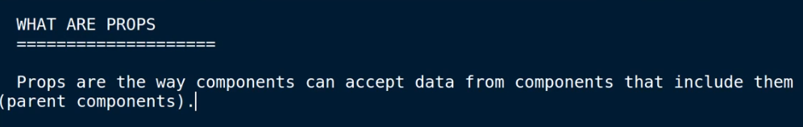
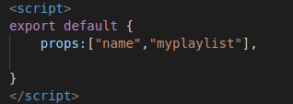
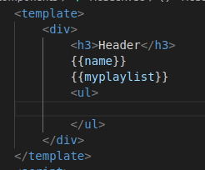
Props

Slide 30
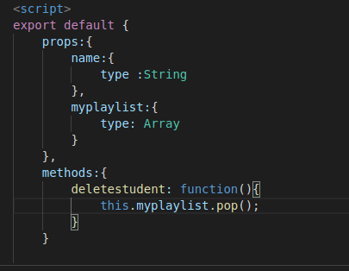
Props Validation

Slide 31
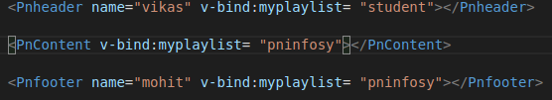
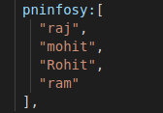
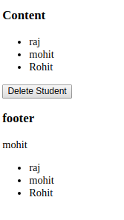
Reference Types and Primitive

Slide 32
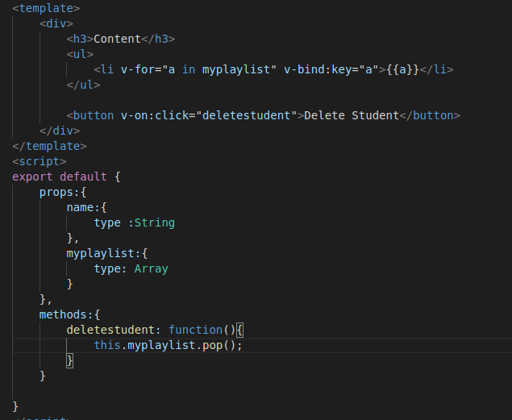

Slide 33
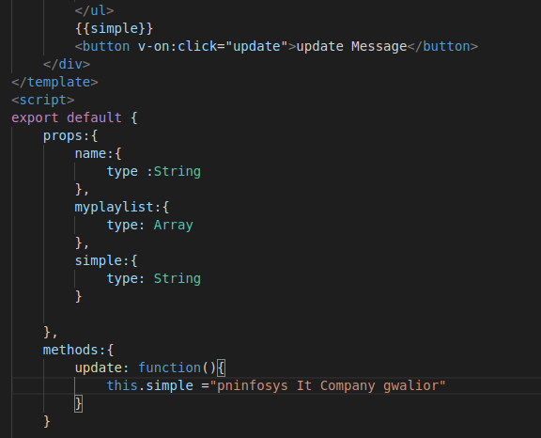
Primitive Types

Slide 34
Fire Event From Child to Parent Component
Fire Event From Child to Parent Component

Slide 35
Event BUS ($emit & $on)

Slide 36
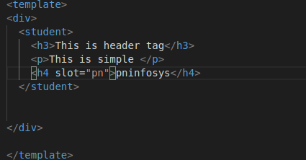
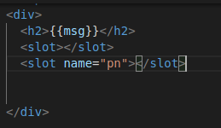
Slots

Slide 37
Dynamic Component

Slide 38
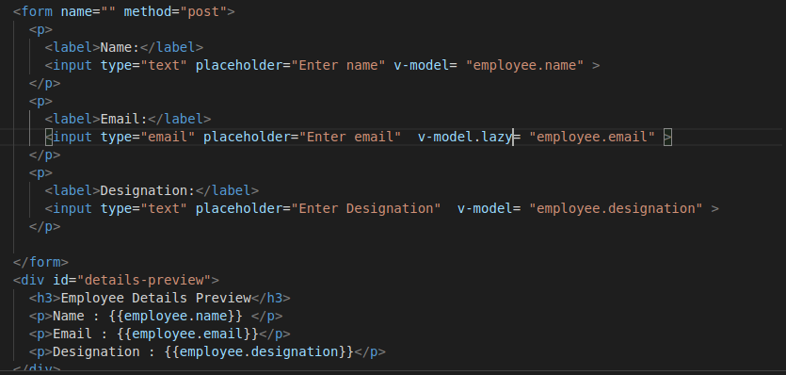
Form Input Binding (lazy)

Slide 39
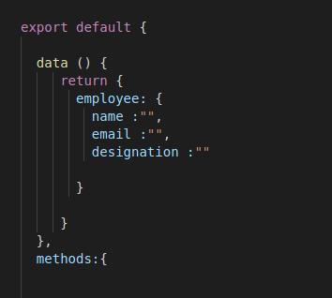

Slide 40
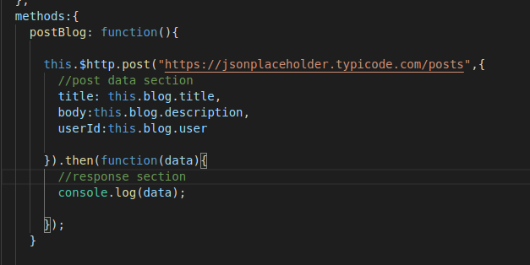
Http Request data send (API)
npm install vue-resource
https://jsonplaceholder.typicode.com/

Slide 41
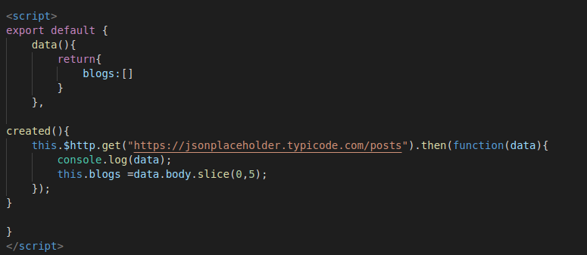
GET REQUEST DATA(API)

Slide 42
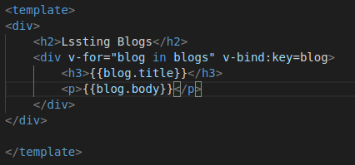

Slide 43
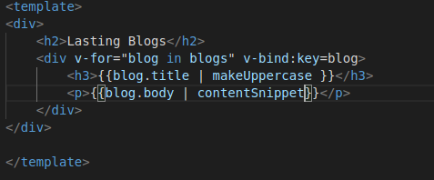
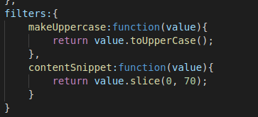
Filters Vue Js

Slide 44
Router Vue js
npm install vue-router --save

Slide 45
Laravel 7 or Vue Js
Laravel install
composer require laravel/ui
php artisan help ui
php artisan ui vue
Npm install && npm install vue-router vuetify
Npm run watch
php artisan ui vue --auth

Slide 46
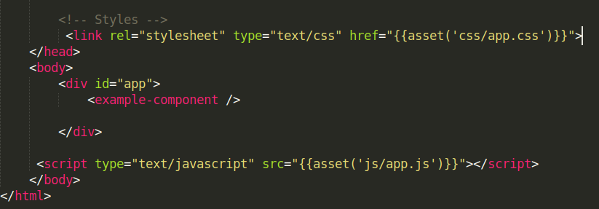

Slide 47
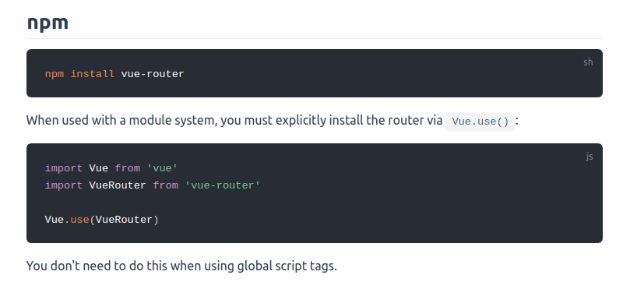
Vue -router
npm install --save vue-router@latest
https://router.vuejs.org/installation.html#direct-download-cdn

Slide 48
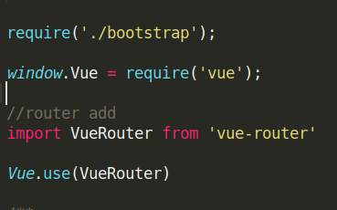
Router add(js/app.js)

Slide 49
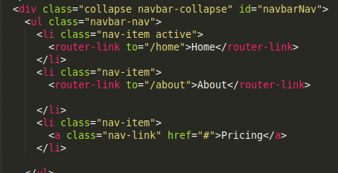
Router Use

Slide 50
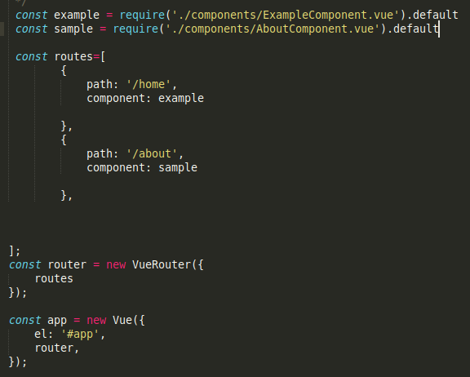
Router app.js

Slide 51
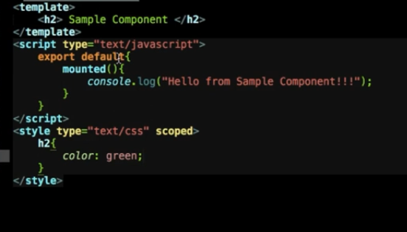
Vue js component laravel
AboutComponent.vue

Slide 52
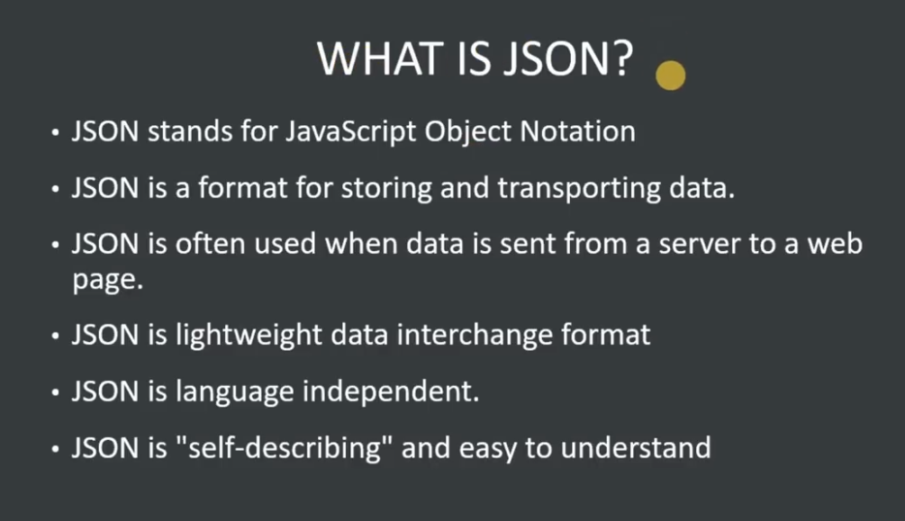
JSON

Slide 53
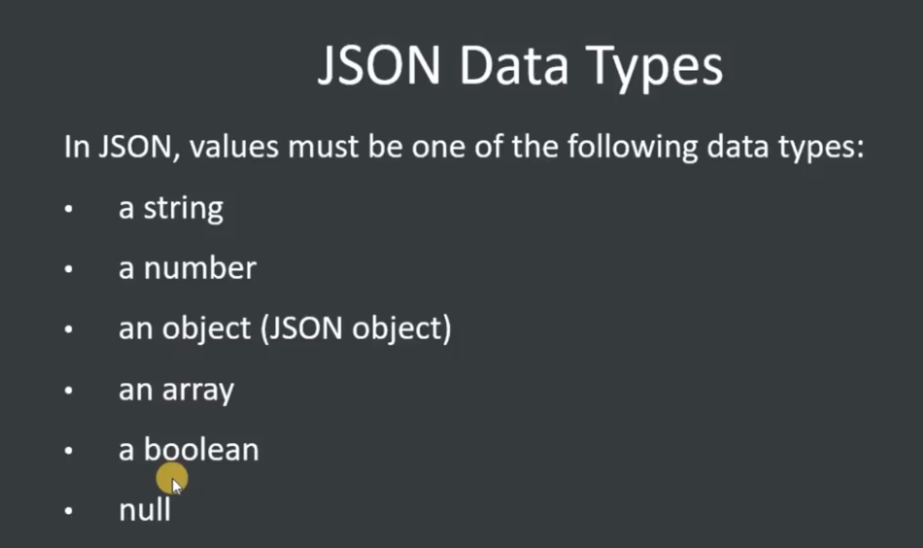

Slide 54
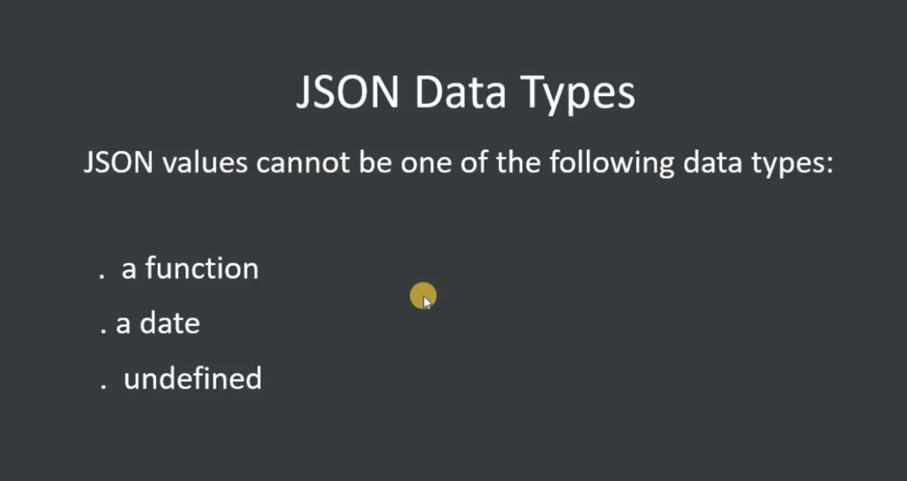

Slide 55
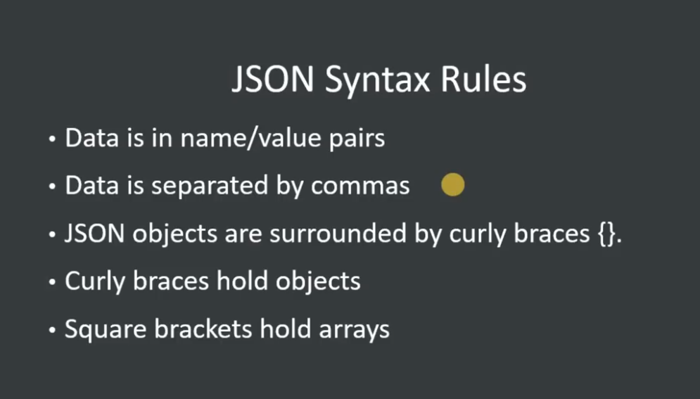

Slide 56
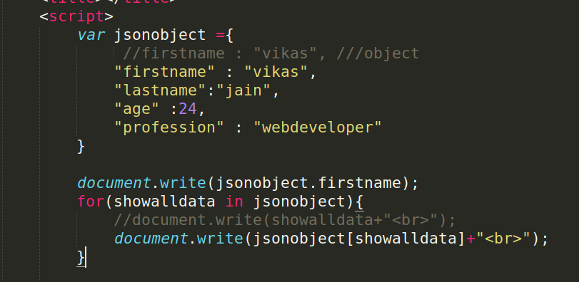

Slide 57
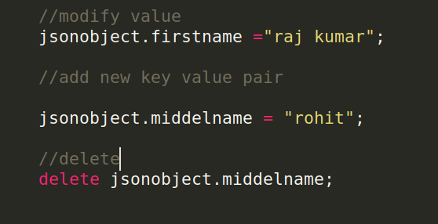

Slide 58
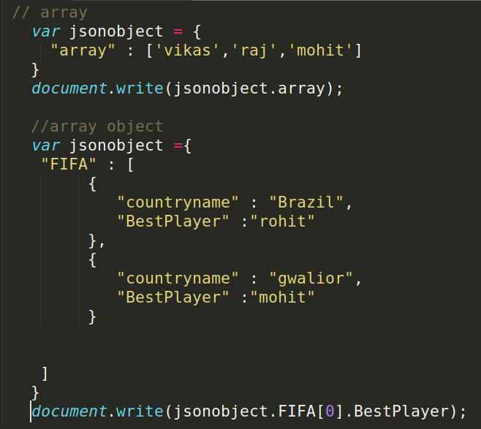


Slide 59

XMLHttpRequest
XML stands for eXtensible Markup Language.
XML was designed to store and transport data.

Slide 60
CURD LARAVEL OR VUE JS

