Slide 1
Veu Js

Slide 2
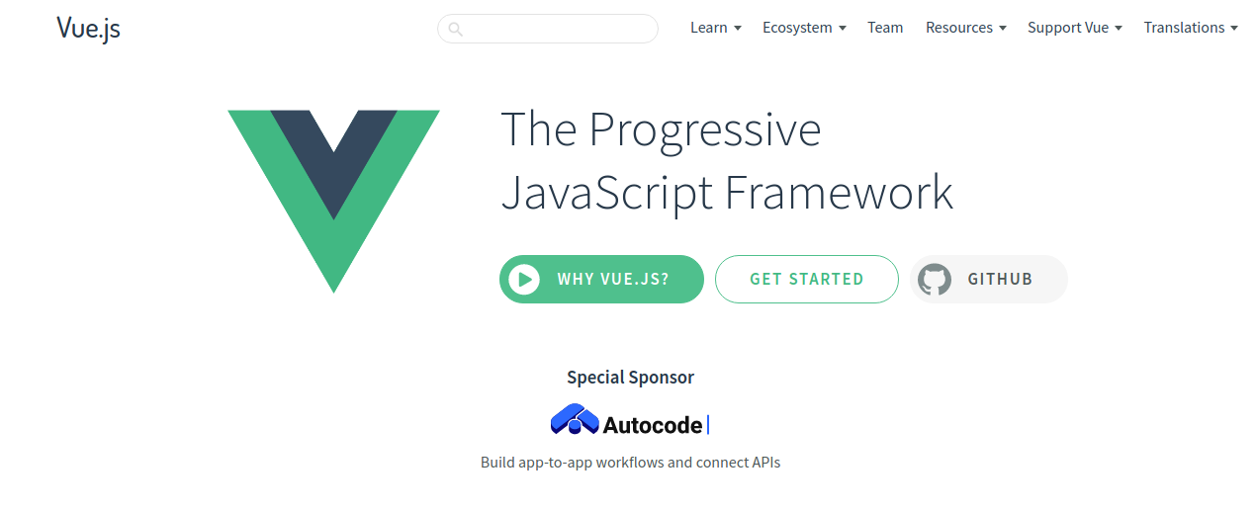

Slide 3
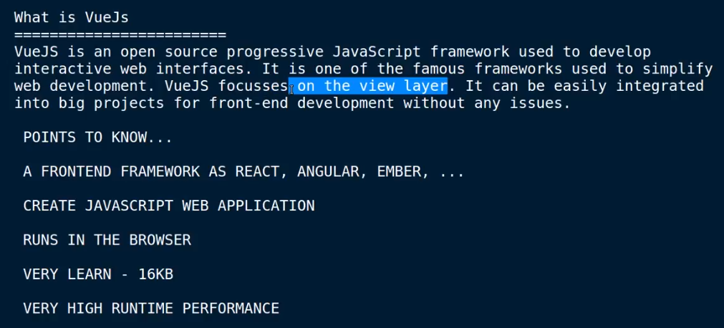
What is Vuejs

Slide 4
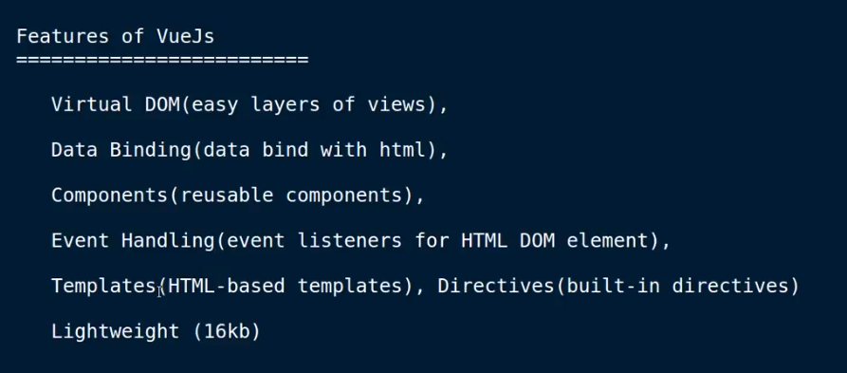
Features of vueJs

Slide 5
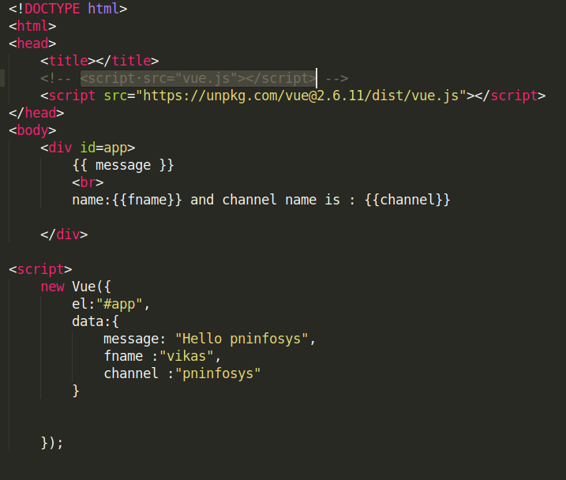
First Code vue js

Slide 6
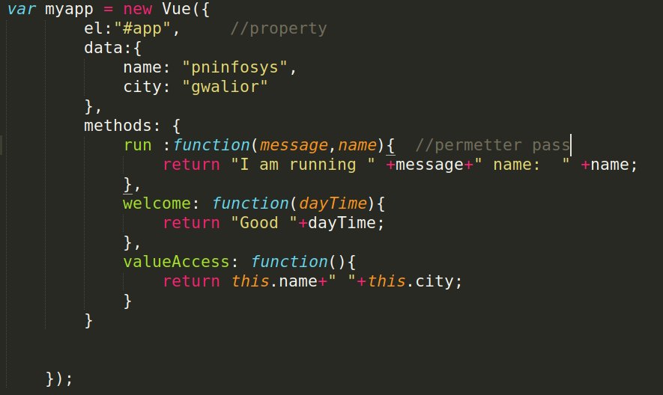
Methods Vue Js

Slide 7
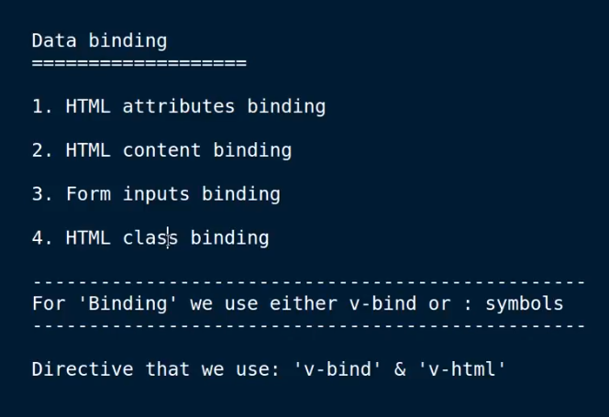

Slide 8
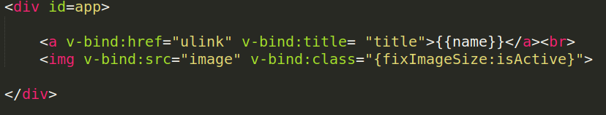
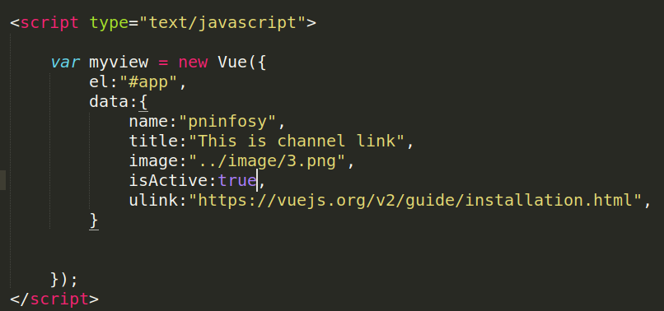
HTML Attributes & Class binding

Slide 9
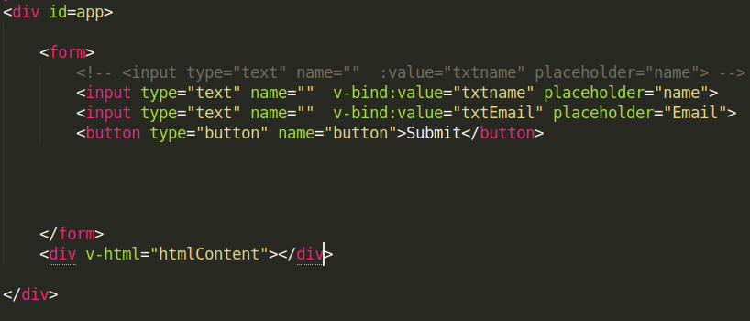
Form Input & Content binding

Slide 10
Event Handling
Click & Double click event
Mousemove , Mouseout , Mouseover
Keypress , Keyup, keydown

Slide 11
Event Modifiers
Once ,Prevent , Stop , capture

Slide 12
Event Handling In Veu js
1. Click and Double click event
2. Mouseover, Mouseout, Mousemove

Slide 13
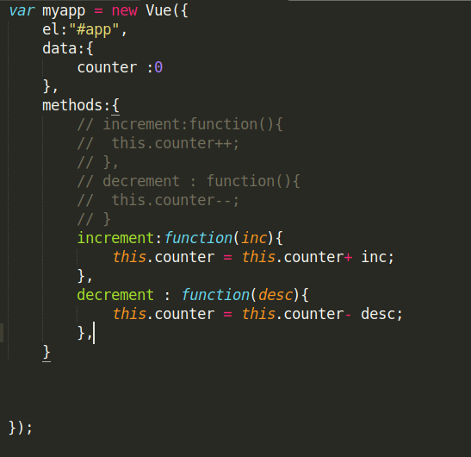
Click &Double event

Slide 14
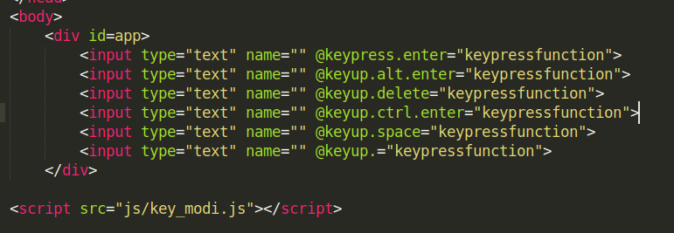
Key Modifiers

Slide 15
Two way data Binding
V-MODE

Slide 16
Computed properties

Slide 17
Add Dynamic classes

Slide 18
Conditional Statement
v-If
v-else-if
v-Show
v-for

Slide 19
Multipal Instances

Slide 20
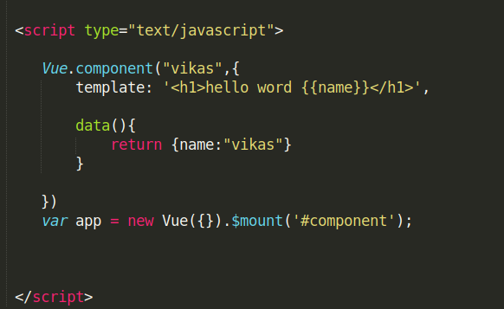

Components

Slide 21
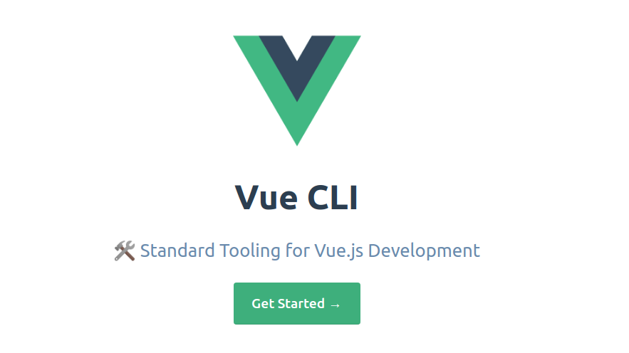
Vue CLI

Slide 22
Node Install
npm install -g @vue/cli
Creating a Project
vue create hello-world
Npm run serve
http://localhost:8080/

Slide 23
Laravel 7 or Vue Js
Laravel install
composer require laravel/ui
php artisan help ui
php artisan ui vue
Npm install && npm install vue-router vuetify
Npm run watch
php artisan ui vue --auth

Slide 24
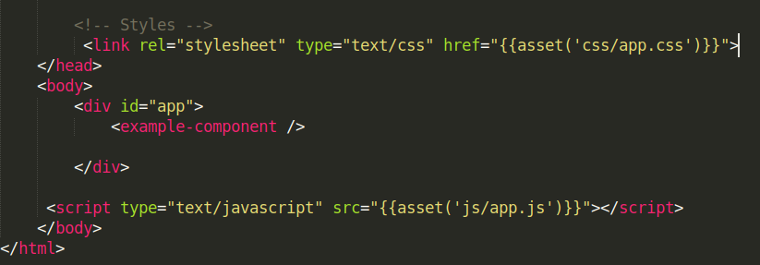

Slide 25
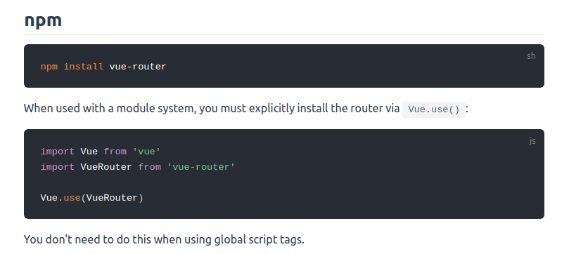
Vue -router
npm install --save vue-router@latest
https://router.vuejs.org/installation.html#direct-download-cdn

Slide 26
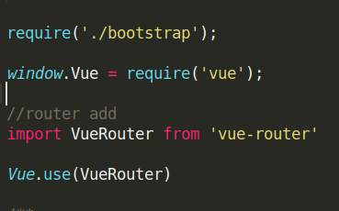
Router add(js/app.js)

Slide 27
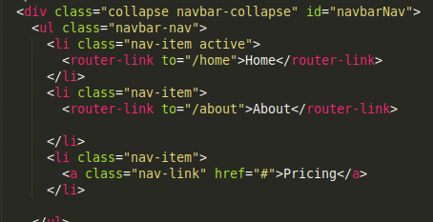
Router Use

Slide 28
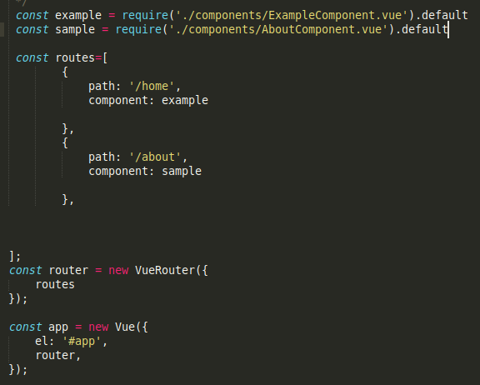
Router app.js

Slide 29
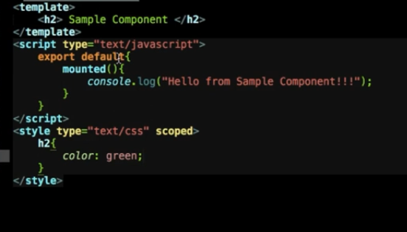
Vue js component laravel
AboutComponent.vue

Slide 30
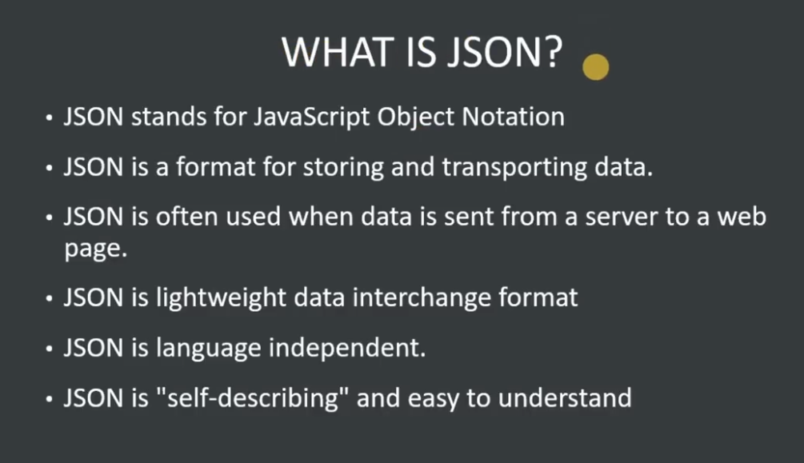
JSON

Slide 31
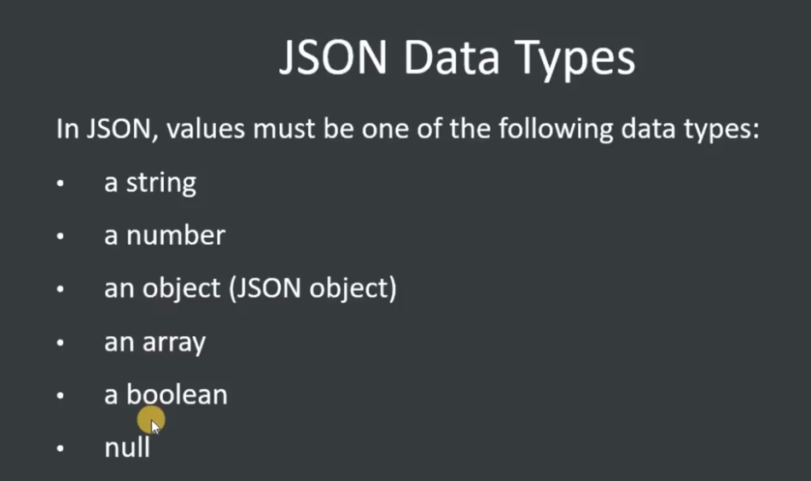

Slide 32
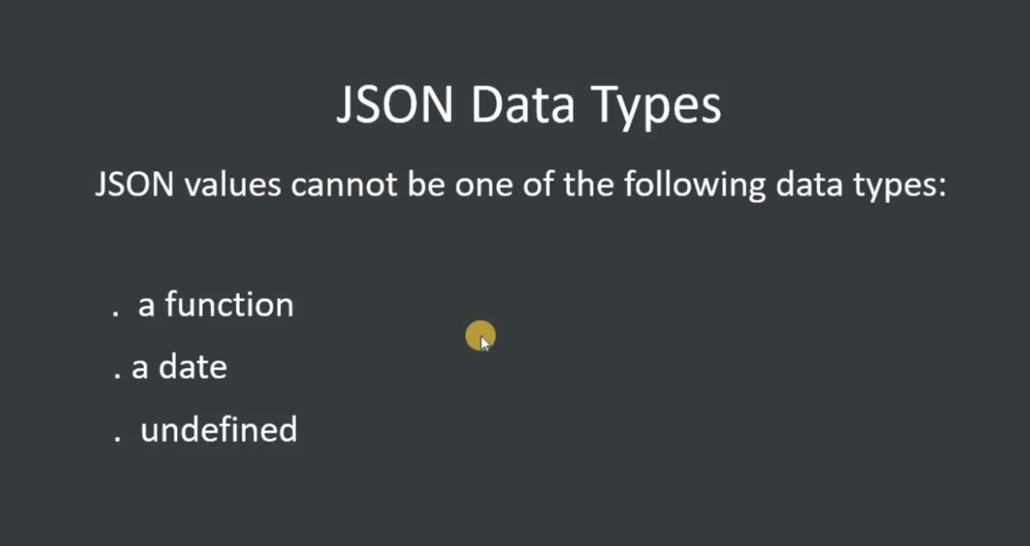

Slide 33
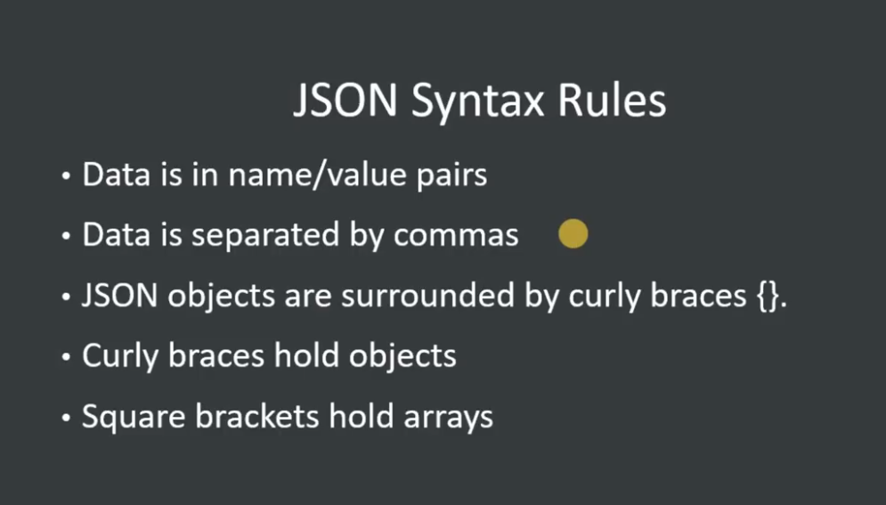

Slide 34
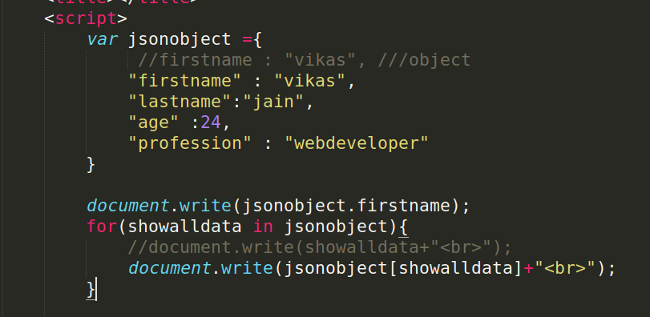

Slide 35
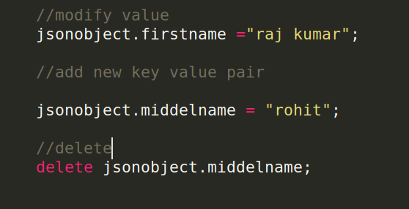

Slide 36
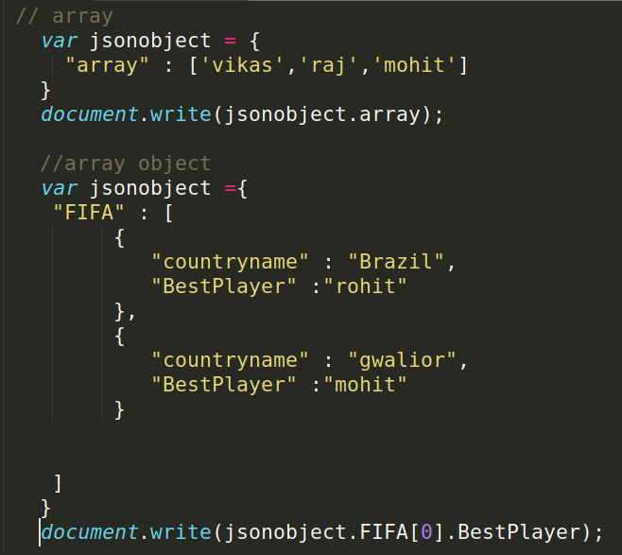
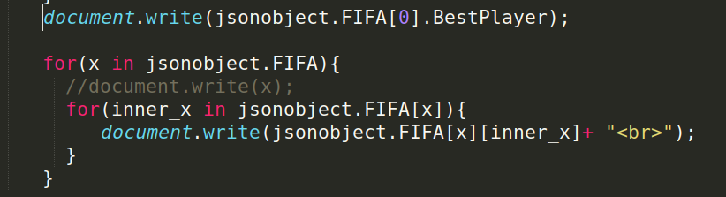

Slide 37
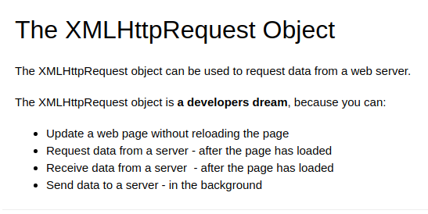
XMLHttpRequest
XML stands for eXtensible Markup Language.
XML was designed to store and transport data.

Slide 38
CURD LARAVEL OR VUE JS

