Slide 1
PUBG 2D
12170910王子骏
11170909张晨佳
11170907史泽昆
11170903张念宇
亮亮图文旗舰店

Slide 2
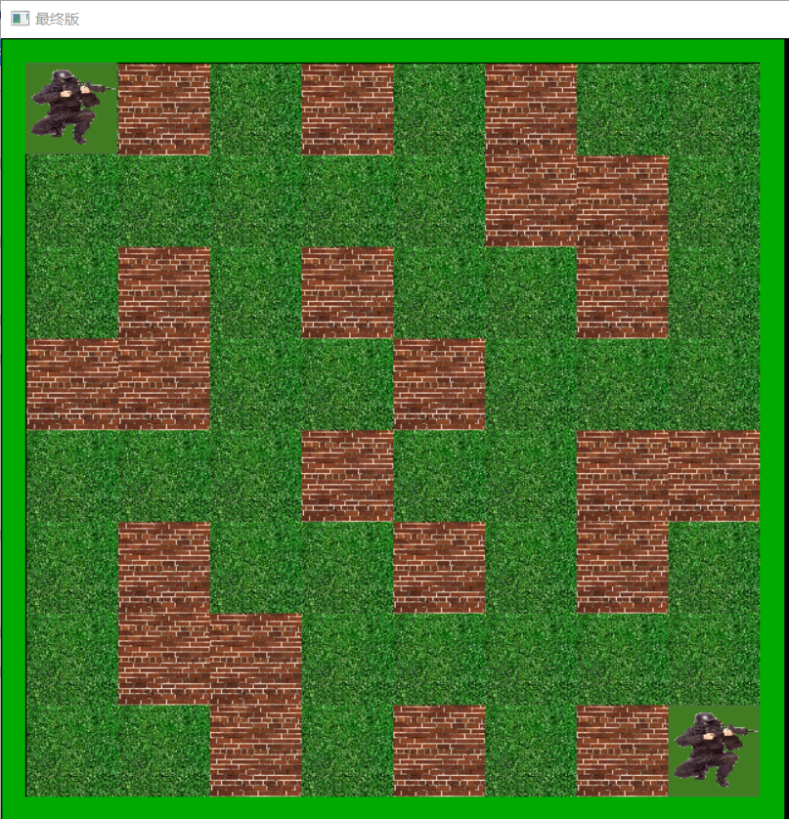

INTRODUCTION
We want to create a game which is like a kind of chess. Two players each can only do three movements in one round, and the movement will be limited by the wall. Sometimes their will be first aid kit to help you or bomb to hurt you. The first aid kit will appear randomly and the bomb will appear on two fixed position by turn. You can play with your partner or with the computer.

Slide 3
GROUP DIVISION
Gabriel(张辰佳)：How to move and attack and how to achieve the round system (two players move by turn)
Logic(王子骏)：The bomb function(When to explode) and the first aid kit function(How to appear randomly)
Staurt(张念宇) and Jaylen(史泽昆)：The function of NPC

Slide 4
ANALYSIS
01
02
03
04
MOVE
ATTACK
ROUND SYSTEM
NPC
To make the players can’t move in certain area and judge whether the players are attacked. We use two-dimension array to assign a value to each point on the graph. By doing this, we can judge the condition by comparing the numerical values.
To achieve the round system, we can use a variable to record the total steps of two players, and by modular algorithm, we can achieve it.
To make the NPC smart we should consider the influence of the wall and the relative position of two players
To make the players move on the screen, we can use loops to draw and delete the image to make the image seem to be moving.

Slide 5
DESIGN
START
mov,HP1,HP2
END
HP1=0 or HP2=0
HP changes
mov mod 6<=2?
mov=mov+1
Player1 moves or attacks
Player2 moves or attacks

Slide 6
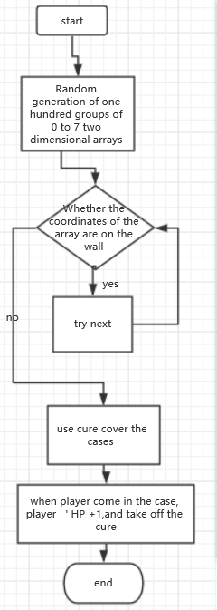
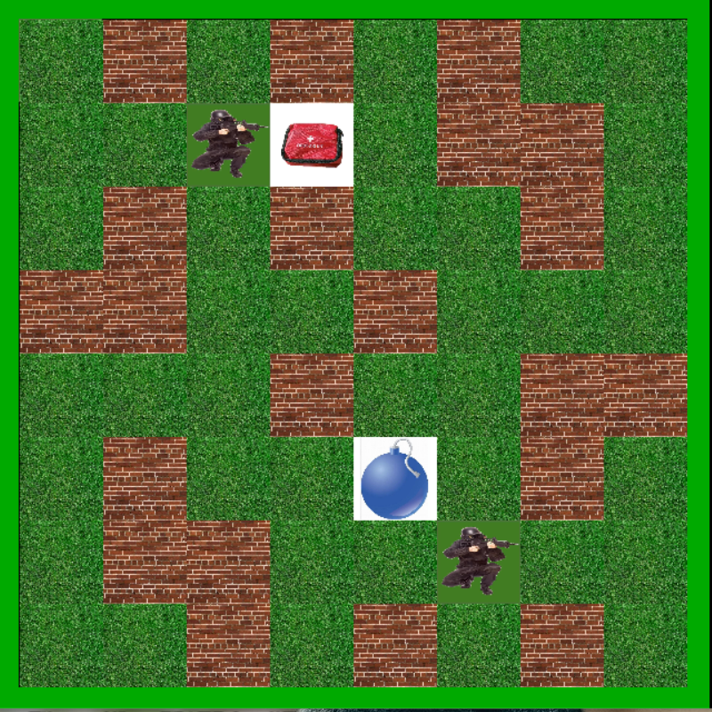
DESIGN

Slide 7
DESIGN
START
END
Input mov
YES
Mov % 6?
Mov % 6=3?
Mov % 6=4?
Mov % 6?=5?
PRO 1
PRO 2
PRO 3

Slide 8
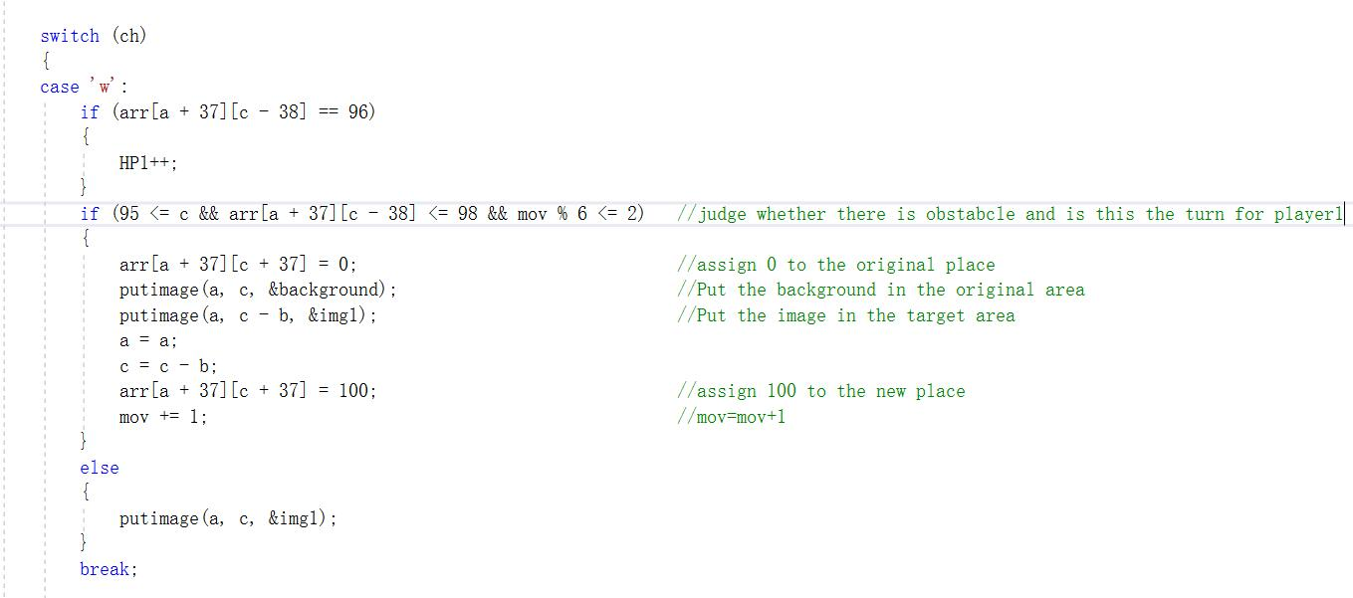
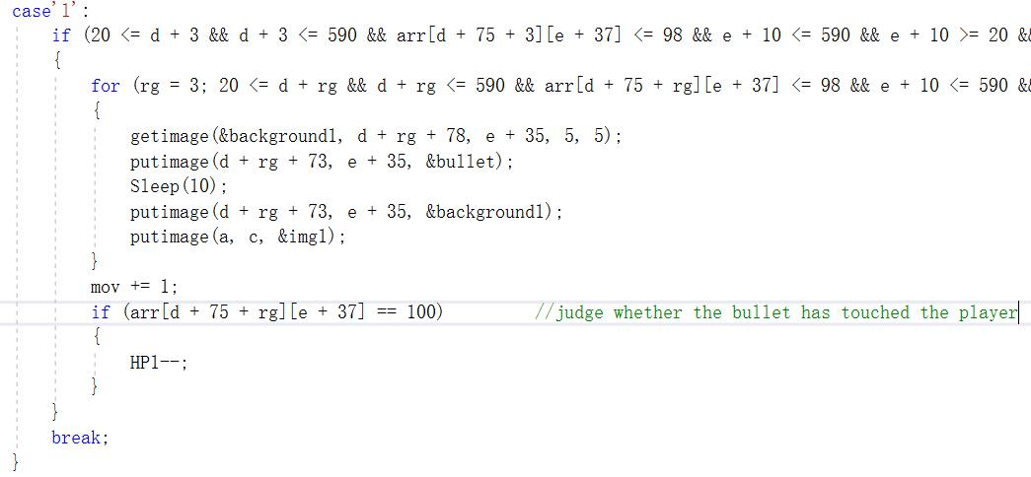
IMPLEMENTATION

Slide 9
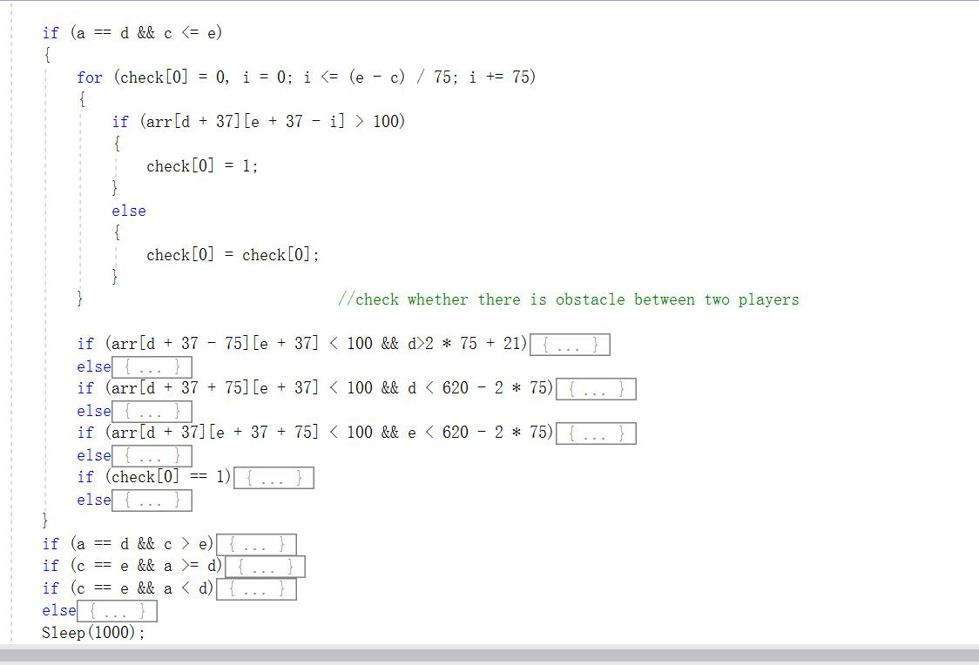
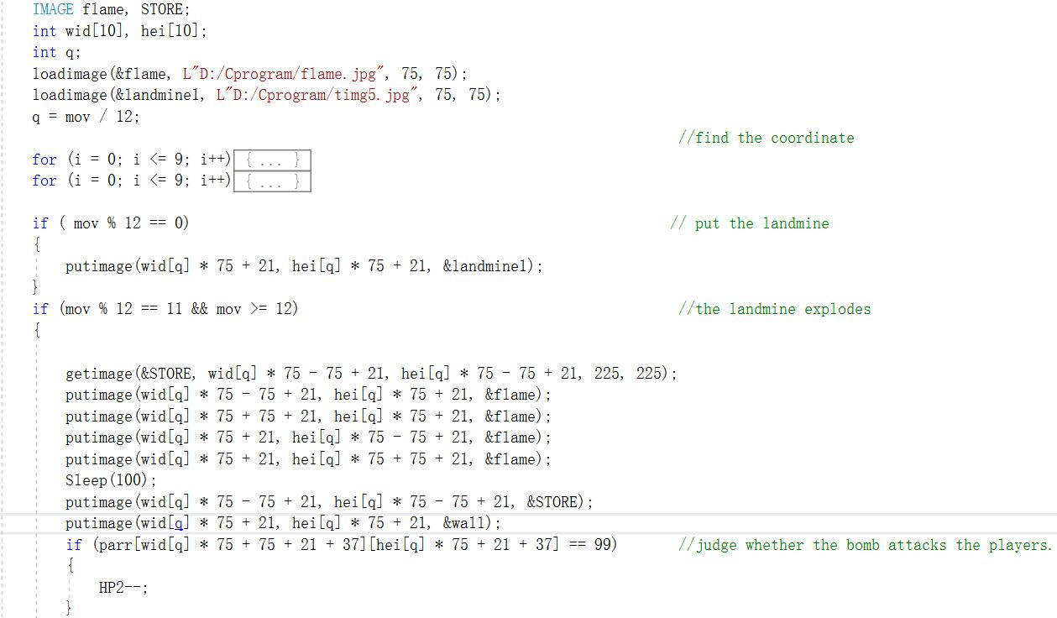
IMPLEMENTATION

Slide 10
TESTING AND RESULT
INPUT | EXPECTATION | RESULT
w(when there is no wall) | Player will move upward | Player move upward
c | Player won’t do anything | Player doesn’t do anything
i | A bullet will move upward until touch something | A bullet keep moving until touch the wall
Press ‘d’ four times | Player will move three times and won’t do anything the fourth time | Player moves three times and stop at the fourth time
Press ’s’ and ‘d’ and ‘d’ | NPC will move upward twice and then downward | NPC moves upward twice and downward
Being attacked until HP=0 | One player will disappear | One player disappear
Press ‘d’ when wall is on your right | Player won’t move | Player doesn’t move

Slide 11
Conclusion
Our program can basically operate as we expect. Player will attack and move fluently. And the NPC will move as the player moves. The player can attack and be attacked as we expect.
Considering the whole project, most requirements are met successfully, however, the NPC is still not smart enough, which means the algorithm of the NPC is still under developing. But all in all, we have basically finished the project and enjoy the result of team work.

Slide 12
THANKS

