Slide 1
Log System Review
GUI team
2017/5/20

Slide 2
Log System
Background:
Current Log system is based on file system
Solution:
1.Design log system based on DB
2.Import the binary log to DB
3.Provide search interfaces for any clients

Slide 3
Log System
System Component
Message Looper
Message Driven
Configuration Driven
MongoDB
MongoDB(Shard)
NodeJS/Sails/WaterLine
Git Source Control
Code Style

Slide 4



System components
Binary log
Log Transfer Service
Window Service
WCF
Restful(HTTP)
HTTP
Looper
Events
(MongoDB)
Log Storage
HTTP Service
Sails
Json(HTTP)
Water Line
NodeJS
Log Provider Service

Slide 5
Message Looper
ThreadPool
Message
Looper
Handler
Message
Task
Import procedure
Message
Message
Message
Message
Message
Long Task

Slide 6
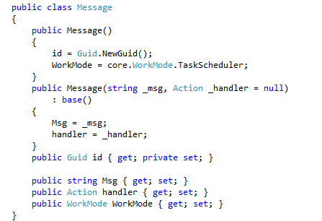
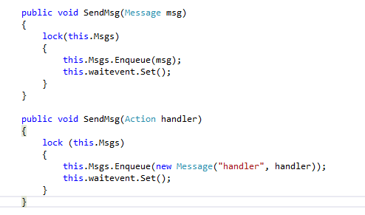
Message driven

Slide 7
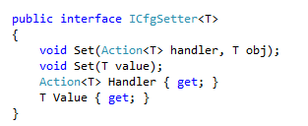
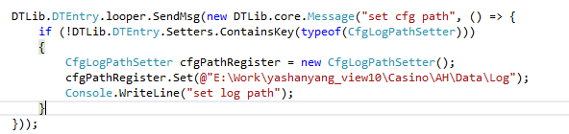
Configuration Driven

Slide 8
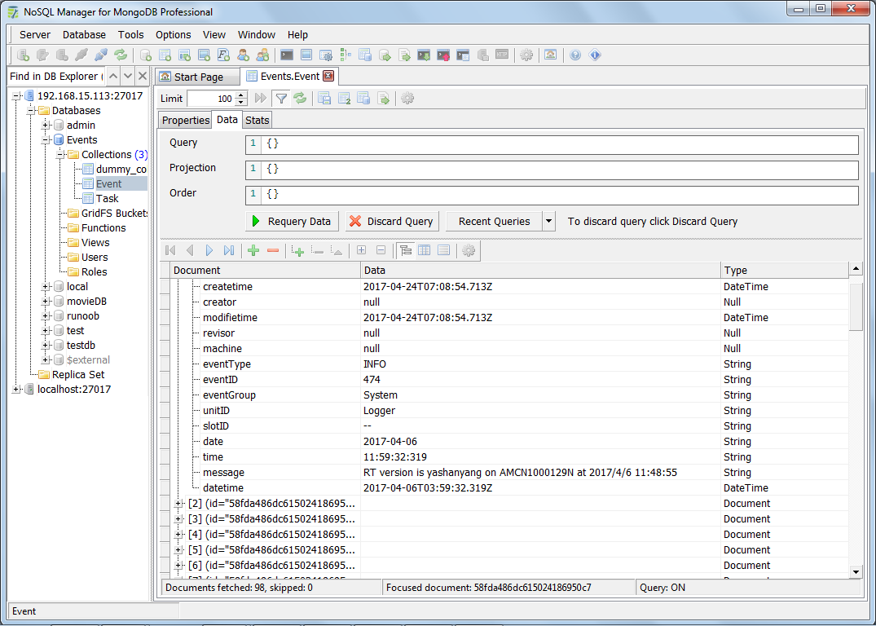
MongoDB

Slide 9
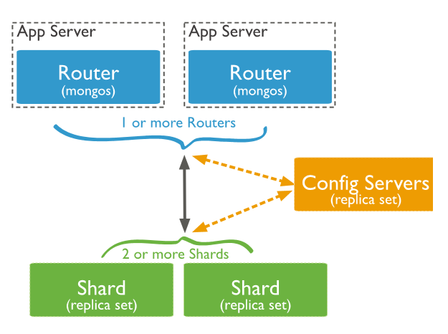
MongoDB(Shard)

Slide 10
NodeJS/Sails

Slide 11
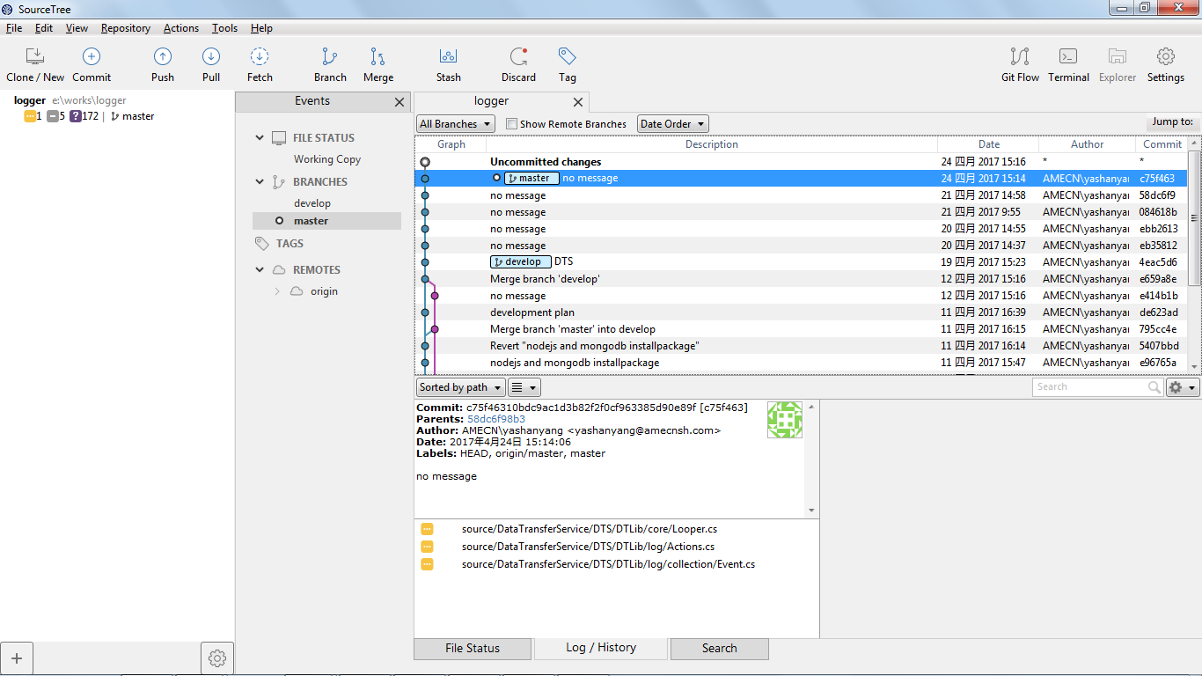
Git Source Control
Repository: https://github.com/firstsoft/logger

Slide 12
Code style
Can be extended
Can be inspected
Can be visualized

