Slide 1
Database Systems-2 SEN232 Term Project Marketing Management Database System
Presenter: Ayberk Ece ÖRTEN
Prepared&submitted by:
Hatice MENTEŞE B1505.090013
Ayberk Ece ÖRTEN B1505.090046
Submitted to: Ögr. Gör. Dr. Adem ÖZYAVAŞ
Presentation Date:22.04.2019(group 3)
Project Report Due Date:07.05.2019

Slide 2
Overall application…
2 ways to enter(login/register)
2 types of users(employee/customer)
Multiple products to select
A basket to keep your data
Easy to use

Slide 3
In our project…
Technologies used:
Programming methods used:
MySQL-for database implementations
Github-to commit changes on a same repository together
Netbeans-for java implementations
Scene Builder-for front-end implementations
Object Oriented Programming

Slide 4
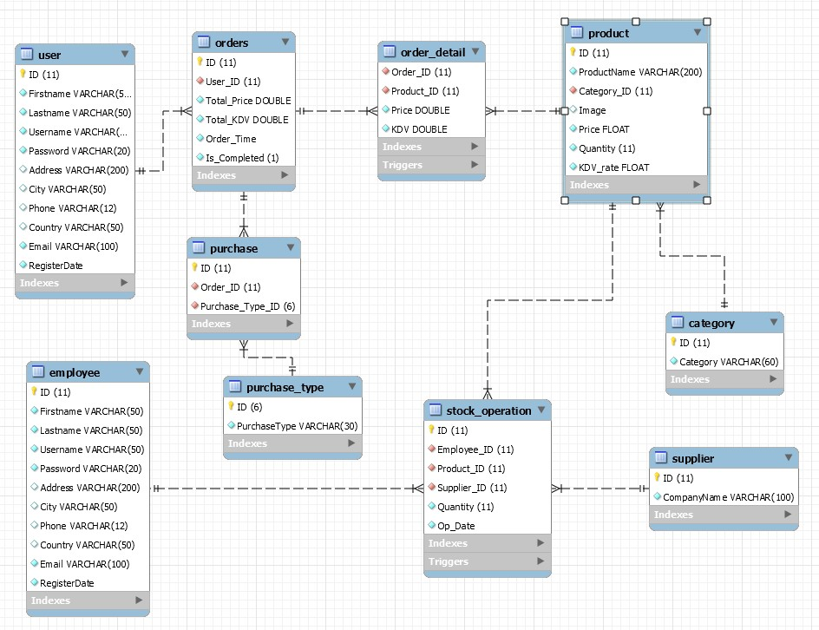
Complete Diagram

Slide 5
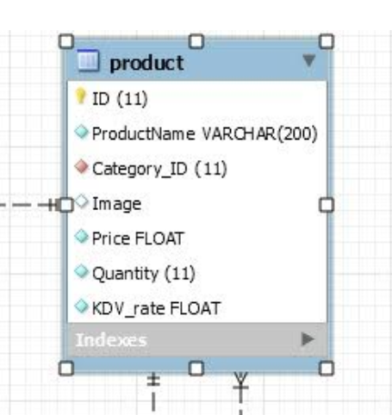
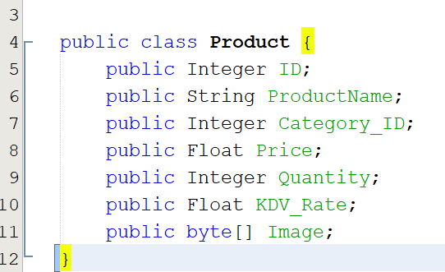
Project class and database table relations…
Example1: Product

Slide 6
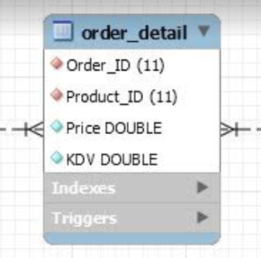
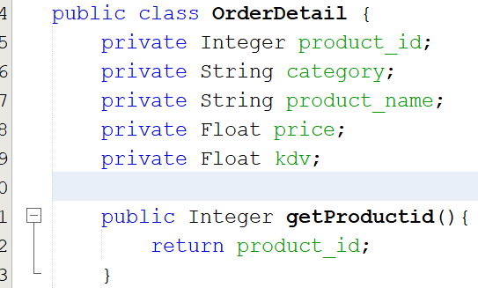
Example2: OrderDetail

Slide 7
Time to see our demo.

