Slide 1
The dashboard logic
Who are the top sales persons ?
What are the top selling products ?
Who are the top clients ?
What are the top selling regions ?
Who contributed most to the growth in year on year sales ?
Who made the biggest effort in increasing his/ her sales ?
Who sells most of what ?
Who has weaknesses in what product ?
What pattern does my top sales person follows ? Could it hep other sales persons increase their sales numbers ?
Who sells most to who ?
Who has weaknesses in what type of clients ?
What pattern does my top sales person follows ? Could it hep other sales persons increase their sales numbers ?
Who sells most where ?
Who has weaknesses in what region ?
What pattern does my top sales person follows ? Could it hep other sales persons increase their sales numbers ?
How do sales figures evolve over time ?
Who (and with which product) made year on year growth ?
Who (and with which clients) made year on year growth ?
Who (and in which region) made year on year growth ?
Who sells most of what, to who and where ?
This allows for easy comparisons between all mentionned elements

Slide 2
Further explanations on the dashboard logic
The goal of this visualisation is to allow a general manager to analyze his sales persons’ performance. Elements are displayed accordingly : in the top left hand corner, one gets the answer to the first question a sales person manager is to ask : who is the best / to whom should I give a bonus ? Then other questions are answered, in a top down fashion : best sellings products / best selling regions / best selling clients. As the general manager wants to analyze the data, the visualisation has to be interactive and allow for investigation on sales persons’performance.
This element is achieved through interactive filtering : all elements in the dashboard can be filtered based on selected elements in the graphs which title mentions « FILTER ». When you select an item (sales person, year, product, region, client, and any combination of those), all graphs are updated to reflect only the element selected (selecting a specific year hides the calulated year on year differences).
All elements are ranked based on total 2009 numbers. This ranking is maintained when elements are filtered, so the order might not reflect the current selection ranking.
The trend graph can be further customized to show only a specific range of dates.
This presentation is generic, so it will adapt to any kind of data (ie not randomly generated, as in this example).
To have even more details, the manager can either hover over a specific graph to get the actual numbers, or right-click and select « view underlying data » to access even more details.
Heat maps use red colors to alert the manager on the « weak spots » in the layout. The weak spots are areas where there might be room for improvement (further data should be used to improve analysis here, for example the « potential » for sales by client type or by region, and this would improve the weak spot detection implemented here).
Please note that red was used as there never is a decrease in sales anywhere. If there were decreases in numbers, another color should be used for weak spot detection. Red would then be reserved for decreases, allowing a manager to immediately spot really problematic areas, not « areas where we could do better ».
Use of colors :
Black for numbers (in the trend graph, decreasing shades of gray signal each sales person, with the strongest shade being the overall top sales person, and the lightest the « worst » sales person, so we can spot them easily at any time).
Blue for increases in amounts (if there were decreases, red would be used to highlight them)
Red for « weak spots » in heatmaps (if there were decreases, another color would be used).

Slide 3
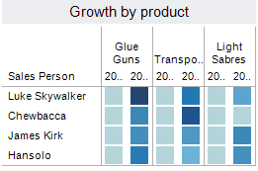
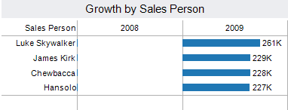
Area for improvement :
Tableau calculated year on year differences. However, it does so by leaving the element from which it derives its calculation. So in the following two graphs, you can see empty columns. If anyone knows how to correct that, I would be glad to learn the trick, as it eats up a lot of graph space, with no added value.
Those areas are empty, because of Tableau’s inner workings.
2008 and 2009

