Slide 1
SMART TODO ORGANIZER
Developed by
Firoz Subair
+971558870182
Firoz.subair@outlook.com
Equitatia Coding Assignment

Slide 2
TODO Application Functionalities
1. TODO Creation
Fields -> Building Name, Activity, AssignedTo, Date, Remove Button, Completion Button
2. TODO Listing Page
3. TODO Status by Building Name
4. TODO Status by Assigend TO
5. Highlight the completed Task on green color
6. Building status on clicking the building name . A popup with pending and completed tasks for the selected building.
7. AssignedTo status on clicking the AssignedTo column. A popup with pending and completed tasks for the selected building.
6. Browser/Local Storage feature.
7. DataBase Storage.
8. Error message popup.

Slide 3
GitHub Details
https://github.com/firugithub/golden-real-estate.git
Pre-requisite
PostgreSQL
Java8+
Maven

Slide 4
DEV Environment
IntelliJ IDEA
VS Code
PgAdmin4 for postgres
GitHub
Technologies used
Backend → Java, Hibernate, Spring
Frontend → VueJs, Bootstrap, Css
Database → PostgreSQL12(localy installed)
Build → Maven , NPM

Slide 5
Steps for the build
- C:\FirozSubair\golden-real-estate-master>mvn clean install
( This will build the front and backend project completly ) -
C:\FirozSubair\golden-real-estate-master>mvn --projects backend spring-boot:run
( This will start the backend project ) -
C:\FirozSubair\golden-real-estate-master\frontend>npm grunt server
( This will start the frontend project )
Access the application via <http://localhost:8081/>

Slide 6
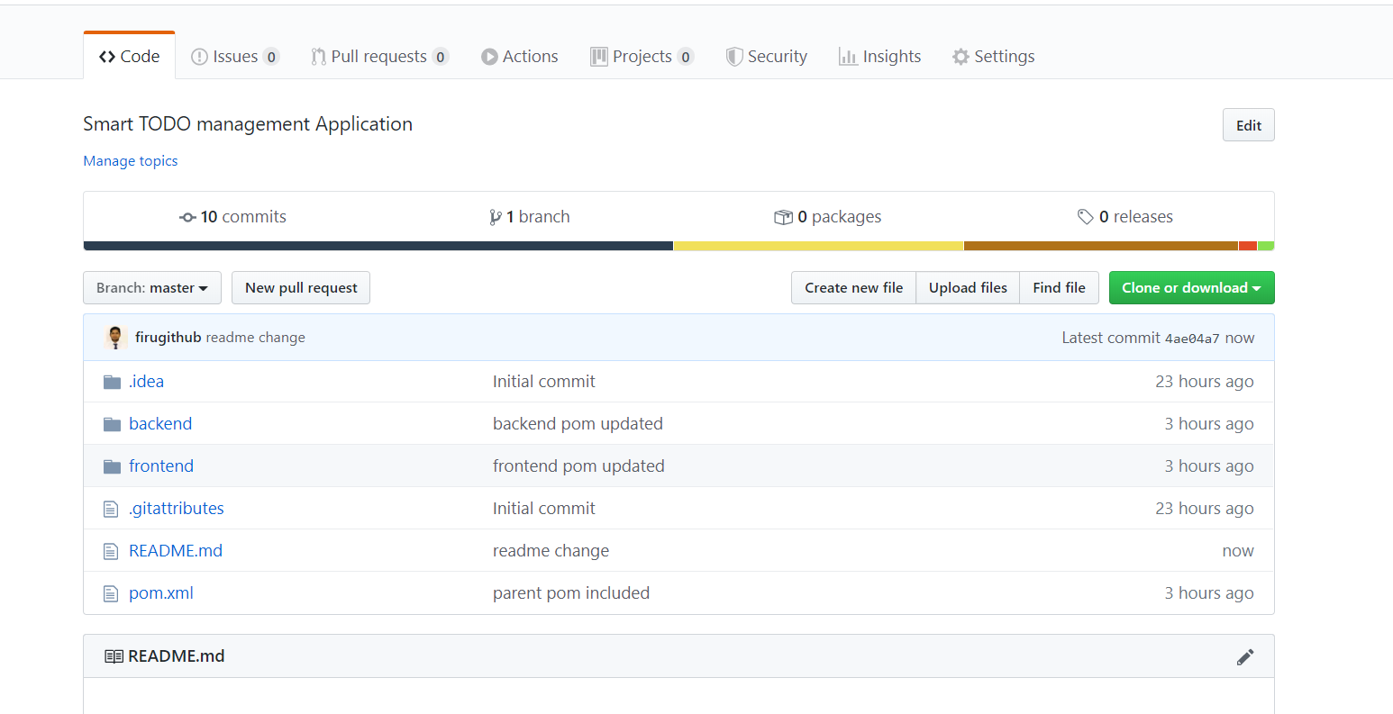
Project Structure in GITHUB

Slide 7
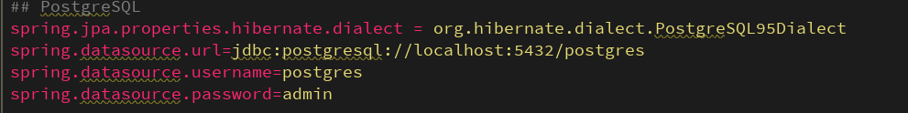
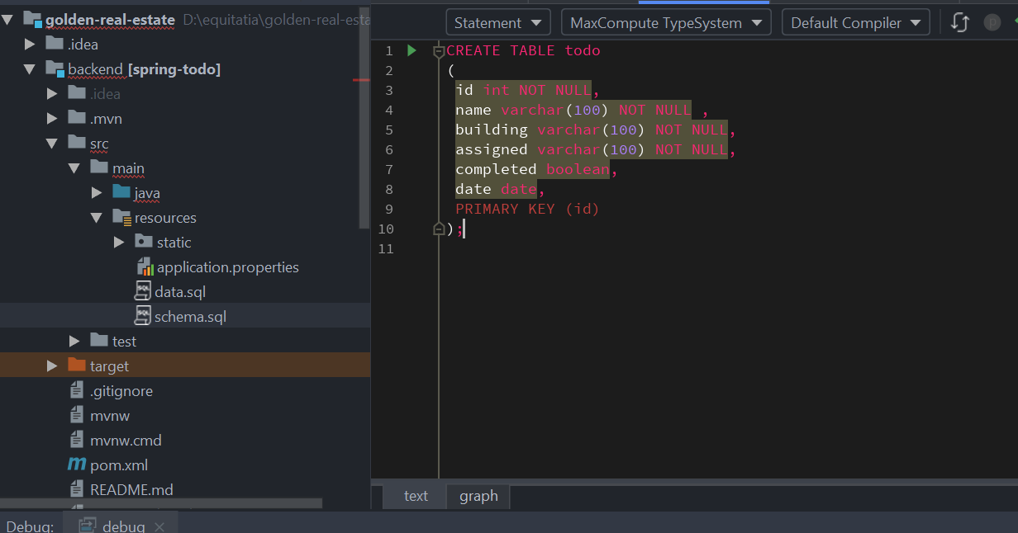
Database Details – Entities will be created automatically by hibernate

Slide 8
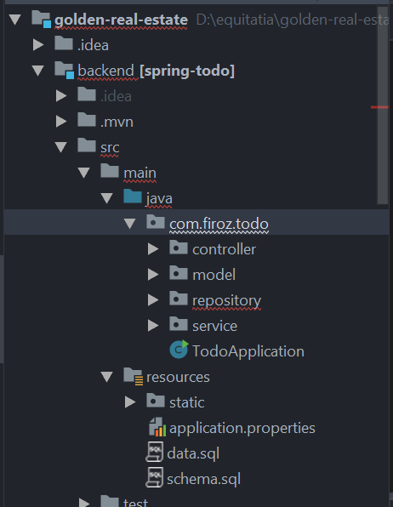
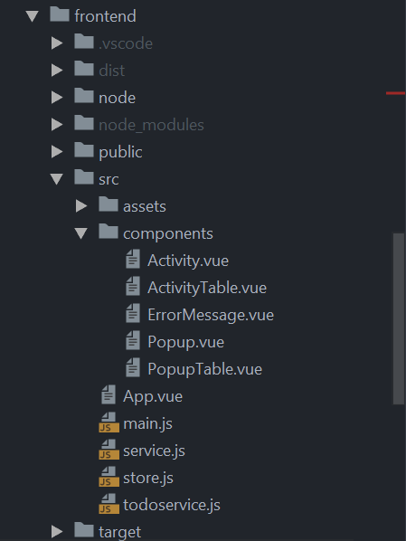
Application Structure
Frontend
Backend

Slide 9
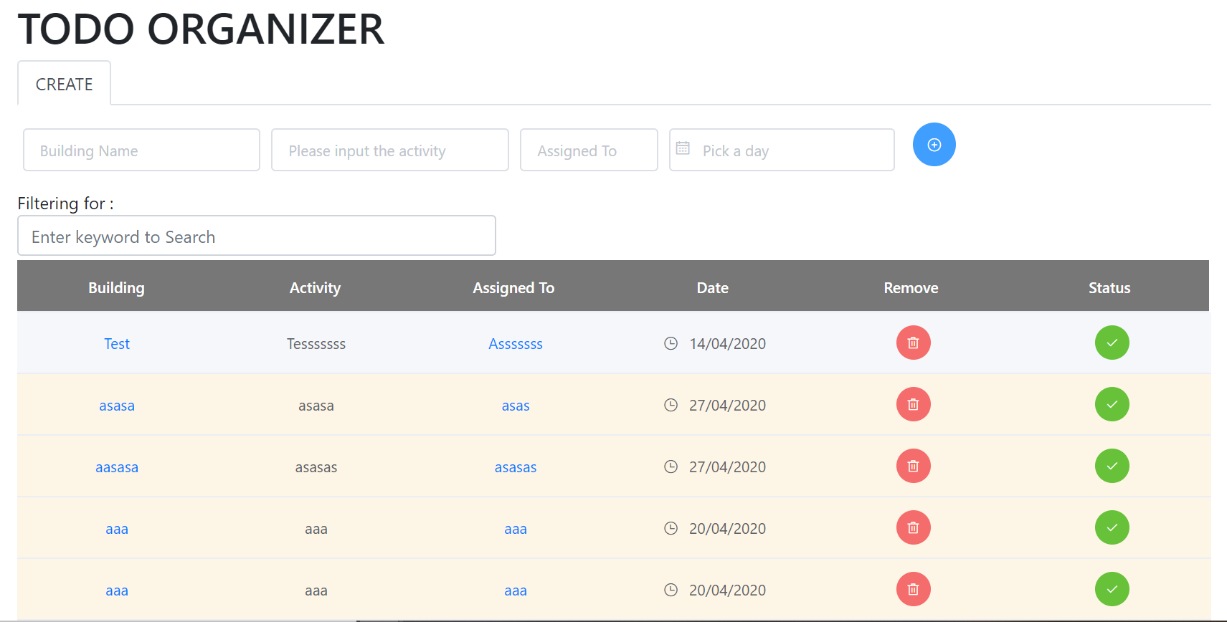
Create a new TODO using below fields and click on ADD icon
Click Remove Button to remove any TODO

Slide 10
Click Status Button to make the status as completed

Slide 11
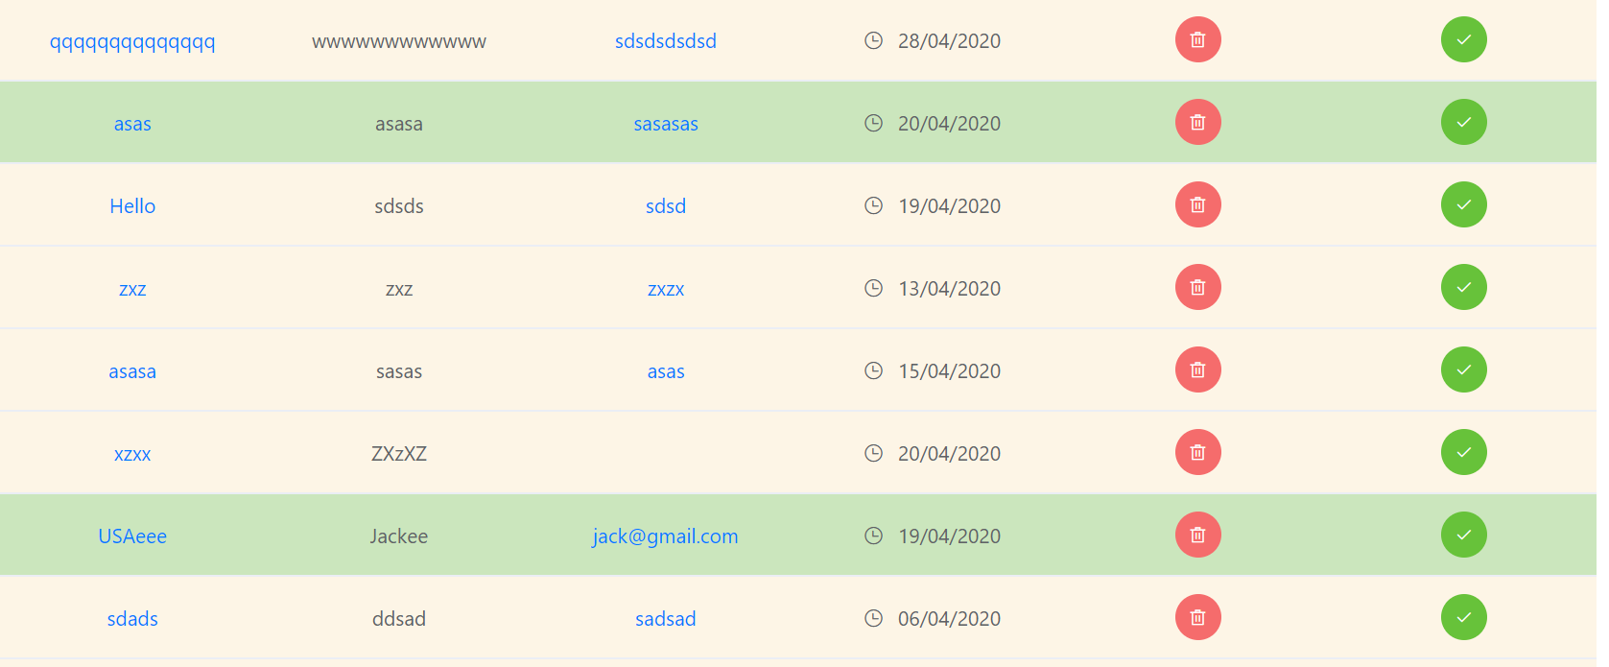
Completed TODOs will highlight in GREEN color

Slide 12
Filter your TODO using below fields and

Slide 13
Click on the Building Name to See the Status at Building Level

Slide 14
Click on the Assigned To Name to See the Status at Assignee Level

Slide 15
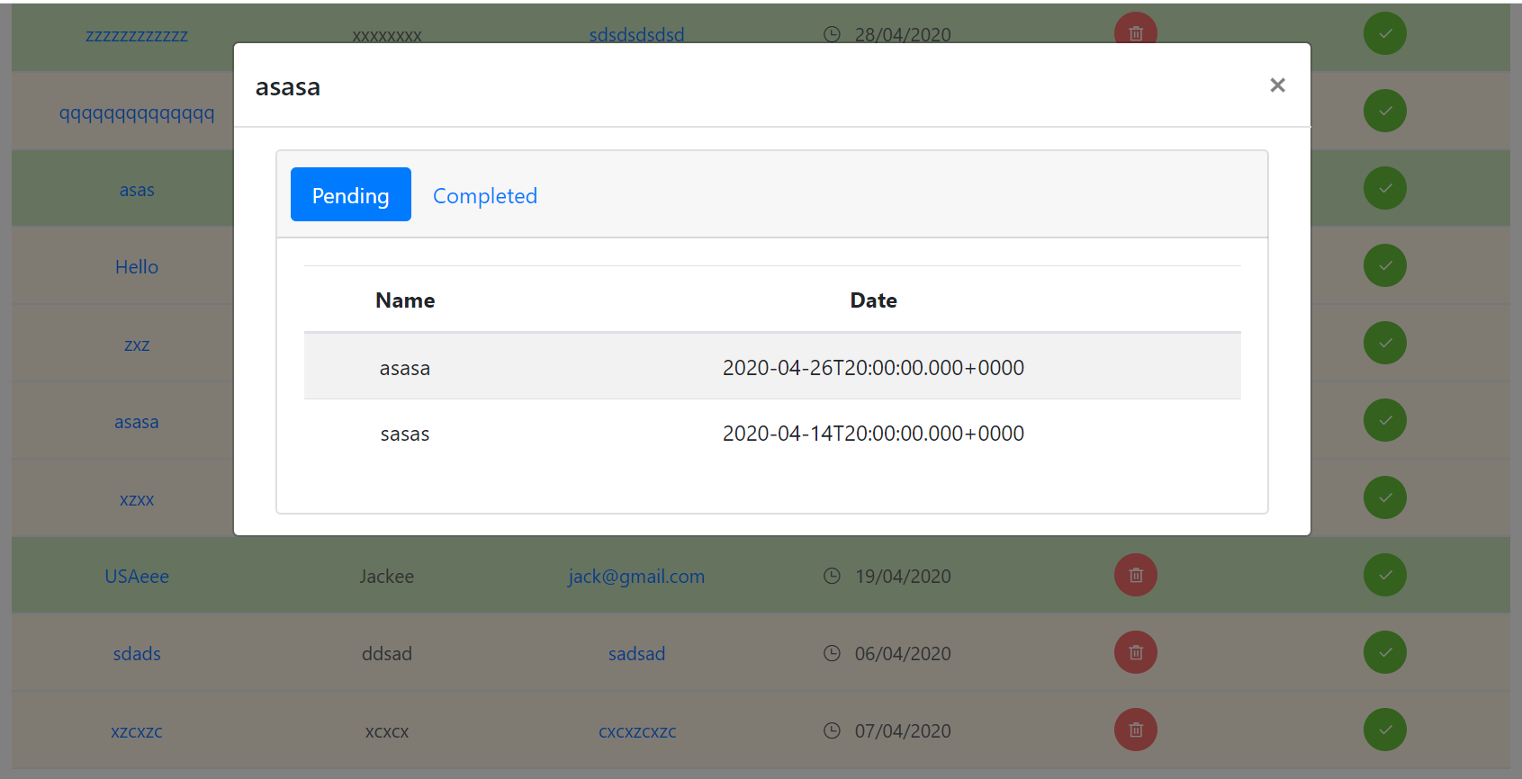
Completed Tasks will be showing under COMPLETED tab
Pending Tasks will be showing under PENDING tab

Slide 16
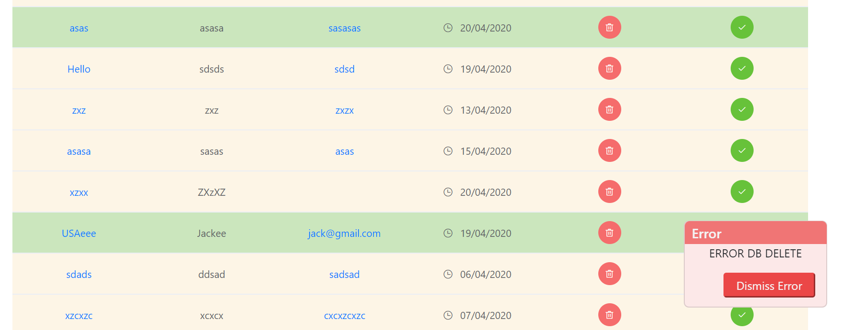
ERROR HANDLING POPUP

Slide 17
Reference
https://spring.io/
https://vuejs.org/v2/guide/
https://www.postgresqltutorial.com/
Thank You

