Slide 1
Project analysis slide 2
Firza Riany
firzariany2@gmail.com
Risks to deforestation from soybean production Country of interest: Brazil
Inspecting the dataset
Identifying the top 10 exporting companies that supply the
most soy to China
Procedures
Analysing the largest soy
producing state in Brazil
Comparing their risks of
deforestation
Identifying the companies that are exposed to deforestation
Recommend the
deforestation-free exporting companies.
Notes:
Thank you for the opportunity to share my results
To understand the link between soy production and deforestation.
To identify the exporting companies that are exposed to deforestation.

Slide 2
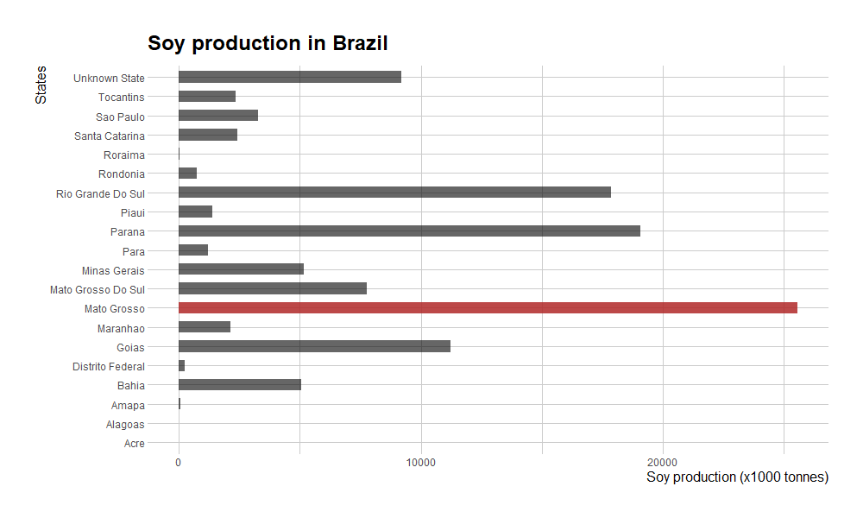
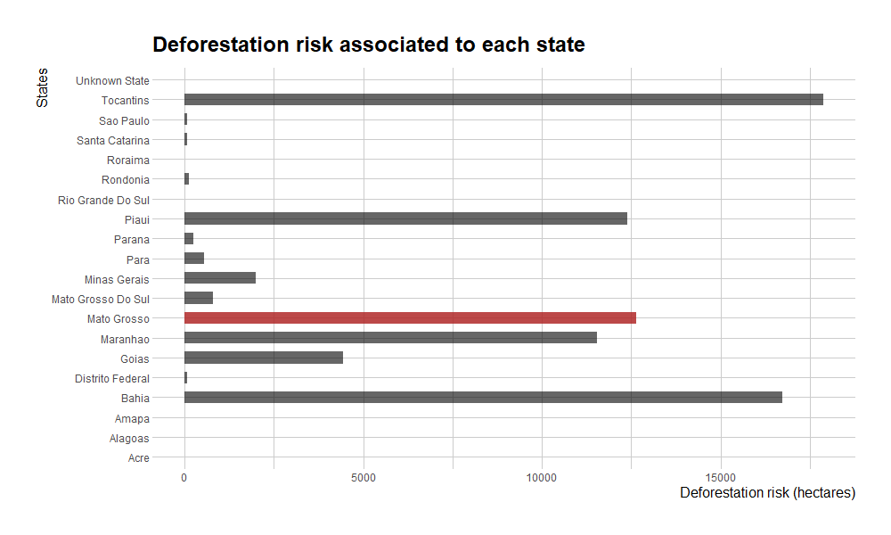
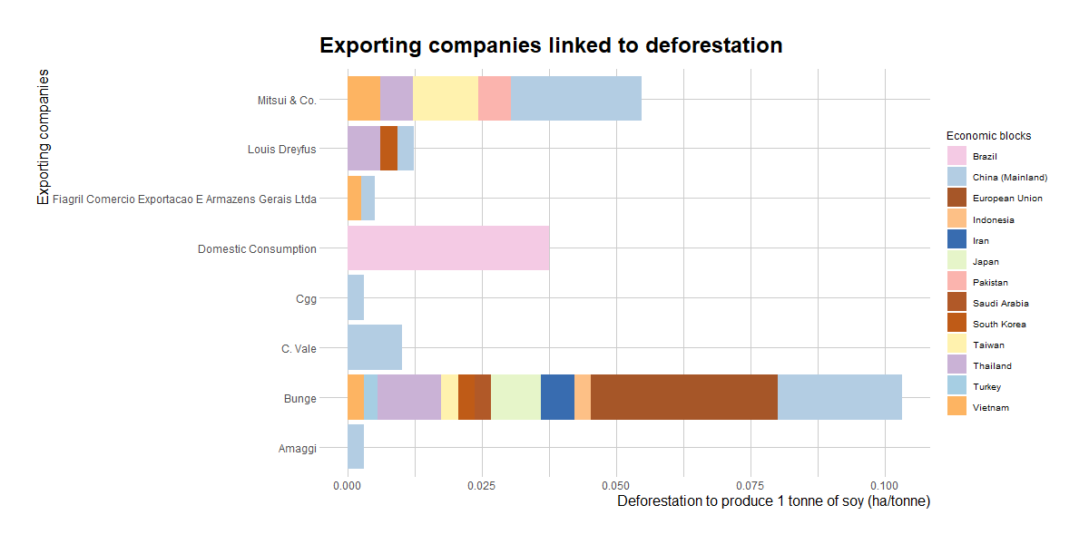
Project analysis slide 5
The largest soy producing state in Brazil
Assumptions:
Each company has the same probability to cause deforestation
Defining the threshold to decide which companies are having high risk of deforestation
Threshold: target / forest / yield = 0.00240 ha/ton
Deforestation target (Silva, et. al., 2021) = 400k ha
Forest areas (FAO, 2020) = 49 million ha
Potential yield soybean (FAO, 2020) = 3.41 tons/ha
Total soy production in
Moto Grosso
25 million tons
The deforestation risk in
Moto Grosso
12.6k hectares
The company with the highest risk to deforestation
Bunge
The economic blocks sourcing from Bunge
China and the EU
Notes:
Total soy production:
Aggregating by state
Wait for the amount
Associated risk
Aggregating by state
2nd question: companies in Mato Grosso linked with deforestation
To compare the companies .. To say if they have high deforestation …
Filter companies in Moto Grosso
Assumptions:
In this sense, how many hectares are deforested to produce 1 tonne of soy. Total soy production, total deforestation risk by company, divide them (ha/ton)
Then I had to define the threshold to say..
Threshold
Why target: halting deforestation while producing soybean
Ton/ha == allowed deforestation to produce 1t of soybean

Slide 3
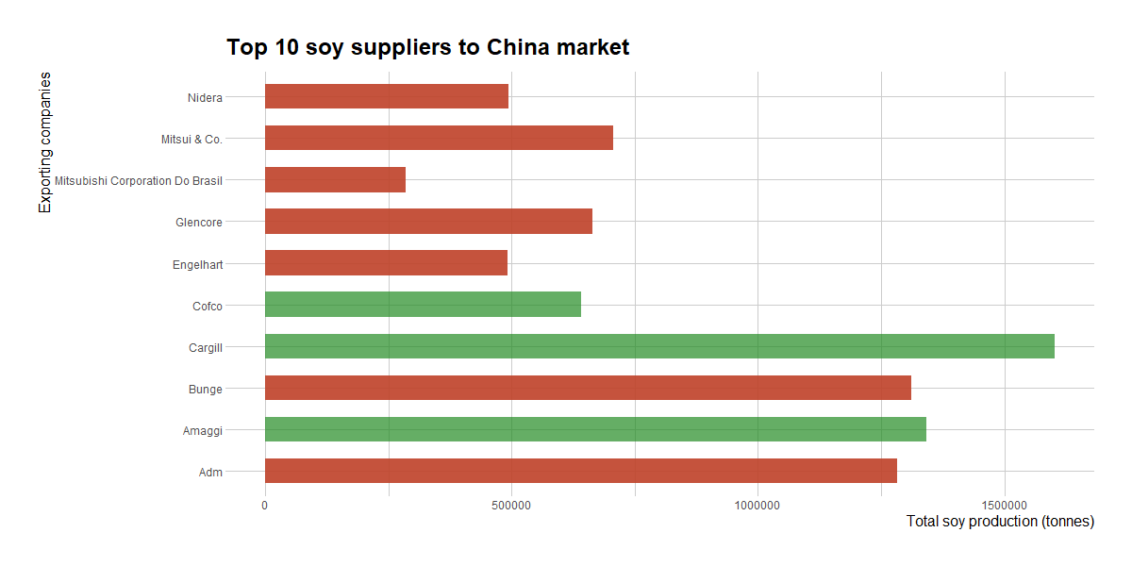
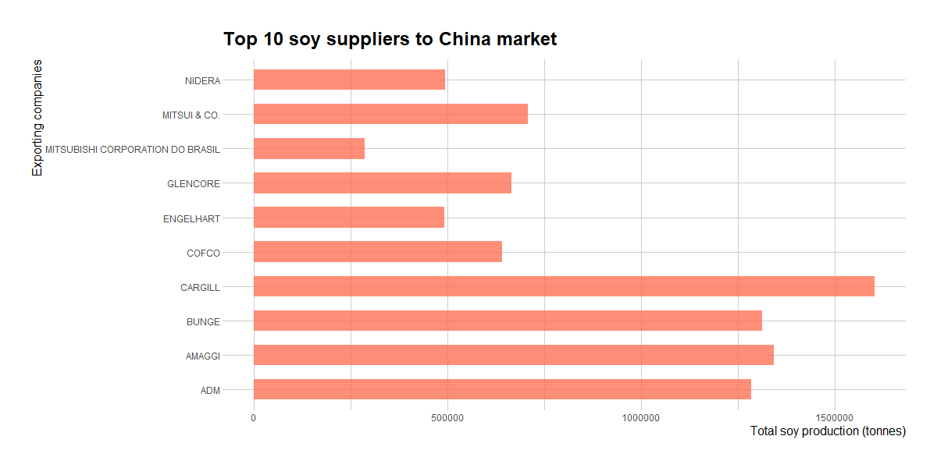
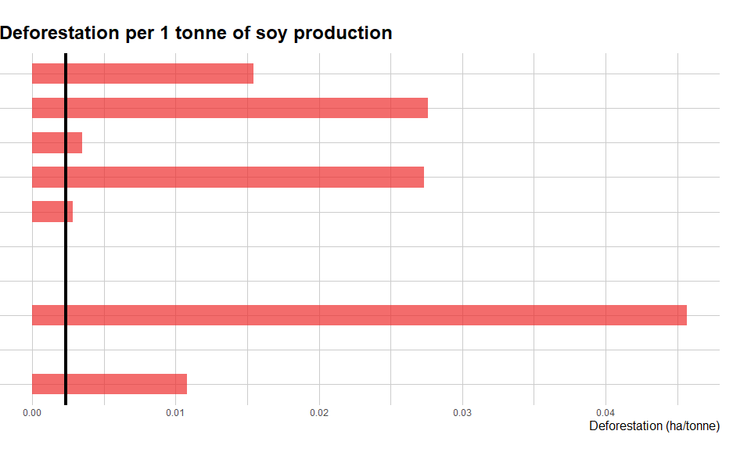
Project analysis slide 5
If I have to recommend someone from China…
The company with the most soy exports
The amount of soy exported by Cargill
The company with the highest risk to deforestation
The deforestation-free company
Cargill
1.5 million tons
Bunge
Cargill
Notes:
Deforestation-free: so even though Cargill produces 1.5 million tons,

Slide 4
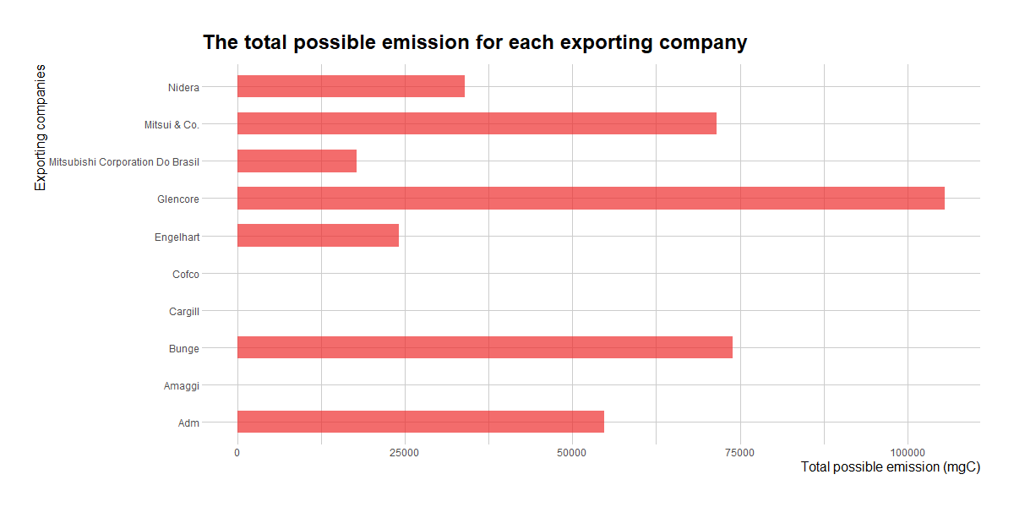
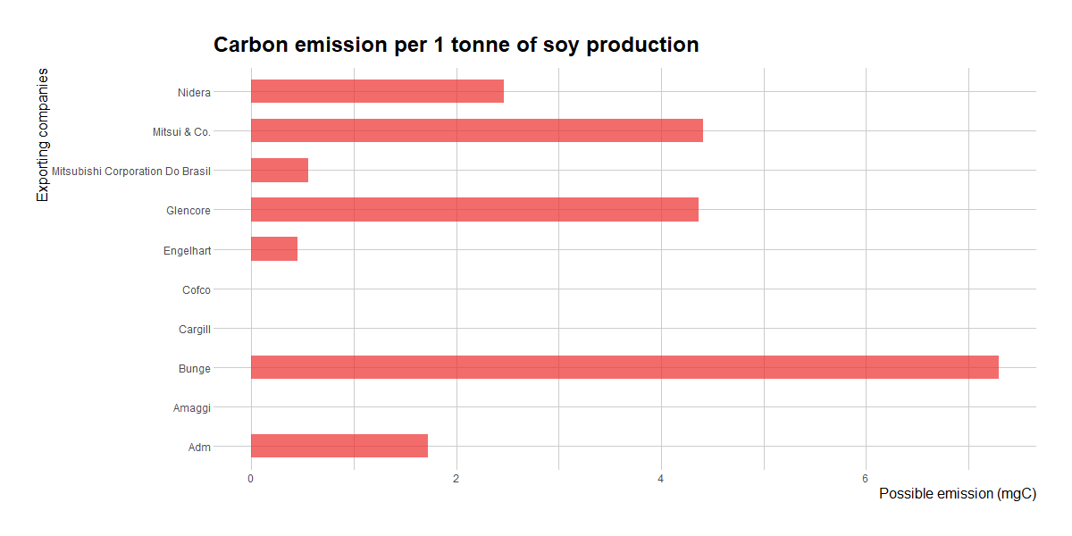
Project analysis slide 5
If I have to recommend someone from China…
Equation = total area changed (ha) x carbon stock in Mato Grosso (mgC/ha); carbon stock (Nogueira et. al. 2009) = 159.7 mgC/ha
The company with the highest emission per 1 tonne of soy
The company with the second highest emission per 1 tonne of soy
Bunge
Glencore
Notes:
Loz productio

