Slide 1
hAPPen
Summer-Planning-Application
By: Sturzu Mihai
Ulkei Szabolcs

Slide 2
The goal
An Application
in which Organizers can easily make public their events
in which possible participants can access all the information they might need
in which participants can make reservations
In which organizers can handle these reservations simple and with easy

Slide 3
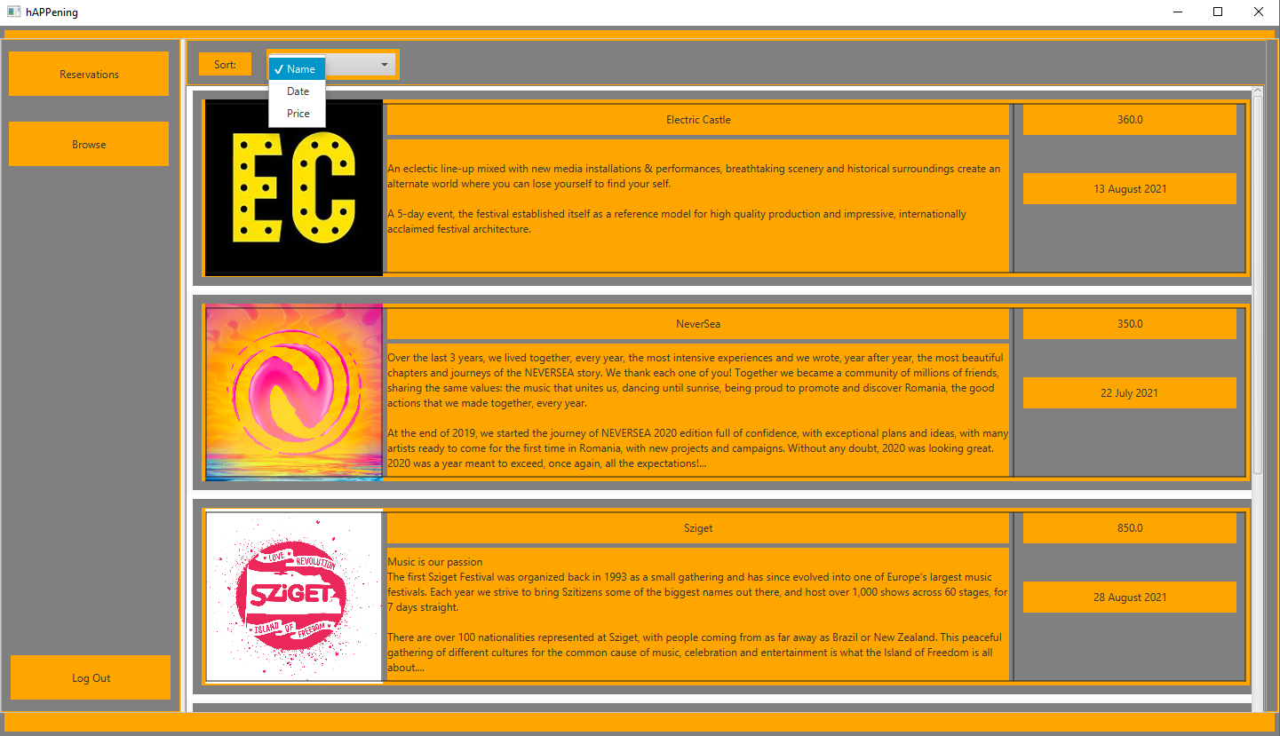
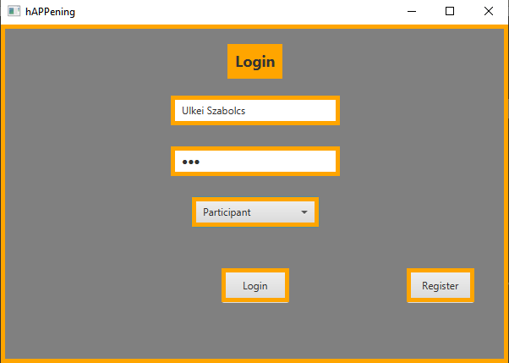
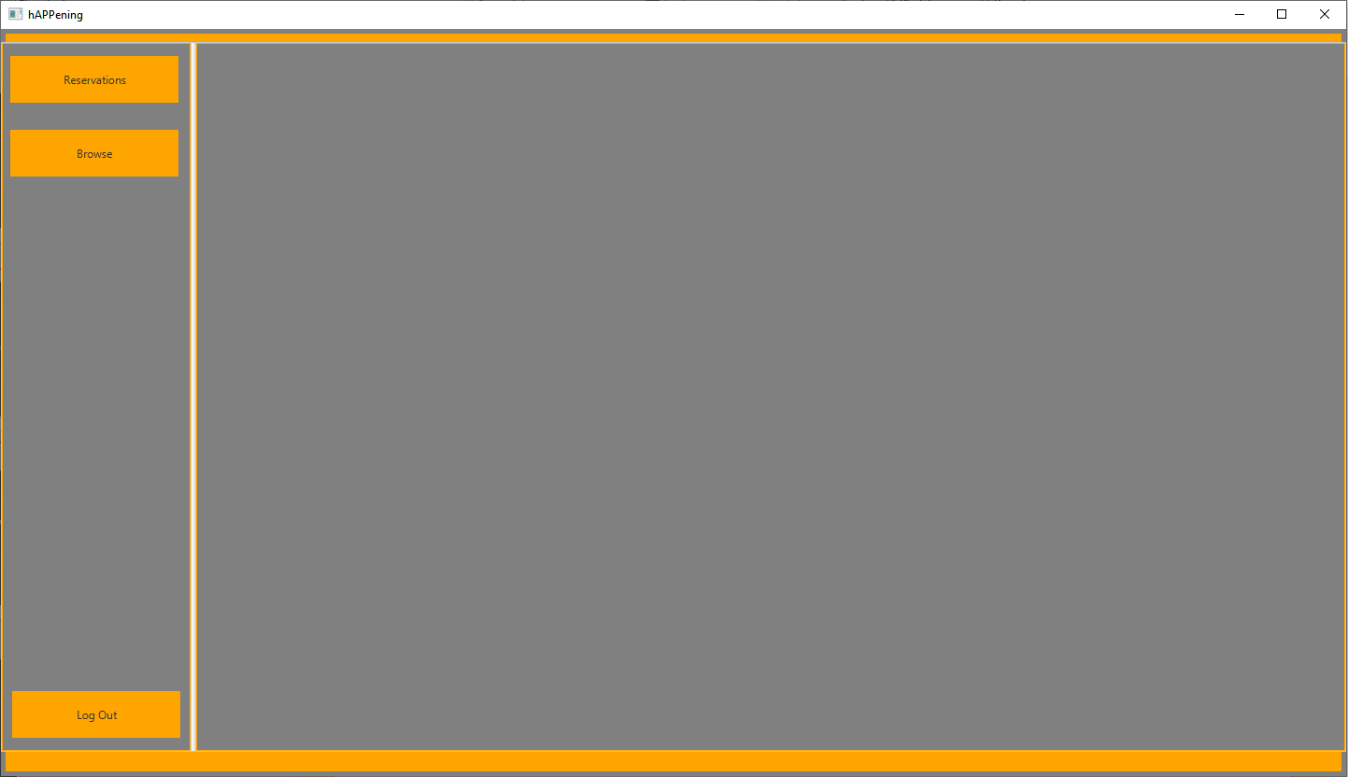
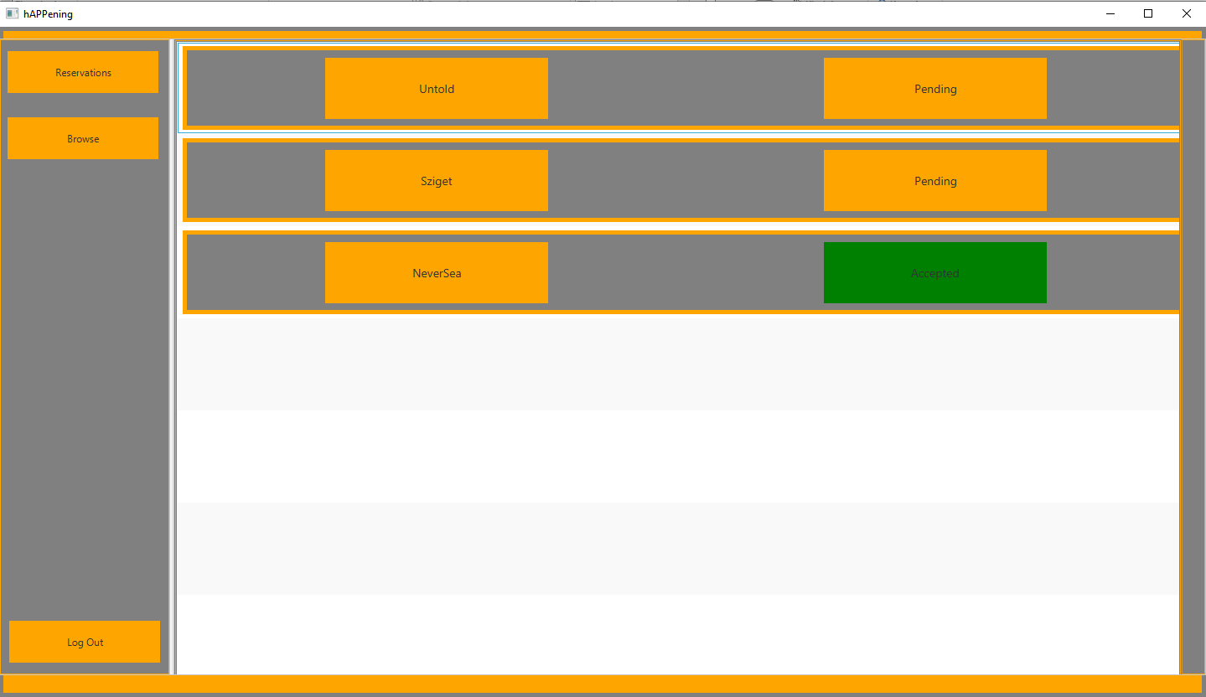
Basic Structure
Login and Registration
Login -> Corresponding Container
Participant Container:
Browse Events:
Sort by Name, Date, Price
View Event Details:
Mark your reservation intent and wait for the organizer’s response
See your Reservations

Slide 4
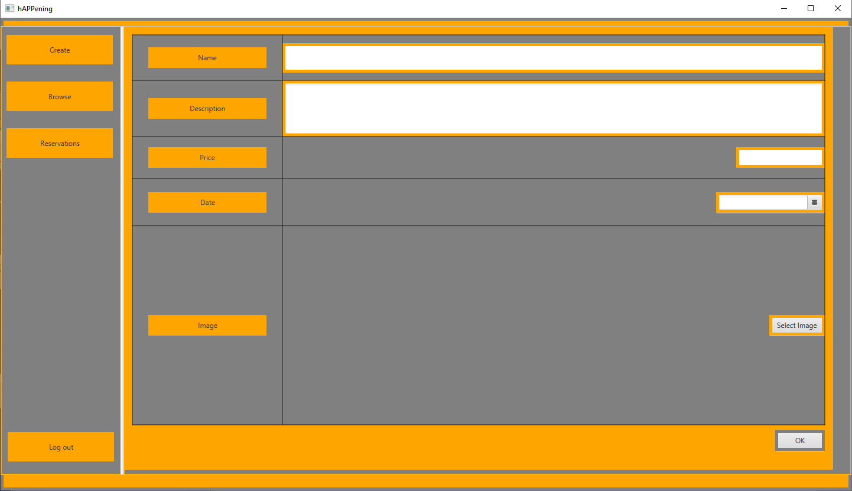
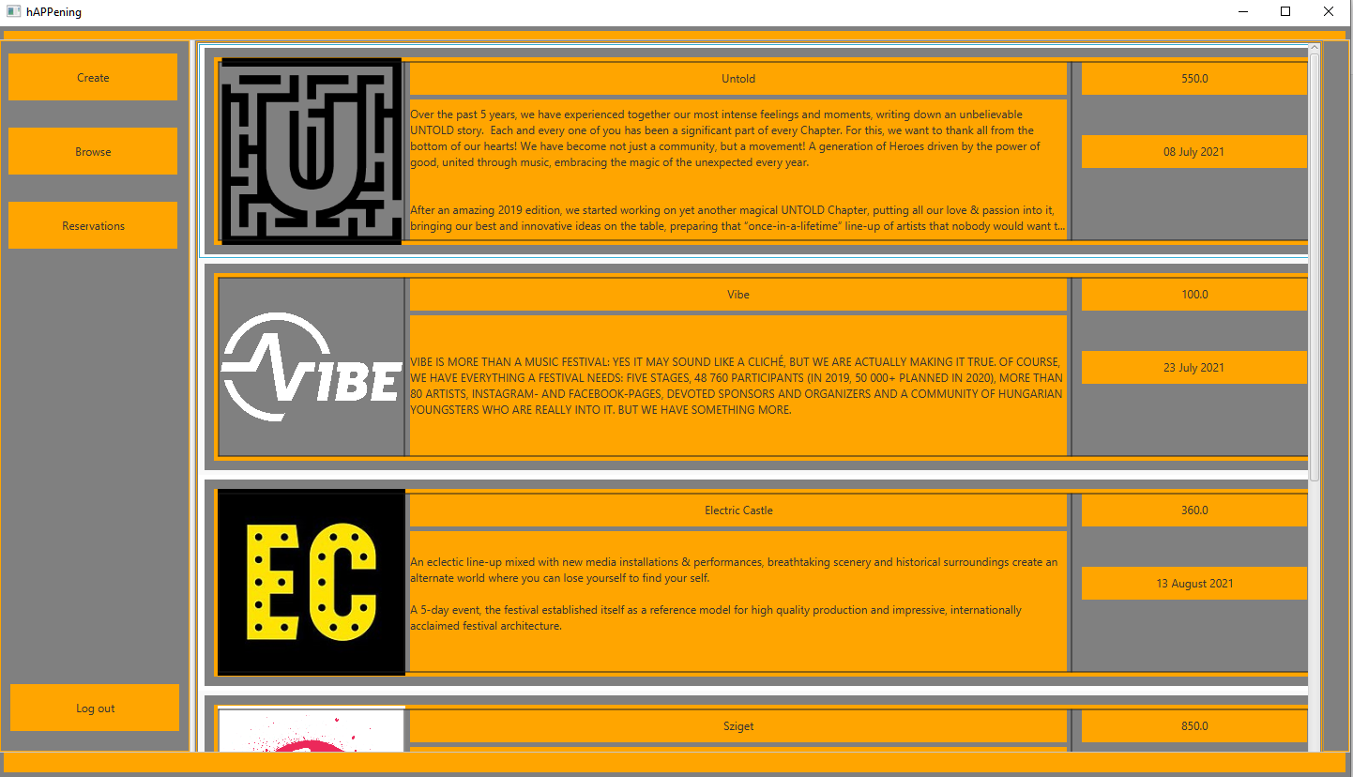
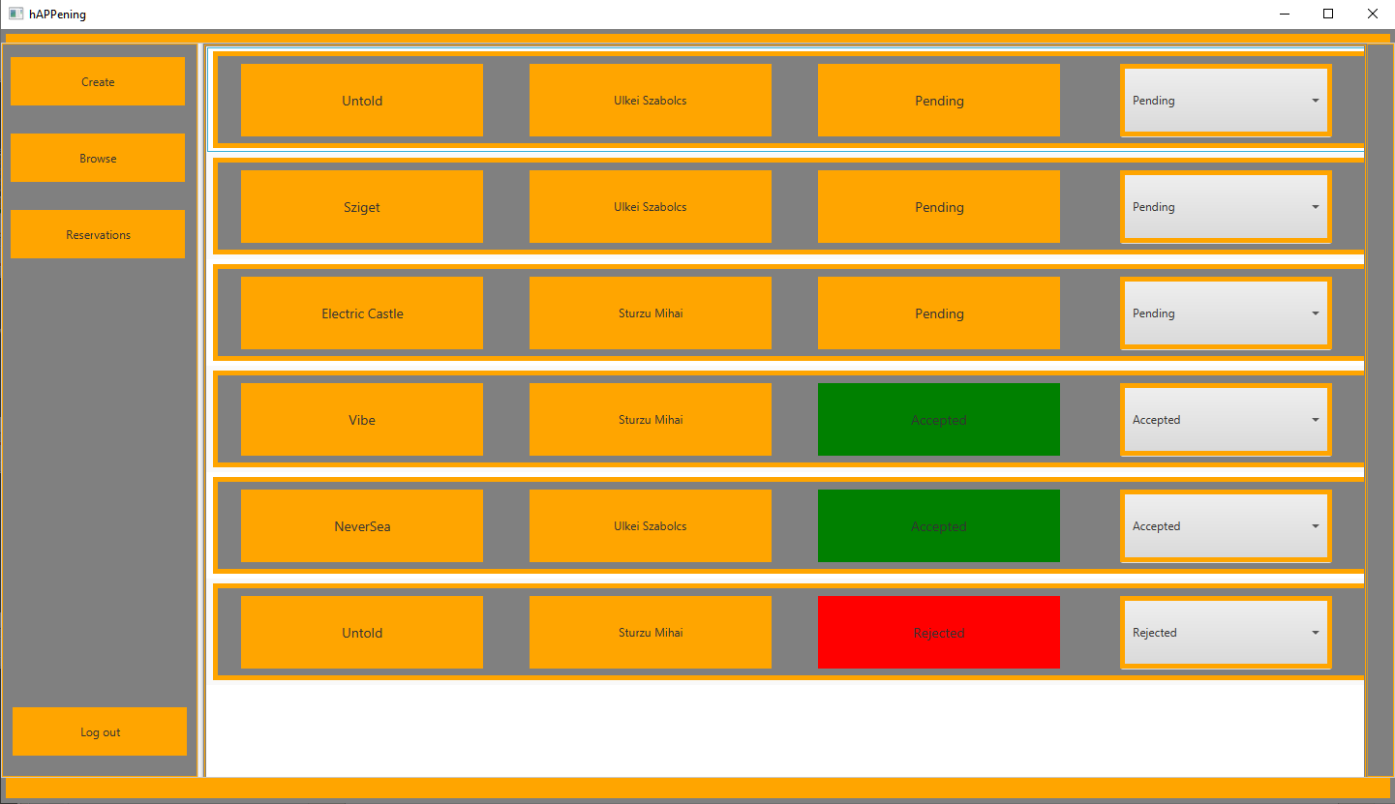
Basic Structure
Login and Registration
Login -> Corresponding Container
Organizer Container:
Create Events:
Add your Event’s Name, Description, Date, Price, Logo
See your Events:
View it’s details
Edit or Delete your Event if you’d like
See Reservations for your Events
Modify the reservation’s status with ease

Slide 5
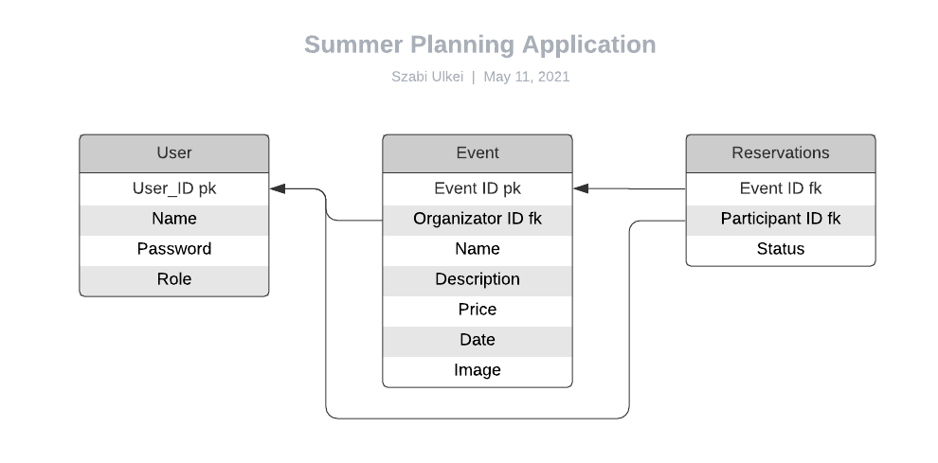
DataBase
Database:
Nitrite

Slide 6
Demo:

