Slide 1
ML FOR MVPs
Fisayo Omilana

Slide 2
Objective
To find a model that can accurately predict the MVP for the 2016-17 NBA Regular Season
To evaluate relevant trends over time among the NBA’s Most Valuable Players

Slide 3
data
Scraped 15 years of data from ESPN.com

Slide 4
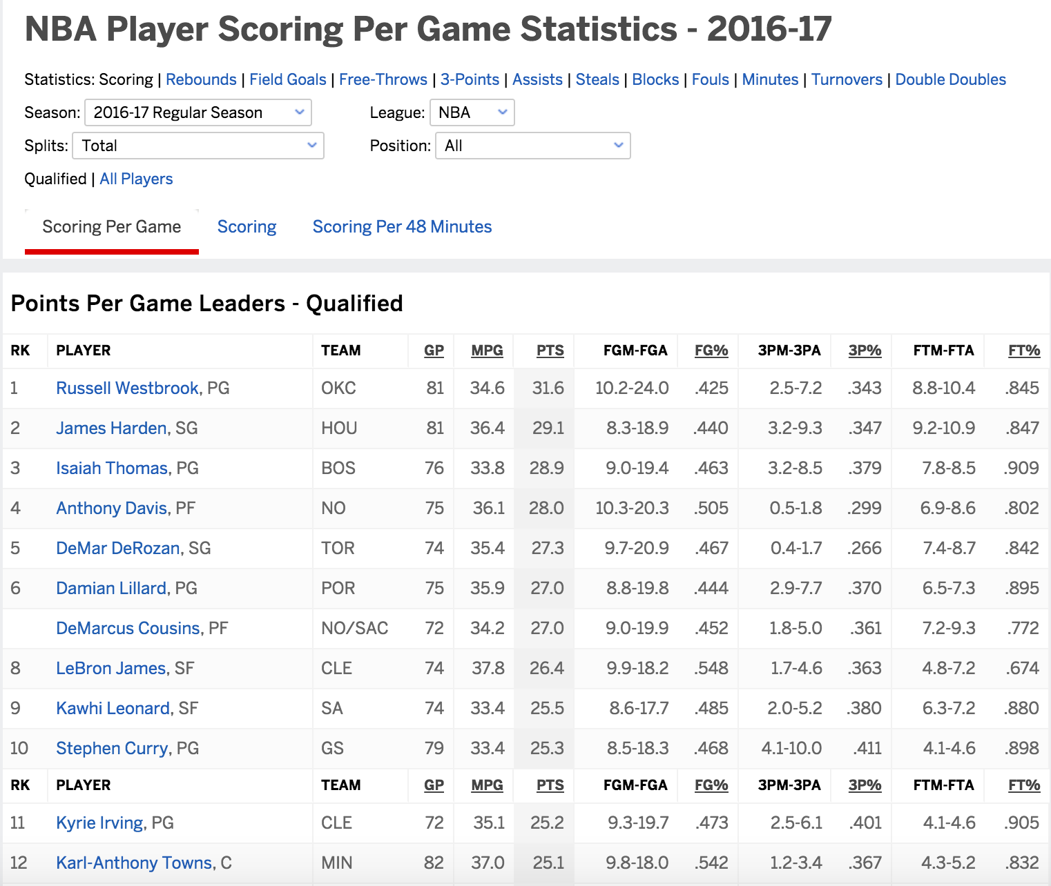
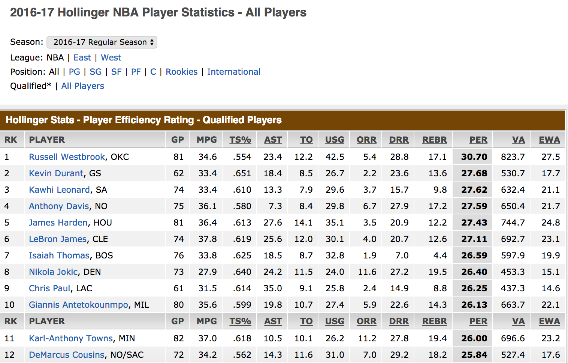

Slide 5
data
Scraped 15 years of data from ESPN.com
Google Scraper (was not a perfect, required lots of data processing)

Slide 6
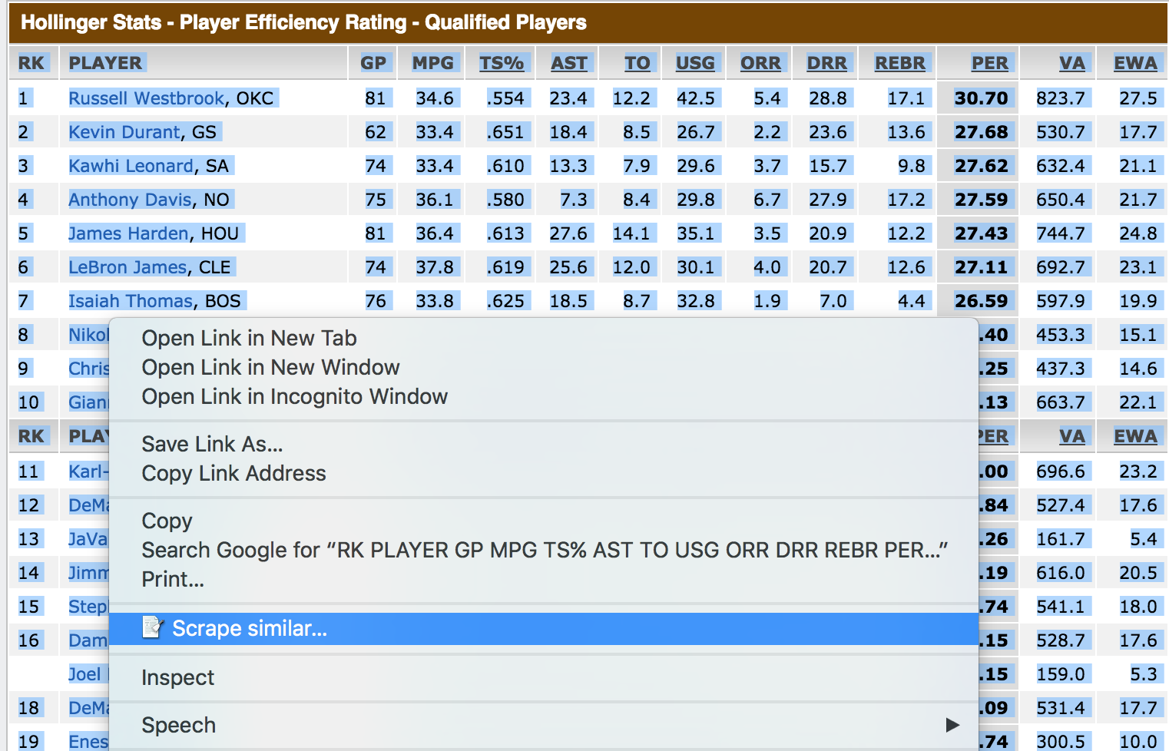
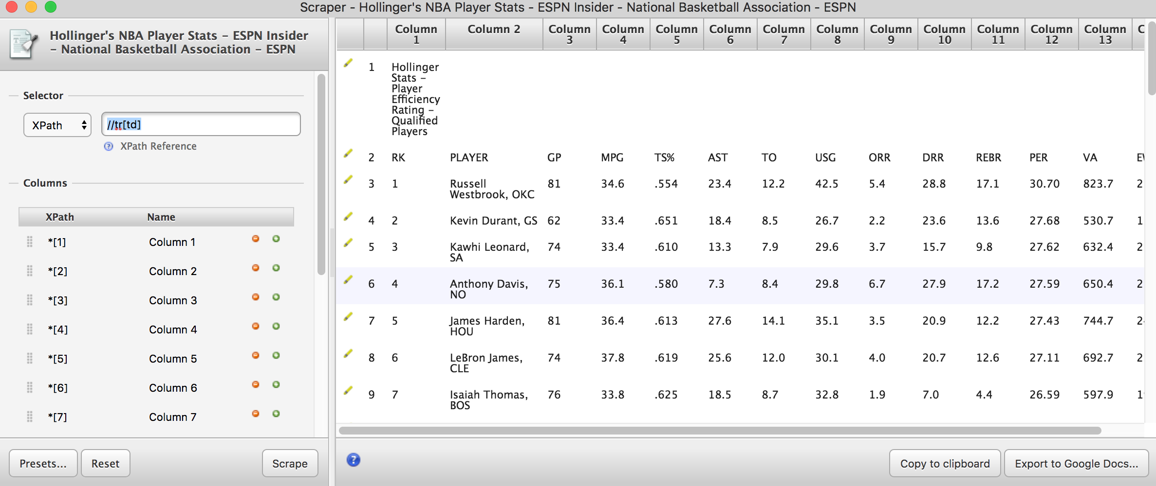

Slide 7
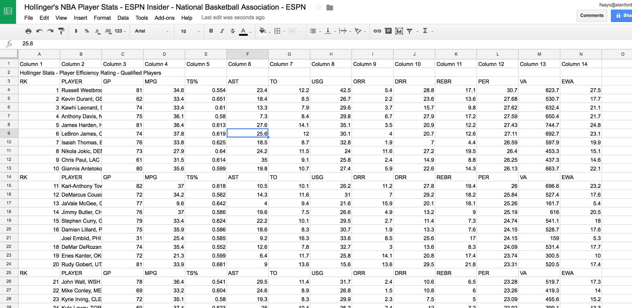

Slide 8
data
Scraped 15 years of data from ESPN.com
Google Scraper (was not a perfect, required lots of data processing)
Manually inputted the results of NBA Awards from BasketballReferene.com
Final product : https://docs.google.com/a/stanford.edu/spreadsheets/d/1RQBrF0zV2V_fCA3mg2aszk1xapQ-snIgoWPVqptW9_s/edit?usp=sharing

Slide 9
Python Script
Used the various scikit-learn classifiers to train and test our model
Naïve Bayes, Logistic Regression, KNN, Decision Trees, Random Forest
Split data up to train on 11 years and test on 3 years
Accuracy vs Precision/Recall
Best Overall Model: Random Forests
99% training accuracy, 92% training precision, 100% training recall
89% testing accuracy, 60% testing precision, 81% testing recall

Slide 10
Predicting the 2016-17 MVP
Tier System
Reasonable yet somewhat surprising results
LeBron James, with an average rank of 2.4 for 10 sample runs
Russell Westbrook, with an average rank of 3.1 for 10 sample runs
James Harden, with an average rank of 2.1 for 7 sample runs
Kawhi Leonard, with an average rank of 1.3 for 6 sample runs
Anthony Davis, with an average rank of 2.7 for 4 sample runs

Slide 11
Finding Impactful Features
Essentially determine which specific statistical categories were most important to consider when distinguishing an MVP
Computed the total difference in performance with and without each feature

Slide 12
TOP 8 Most Telling Stats
MPG 32.09% NET DIFFERENCE IN RESULTS
DBLDBL 17.24% NET DIFFERENCE IN RESULTS
AST 13.54% NET DIFFERENCE IN RESULTS
PPG 13.47% NET DIFFERENCE IN RESULTS
USG 9.61% NET DIFFERENCE IN RESULTS
STL 9.18% NET DIFFERENCE IN RESULTS
PER 7.97% NET DIFFERENCE IN RESULTS
TRIDBL 7.06% NET DIFFERENCE IN RESULTS

Slide 13
Evaluating trends over time
Broke up all data into five-year intervals and took averages of MVP candidates from each mini-era in some of the significantly telling categories
Created Tableau visualizations from the above:
https://public.tableau.com/profile/fisayo.omilana#!/vizhome/NBAMVPStandardsOvertheYears/NBAMVPStandardsOvertheYears

Slide 14
Insights
The caliber of play/output among the NBA’s best has grown higher and higher (USG, PPG, PER, AST, & TRIDBL)
Faster pace
Is becoming MVP now more difficult than before?
Triple Double spike in recent five years
Machine-like production from players like Westbrook, Harden, and LeBron
Minutes Per Game decreasing
Smarter workload reduction for stars or competiveness declining in the league?
Double Doubles decreasing
Extinction of the old-school big men, rise of athletic/scoring powerhouse guards

