Slide 1
Milton
A Robust Framework for Photorealistic Rendering
Travis Fischer ‘09

Slide 2
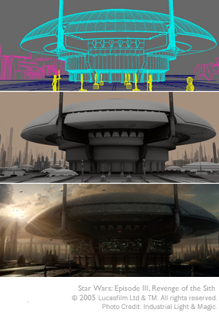
Motivation
Rendering is used everywhere
Goal of photorealistic rendering
Rendering is difficult…
Who is Milton?

Slide 3

Introducing Milton
A Framework for exploring rendering techniques
Goals:
Design
Robustness
General-Purpose
MLT
Features:
Open source C++
Efficient
Extensible
Implements several advanced rendering algorithms

Slide 4
Talk Overview
Goal is to discuss the interesting things in Milton’s life and the lessons he’s learned along the way
Why should you care?
Really cool algorithms and results
Lots of interesting software design considerations
There will be dragons..
Talk Layout
Brief background
Discussion of Milton’s design
MC Rendering in Milton
Results
Feedback on how awesome the results look..
Acknowledgements / Questions

Slide 5
Background
Model of light
Assumptions:
Geometric optics
Unpolarized, incoherent
No participating media or subsurface scattering
Physically-based rendering
Generate an image by simulating paths of light
Only interested in paths which emanate from a light source and eventually reach the virtual camera
Model / simulate interaction of light with materials in the scene

Slide 6
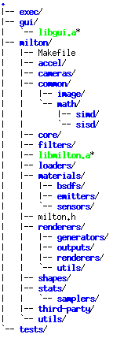
Design (1/8)
High-Level Overview
Broken up into a core milton lib, gui lib, executable, and test suite
Heavy use of OOP including run-time extensions via external plugins
Uses Qt for threading and (optional) GUI in order to remain cross-platform
Design topics we’ll cover:
Material representation
PropertyMap
Path data structure
Optimization
Renderer design
Problems & difficulties with current design

Slide 7
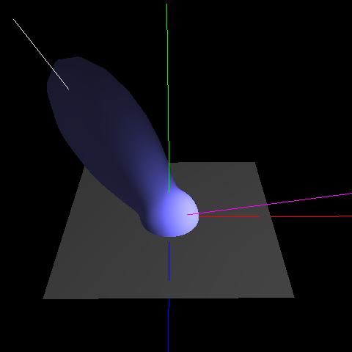
Design (2/8)
Material Representation
Color vs Reflectance
Reflectance defined by a BSDF hierarchy
Material : surface -> BSDF parameterized by point on surface

Slide 8
Design (3/8)
PropertyMap Paradigm
Wrapper around map<string, boost::any> which all core, customizable classes derive from
Pro: cleaner, more extensible interface
Con: lose strict compile-time type checking
Complements Milton scenefile format
Based on JSON
Accepts arbitrary key-value pairs just like PropertyMap
Extensible – external plugins can accept their own parameters without changing the built-in scene loader

Slide 9
Design (4/8)
{ "scenefile" : { "renderer" : { "type" : “dynamic", “path" : “/path/to/my/librenderer.so” }, "camera" : { "type" : "thinlens", "eye" : [ 0, 10, 0 ], "aperture" : 50, "fstop" : 18 }, "scene" : { "material" : { "emitter" : { "type" : "oriented", "power" : [ 80, 80, 80 ] }, "plane" : { } } } } }

Slide 10
Design (5/8)
Path data structure
Represents a path of light as it bounces around the scene
Deque containing zero or more vertices
Abstracts out all of the complicated MC logic
Sampling paths incrementally
Storing cumulative data about the path overall
Cumulative probability density of having the created path (p)
Cumulative light transport along path (f)
Cumulative MC weight along path (f / p)
Allows for efficient implementation of almost any MC rendering algorithm
Ex. path tracing, bidirectional path tracing, photon mapping, and MLT

Slide 11
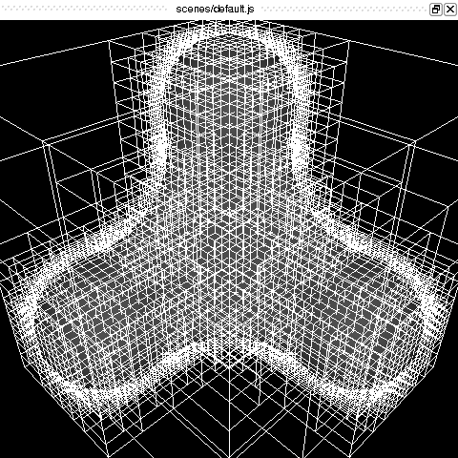
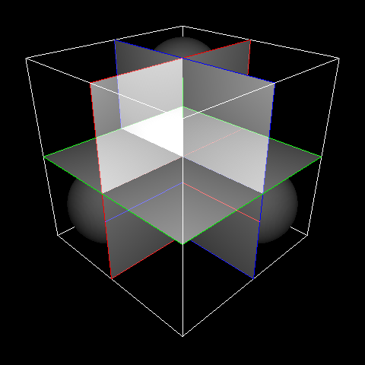
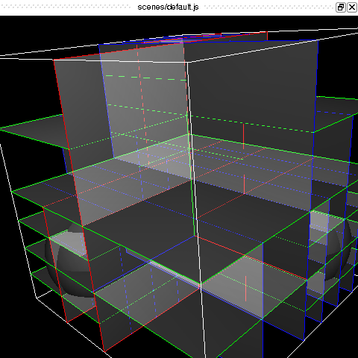
Design (6/8)
Optimization
Highly multithreaded
SSE-accelerated vector/matrix library
Hand-optimized SAH kd-Tree

Slide 12
Design (7/8)
Renderer Design
Most rendering algorithms reconstruct an image by point sampling the film plane
Many different ways of generating those sample points
Uniform, stochastic, jittered, low discrepancy sequences, etc.
Milton separates point generation and evaluation
Standard producer-consumer problem
Arbitrary number of render threads

Slide 13


Design (8/8)
Difficulties with current design
Lack of consistent, meaningful units
Sampling specular surfaces
Singularity in geometry term

Slide 14


Rendering in Milton (1/4)
Monte Carlo-based rendering algorithms
Estimate output image stochastically
Differentiating factor between MC algorithms is how X_{i} is sampled
Most determine X_{i} incrementally, sampling one vertex at a time
Path tracing samples paths by starting from the eye
Particle tracing samples paths by starting from the lights
Bidirectional path tracing samples paths by starting from both the eye and the lights
All suffer from poor theoretical convergence

Slide 15
Rendering in Milton (2/4)
Metropolis Light Transport (MLT)
Extremely robust and able to handle very “difficult” scenes
Notoriously hard to implement
One of the driving forces behind Milton
Clean, open source reference implementation
Based on the Metropolis-Hastings sampler

Slide 16
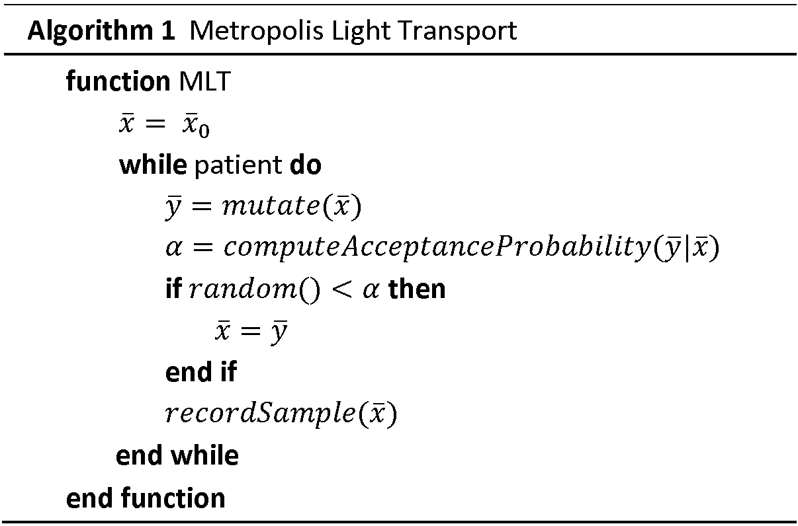
Rendering in Milton (3/4)
Detailed Balance
Achieving detailed balance yields a Markov chain which will converge to ≈ f
MLT Pseudocode

Slide 17
Rendering in Milton (4/4)
Sounds great, right?
Achieving detailed balance isn’t good enough in practice ☹
Walk may get stuck in local maxima for a long time
Need to ensure convergence as quickly as possible
Main challenge with MLT is creating mutation strategies which ensure progress regardless of scene complexity
Bidirectional mutations
Large, low acceptance probability
Lens subpath mutations
Small, stratify samples across the film plane
Perturbation mutations
Small changes to the path designed to complement bidirectional mutations

Slide 18
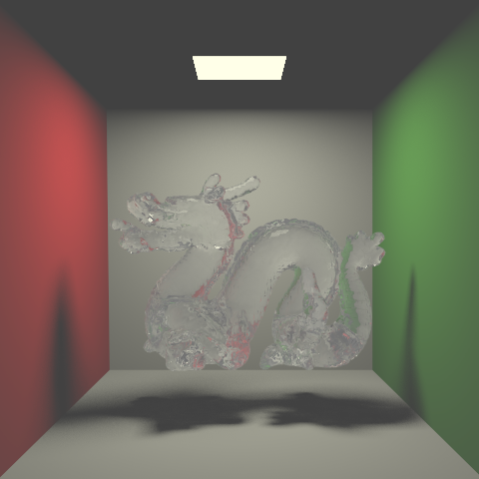
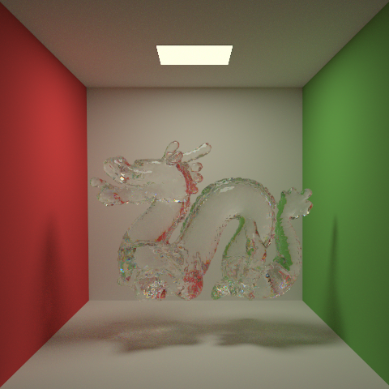
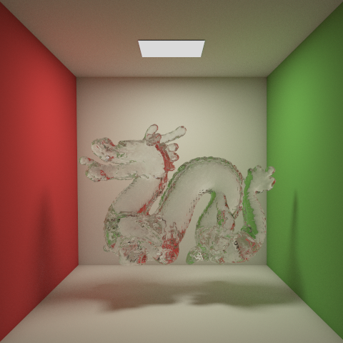
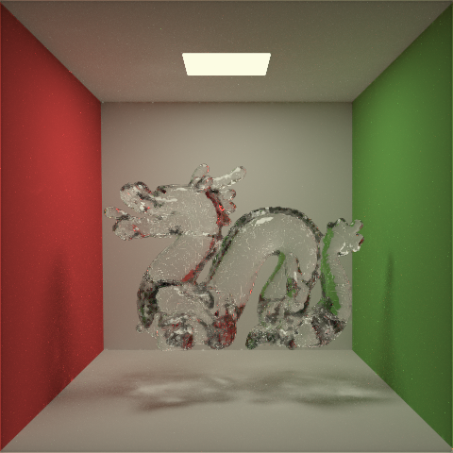
Results (1/4)
Ray tracing
Path tracing
Bidirectional path tracing
MLT

Slide 19
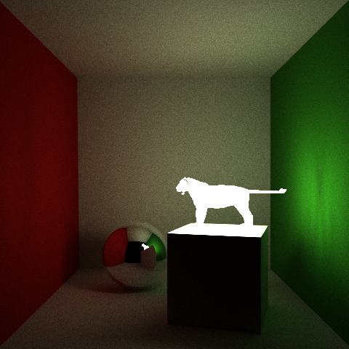
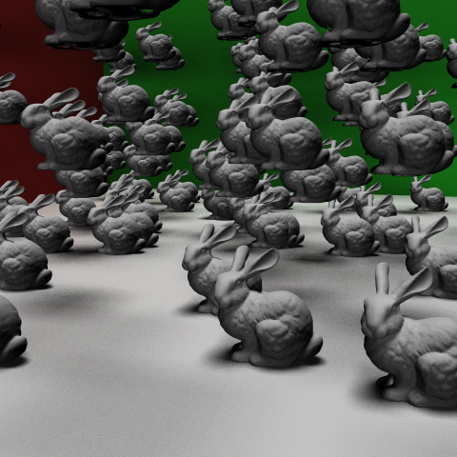
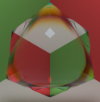
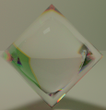
Results (2/4)

Slide 20
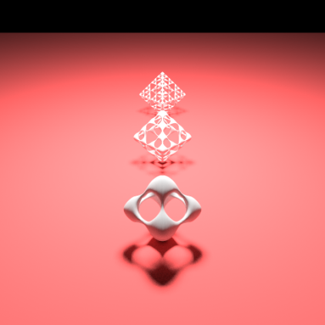
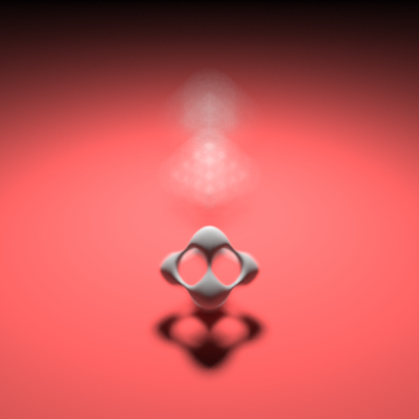
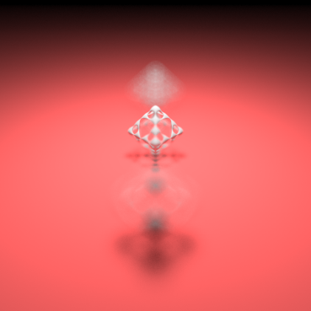
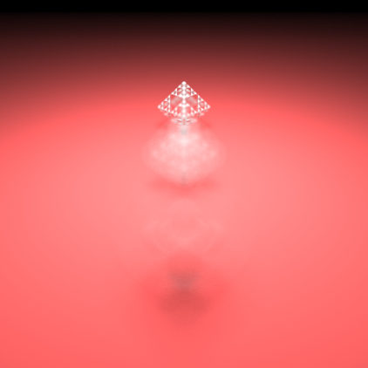
Results (3/4)

Slide 21
Results (4/4)
Lots of rendering engines out there
Surprisingly hard to find any that are free, open source, capable of advanced rendering, and also well-written
Niche
Milton is by no means ‘photorealistic’ yet¹, but it has a great core design and will hopefully continue to develop as an open source project
1) Largely due to my lack of artistic skills..

Slide 22
Acknowledgements / Questions
Spike and Andy (Milton’s advisors)
Matt Jacobs (Milton’s mom)
Eric Veach (Milton’s uncle)
Brown CS (Milton’s home)
Questions?

