Slide 1
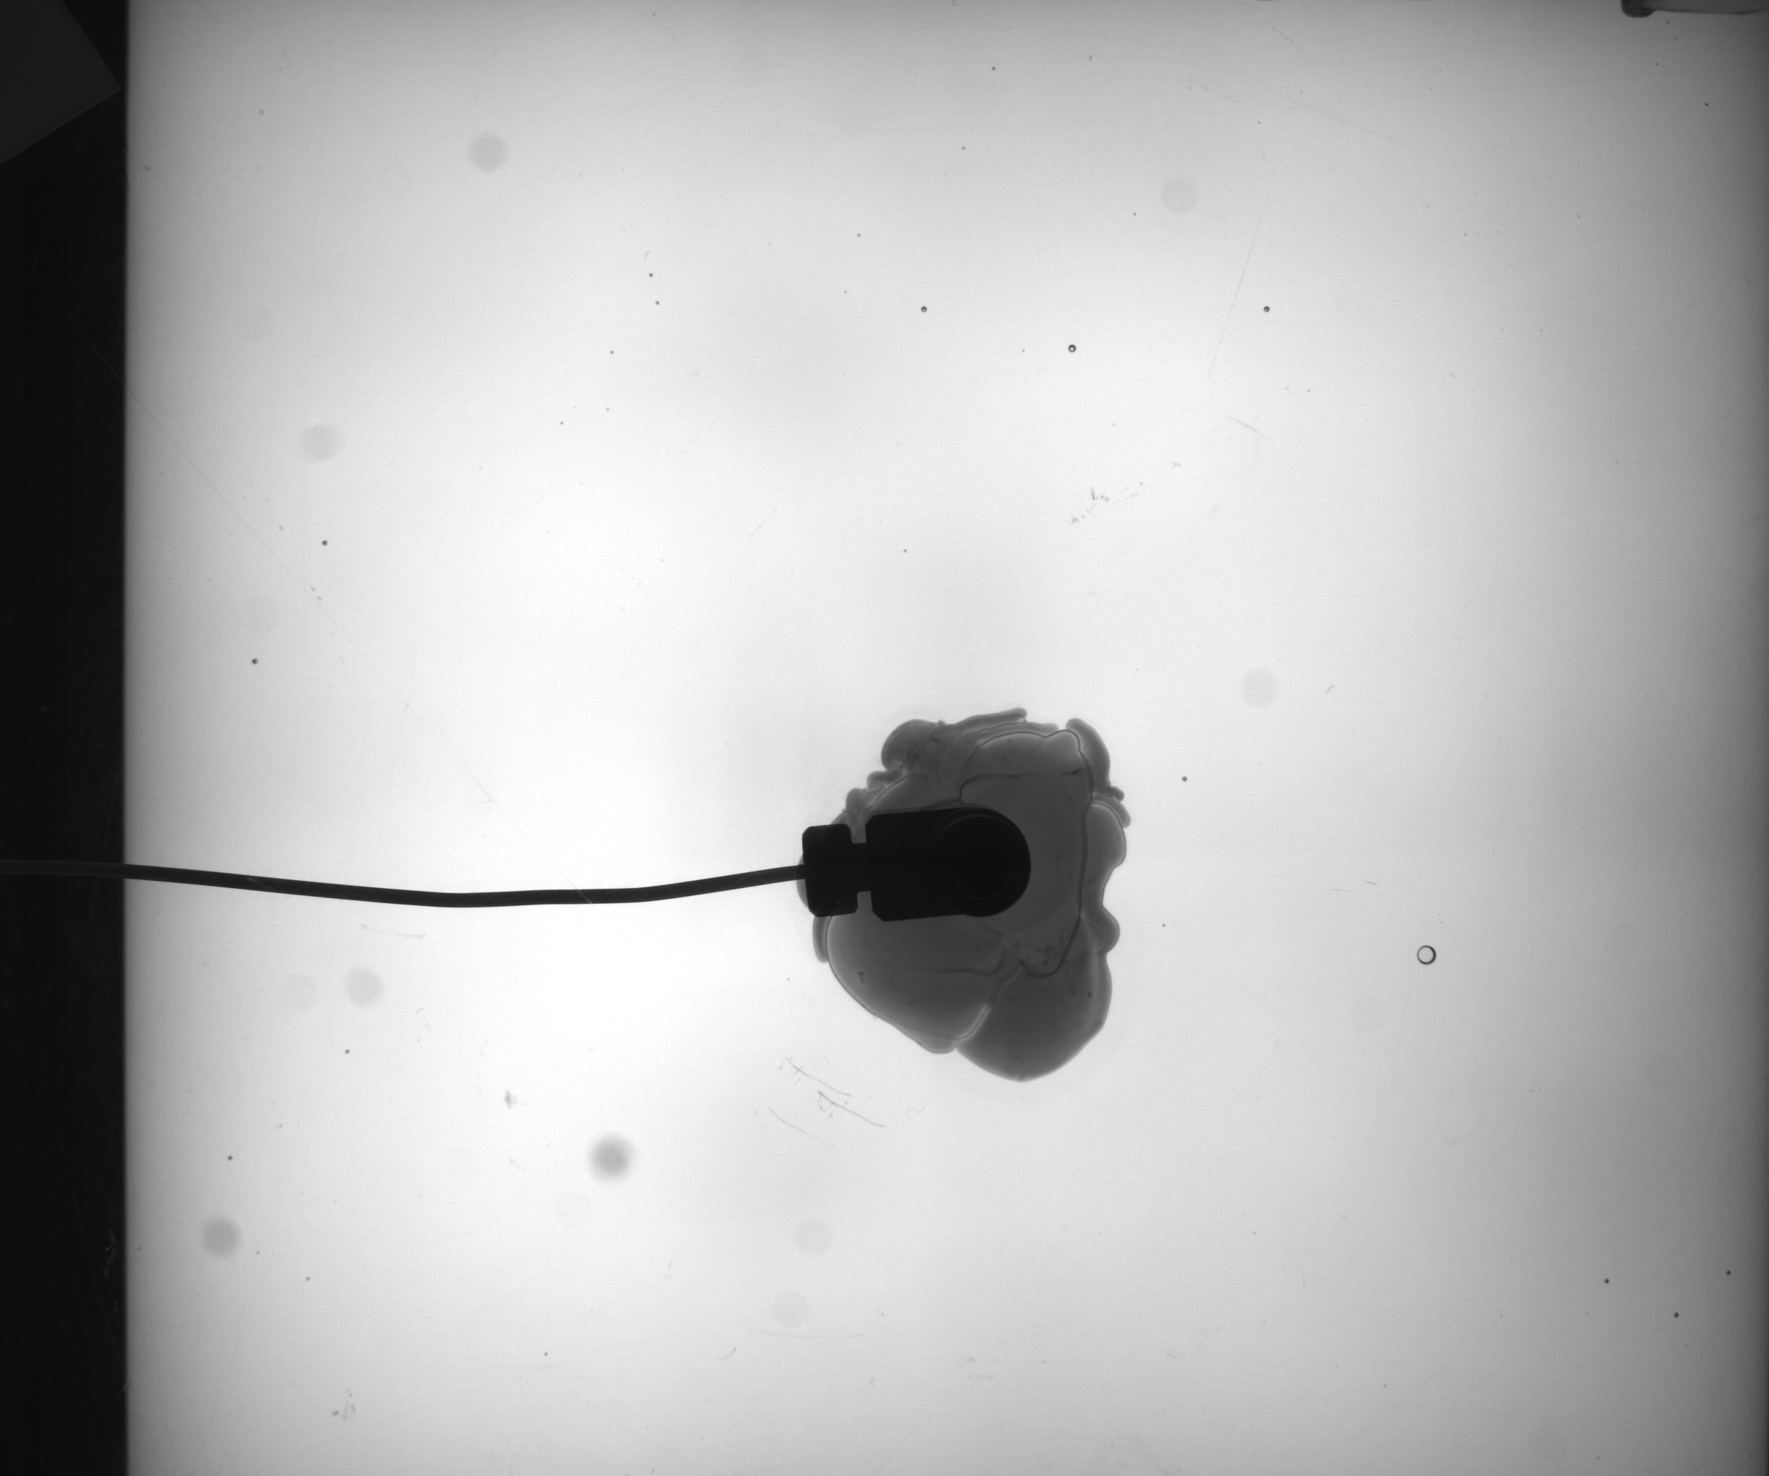
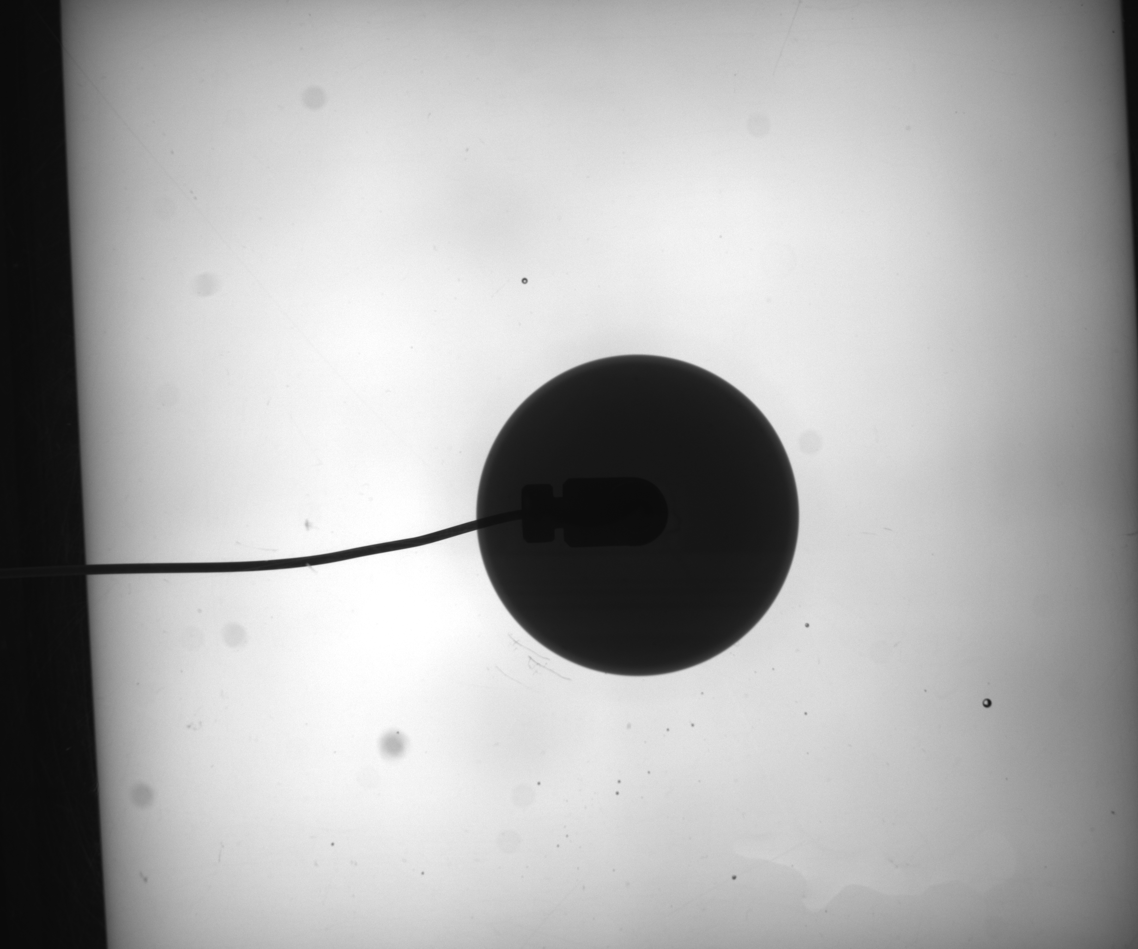
Instability-Processing

Slide 2
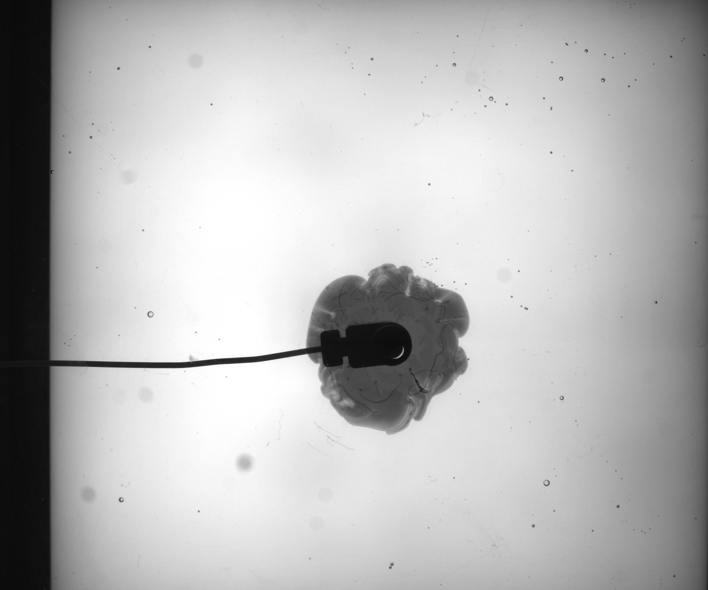
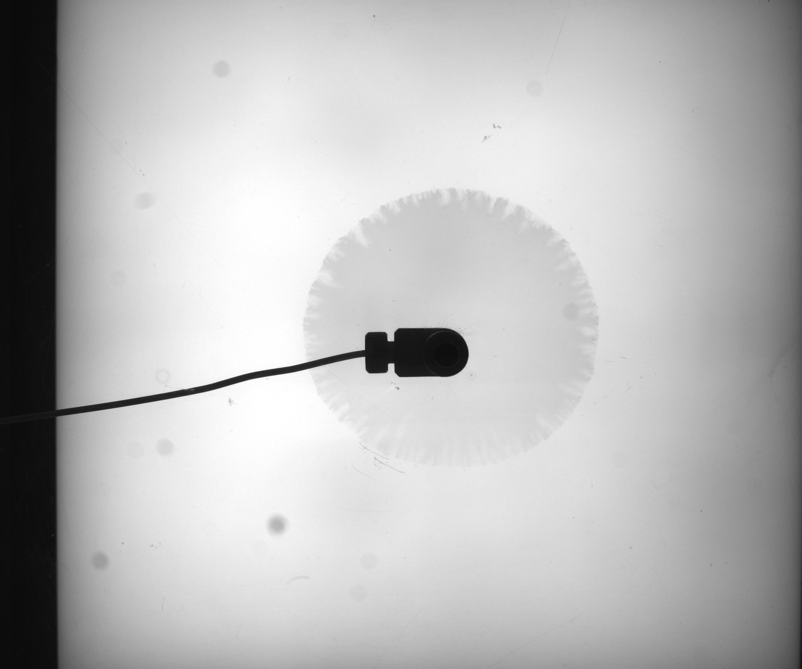
Different gap heights
0.1 mm
0.5mm
0.75mm

Slide 3
goal
Instability area growth over time
Instability contour over time

Slide 4
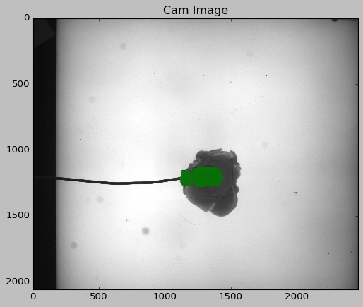
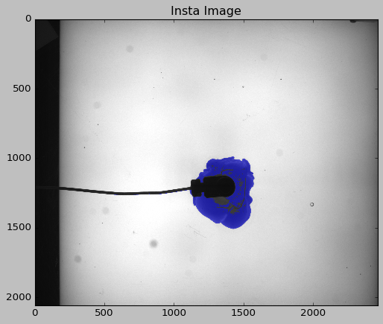
Image processing approach
Raw image
Segment camera
Segment instability

Slide 5
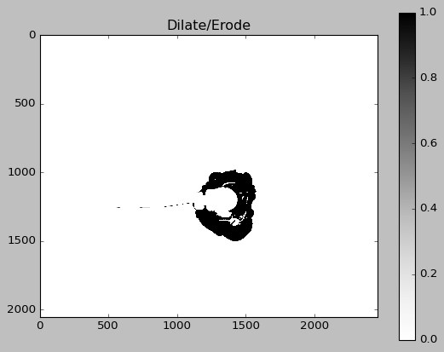
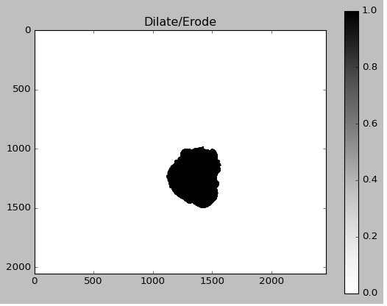
Current state

Slide 6
Contour information
Csv file with contour pixel locations
t1_x | t1_y | t2_x | t2_y | ...
... | ... | ... | ... | ...
... | ... | ... | ... | ...

