Slide 1
Instability processing
Space for further information
Institute · Department · Title / first / last name · email · www.hzdr.de

Slide 2
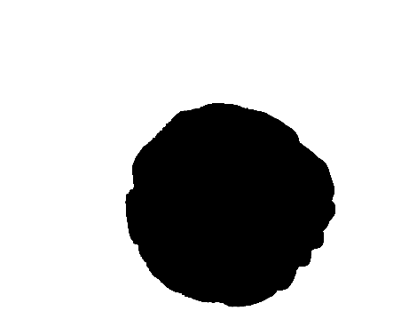
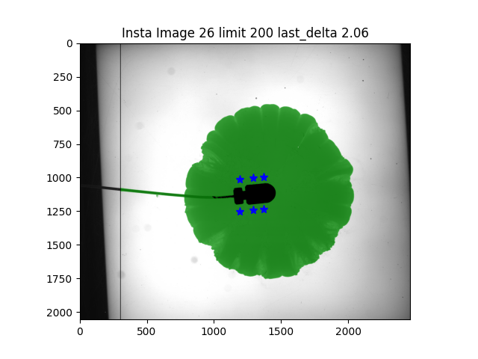
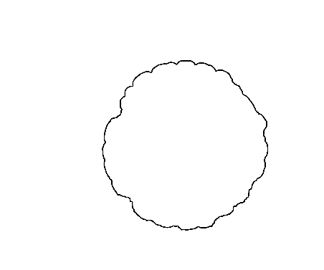
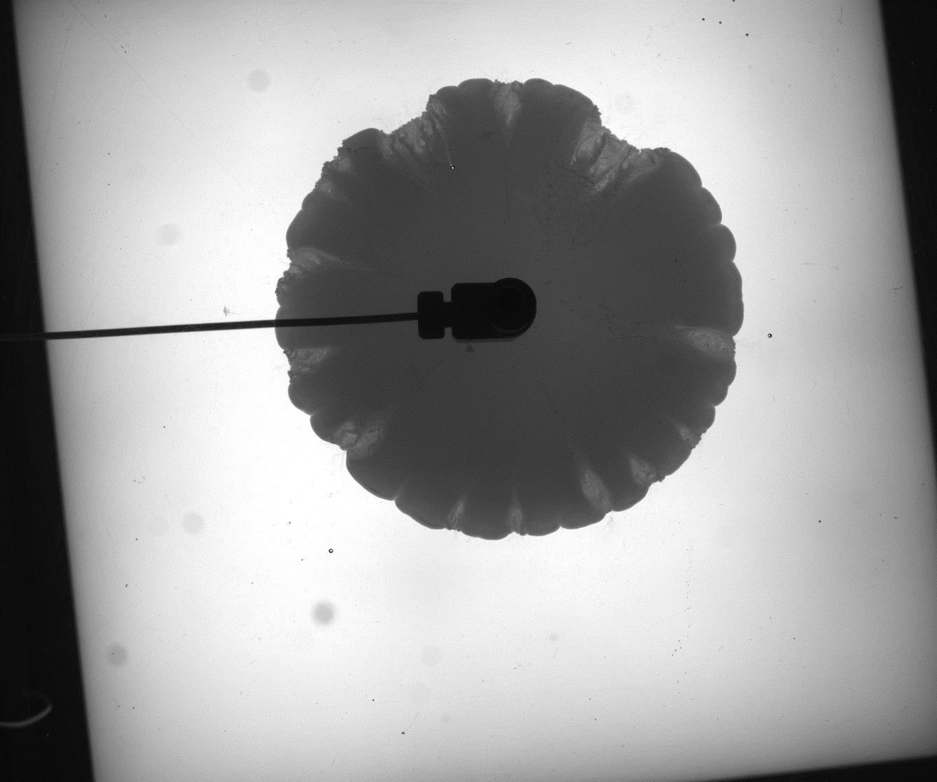
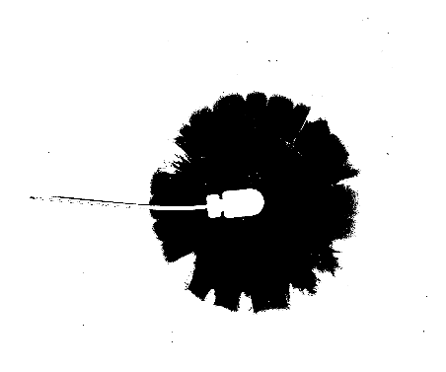


Goal and Strategy
Instability segmentation
Segmentation
(region growing)
Raw image
A_{finger}
A_{total}
Intensity filter
(intensity window)
$$r=\frac{A_{finger}}{A_{total}}$$
Dilation/Erosion

Slide 3
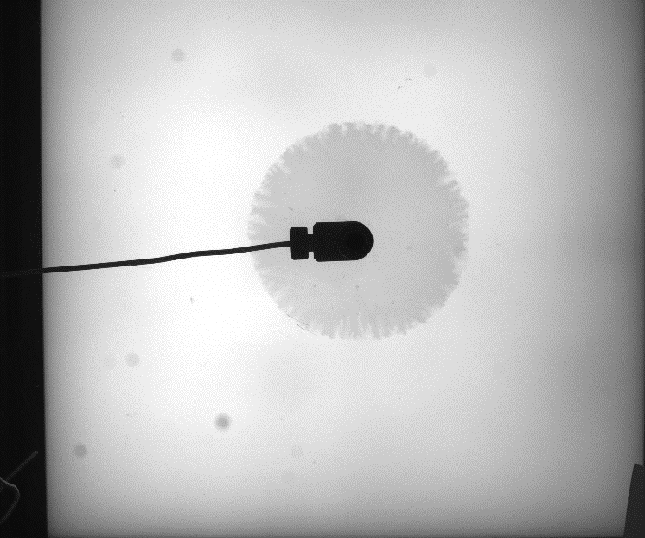
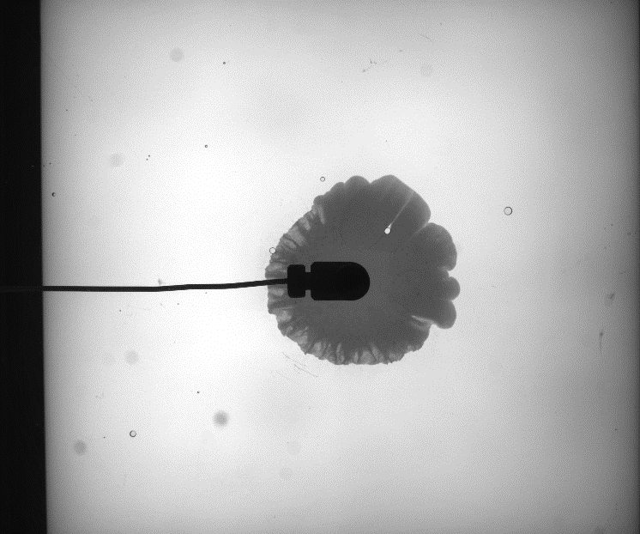
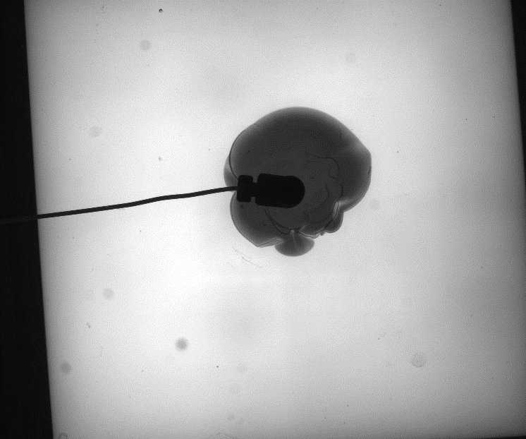
Input data
Different gap heights
0.1 mm
0.5 mm
0.6 mm

Slide 4
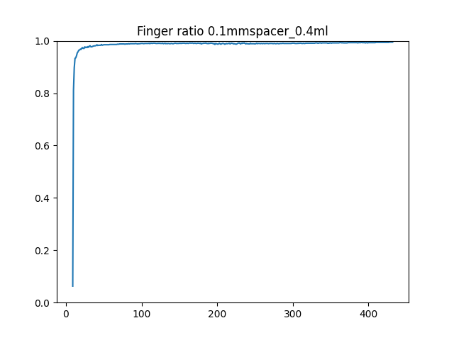
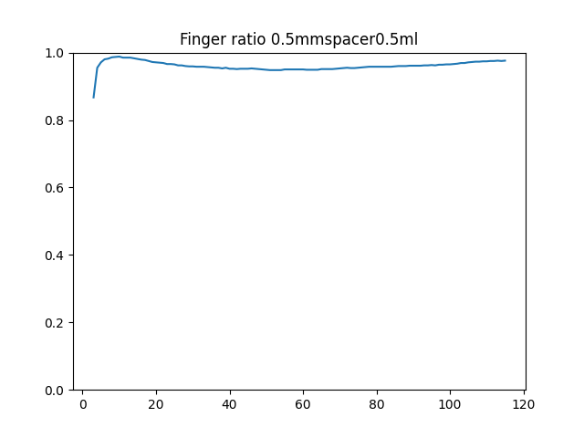
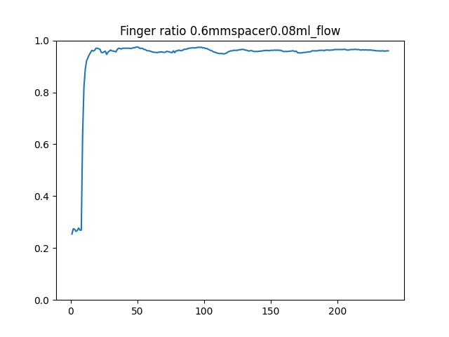
results
Intensity window method (area ratio calculation)
Ratio over time can be investigated but comparing between cases is of most interest (all_cases.csv)

Slide 5
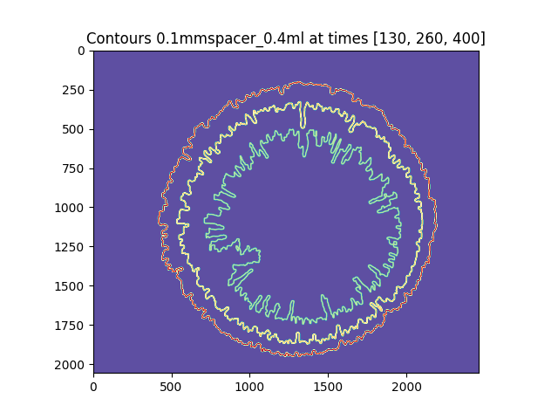
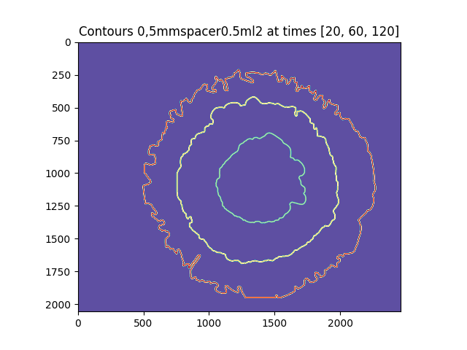
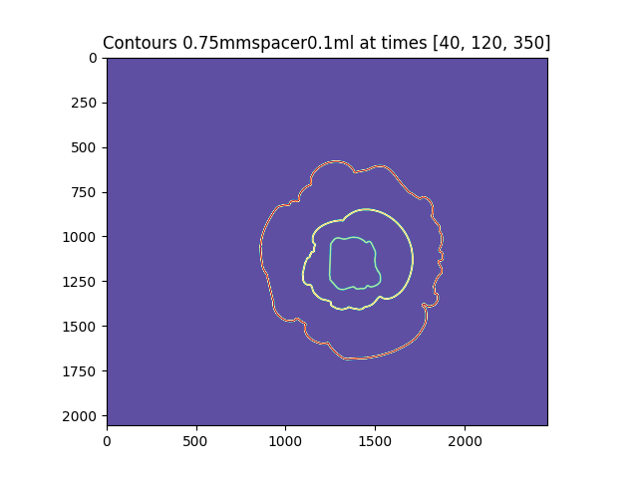
results
Region growing
Contour evolution over time can be plotted

Slide 6
Conlusion
Initial processing of nearly all provided cases done
instability area
instability boundary
Area ratio
Developed methods can be applied to further experiments as long as data is provided in the same way
Methods can be changed/ further improved
Using background substracted data as input for region growing (might improve instability finger detection)
Dynamically chosing intensity window boundaries based on image features
Software could be adopted to recently introduced FWDT gitlab group standards
All results are here: \\gssnas\bigdata\FWDT\DFischer\image_proc
The source code is here: https://github.com/fischer-sw/instability-processing

Slide 7
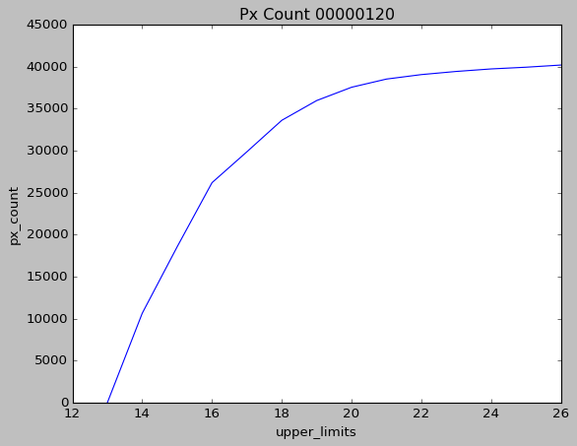
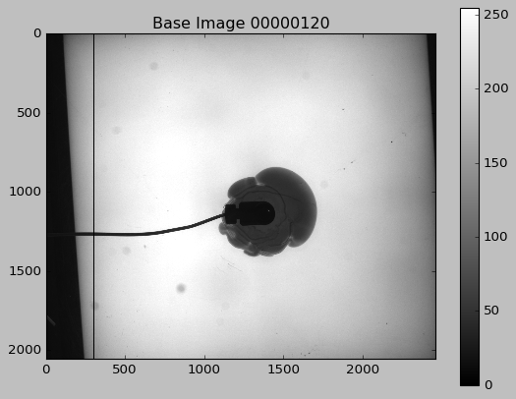
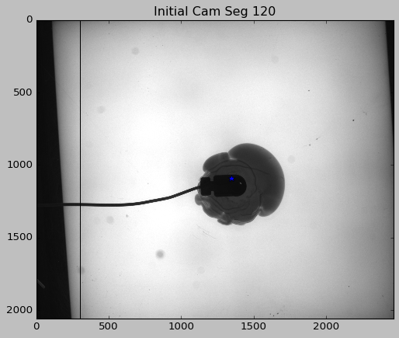
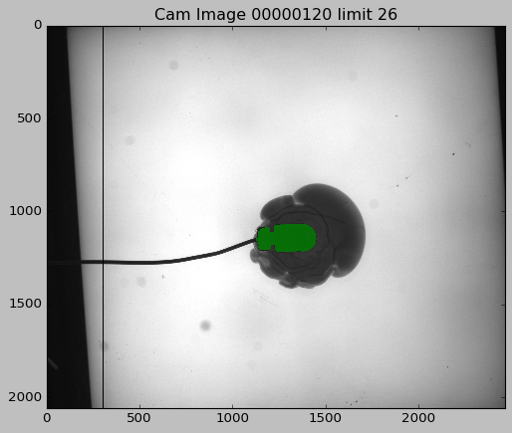
Methodology region growing
Segement camera with found seed (limit threshold if 4e4 pixels are detected)
Base image
Find camera by darcest pixel in specific region

Slide 8
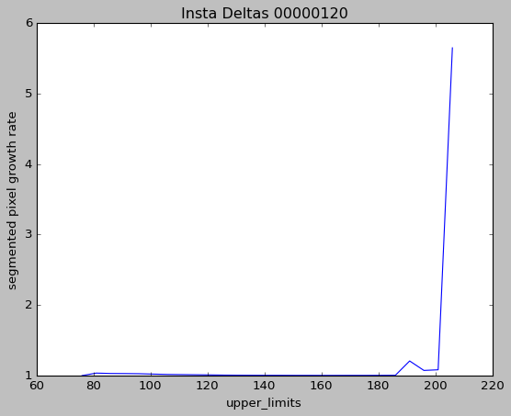
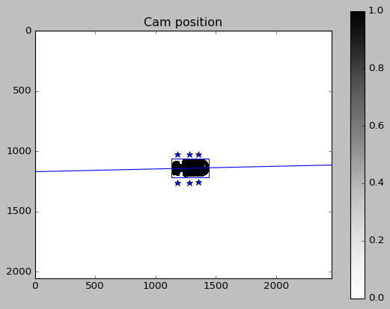
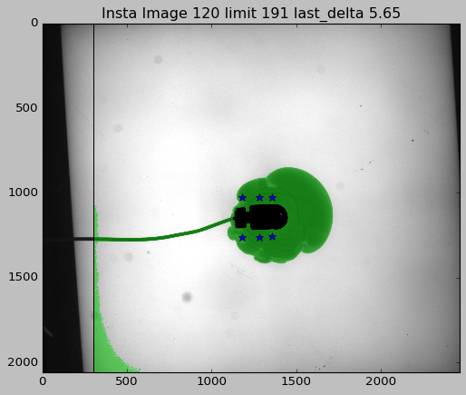
Methodology region growing
Set instability seeds based camera segmentation (determine main axis with bounding box → cabel detection)
Determine threshold by looking at growth rate of segmented area (if rate > 2 move 4 steps back)

Slide 9
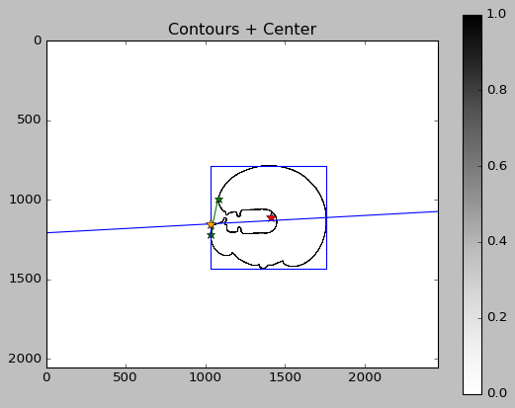
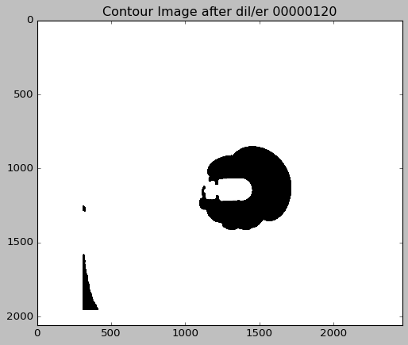
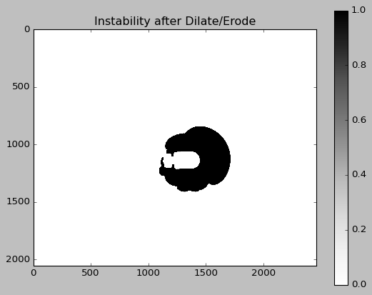
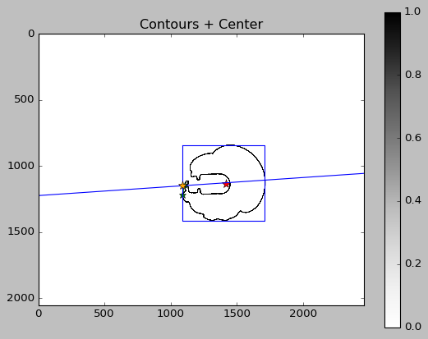
Methodology region growing
Hole closing successful
Clean instability segmentation by Dilation and Erosion + only keep area with longest contour
Hole closing not successful
Close hole in instability by using main axis (search points most left above and bellow the yellow point)
- if the hole is not closed just fill
the camera segmentation

Slide 10
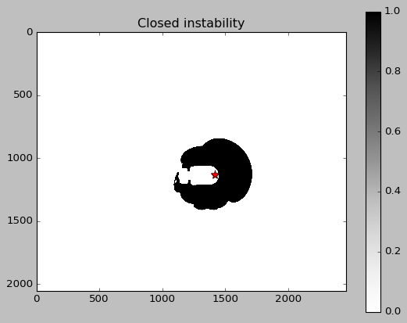

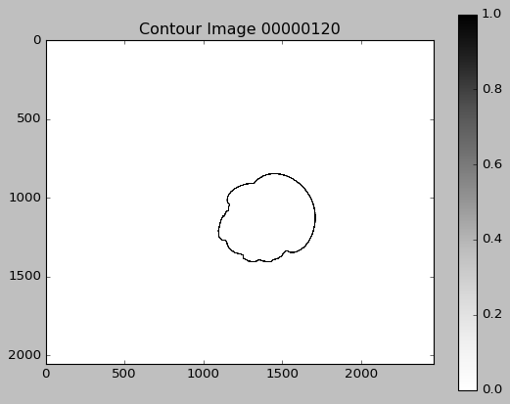
Methodology region growing
Fill closed instability
Generate contour from instability

