Slide 1
Topic diploma thesis Daniel Fischer
TU Dresden
Chair of Transport Processes at Interfaces
10.06.2022

Slide 2
Overview
Topic
Numerical simulation of a Reaction-Diffusion-Advection front in a radial geometry reactor
Reaction-Diffusion-Advection (RDA) front
Evolving (time-dependent) 3D structure (field) in space
Consists of 3 main parts
  Advection
  Diffusion
  Reaction

Slide 3
RDA-Fronts
Advection
species transport due to moving flow (appearing in direction of the flow)
Mostly influenced by input velocity
Diffusion
transport taking place mostly within a species
dependant on diffusion coefficients
Reaction
species creation
dependant on kinetics (temperature and activation energy)

Slide 4

Experimental Setup
0.12 mm < b < 0.75 mm
C₁₄TAB
XG
Pump
0.05 mL/min < q < 5 mL/min

Slide 5
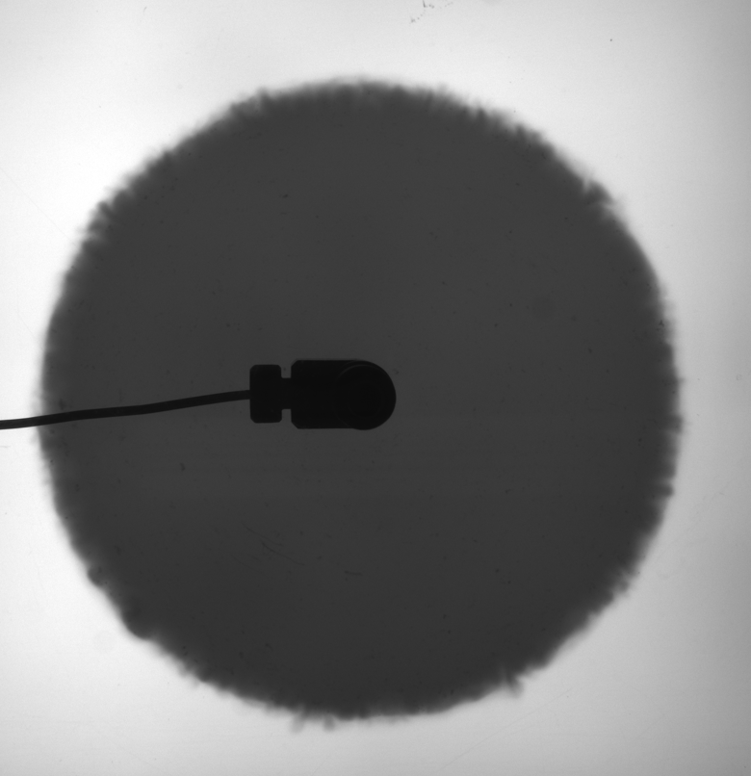
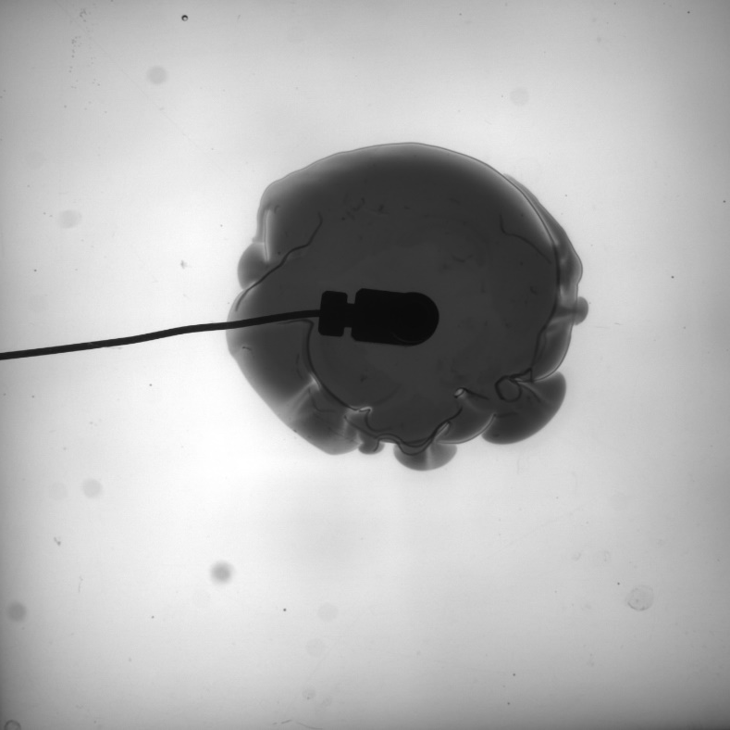
Experimental Results (examples)

Slide 6
Modelling Setup
Source for fluid b at centreline
Cylinder filled with fluid a
Modelling plane

Slide 7
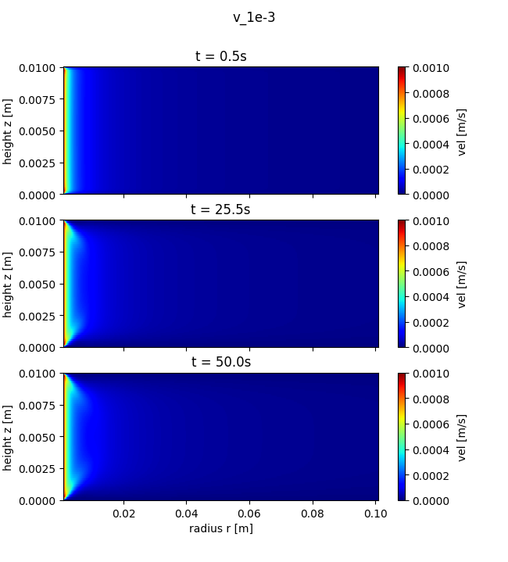
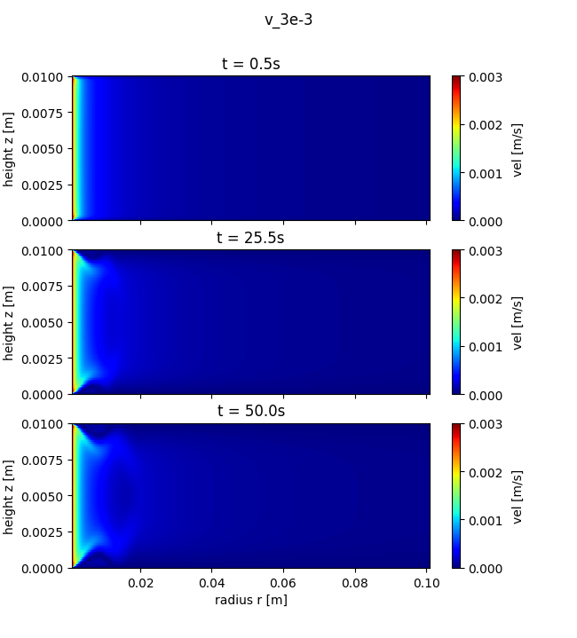
Results + Current challenges

Slide 8
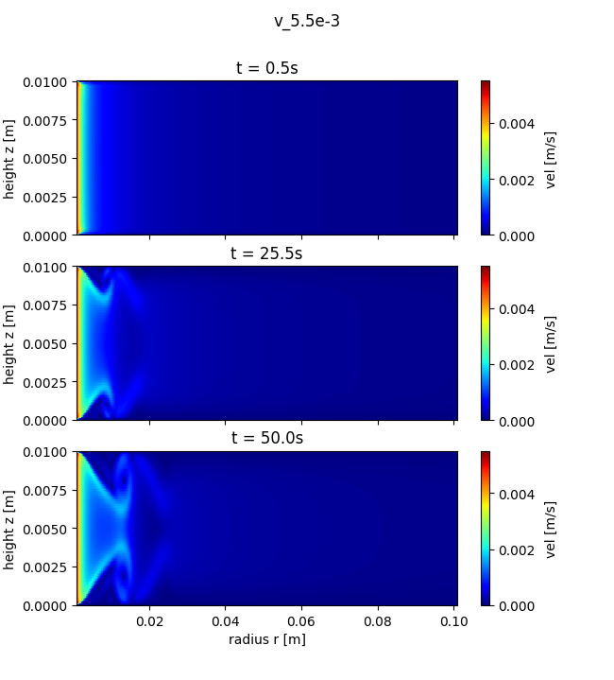
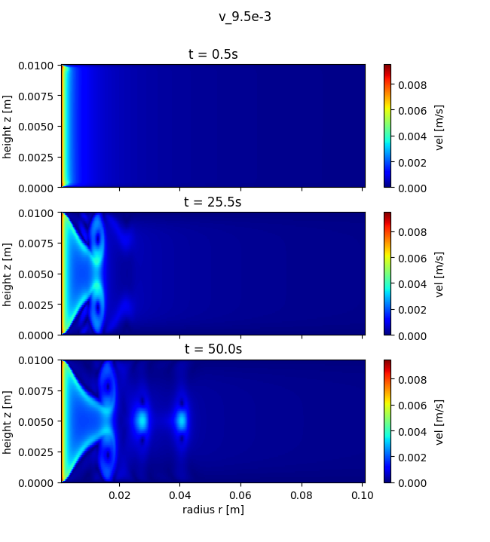
Results + Current challenges

Slide 9
Outlook
Adding realistic dimensions to simulation
  Geometry
  Input velocity
Adding reaction back into simulation once input velocity field looks promising
Increasing simulation time once all looks fine

Slide 10
Thank you for your attention

