Slide 1

Defense diploma thesis Daniel Fischer
Fakultät Maschinenwesen
Professur für Transportprozesse an Grenzflächen

Slide 2
Content
Introduction
Goemetric system
Governing equations
Mass- & momentum conservation
Energy equation
Reaction equation
Species distribution PDE system
Mesh dependency and validation
Simulation results
Limitations
Conclusion & Outlook

Slide 3
geometry
modelling plane
x
r
Radial geometry
Domain filled with reactant A
Reactant B injected radially into B
Axisymmetric assumption → 2D Case sufficient to model

Slide 5
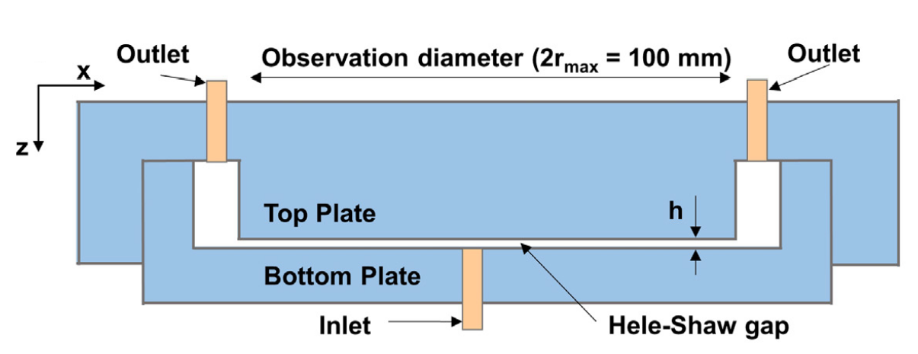
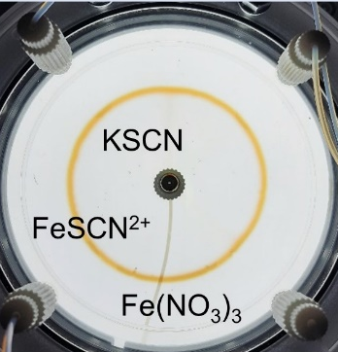

Experimental setup
Hele-Shaw-Cell with
0.2mm gap height
80mm radius
Reaction
${SCN}^{−}+{Fe}^{3+} →FeSCN^{2+}$

Slide 6
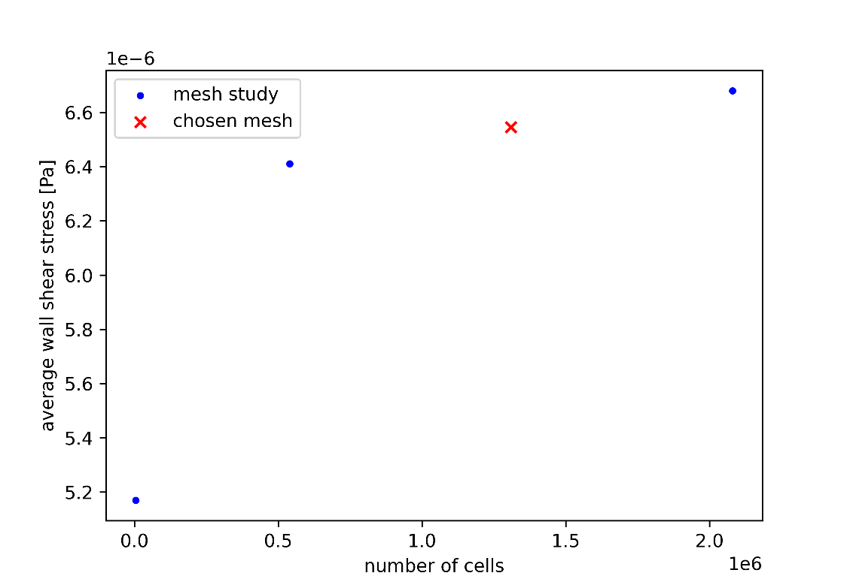
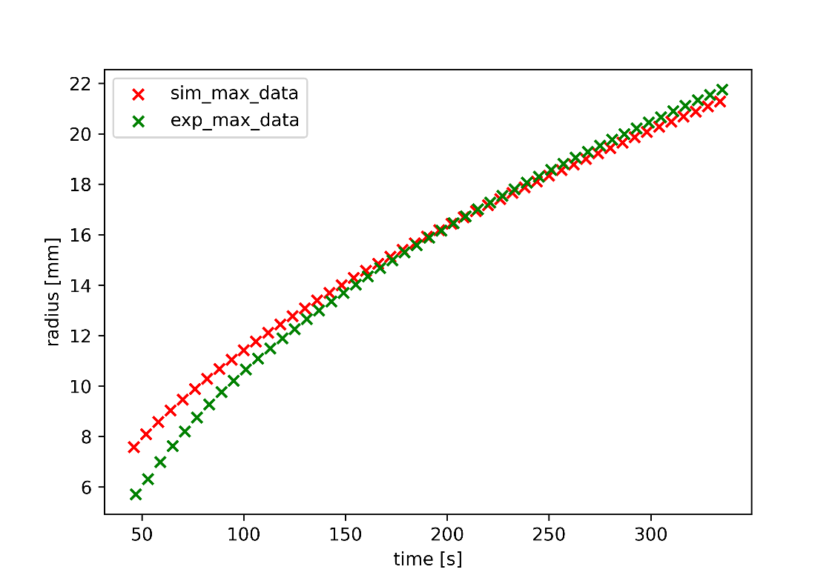
Mesh dependency and validation
Different mesh densities investigated
Validation against existing experimental data

Slide 7
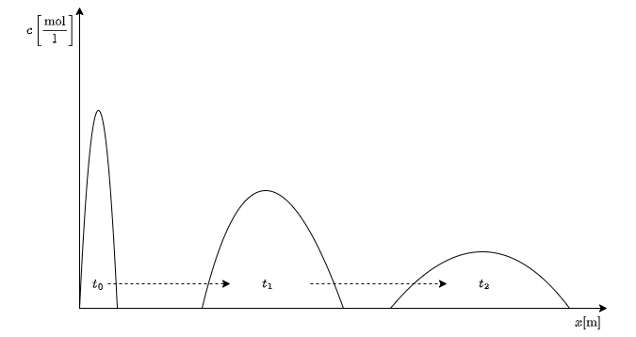
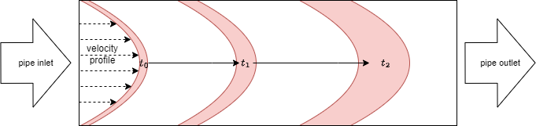
Taylor dispersion
Spreading in space and time
Spreading of a front in a pipe
Spreading of gap averaged values

Slide 8
Thank you for attention

