Slide 1

Defense diploma thesis Daniel Fischer
Fakultät Maschinenwesen
Professur für Transportprozesse an Grenzflächen

Slide 2
Content
Introduction
Goemetric system
Governing equations
Mass- & momentum conservation
Energy equation
Reaction equation
Species distribution PDE system
Mesh dependency and validation
Simulation results
Limitations
Conclusion & Outlook

Slide 3
geometry
modelling plane
x
r
Radial geometry
Domain filled with reactant A
Reactant B injected radially into B
Axisymmetric assumption → 2D Case sufficient to model

Slide 4

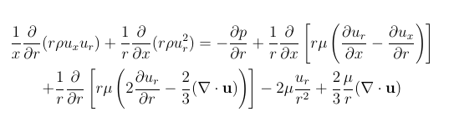
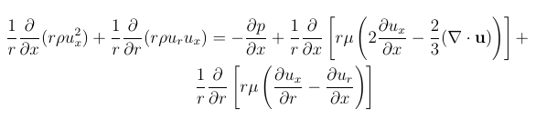
Governing equations
Mass conservation
Continuity equation
Momentum equations
Radial momentum equation
Axial momentum equation

Slide 5

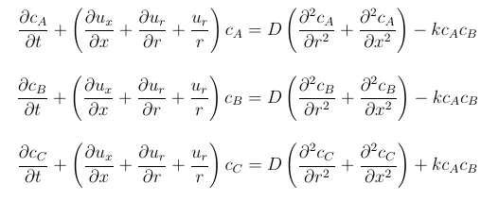
Governing equations
Energy equation
Species distribution equations

Slide 6





Governing equations
Reaction equation
Reaction rate
Reaction rate constant

Slide 7
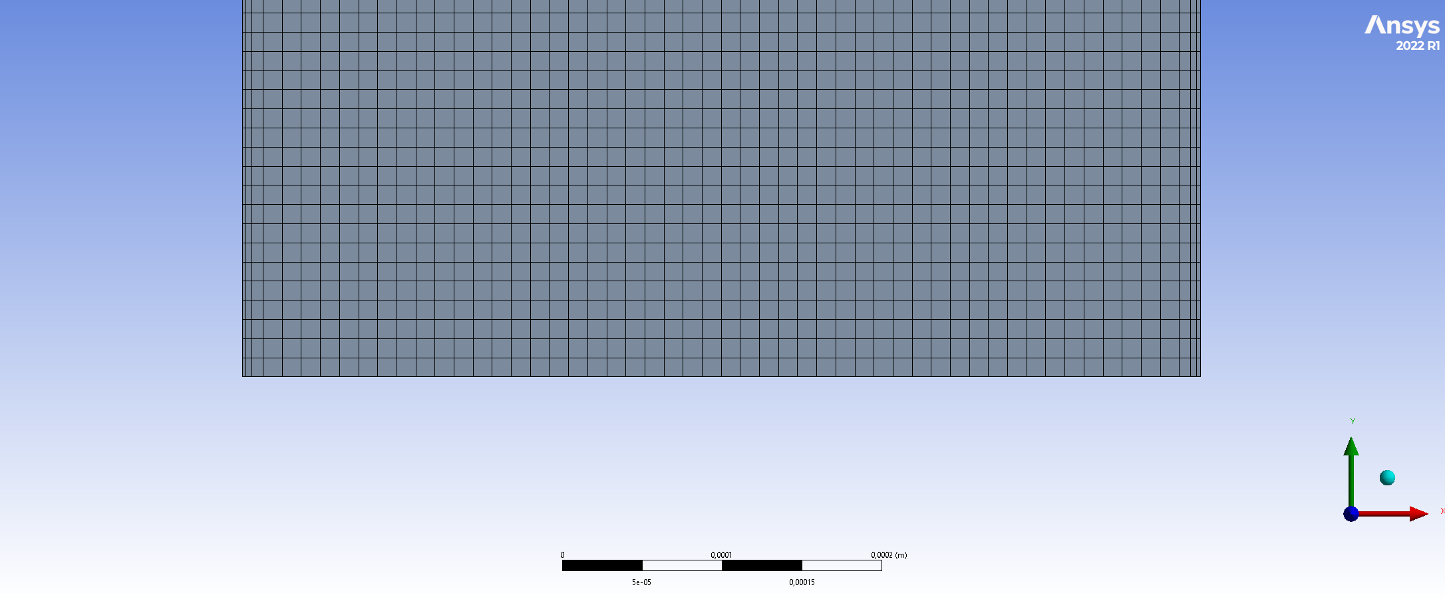
Mesh creation

Slide 8
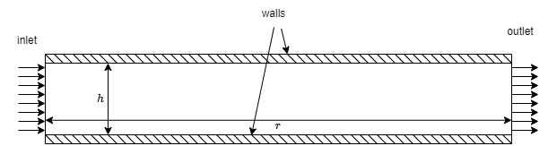
Boundary conditions
No slip
Inlet velocity magnitude
Pressure outlet

Slide 9
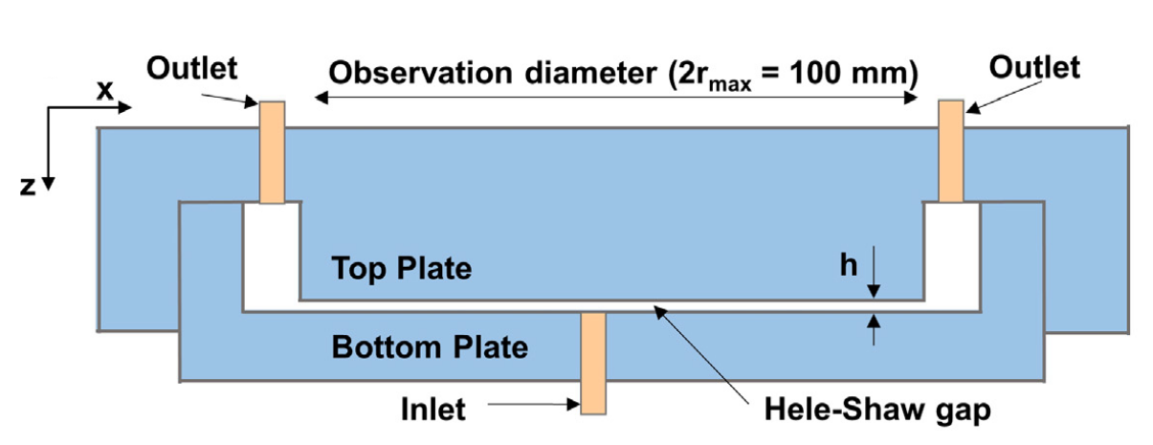
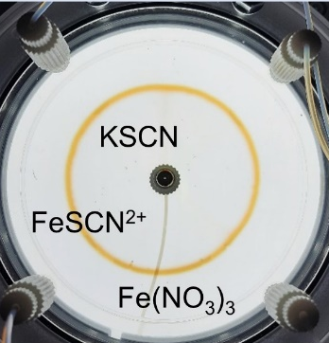

Experimental setup
Hele-Shaw-Cell with
0.2mm gap height
80mm radius
Reaction
${SCN}^{−}+{Fe}^{3+} →FeSCN^{2+}$

Slide 10
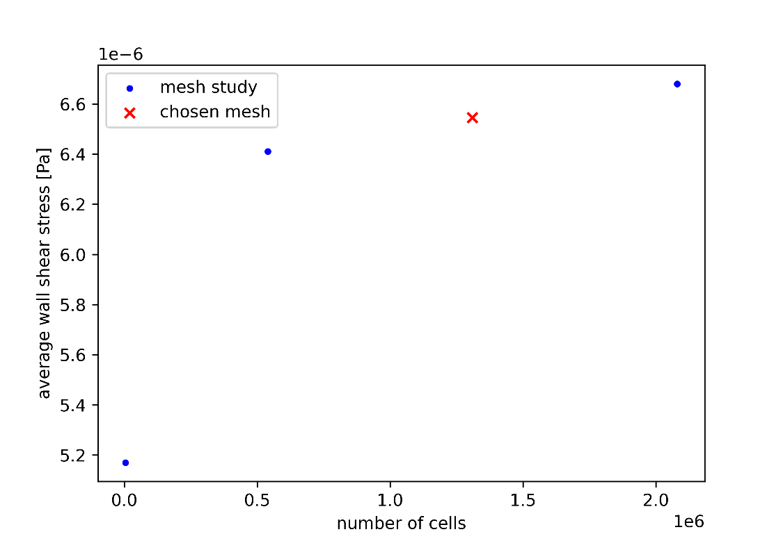
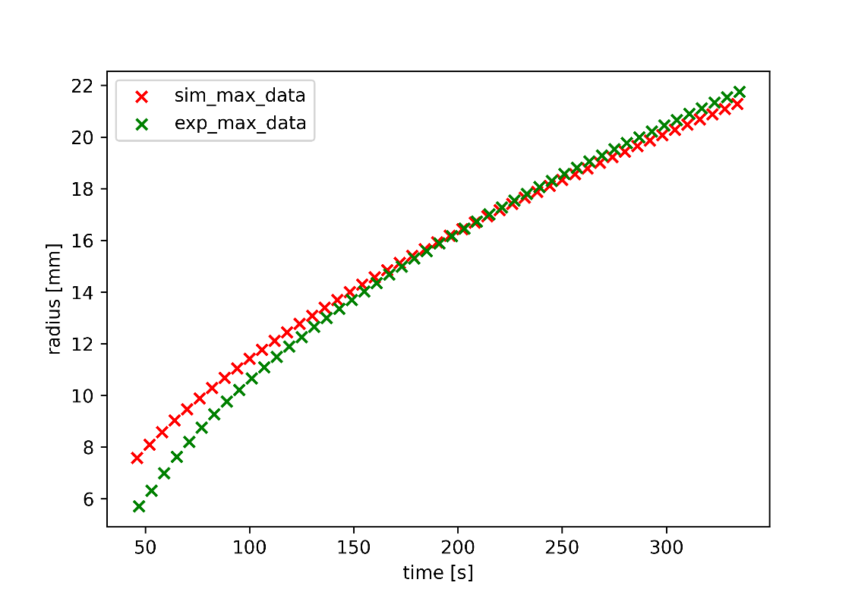
Mesh dependency and validation
Different mesh densities investigated
Validation against existing experimental data

Slide 11
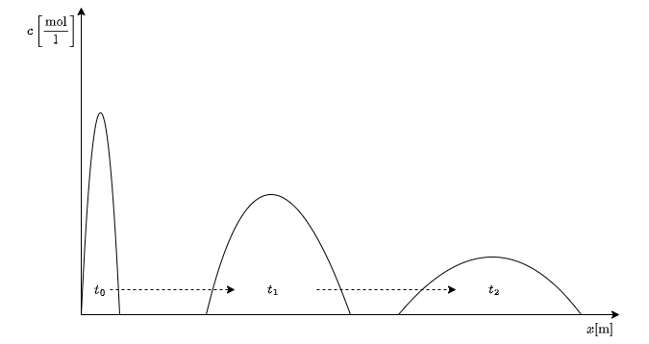
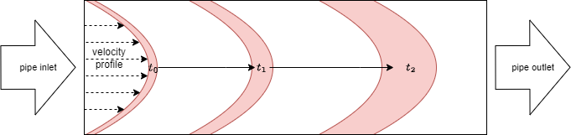
Taylor dispersion
Spreading in space and time
Spreading of a front within a pipe
Spreading of gap averaged values

Slide 12
Results

Slide 13
Results

Slide 14
Front positions

Slide 15
Front widths

Slide 16
Total product formed

Slide 17
Thank you for attention

