Slide 1
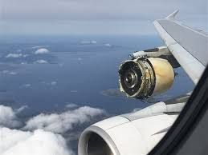
Flight Engineer
Aircraft Engine Anomaly
and Fault Detection

Slide 2
Planing to Avoid Failure
Expensive!
Laws of physics and mechanics
Preventative maintenance desirable
  Prevents failure while operating
  “Replace after failure” - not an option
Schedule timelines
  Replace when old...
  Not to old...

Slide 3
Planing to Avoid Failure
NASA Dataset
  Industry standard aircraft engine simulator
  26 measurements from the engine
  Randomize starting inputs
  Each engine operated until replacement required
  26 measurements taken at 1 point during operation
  4 series of tests of increasing complexity

Slide 4
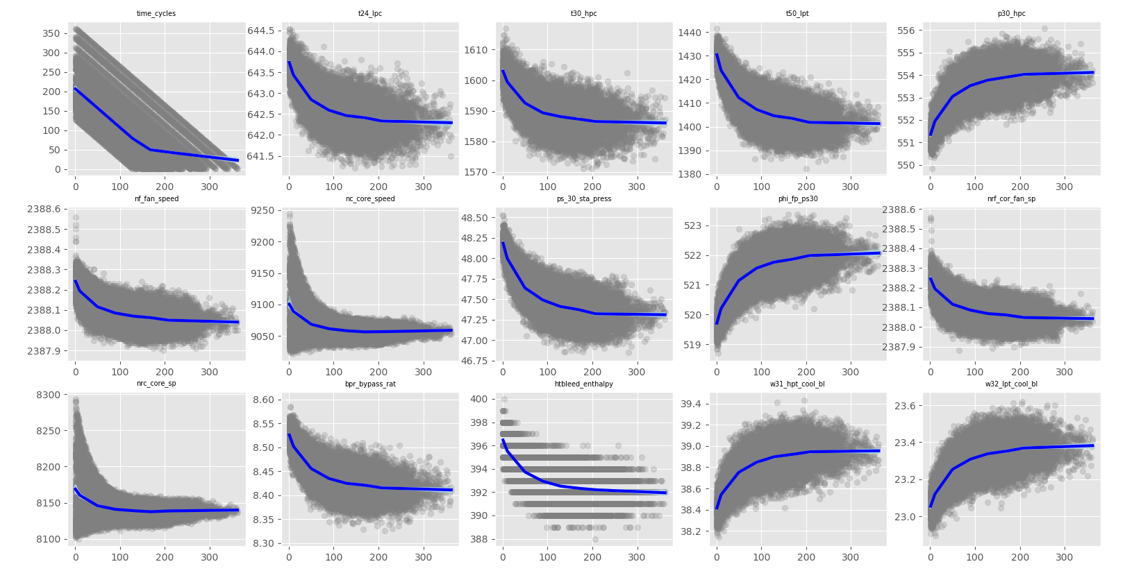
Predictive Features

Slide 5
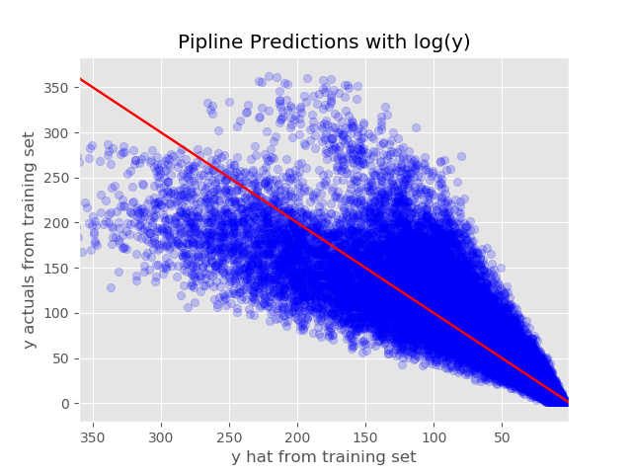
Current Results Using Training Data

