Slide 1
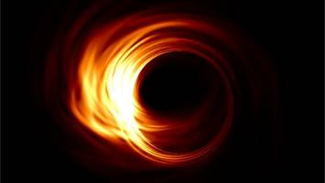

Física computacional II
Mauricio Suárez Durán
Unidad 1, Clase 2
Departamento de Física y Geología
Universidad de Pamplona
I Semestre, 2020

Slide 2
Análisis de datos
Data analysis is a process of inspecting, cleansing, transforming, and modeling data with the goal of discovering useful information, informing conclusions, and supporting decision-making.
https://en.wikipedia.org/wiki/Data_analysis

Slide 3
Distribuciones de datos
(Histogramas)
A histogram is an accurate representation of the distribution of numerical data. It is an estimate of the probability distribution of a continuous variable
https://en.wikipedia.org/wiki/Data_analysis

