Slide 1
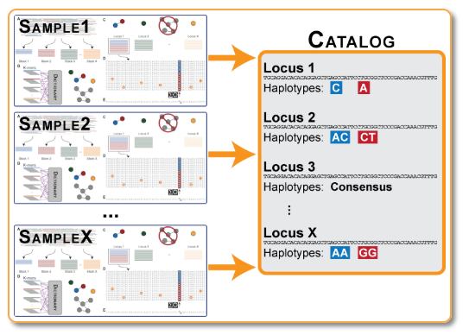
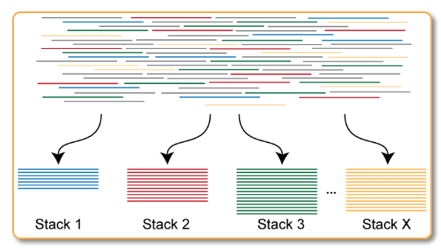
Raw data (37 gb fq.gz)
Directory with ustacks output (Name.tags.tsv.gz,
Name.snps.tsv.gz,
Name.alleles.tsv.gz
Directory with ustack, cstacks, and sstacks outputs
Barcode file (.txt)
Run `tsv2bam` to transpose data to a bam alignment by loci instead of by specimen
Run `cstacks` on all samples to build catalog of loci (de novo genome)
Demultiplex samples with `process_radtags`
STUCK HERE
Adds bam files to same directory (name.matches.bam)
Directory with 48 fq.gz files, 1 per specimen
Run `gstacks` to do something?
Filter and cap samples by read number with my script
Adds
Directory with 44 fq.gz files.
1e5<n-reads<2e6
Figure http://catchenlab.life.illinois.edu/stacks/param_tut.php
Run `gstacks` to do something?
Directory with ustacks and cstacks output data (same format as ustack but name is Catalog)
Run `ustacks` on each sample to find loci
Run `sstacks` on all samples to align against the catalog
Adds sstacks output data to same directory as ustacks and ccstacks data (name.matches.tsv.gz)
Figure http://catchenlab.life.illinois.edu/stacks/param_tut.php

