Slide 1
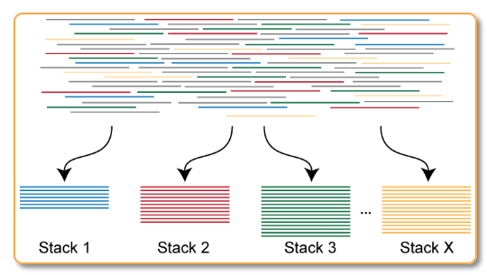
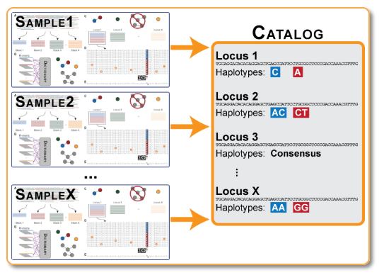
Stacks pipeline (cont)
Stacks pipeline
Run `ustacks` on each sample to find loci
Raw data (37 gb fq.gz)
Directory with sstacks output data (name.matches.tsv.gz)
Barcode file (.txt)
Run `populations` to
Figure http://catchenlab.life.illinois.edu/stacks/param_tut.php
Demultiplex samples with `process_radtags`
Run `cstacks` on all samples to build catalog of loci (de novo genome)
Ajordan86(fq.gz)
Cmelanu89(fq.gz)
1 fq.gz per specimen (48 total)
Lflorae666(fq.gz)
…
Rattenuatu(fq.gz)
Figure http://catchenlab.life.illinois.edu/stacks/param_tut.php
Filter and cap samples by read number with my script
Run `csstacks` on all samples to algin against the catalog
Directory with ustacks and cstacks output data (Name.tags.tsv.gz,
Name.snps.tsv.gz,
Name.alleles.tsv.gz
& Catalog.tags.tsv.gz…)
Directory with 44 fq.gz files. 1e5<n-reads<2e6

