Slide 1
Analyzing RADSeq Data
Jennifer Gardner
FISH 546: Bioinformatics

Slide 2
Question:
What are the steps to go from raw RADSeq data to data that could be input into a tree?

Slide 3
Question:
What are the steps to go from raw RADSeq data to data that could be input into a tree?
Can I perform those steps following along from the methods section of a paper?

Slide 4
Question:
What are the steps to go from raw RADSeq data to data that could be input into a tree?
Can I perform those steps following along from the methods section of a paper?
Spoiler alert: NO

Slide 5
RADSeq Workflow using Stacks v 2.2
Gitbash
Windows Ubuntu
Download raw data from Google Drive
Install Stacks
Virtual
Machine
Run Stacks Pipeline
Use Data to make Tree
Next Steps
Simple
Challenging
Impossible without help

Slide 6
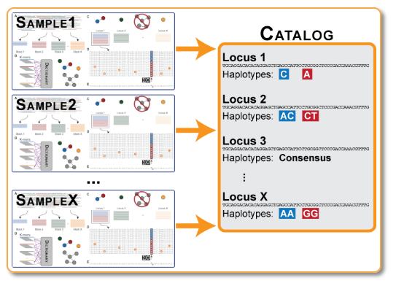
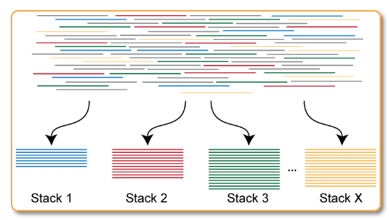
Raw data (37 gb fq.gz)
Directory with ustacks output (Name.tags.tsv.gz, Name.snps.tsv.gz,
Name.alleles.tsv.gz
Directory with ustack, cstacks, and sstacks outputs
Barcode file (.txt)
Run `tsv2bam` to transpose data to a bam alignment by loci instead of by specimen
Run `cstacks` on all samples to build catalog of loci (de novo genome)
Demultiplex samples with `process_radtags`
Directory with tsv2bam output and ustacks, cstacks, and cstacks outputs (name.matches.bam)
Directory with 48 fq.gz files, 1 per specimen
Run `gstacks` to genotype
Filter and cap samples by read number with my script
Directory with gstacks outputs?
Directory with 44 fq.gz files.
1e5<n-reads<2e6
Figure http://catchenlab.life.illinois.edu/stacks/param_tut.php
Run `populations` to get population summary statistics such as F_{ST} and output data into a fasta or phylip that can be used for analysis
Directory with ustacks and cstacks output data
(ustack files and catalog files)
Run `ustacks` on each sample to find loci
Run `sstacks` on all samples to align against the catalog
Fasta or phylip files that can now be used to make a tree!!
Directory with sstacks, ustacks and ccstacks data
(name.matches.tsv.gz)
Figure http://catchenlab.life.illinois.edu/stacks/param_tut.php

Slide 7
Raw data (37 gb fq.gz)
Directory with ustacks output (Name.tags.tsv.gz, Name.snps.tsv.gz,
Name.alleles.tsv.gz
Directory with ustack, cstacks, and sstacks outputs
Barcode file (.txt)
Run `tsv2bam` to transpose data to a bam alignment by loci instead of by specimen
Run `cstacks` on all samples to build catalog of loci (de novo genome)
Demultiplex samples with `process_radtags`
Directory with tsv2bam output and ustacks, cstacks, and cstacks outputs (name.matches.bam)
Directory with 48 fq.gz files, 1 per specimen
Run `gstacks` to genotype
Filter and cap samples by read number with my script
denovo_map.pl
Directory with gstacks outputs?
Directory with 44 fq.gz files.
1e5<n-reads<2e6
Figure http://catchenlab.life.illinois.edu/stacks/param_tut.php
Run `populations` to get population summary statistics such as F_{ST} and output data into a fasta or phylip that can be used for analysis
Directory with ustacks and cstacks output data
(ustack files and catalog files)
Run `ustacks` on each sample to find loci
Run `sstacks` on all samples to align against the catalog
Fasta or phylip files that can now be used to make a tree!!
Directory with sstacks, ustacks and ccstacks data
(name.matches.tsv.gz)
Figure http://catchenlab.life.illinois.edu/stacks/param_tut.php

Slide 8
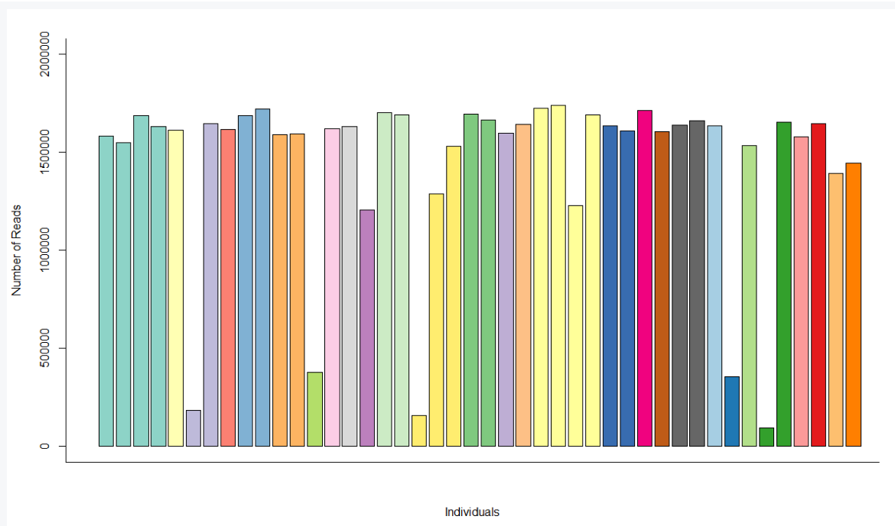
Visualization

Slide 9
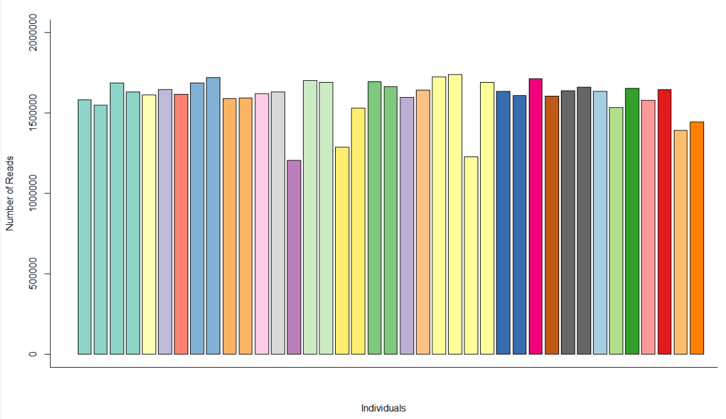
Visualization

Slide 10
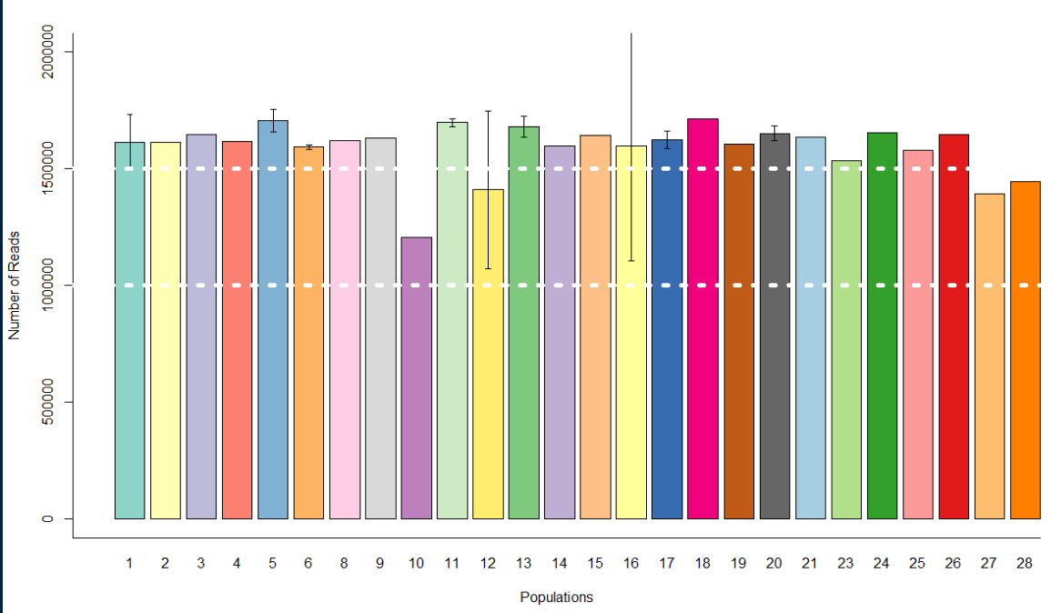
Visualization

Slide 11
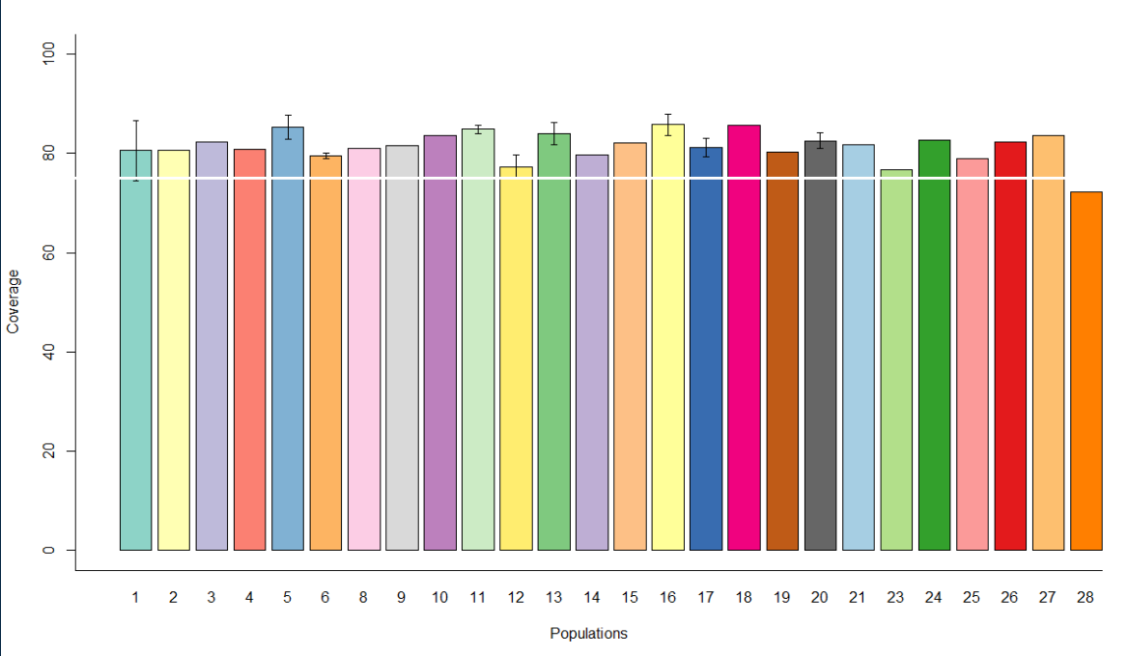
Visualization

Slide 12
Next Steps RADSeq
Analyze output from denovo_map.pl
Determine why it was failing outside the pipeline
Take the data and make a tree
Compare that tree to one generated in the paper I’m following
Try it all again with Ipyrad and see if it gives similar trees

Slide 13
Bonus Question:
Can I use the command line to automate downloading and renaming CT scanning files to save time and remove user error?

Slide 14
Bonus Question:
Can I use the command line to automate downloading and renaming CT scanning files to save time and remove user error?
Spoiler Alert! YES!!

Slide 15
Text file with VNHM numbers to be downloaded
Curl each Zip file from VNHM
Directory with all renamed .log files and corresponding renamed .zip image stacks
Unzip
Run Batch Uploading script with this directory as input
Info.txt
Scanner.log
Stack.zip
Repeat for every number in input text file
Scrub information from Info.txt
Outputs Excel Workbook with specimen data from iDigBio and scanner settings from .log files
Set Naming Variables
Put zips on Duke server using Filezilla.
Upload Excel sheet via Morphosource Batch Import
Rename .log file, all images files in the .zip file, unzipped and zipped directories with images.
All specimens uploaded to Morphosource!!
Move renamed .log and .zip
Uwfc-A-xxxxxx.log
Uwfc-A-xxxxxx.zip

